Slide 1
LVMH Moët Hennessy Louis Vuitton (MC FP)
Initiating Coverage · Luxury Goods
BUY · Target €505 · Upside +30% · Current €388.10
Axone Equity Research | Prepared by Sabashvili Rezi | Octobre 2026

Slide 2
Investment thesis: the luxury benchmark at a cyclical low
LVMH trades at 11.9x EV/EBIT 2026E versus a 16.5x median for core luxury peers, a 28% discount. The shares are down 40% year to date and sit 41% below their 52-week high.
Quality at a discount
Group organic growth held at +2% in the first nine months of 2026 while Fashion & Leather Goods fell 2%. Watches & Jewelry (+8%) and Selective Retailing (+6%) took over, and Fashion still earned a 34.1% margin in H1 2026.
Diversification at work
Net financial debt of €8.2bn is only 0.4x EBITDA, with AA- / Aa3 ratings. We model €68bn of unlevered FCF from FY27E to FY31E, enough to fund rising dividends and buybacks and reach net cash by FY28E.
Fortress balance sheet
We only rebuild the Fashion margin to 36.5% by FY30E, against 39.9% in FY23. A faster creative turnaround at the Maisons, or a China recovery, would be upside to our €505 target.
Fashion reset is a free option
Source: Company filings, Axone Equity Research estimates | Strictly Private & Confidential
2

Slide 3
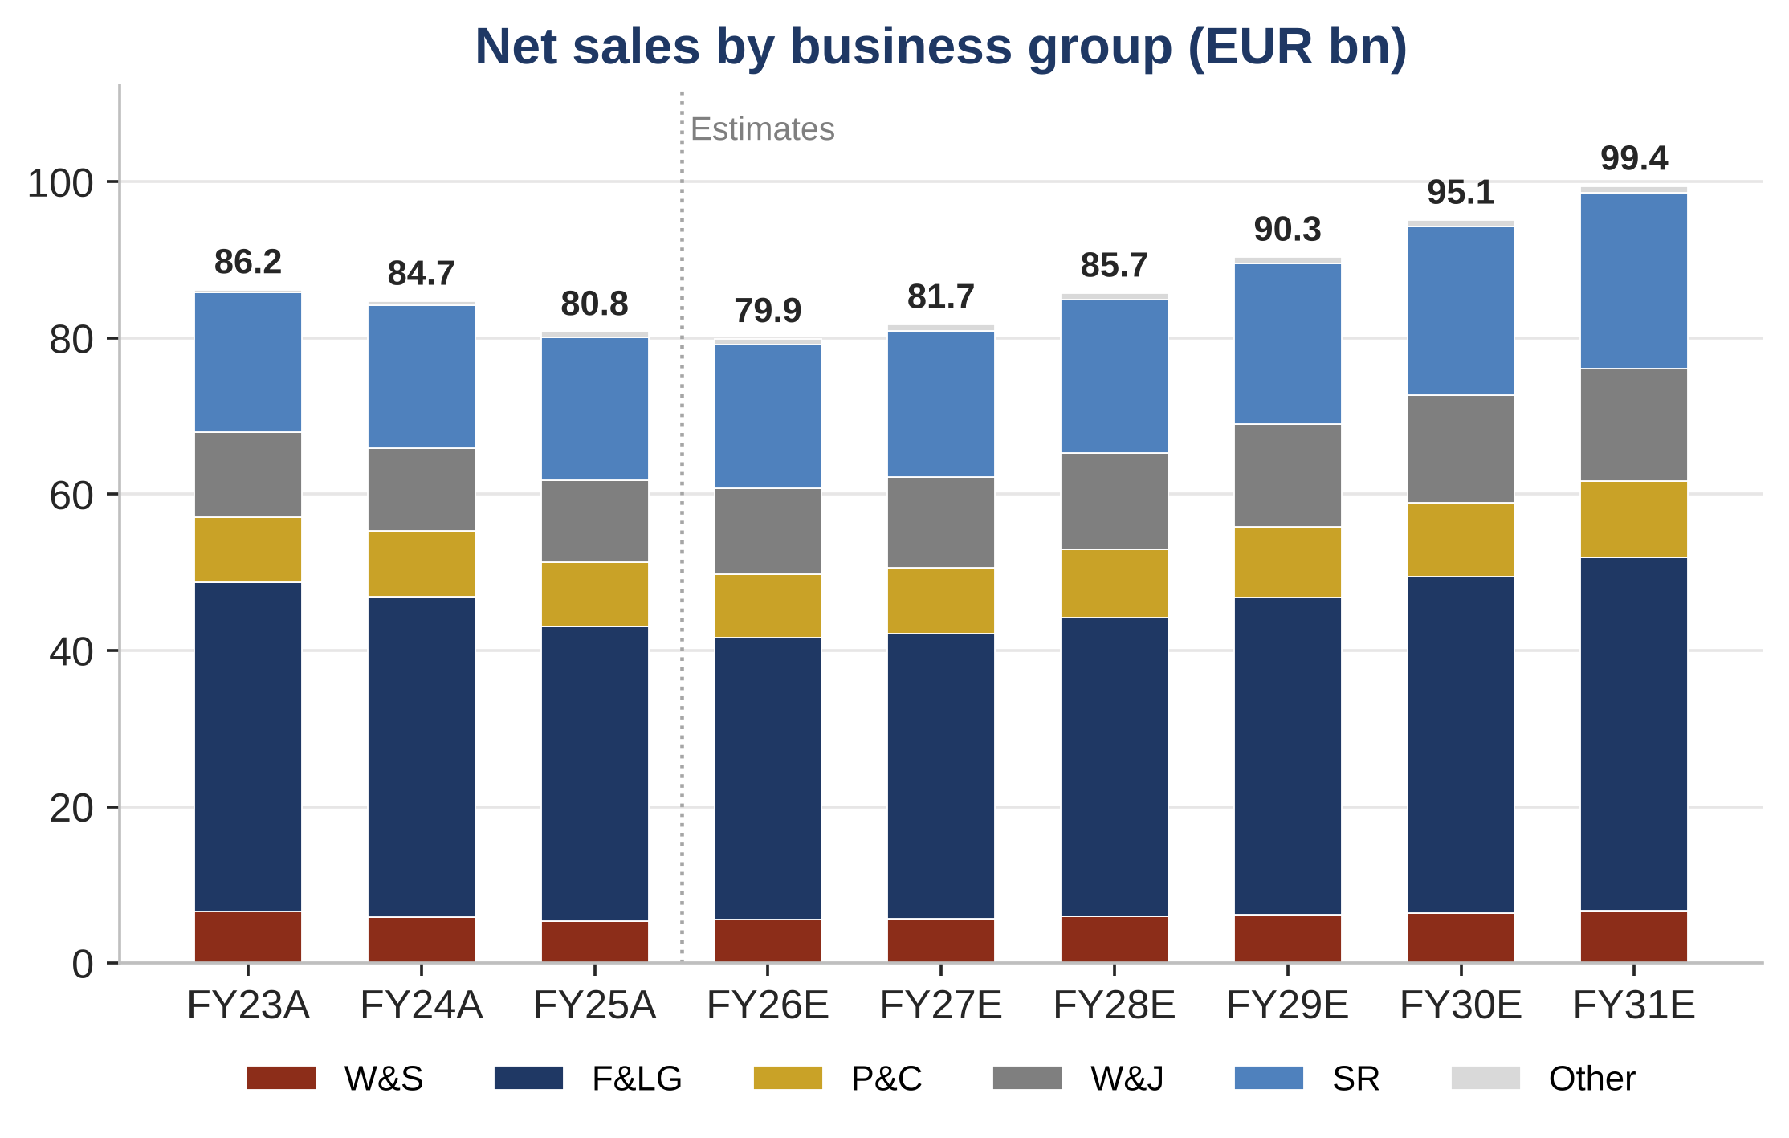
A diversified portfolio of 75 Maisons across five business groups
Key Takeaways
Fashion is the profit engine : Fashion & Leather Goods made 47% of FY25 sales but 74% of profit from recurring operations, at a 35.0% margin.
Growth has rotated : In the first nine months of 2026, Watches & Jewelry (+8% organic) and Selective Retailing (+6%) offset the slowdown in Fashion (-2%).
Portfolio pruning : The sale of Marc Jacobs to WHP Global and of DFS Greater China to China Tourism Group Duty Free refocus the group on its core Maisons.
Source: Company filings, Axone Equity Research estimates | Strictly Private & Confidential
3

Slide 4
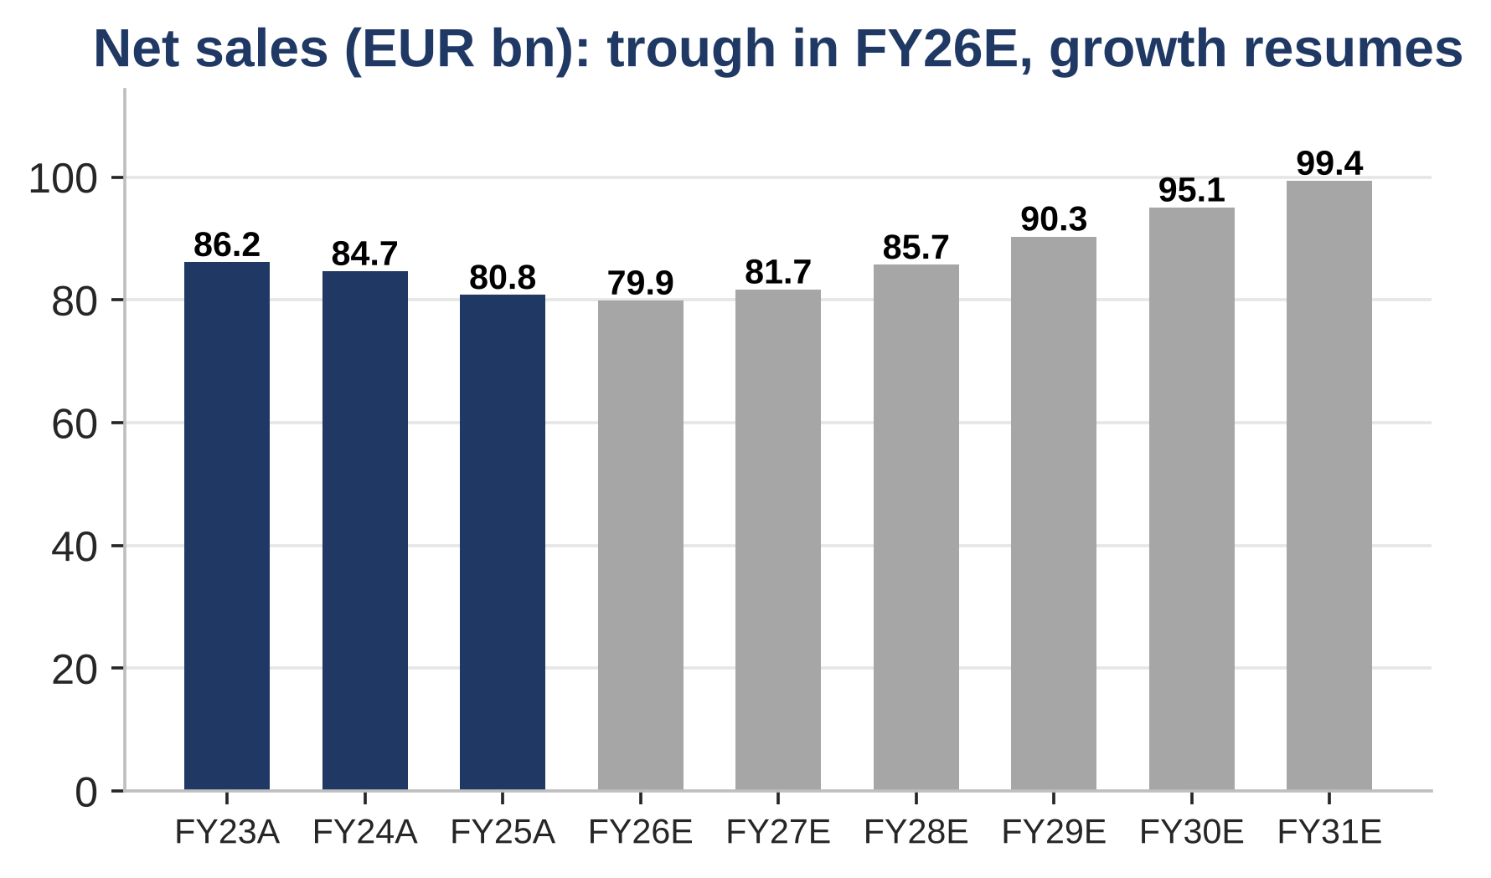
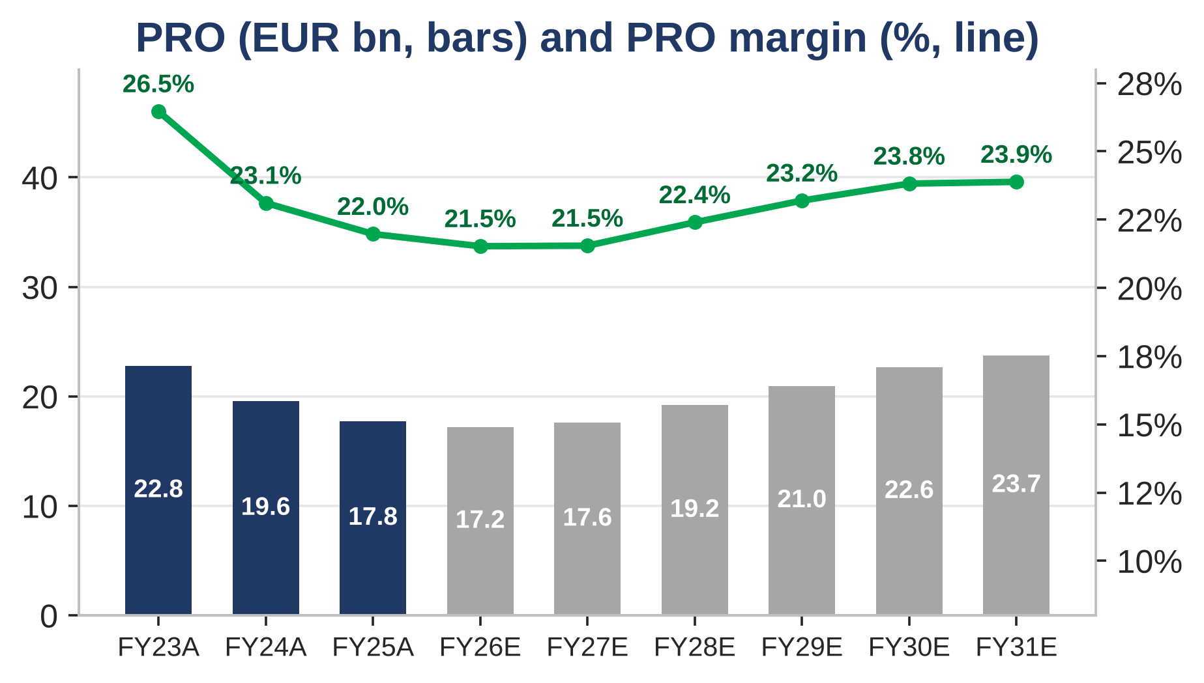
FY26E marks the trough; growth and margins rebuild from FY27E
Takeaway: Built from 9M actuals plus Q4, FY26E sales reach €79.9bn (-1.1% reported) and PRO €17.2bn (21.5% margin). Sales then grow at a 4.5% CAGR to FY31E and the margin recovers to 23.9%, still below FY23's 26.5%.
Source: Company filings, Axone Equity Research estimates | Strictly Private & Confidential
4

Slide 5
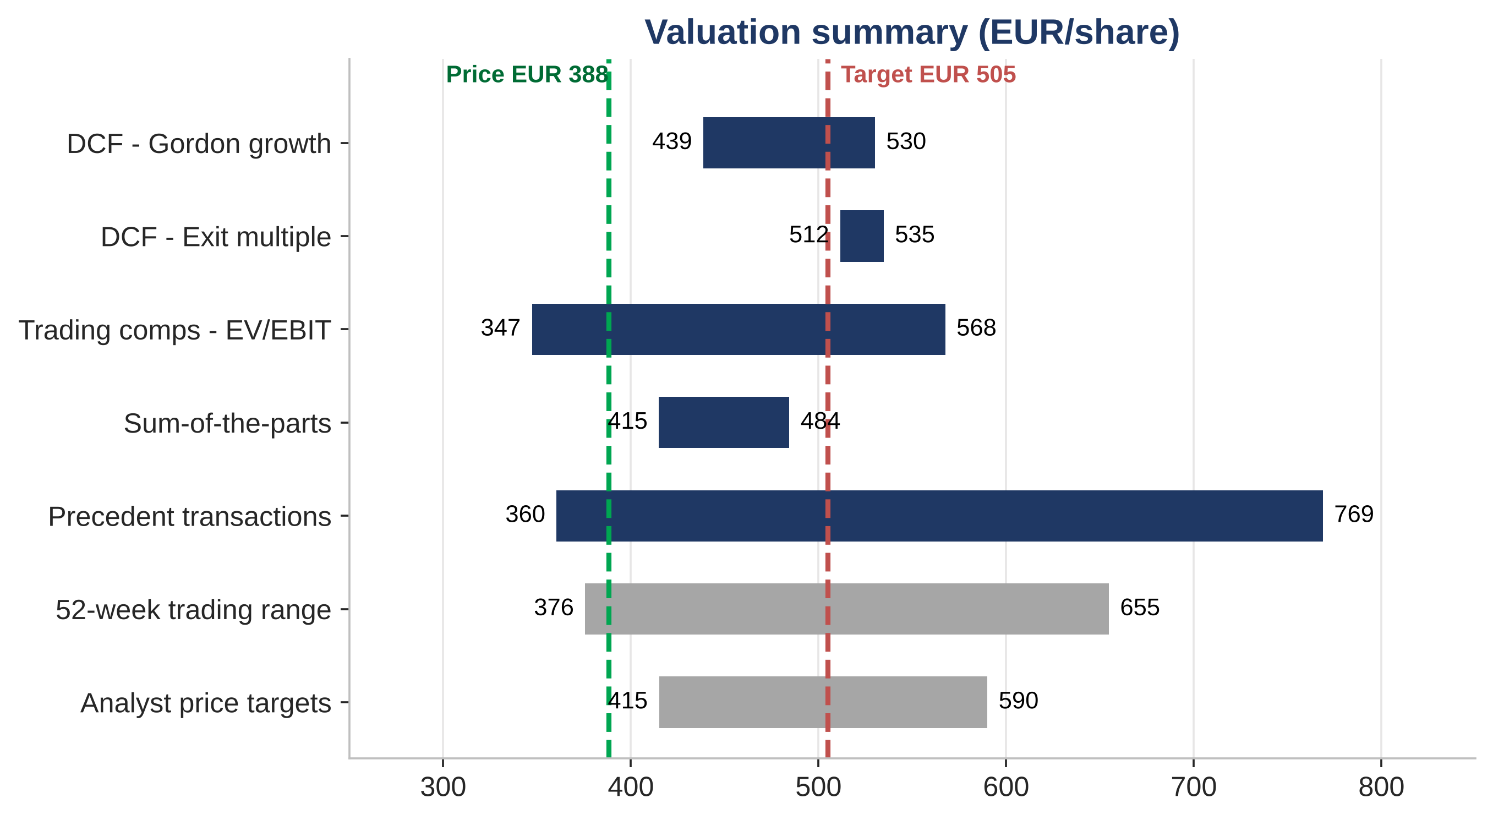
Valuation points to upside on every central estimate
Key Takeaways
DCF : €480 (Gordon, g 2.5%) to €523 (exit 11.0x), at an 8.1% WACC.
Sum-of-the-parts : €450 per share, valuing each business group on the EV/EBIT of its own listed peers.
Trading comps : €545 at the 16.5x core-peer median. Kering's trough earnings inflate that median, so we use it as a cross-check only.
Conclusion : €505 blended target, +30% upside, +3% versus the €492 consensus.
Source: Company filings, MarketScreener, Axone Equity Research estimates | Strictly Private & Confidential
5

Slide 6
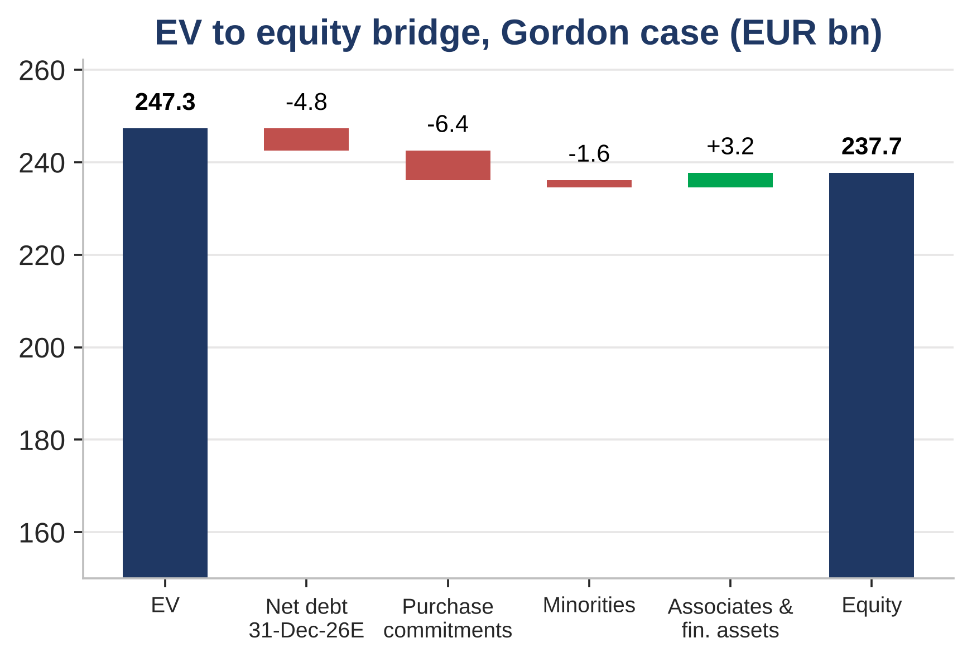
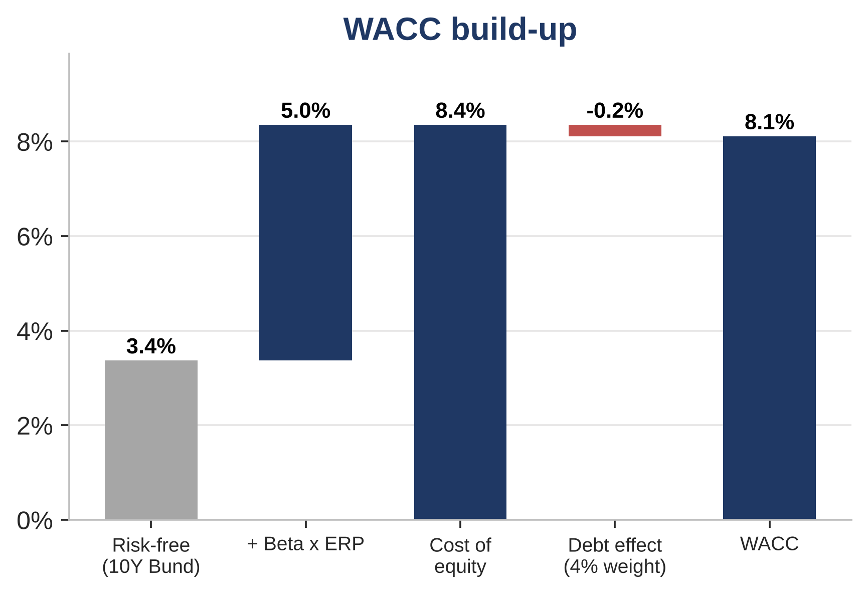
DCF supports a €480-523 intrinsic value
Key Modeling Assumptions
▪ Discount rate & TV: WACC of 8.1% (10Y Bund 3.37%, Blume beta 0.91, ERP 5.5%). Terminal growth 2.5%; exit multiple 11.0x EV/EBITDA (Gordon-implied 9.9x).
▪ Cash flows: UFCF = NOPAT + D&A - capex - change in NWC - net lease cost (pre-IFRS 16 basis). Tax at 30% in FY26E (French surtax), 27% thereafter.
▪ Valuation at 31 December 2026: EV of €247bn (Gordon) and €268bn (exit); terminal value is 78% of the Gordon EV. The bridge deducts net debt, minorities and purchase commitments (incl. Diageo's 34% of Moët Hennessy).
Source: Company filings, Axone Equity Research estimates | Strictly Private & Confidential
6

Slide 7
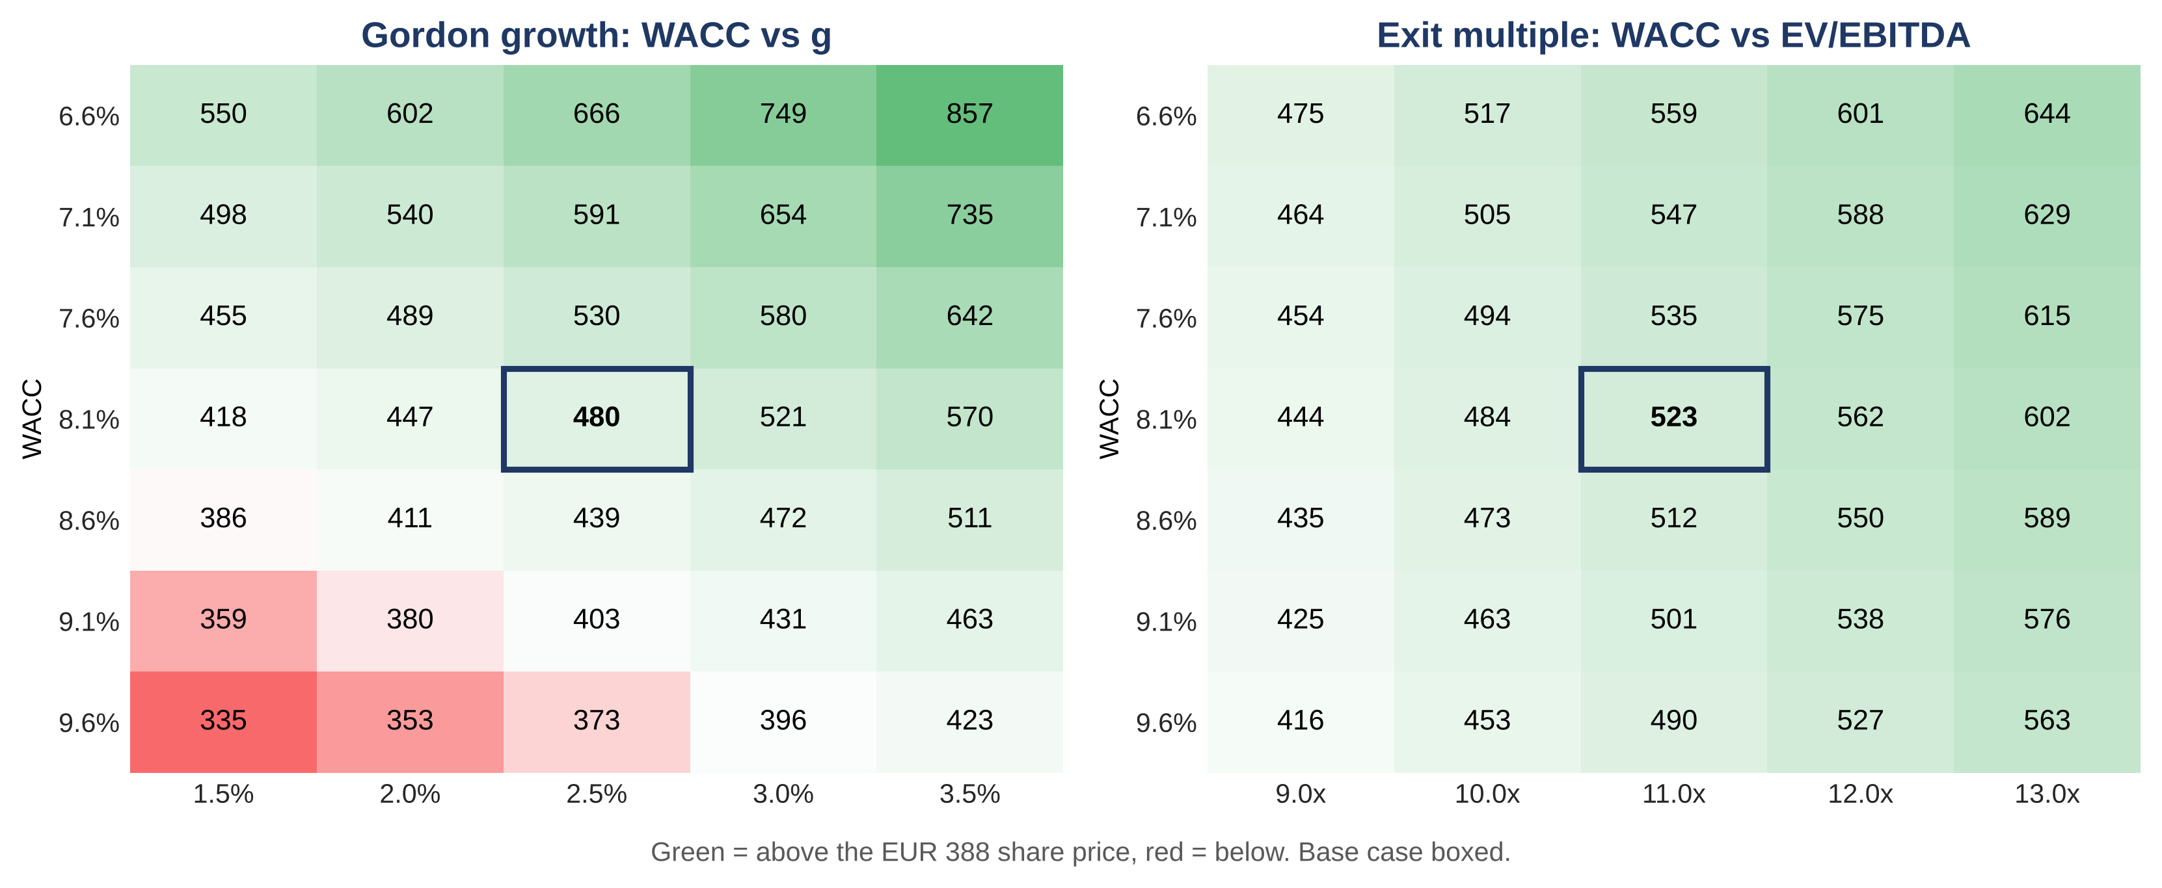
The share price already discounts a ~9.4% WACC
Key Takeaways
Base case : At an 8.1% WACC and 2.5% growth, the Gordon DCF gives €480 per share.
What the market prices in : The €388 share price implies a WACC of about 9.4%, close to the 9.6% obtained with the stressed French OAT (4.93%) as risk-free rate.
Downside protection : Even at a 9.6% WACC, the exit-multiple DCF still gives €490 per share at 11.0x.
Source: Company filings, Axone Equity Research estimates | Strictly Private & Confidential
7

Slide 8
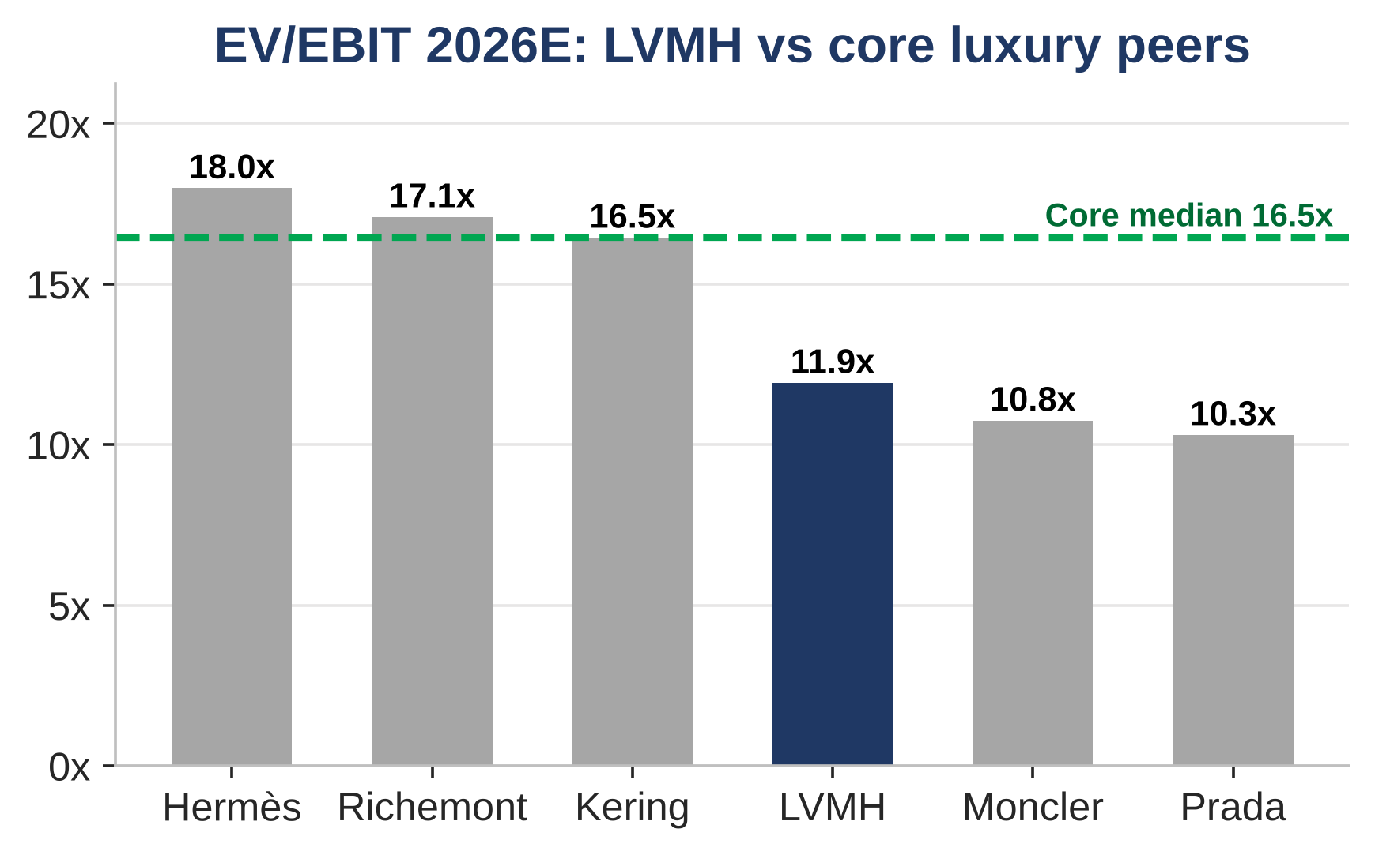
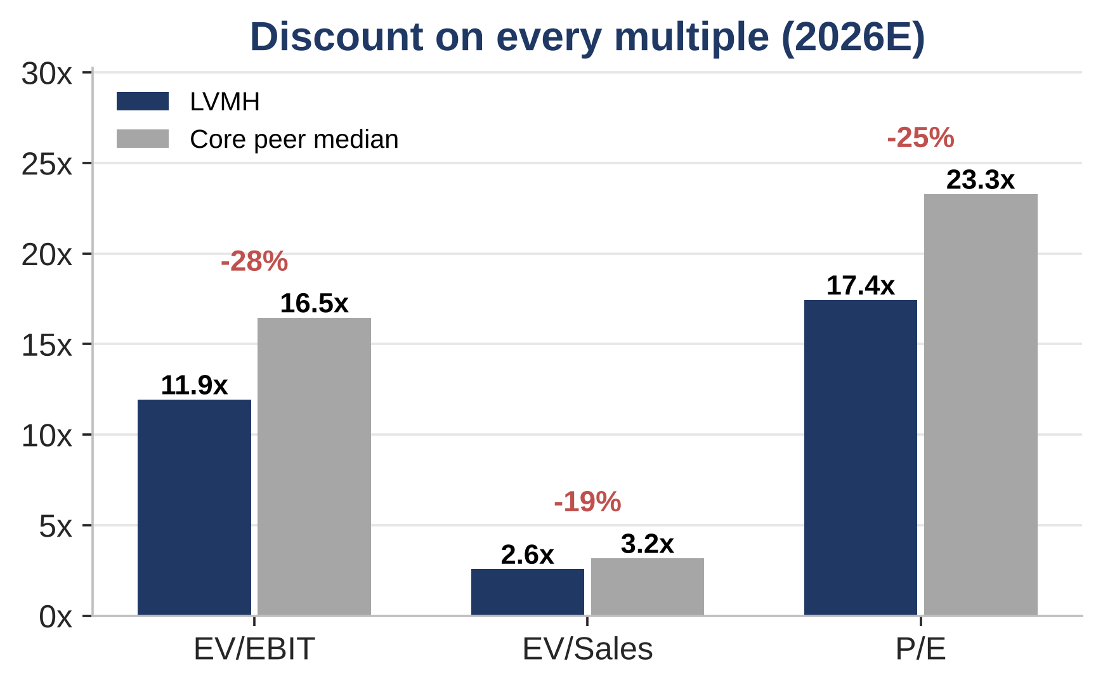
LVMH trades at a 28% EV/EBIT discount to luxury peers
Takeaway: At 11.9x EV/EBIT and 17.4x P/E 2026E, LVMH trades 28% and 25% below the median of Hermès, Richemont, Kering, Prada and Moncler. Applying the 16.5x median EV/EBIT would value the shares at €545.
Source: Company filings, MarketScreener / Zonebourse consensus, Axone Equity Research estimates | Strictly Private & Confidential
8

Slide 9
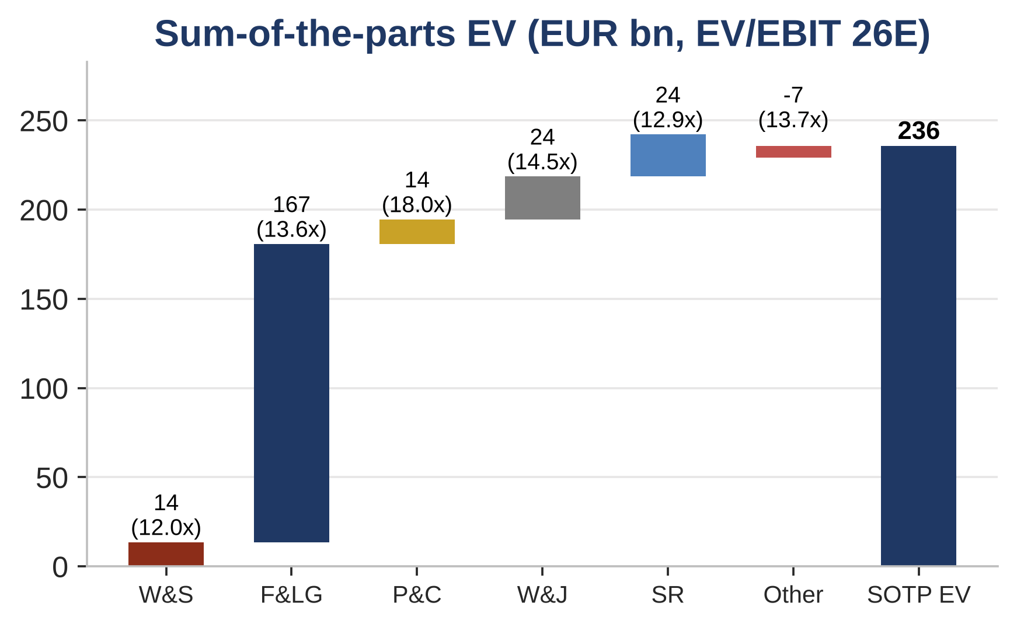
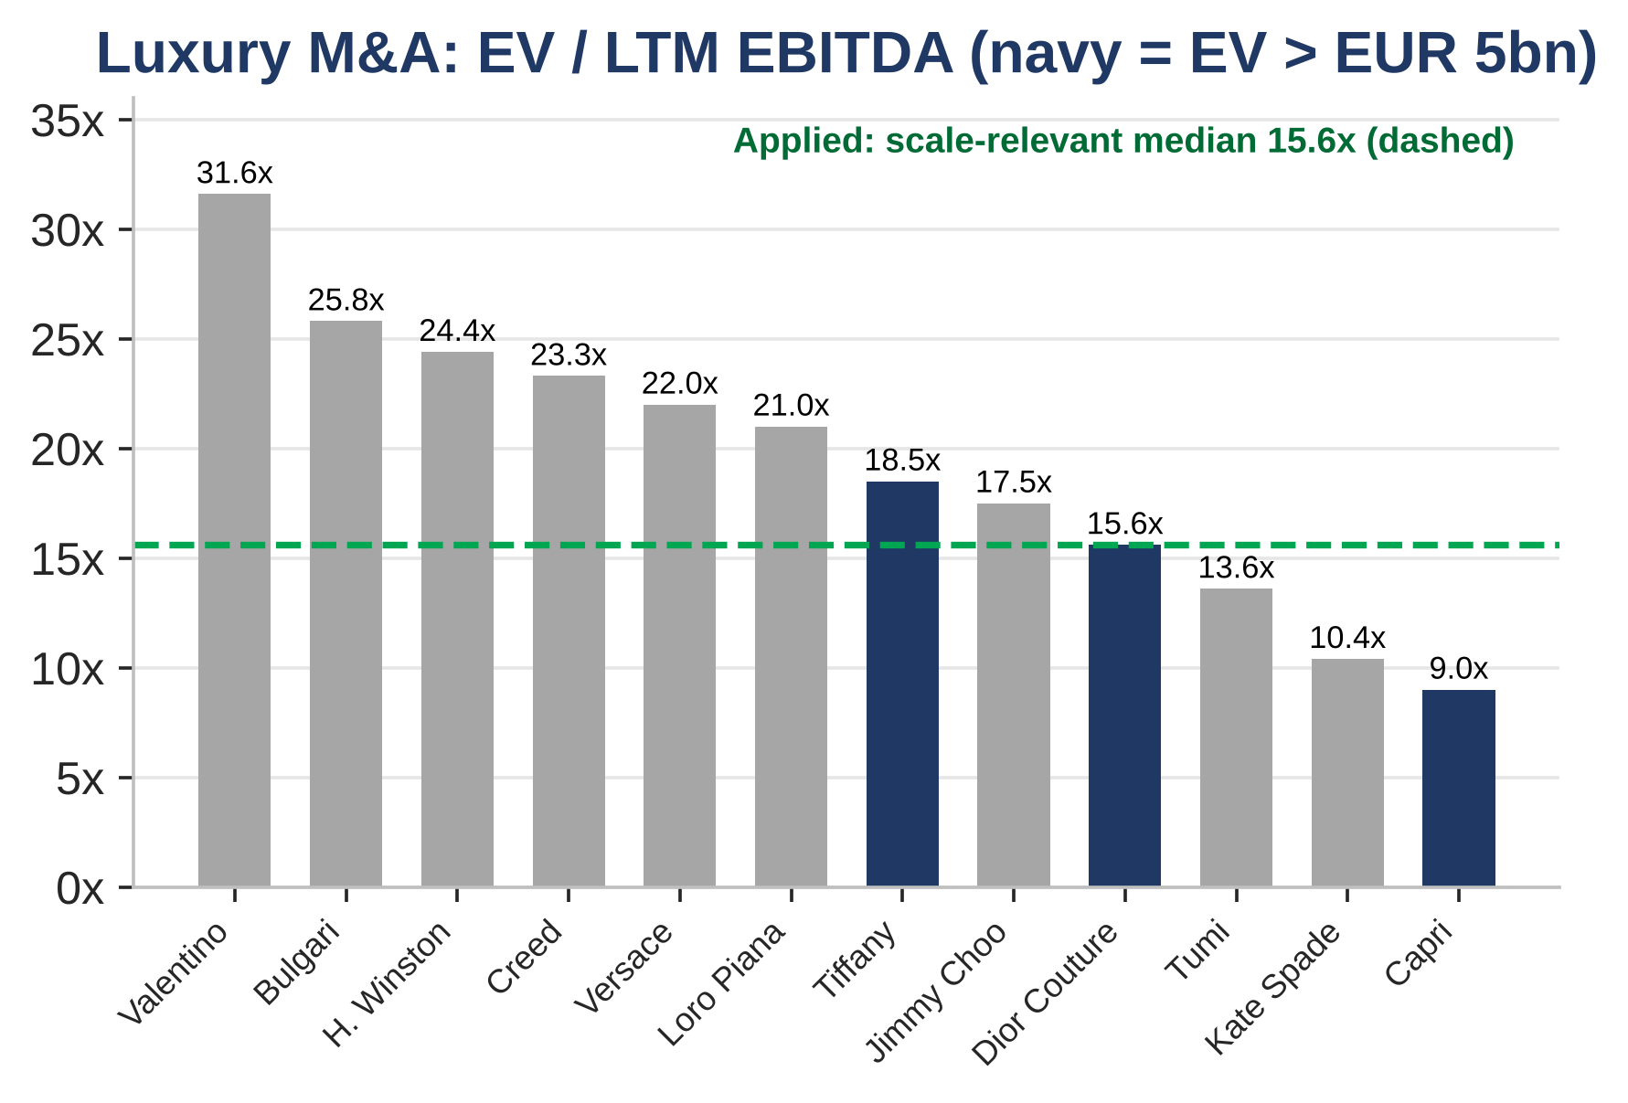
Sum-of-the-parts and LVMH's own deal history confirm the upside
Takeaway: Valued business group by business group, LVMH is worth €236bn of EV or €450 per share, so the market applies a 13% conglomerate discount. LVMH itself paid 15.6x EBITDA for Dior Couture and 18.5x for Tiffany; the 15.6x scale-relevant median implies €644 on a control basis.
Source: Tiffany DEFM14A (SEC), KPMG Advisory, FT, BoF, company filings, Axone Equity Research estimates | Strictly Private & Confidential
9

Slide 10
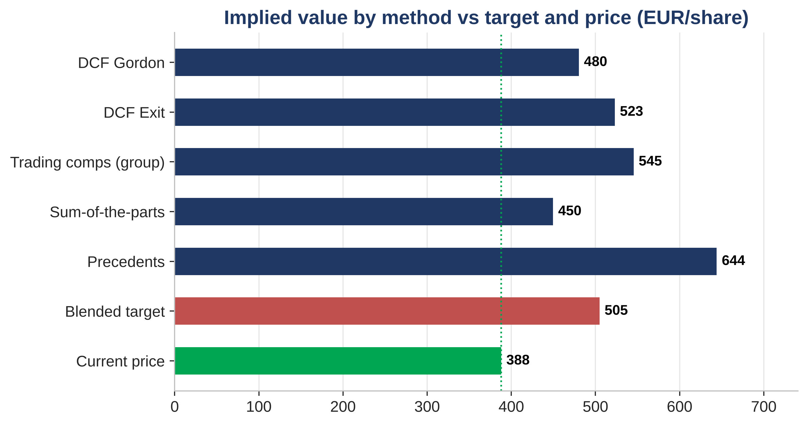
Triangulating to a €505 blended target price
Key Takeaways
Methodology weighting : 50% DCF (average of Gordon and exit), 35% sum-of-the-parts and 15% precedent transactions, as for all Axone coverage.
Why this mix : The DCF captures the margin recovery, the SOTP prices each business group against its own listed peers, and precedents are limited to deals above €5bn.
Final target : The blend gives €504.84, rounded to €505: +30% upside and a BUY rating.
Source: Company filings, Axone Equity Research estimates | Strictly Private & Confidential
10

Slide 11
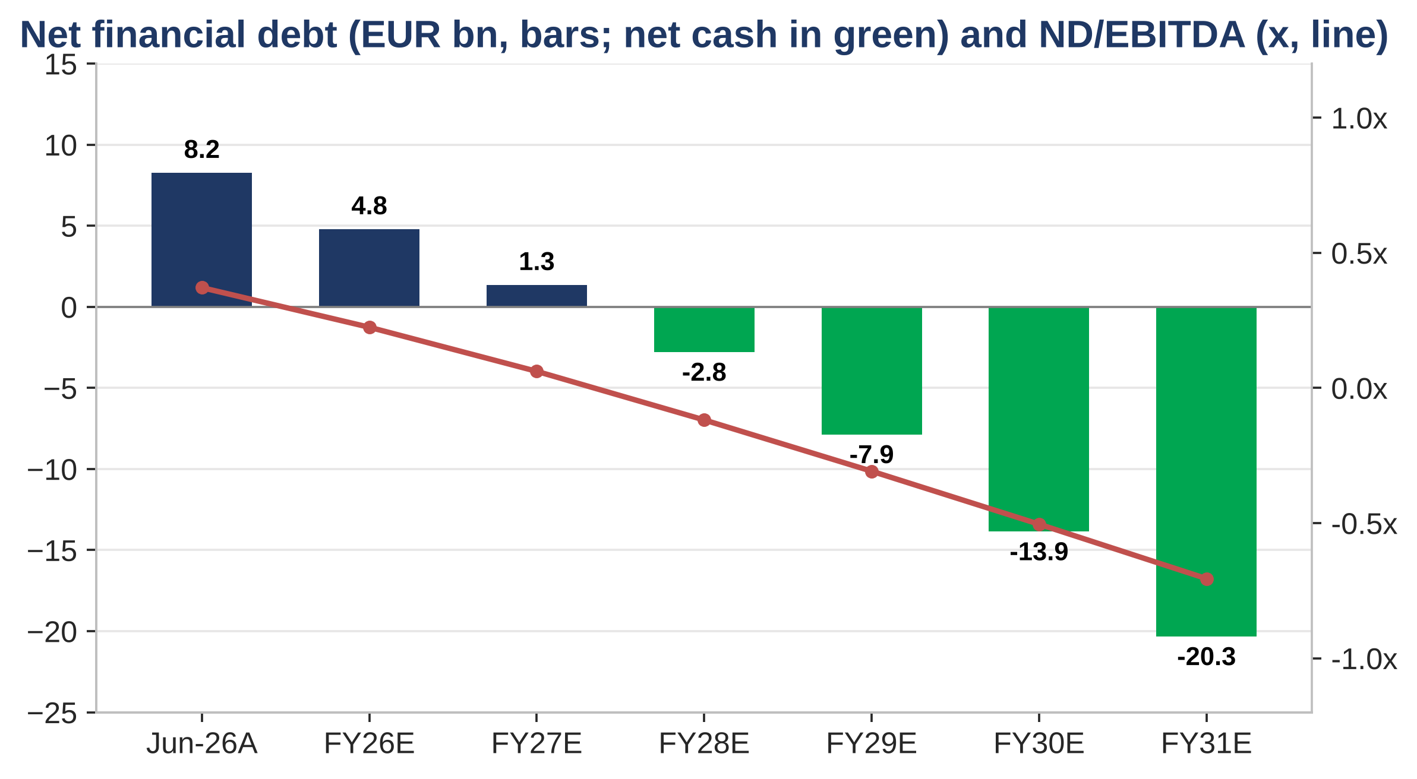
Cash generation funds rising dividends and a move to net cash
Key Takeaways
Current position : Net financial debt of €8.2bn at 30 June 2026, or 0.4x EBITDA, excluding €16.3bn of lease liabilities.
Cash conversion : Unlevered FCF of about 90% of NOPAT, or €68bn cumulated from FY27E to FY31E.
Uses of cash : Dividends of €13.0-15.0 per share (€35bn) and €1.5bn a year of buybacks still leave LVMH in net cash from FY28E, with room for bolt-on M&A.
Source: Company filings, Axone Equity Research estimates | Strictly Private & Confidential
11

Slide 12
Key risks to our thesis
▪ China slowdown : Chinese clientele fell by mid-teens in Q3 2026 and Fashion & Leather Goods declined 5% organically; a longer downturn would delay our margin recovery.
▪ Fashion creative reset : The new creative directions across the Maisons must win customers back; failure would keep the 36.5% FY30E Fashion margin out of reach.
▪ Currency : FX cut reported sales by about 5 points in H1 2026; a stronger euro against the dollar and the yen would weigh on reported profit.
▪ Middle East & tourism : The regional conflict cost about 1 point of organic growth in Q2 2026 and keeps disrupting travel retail.
▪ US tariffs : Threats of tariffs of up to 200% on French wines and champagne (January 2026) put Moët Hennessy's US business at risk.
▪ French fiscal risk : An OAT near 5% and the corporate surtax could push both the discount rate and the tax rate above our 27% normalised assumption.
Educational purposes only; not investment advice, an offer, or a solicitation. Prepared for the Axone platform based on public filings, consensus data and proprietary estimates. Figures as of 27 October 2026.
Source: Company filings, Axone Equity Research estimates | Strictly Private & Confidential
12

