Slide 1
Well Completion
Dr.Alireza Fathollahi
Reza Kahe
810401119

Slide 2
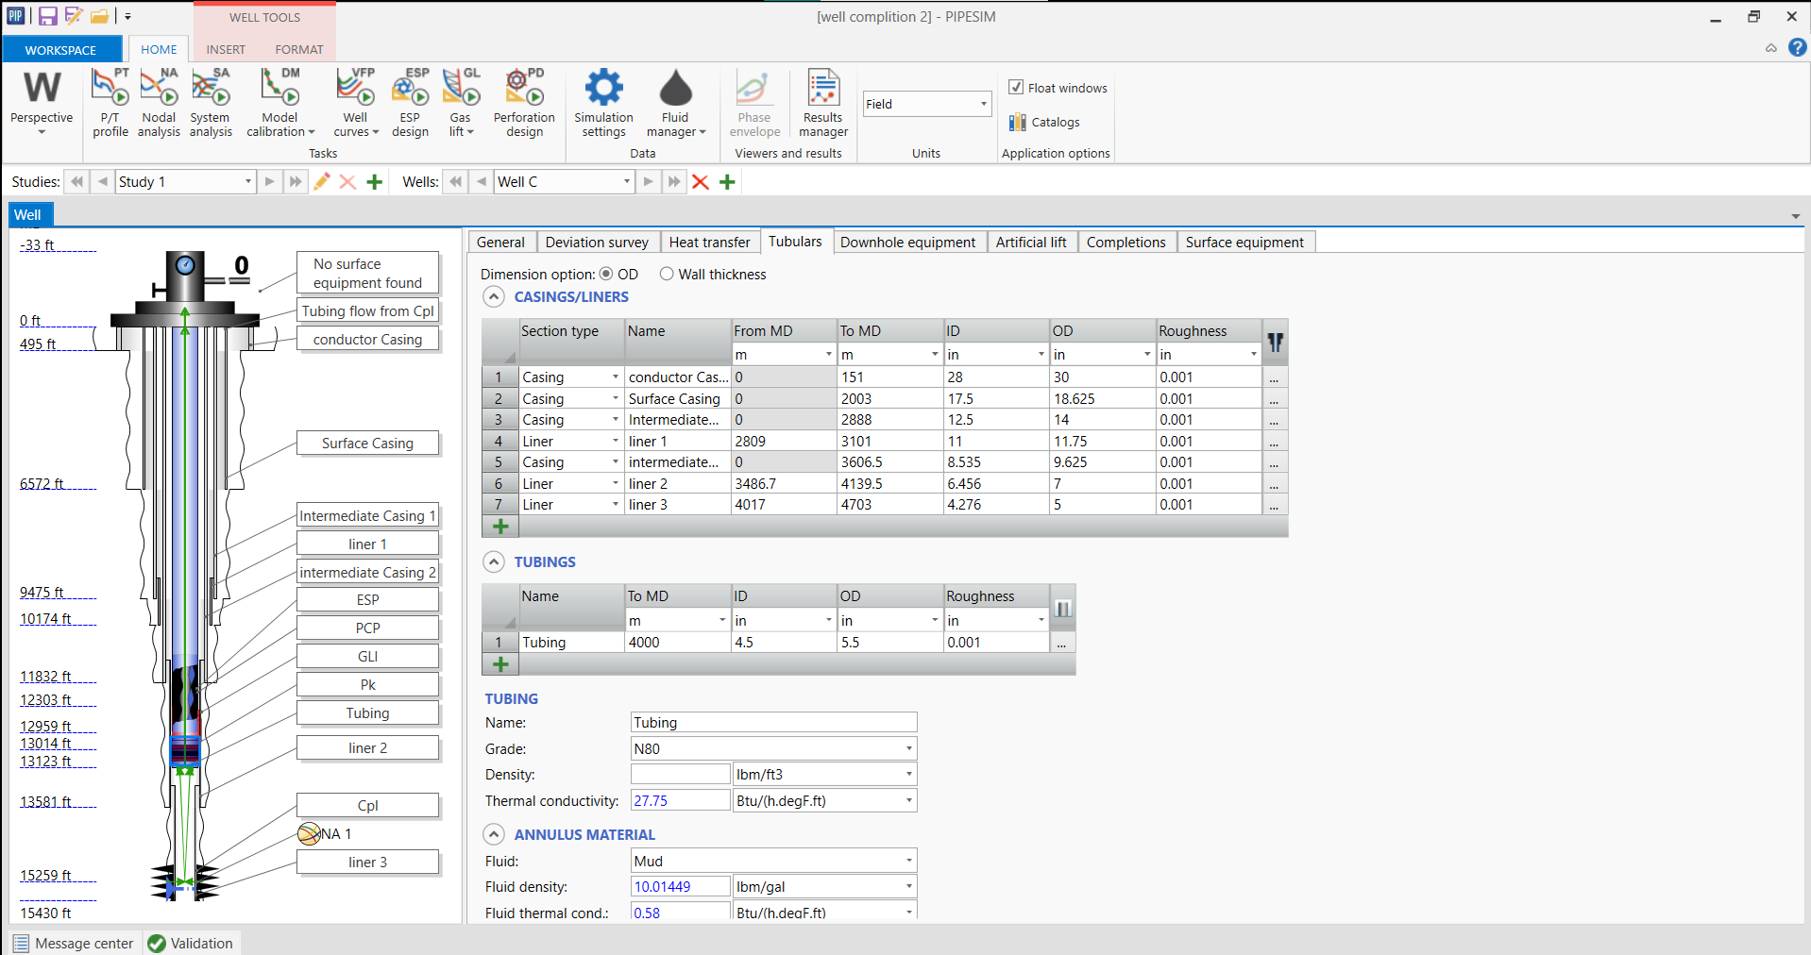
Tubulars

Slide 3
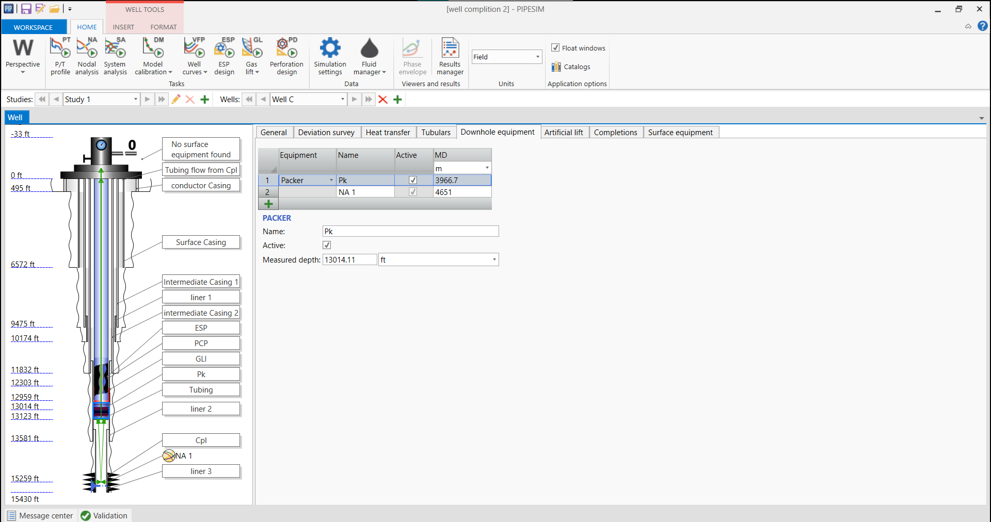
Downhole Equipment

Slide 4
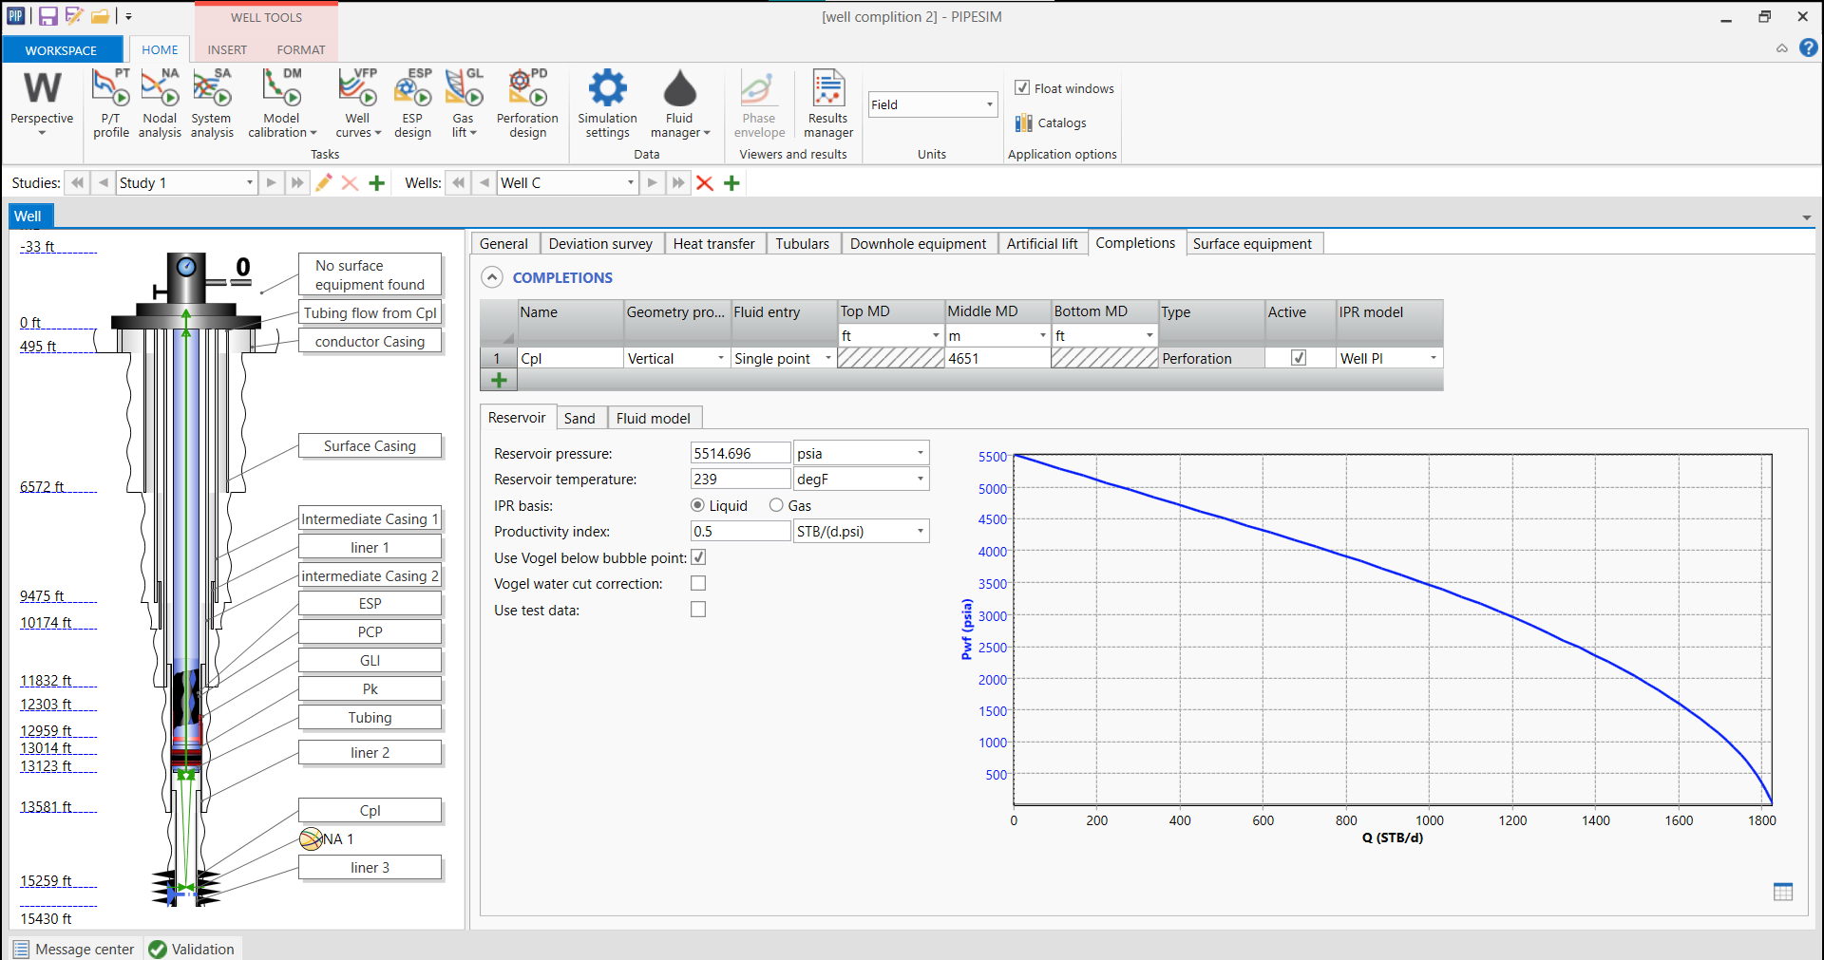
Completions

Slide 5
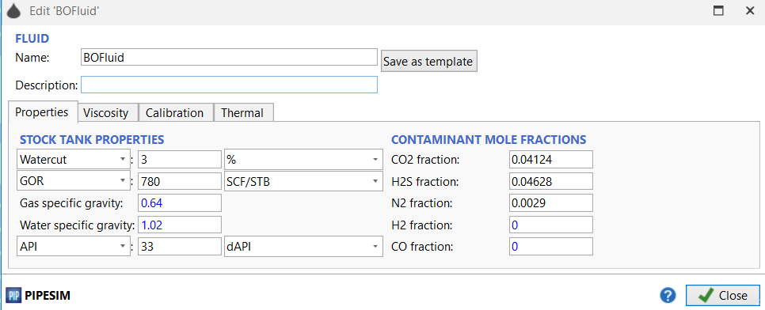
Fluid Properties

Slide 6
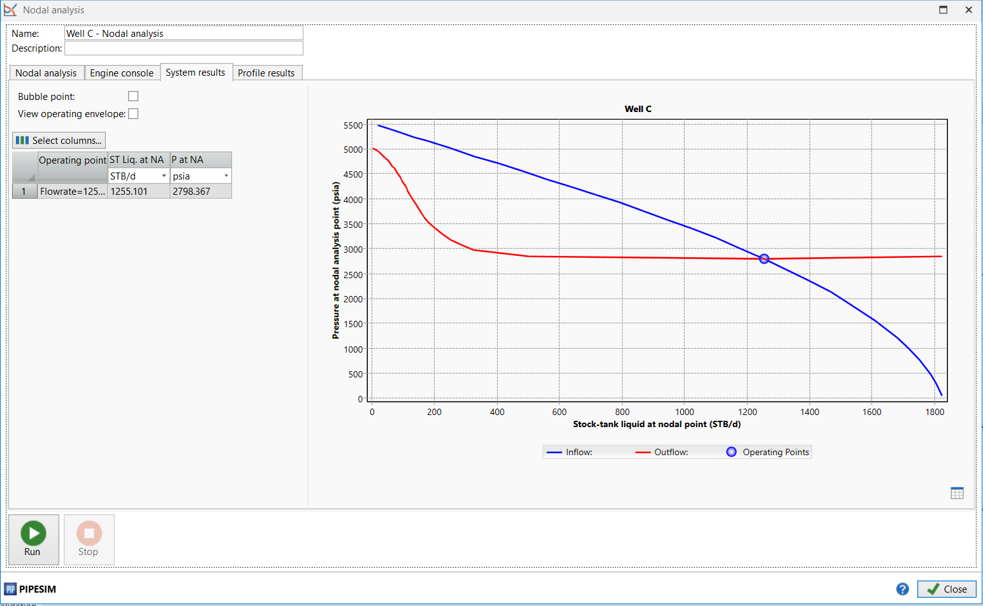
Flowrate (Packer in 9-5/8”)

Slide 7
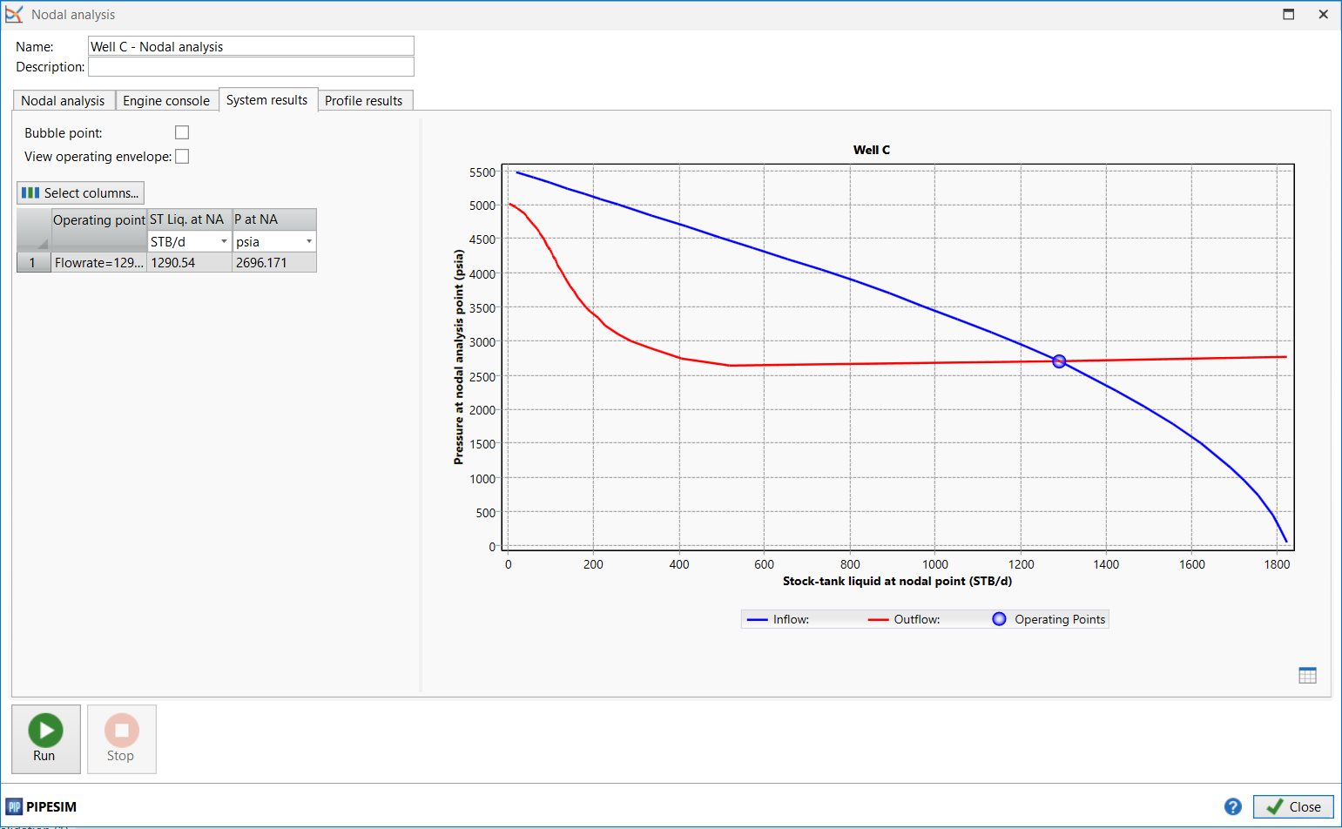
Flowrate (packer in liner 5”)

Slide 8
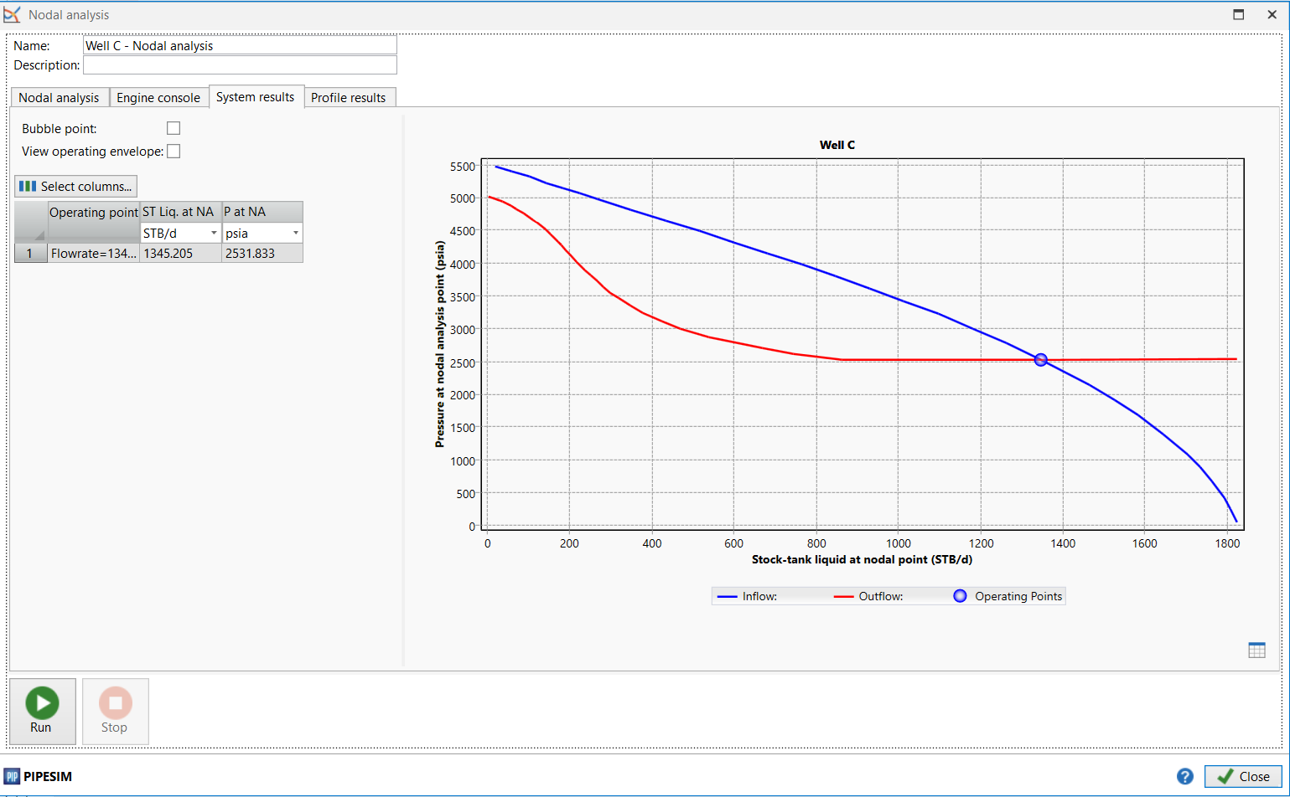
Flowrate (Packer in liner 7”)

Slide 9
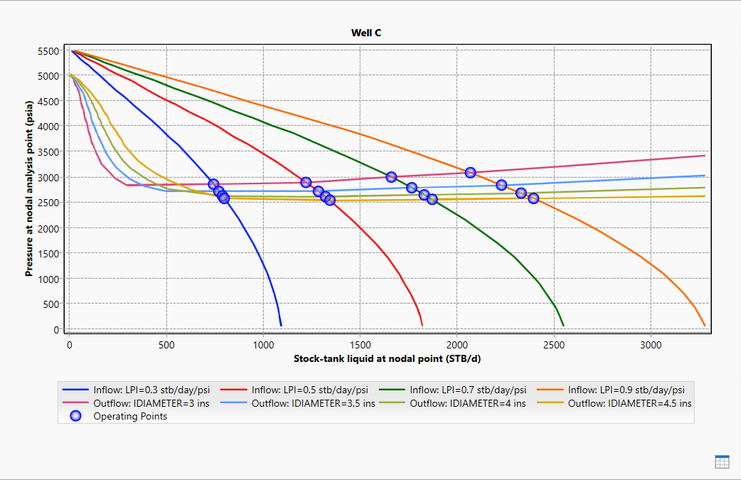
Nodal analysis of varying LPI & Diameter

Slide 10
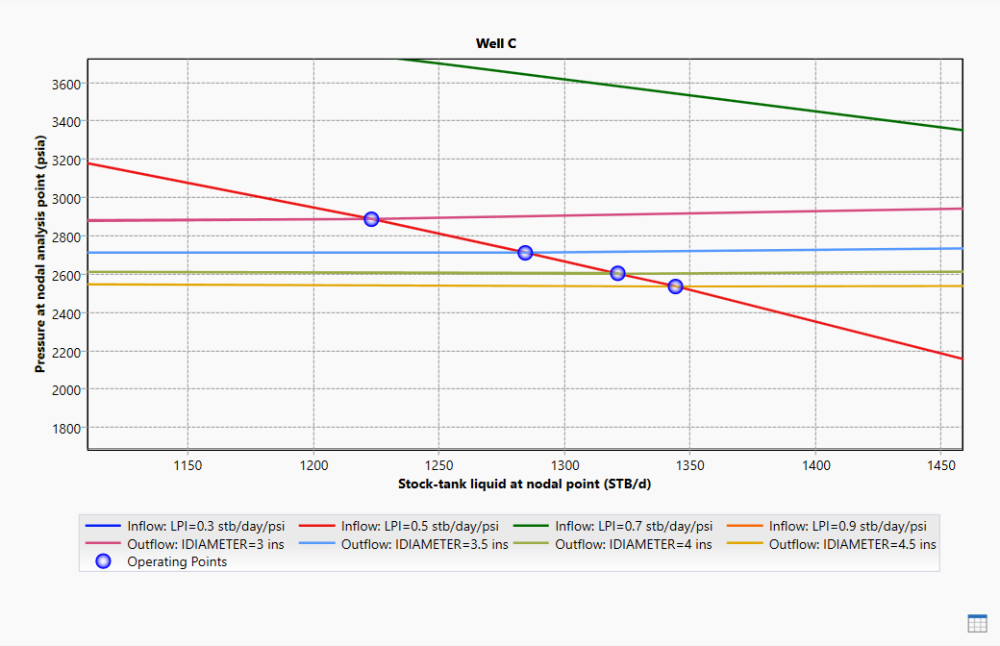
Nodal analysis of varying LPI & Diameter

Slide 11
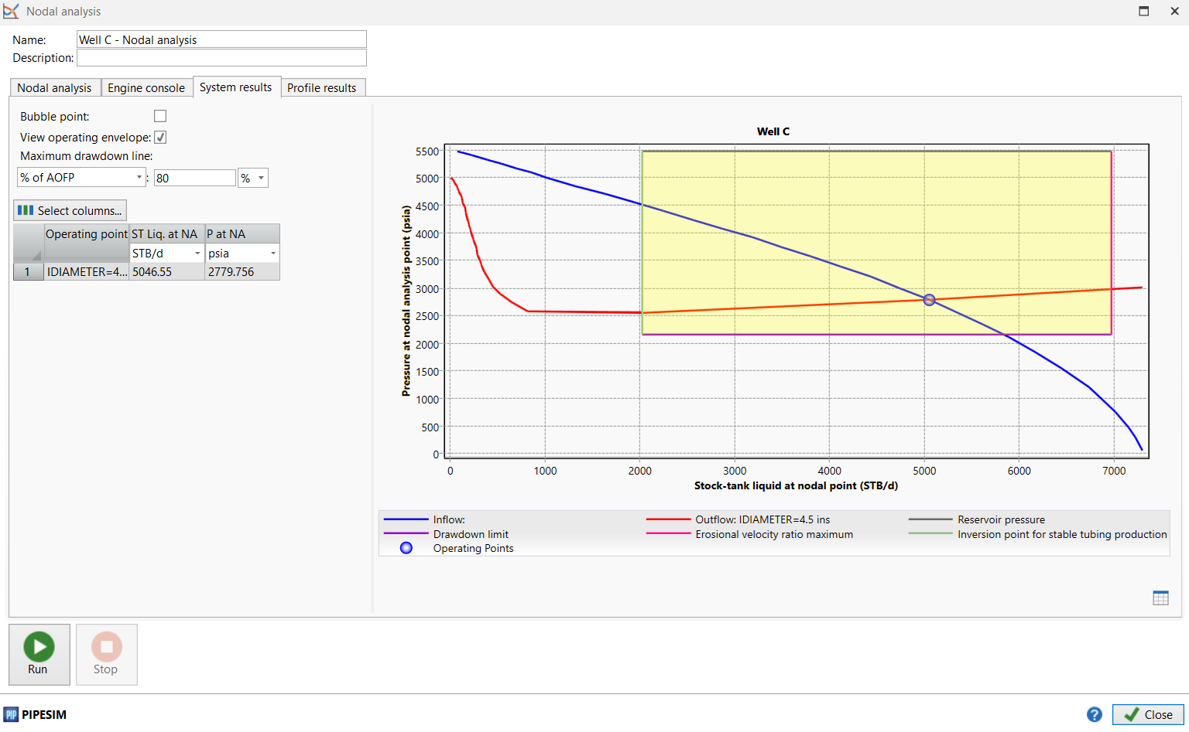
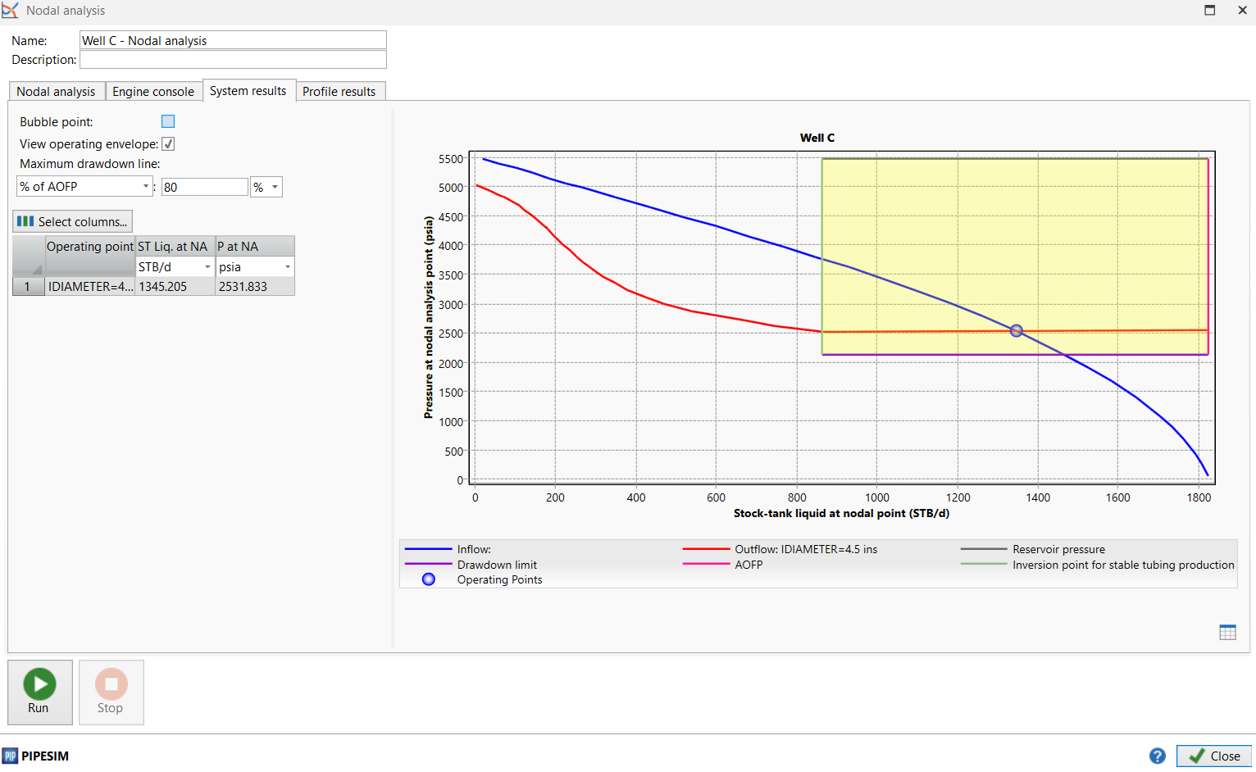
Erosion analysis

Slide 12
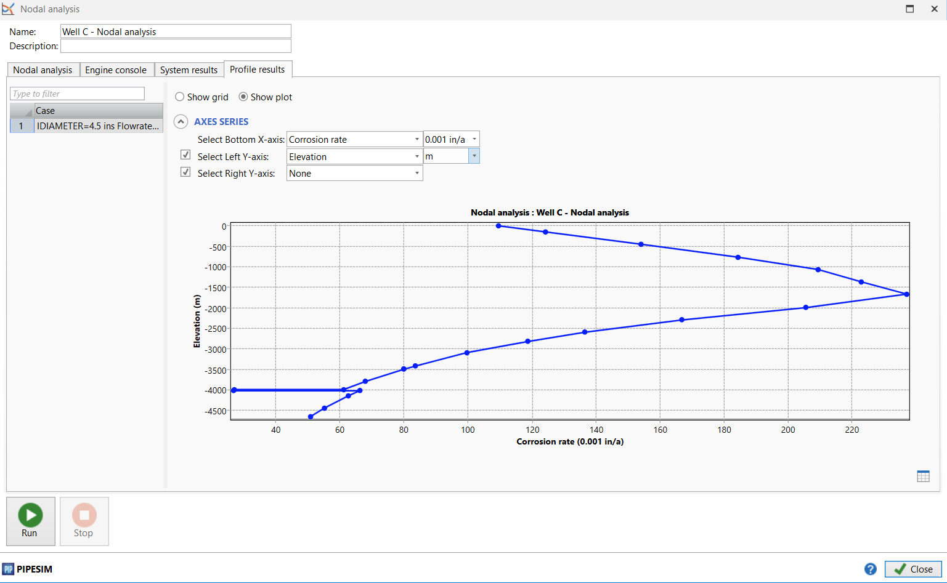
Corrosion analysis

Slide 13
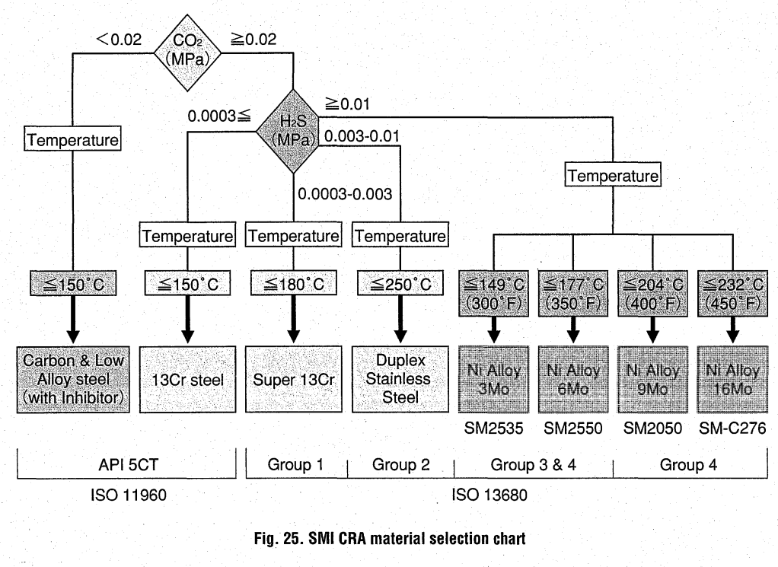
Material selection

Slide 14
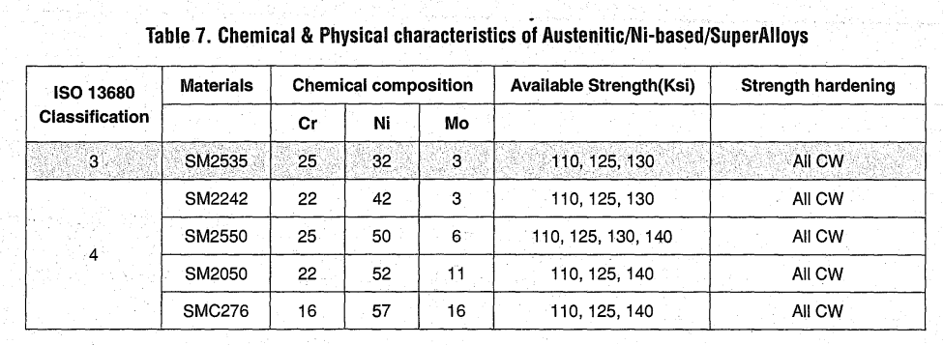
Material selection
Group 3 covers only P110 material
Group 4 covers different versions of 0125 meant for high strength applications. Type 1 Q125 is required per API 5CT/IS011960 a tighter chemistry control with addition of Gr and Mo elements.

Slide 15
Material selection
L80)
2-3$/kg
nominal weight= 26.8 Ib/ft
=12.1kg/ft * 30ft
= 363kg * 437= 158631g
158631 * (2-3) = (320000-476000)$
158631* (2.5) = (397000)
P110)
4.5$/Kg
nominal weight= 26.8 Ib/ft
=12.1 kg/ft * 30ft
= 363kg * 437= 158631kg
158631 * (4.5) = 750000$

Slide 16
Material selection
P110
High-strength tubing typically is used in deep sweet oil and gas wells with high pressures. Sensitive to Sulphide Stress Cracking (SSC) failures unless the temperatures are relatively high (> 175°F). this type is more expensive than C and N model.
Q125
API tubing grade, often used for critical service wells. Fit for H2S service at temperature greater than 260°F.

Slide 17
Maerial selection
sustained production rate | 1350 | bpd |  |  | L80 |  |  | P110
value of accelerated oil after opex and tax | 20 | $/bbl
capital cost of P110 completion (includes installation) | 3 | $ million |  |  | Delay of production |  |  | total cost
incremental cost of upfront duplex completion | 1 | $ million
Delay in production beforerig can perform workover | 3 | month |  |  | $27,000.00 |  |  | $3,000,000.00
Cost of workover | 1.5 | $ million |  |  | $2,430,000.00
 |  |  |  |  | Delay & Workover
 |  |  |  |  | $3,930,000.00

Slide 18
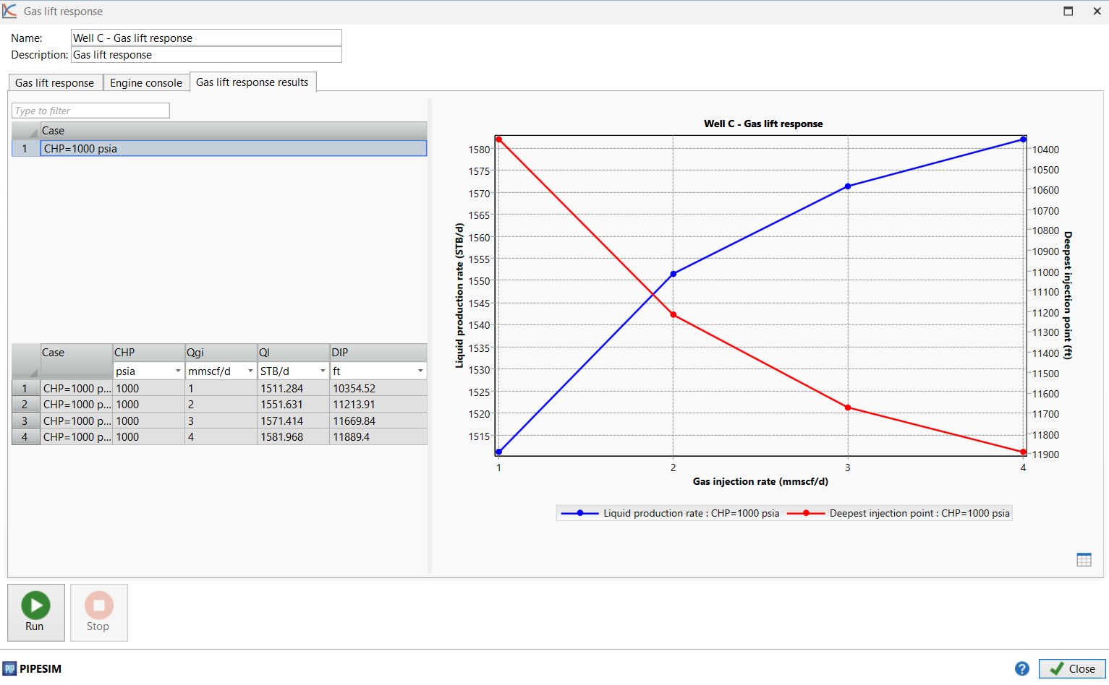
Gas Lift analysis

Slide 19
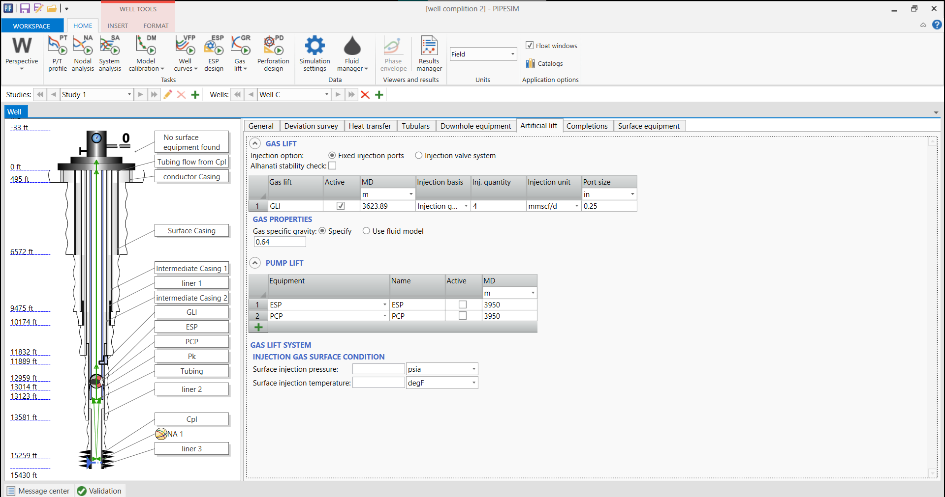
Gas Lift analysis

Slide 20
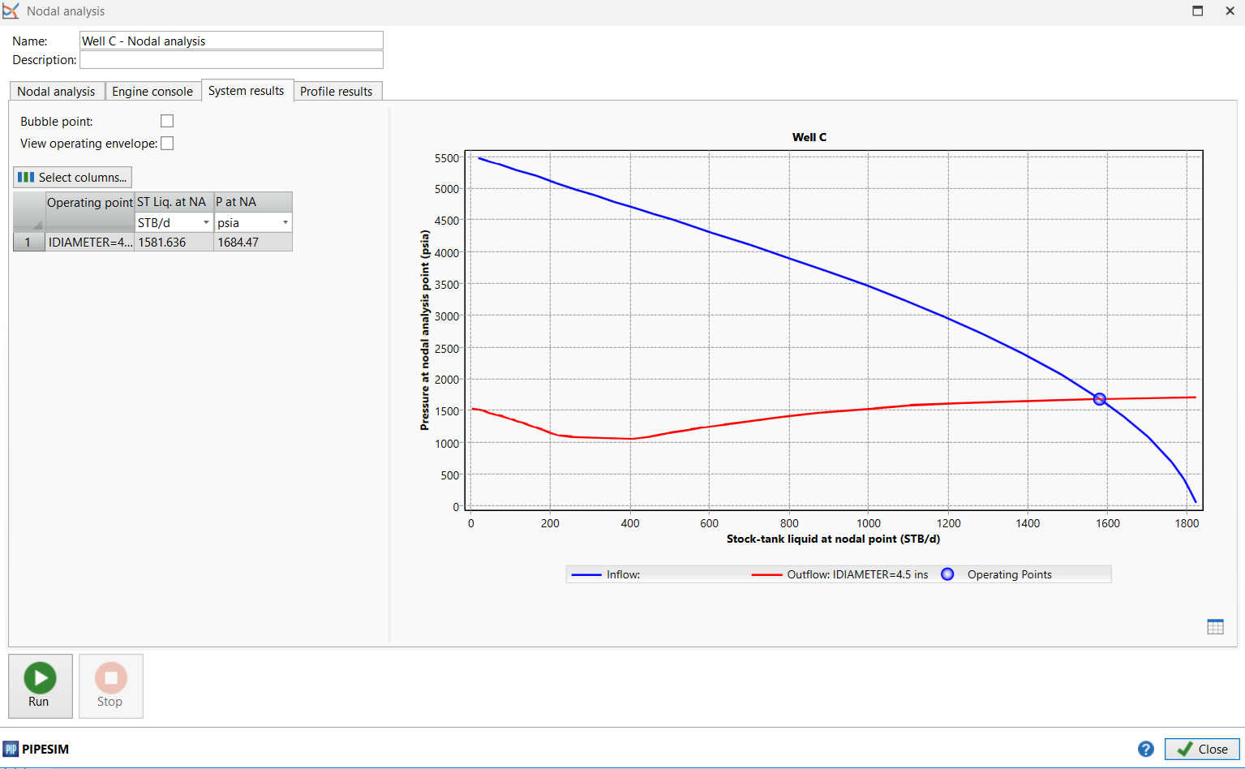
Gas Lift analysis

Slide 21
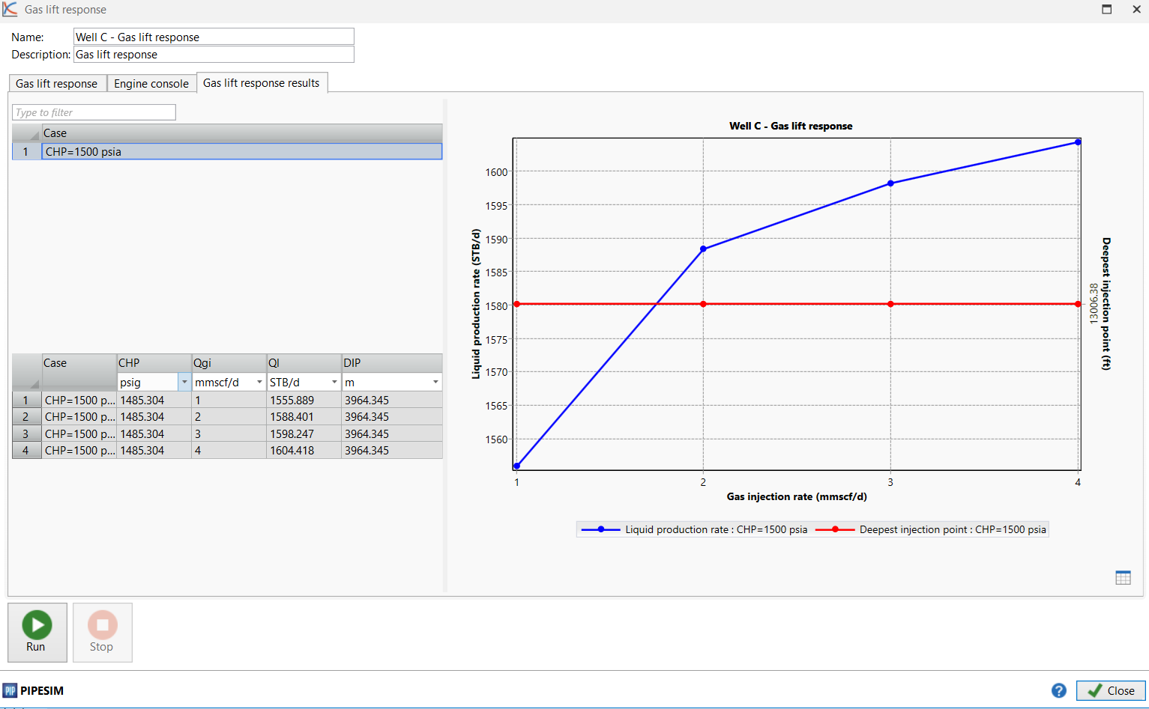
Gas Lift analysis

Slide 22
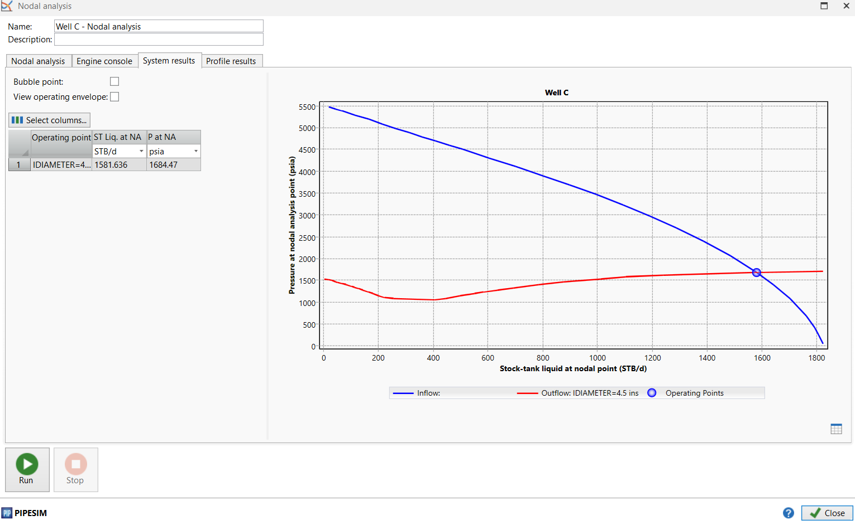
Gas Lift analysis

Slide 23
END

