Slide 1

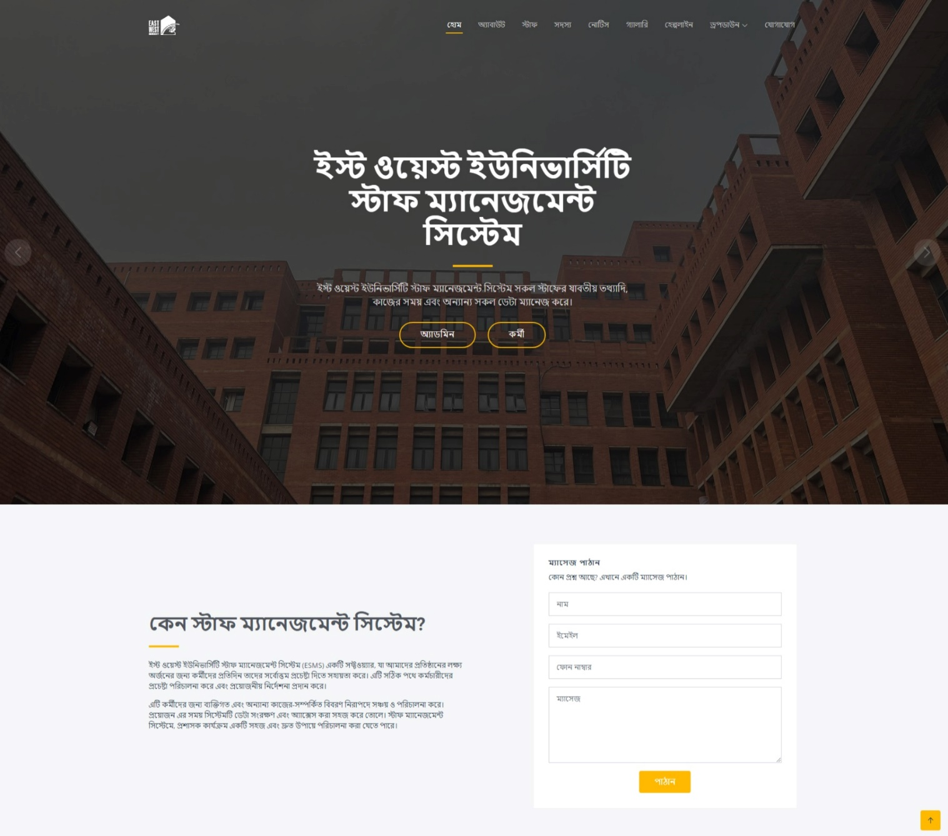
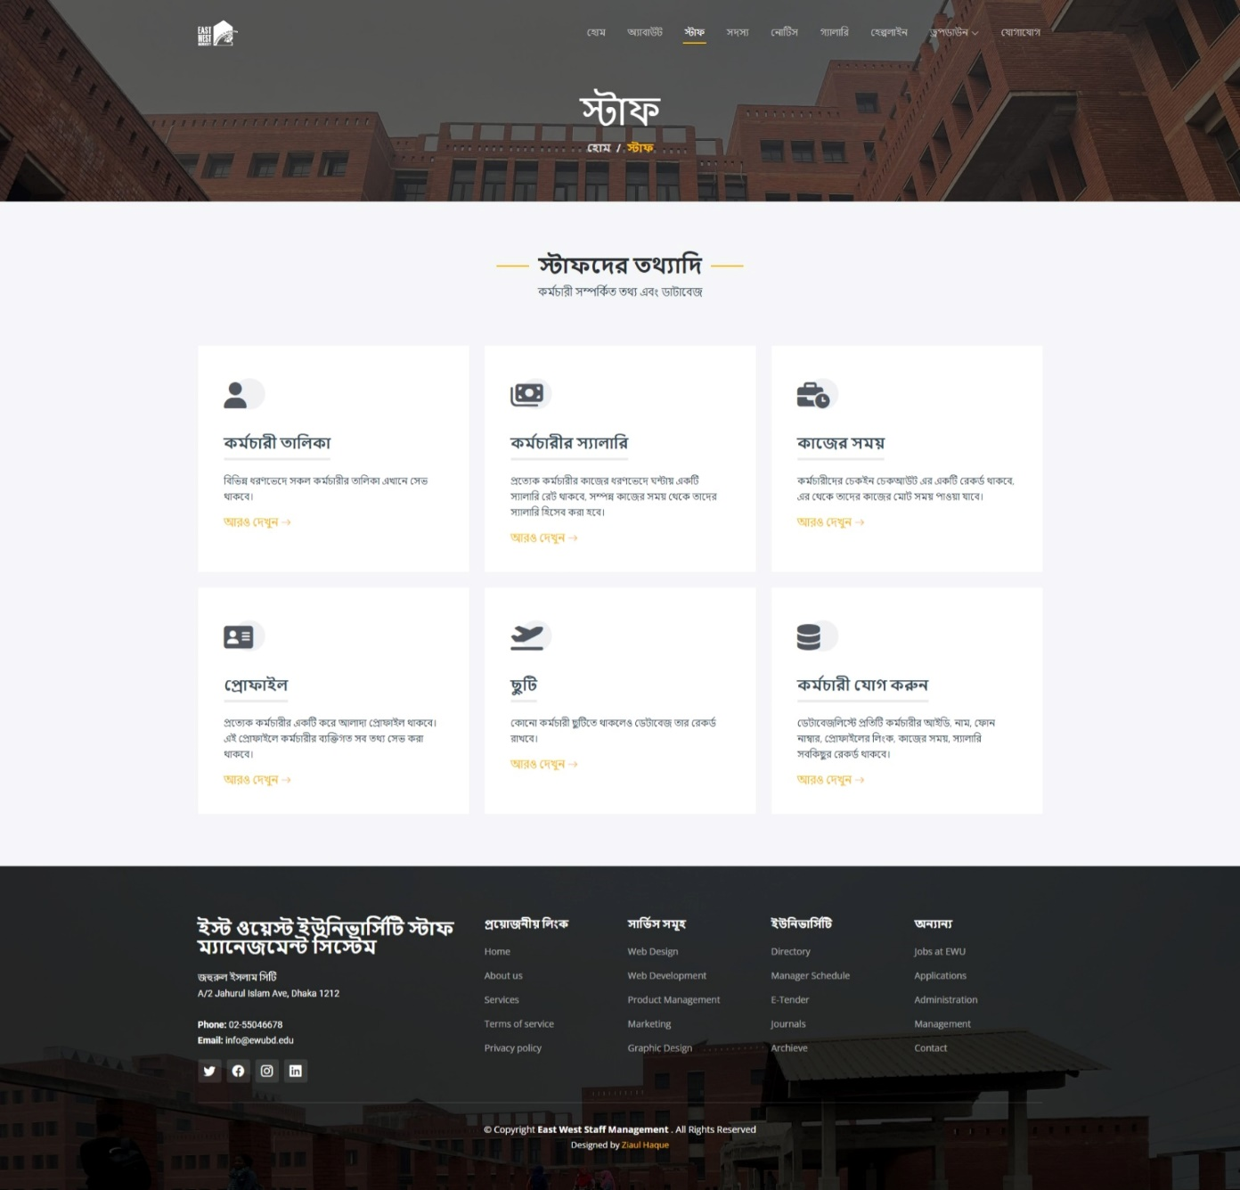
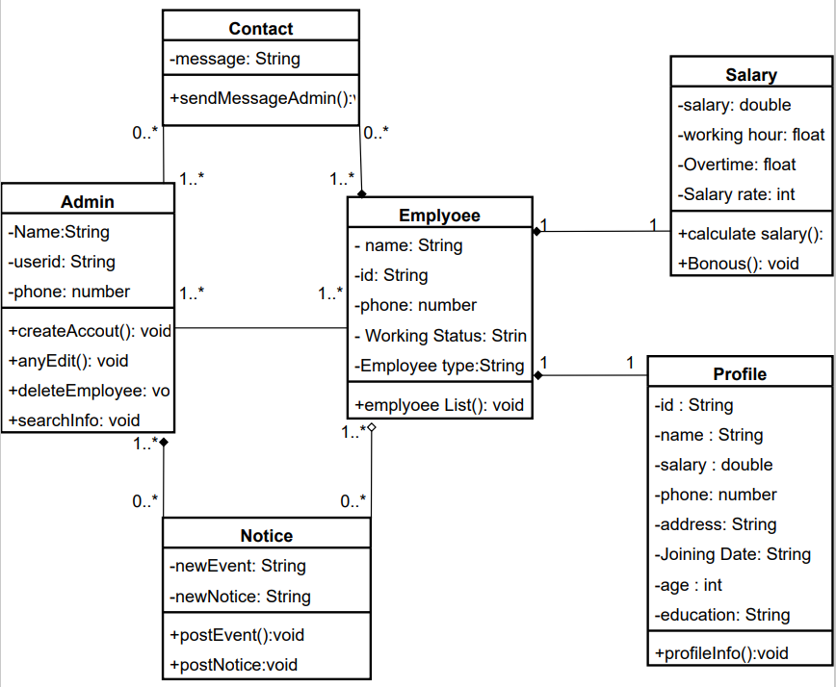
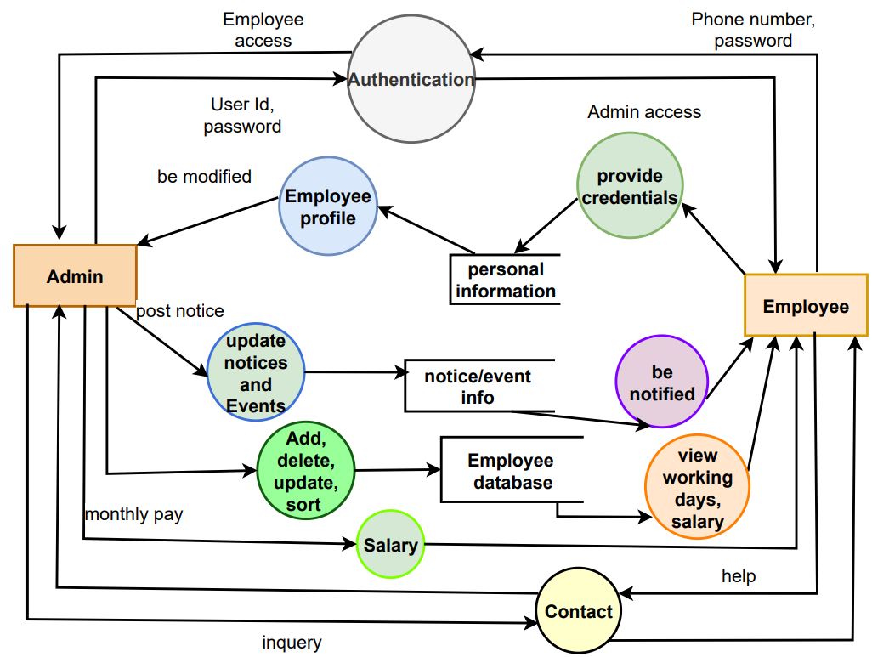
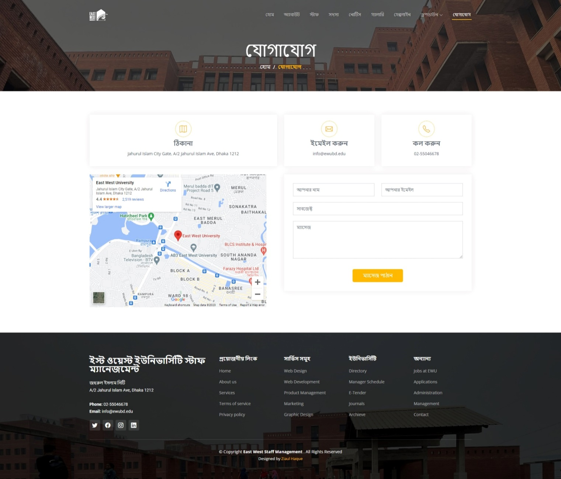
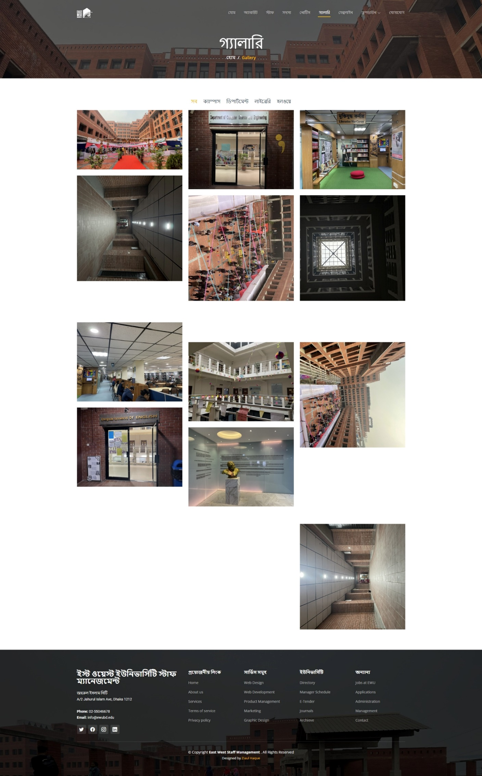
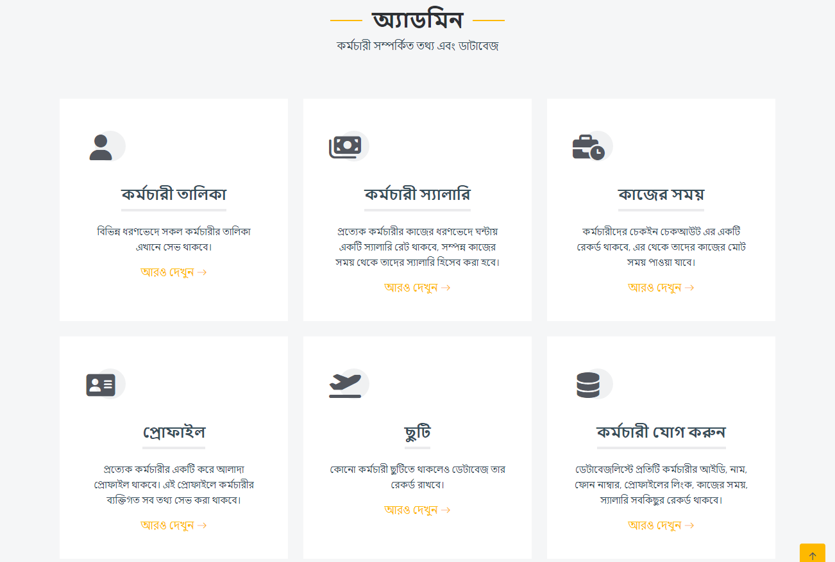
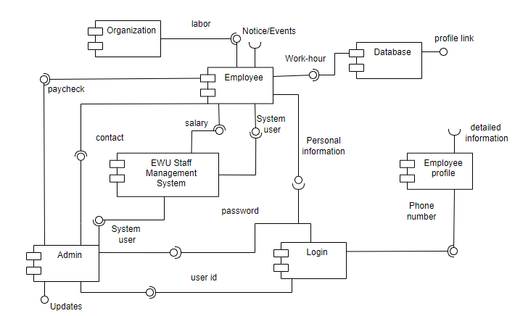
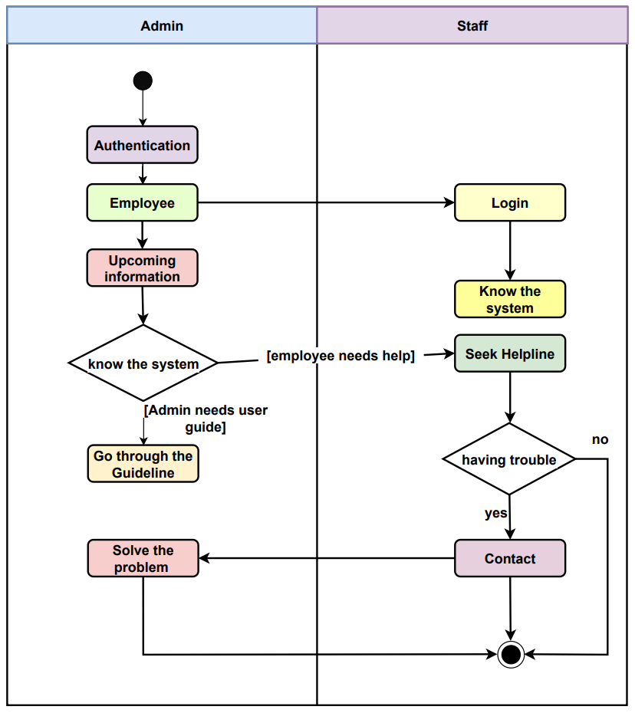
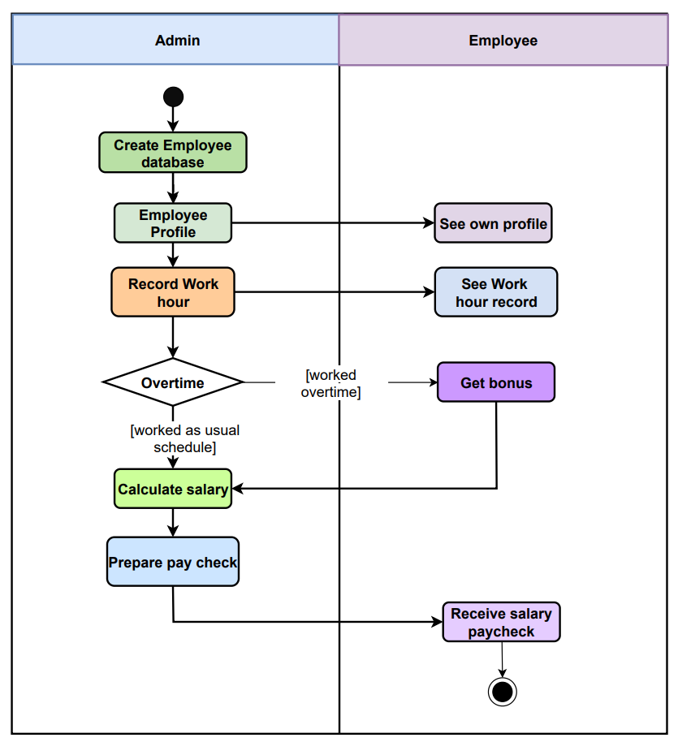
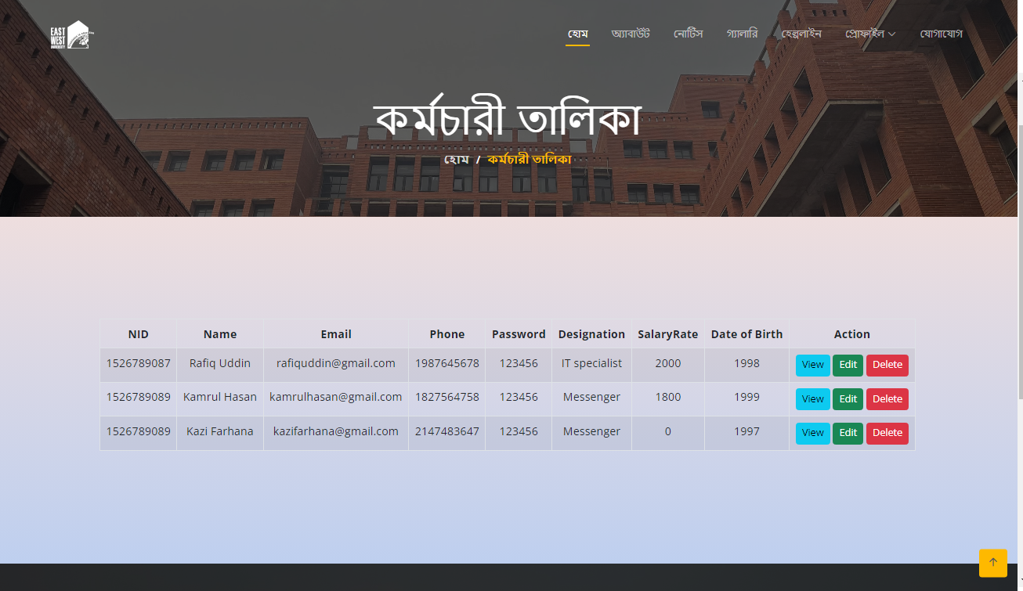
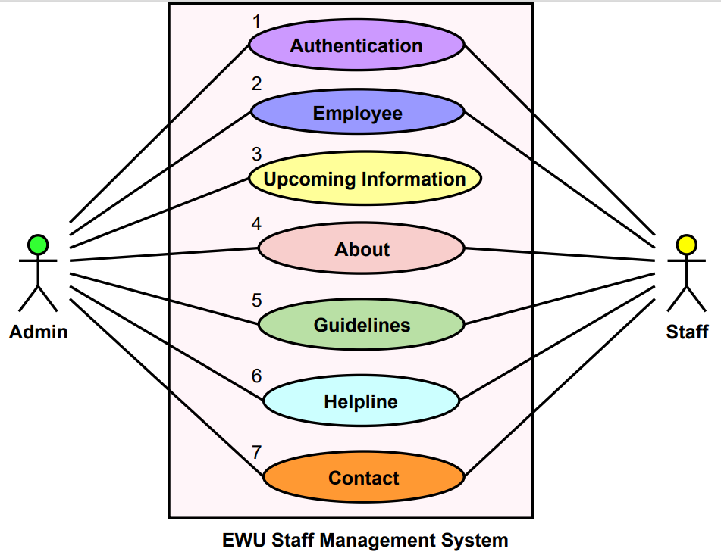
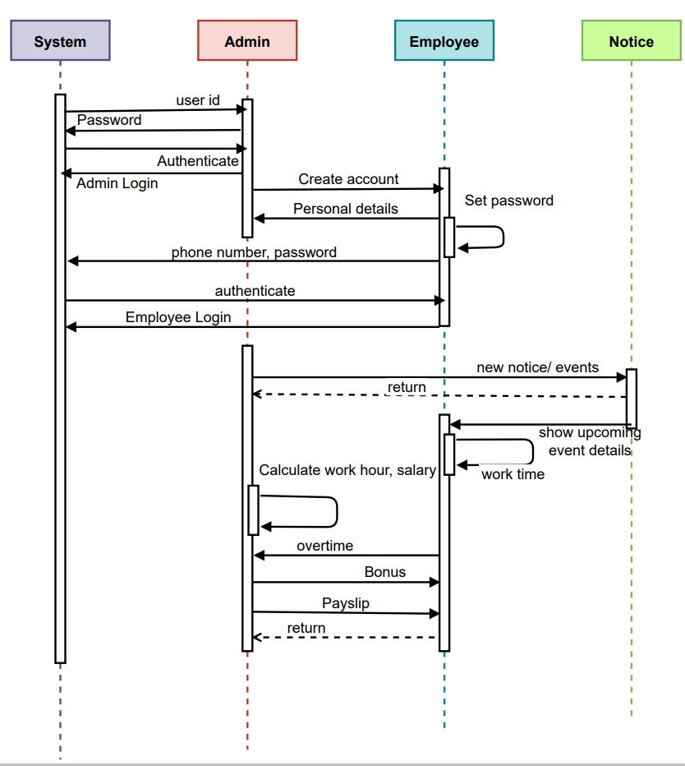
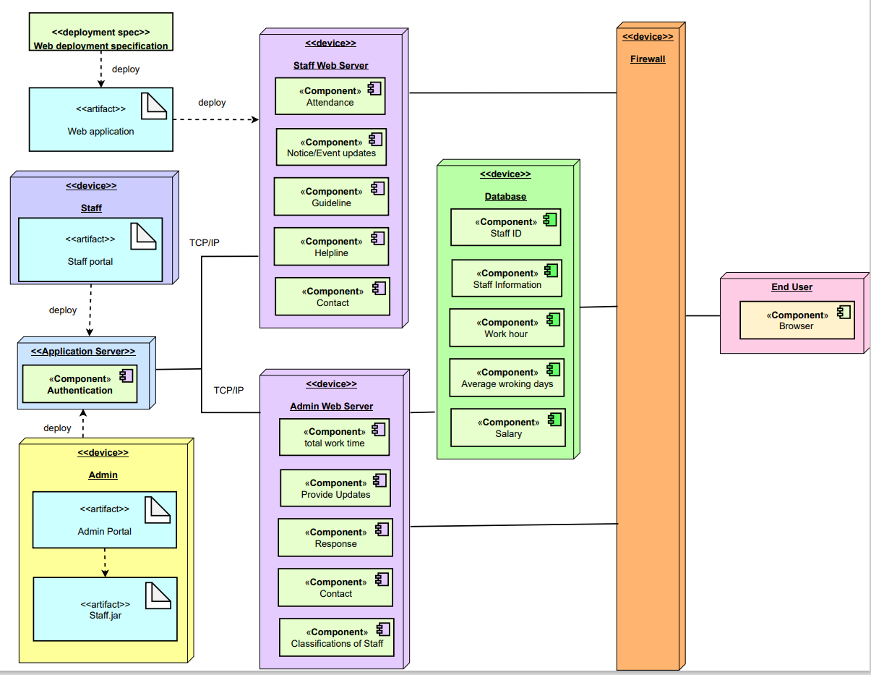








EWU Staff Management System
UI/UX
Introduction
Class Diagram
Data Flow Diagram
EWU Staff Management System will be used to get a better outcome for the organization. Manages the subordinates in an organization. Often, large organizations have many of these functions performed by a specialist still required to supervise and administer the activities to ensure the well-being of the staff as well as the organization.
Features
Staff
Admin
Staff Panel
Be authenticated
Record check in, check out times of a day
Be notified about new notices or events
Use guidelines
Seek helpline
Provide personal information
View own work-hour and working days.
Feedback / comment Section
Salary check
Admin Panel
Authentication
Management (Add, Delete ,Update)
Update notice/events
Access staff’s account
Manage Database (total work hour, average working days, unique ID, staff name, phone number, salary)
Paycheck
Component Diagram
Swim Lanes
User Case Diagram
Sequence Diagram
Deployment Diagram
Technology
Presented by:
Ziaul Haque Rafi
Imran Hasan
Rezmah Jemima Rupin
Project Mentor
Nishat Tasnim Niloy

