Slide 1
MongoDB Implementation & Optimization for EduHub Platform
A NoSQL Solution for a Scalable Education Database
By Ridwan Badamasi

Slide 2

Project Overview
Platform Goal: To build a robust and scalable database for an online learning platform (EduHub).
.
Why MongoDB:
Flexibility: Easily adapt the schema without downtime.
Scalability: Horizontal scaling to handle millions of students and instructors.
Rich Querying: Native support for complex queries (Aggregation Framework).

Slide 3
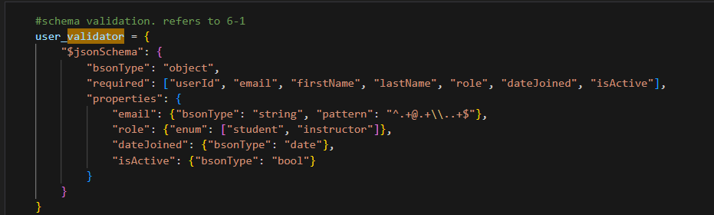
Data Model & Schema Validation (Task 1 & 2)
Data Model: Show a simple diagram or list of the 6 collections and their primary relationships
(e.g., users ↔ enrollments ↔ courses).
Core Collections: users, courses, enrollments, lessons, assignments, submissions.
Schema Enforcement:
Focus: Used JSON Schema Validation on the users collection.
Example Constraint: Required fields (userId, email, role), and strict enumeration for the role field (student, instructor).

Slide 4
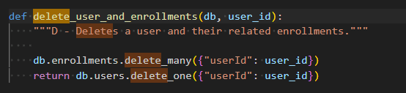
CRUD Operations Showcase (Task 3)
Goal: Demonstrate the operational integrity of the database.
CREATE Example: Adding a new course with a simple insert operation.
Complex DELETE:
Function: delete_user_and_enrollments(db, user_id)
Description: Showcases referential integrity by deleting a user and associated records using delete_many().

Slide 5
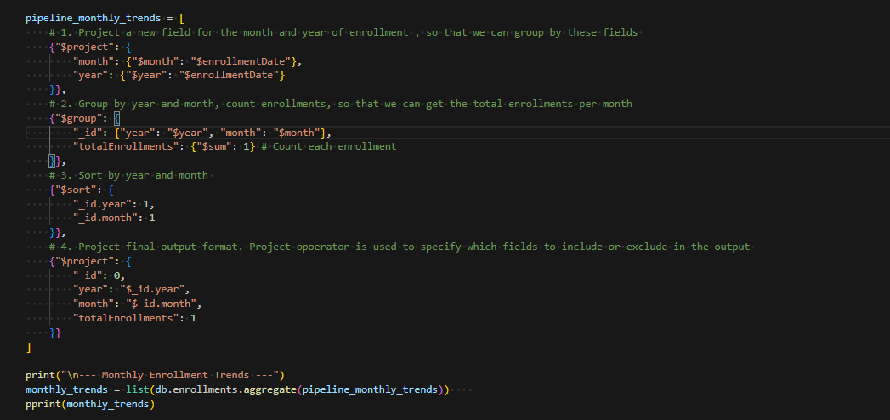
Insights through Aggregation (Task 4)
Goal: Extract meaningful insights from the operational data through pipelines.
A pipeline helps gather insights through aggregation. It's useful for generating reports and analytics.
A pipeline is written by chaining multiple stages together, where each stage performs a specific operation on the data.
Each stage takes the output of the previous stage as its input.
Pipeline example: Monthly Enrollment Trend
Used $project, group and sort.

Slide 6
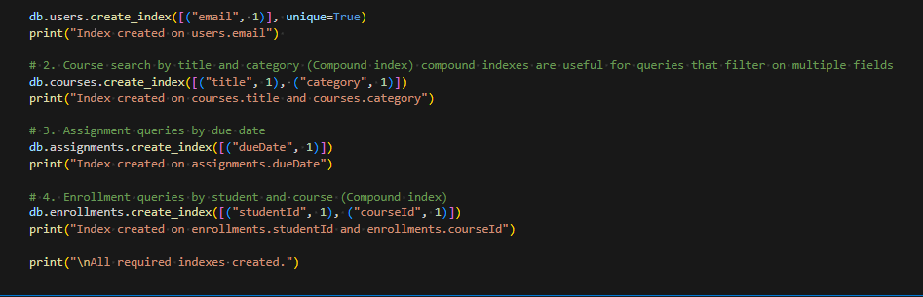
Optimization Strategy: Indexing (Task 5)
Solution: Create targeted indexes to replace slow collection scans with fast index lookups.
creating an index helps optimize query performance, especially for large datasets. An index is created by specifying the field(s) to index and the type of index.

Slide 7
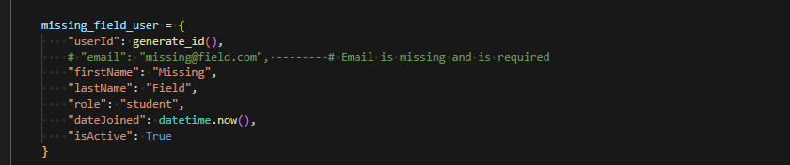

ERROR HANDLING: (TASK 6)
Querying errors like Duplicate key errors (violating a unique index) and invalid data type insertions are best solved using try-except blocks in Python.
Schema validation errors are handled at the database level, but catching exceptions during insertions helps manage them.

Slide 8
Project Conclusion
Successfully designed and implemented a scalable MongoDB schema, demonstrated advanced data manipulation via CRUD and Aggregation, with indexing.

Slide 9


