Slide 1

Mobile Price Classification

Slide 2
Presented By
Supervised By
Ameer Talha (18.01.04.036) Sheikh MD Rezone Ullah (18.01.04.037)
Samin Ul Alam (18.01.04.043)
Faisal Muhammad Shah
Sajib Kumar Saha Joy

Slide 3
Introduction
• Mobile nowadays is one of the most selling and purchasing devices. So, the mobile price class prediction is a case study for the given type of problem finding an optimal product.
• There are many features that are important to consider for a mobile price like display resolution, ram, camera, processor, and mobile thickness.
• We will use many of the above-mentioned features to classify whether the mobile would be very economical, economical, and expensive or very expensive.

Slide 4
Motivation
Mobile technology is a portable technology moving with the users. The number of mobile users in the world in 2019 is about 3.2 billion and increasingly in 2020 is about 3.5 billion. the use of mobile phones is increasing day by day and the prices also vary by their different configuration. There are many companies and many types of quality products in the market. One goes to market and search for different phones with a different configuration of different brands. So, it makes the customer confused, budget problems, waste time, and so on.

Slide 5
References
Muhammad Asim, Zafar Khan, “Mobile Price Class prediction using Machine Learning Techniques”, 29 March 2018, ResearchGate.
Keval Pipalia, Rahul Bhadja, “Performance Evaluation of Different Supervised Learning Algorithms for Mobile Price Classification”, June 2020, IJRASET.
Hoque, Ahsanul, Sakib, Khan, Asif, Shakir, Shanjoy, Shutradhar, Abu, MD, Saleh, Washim, Akram, Md Badruzzaman, Khaleed Been, Biplop, “A hybrid model for predicting Mobile Price Range using machine learning techniques”, January 2022, ACM.
Akash A Gupta, Dr. Suhasini Vijaykumar, “Mobile Price Prediction by its Features Using Predictive Model of Machine Learning”, February 2020, ResearchGate.

Slide 6
Literature Reviews
Title: Mobile Price Class prediction using Machine Learning Techniques
In paper [01] author has used only two models. One is the Decision tree classifier and another is Naïve Bayes classifier. The accuracy of these two classifiers is respectively about 70.14% and 64.83%. So, the decision tree classifier has given the best accuracy.

Slide 7
Literature Reviews
Title: Performance Evaluation of Different Supervised Learning Algorithms for Mobile Price Classification
In paper [02] author has implemented five models. These are Logistic Regression, Decision Tree, K – Nearest Neighbour (KNN), SVM, and Gradient Boost Algorithm. The accuracy of the models are respectively 81% for (Logistic Regression), 55% for (KNN), 82% for (decision tree), 84% for (SVM), and 90% for (gradient Boost). Gradient Boost Algorithm has given the best accuracy. Mobile price classification dataset is used.

Slide 8
Literature Reviews
Title: A hybrid model for predicting Mobile Price Range using machine learning techniques
In paper [03] author has used two machine learning models are Decision tree and Random Forest and one is Hybrid Ensemble Learning. The accuracy of these two models are 83% for Decision tree and 90% for Random Forest. And the accuracy of Hybrid Ensemble Learning is about 94%. Hybrid Ensemble Learning performs best.

Slide 9
Literature Reviews
Title: Mobile Price Prediction by its Features Using Predictive Model of Machine Learning
In paper [04] author has used four models. These are linear regression, k-nearest neighbors (KNN), Decision Tree, and Naïve Bayes. The accuracy of linear regression is 82%, KNN is 84%, Decision tree is 90%, and Naïve Bayes is 95%. Naïve Bayes algorithm has given the best accuracy among the all algorithm. Mobile price classification dataset is used.

Slide 10
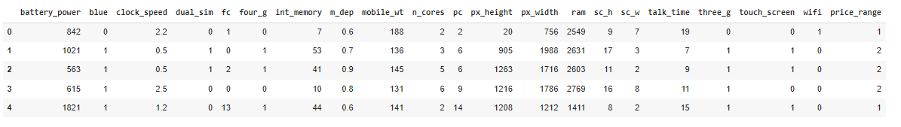
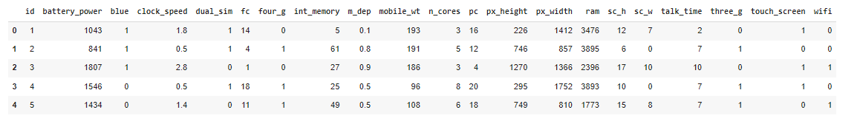
Dataset
Train data:
Test data:

Slide 11

Data Preprocessing

Slide 12
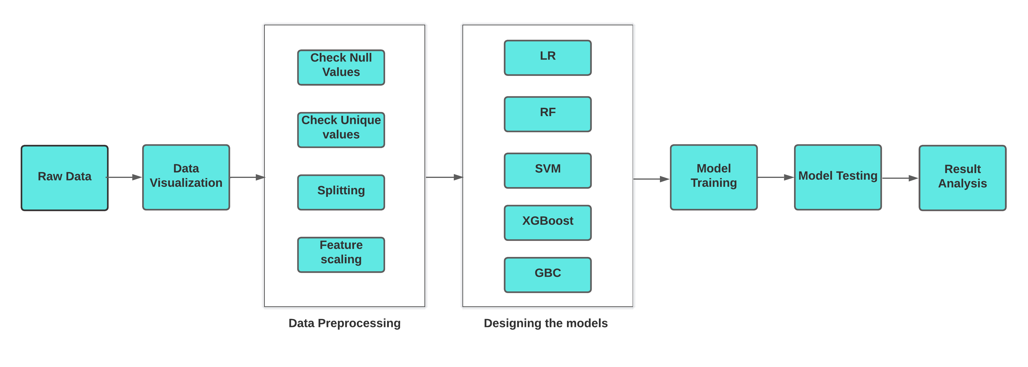
Methodology

Slide 13
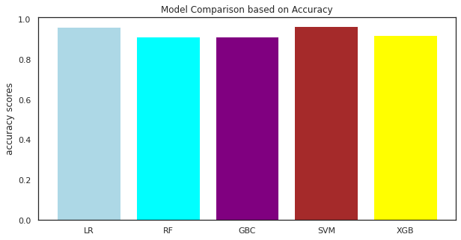
Result Analysis
According to the model comparison-based accuracy curve SVM is best model and its accuracy is 96.25%. It’s the best performer model based on accuracy in our project.

Slide 14
Result Analysis
 | Low cost | budgeted | medium cost | flagship
Accuracy | 98.21 | 97.22 | 97.96 | 98.97
Precision | 95.15 | 96.84 | 95.10 | 98.00
Recall | 98.00 | 92.00 | 97.00 | 98.00
F-score | 96.55 | 94.36 | 96.04 | 98.00
From the chart, we see that the Classification Report for Support Vector Machine.

Slide 15
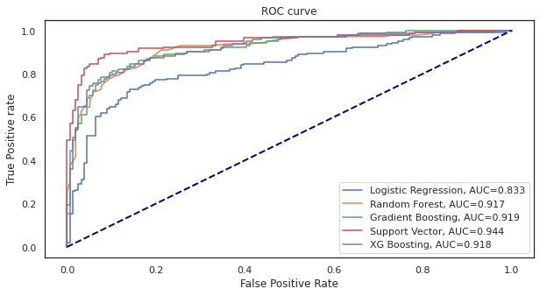
ROC Curve

Slide 16
Conclusion
In this project, we have used mobile price classification dataset and experimented with five machine learning algorithms like Logistic Regression, Support Vector Machine (SVM), Random Forest Classifier, Gradient Boosting Classifier(GBC), and XGBoost(XGB). We trained and evaluated the stated model and found out SVM model performed better than other models in classifying mobile price range from the dataset. The SVM model achieved an accuracy of about 96.25% which is very impressive. From this result, we could correctly predict the mobile price and classify it properly.

Slide 17
Future Work
To achieve maximum accuracy and predict more accurately, more and more instances should be added to the data set.
Software or Mobile app can be developed that will predict the market price of any newly launched product.

Slide 18
Thank You

