Slide 1
Traffic signs classification using deep learning

Slide 2
Presented by
Ameer Talha (18.01.04.036)
Sheikh MD Rezone Ullah (18.01.04.037)
Samin Ul Alam (18.01.04.043)

Slide 3
refERENCES
[1] Citlalli Gamez Serna and Yassine Ruichek, “Classification of Traffic Signs: The European Dataset”, 2018, IEEE.
[2] Dong Li, Dongbin Zhaoy, Yaran Cheny, Qichao Zhangy, “DeepSign: Deep Learning based Traffic Sign Recognition”, 2018, IEEE.
[3] Mrinal Haloi, “Traffic Sign Classification Using Deep Inception Based Convolutional Networks”, 2016.
[4] Xiucai, Guo, Changxuan, Zhao, Yaodong, Wang, “Traffic Sign Recognition Based on Joint Convolutional Neural Network Model”, August 2019, ACM.
[5] Zhilong, He, Zhongjun, Xiao, Zhiguo, Yan, “Traffic Sign Recognition Based on Convolutional Neural Network Model”, 2020, IEEE.
[6] Zheng Qiumei, Tan Dan, and Wang Fenghua, “Improved Convolutional Neural Network Based on Fast Exponentially Linear Unit Activation Function”, 2017, IEEE

Slide 4
Introduction
Traffic sign classification is a technology that can automatically read traffic signs and display them to vehicles.
It plays a vital role in reducing accidents and speed limits.
It ensures the safety of drivers, and automated vehicles as well as increase the comfort of driving.

Slide 5
Related Work
Title: Classification of Traffic Signs: The European Dataset
LeNet, IDSIA, URV, CNN 8-layers and CNN Assymetric-k models are used in the paper
Among these model CNN 8-layers and Assymetric-K performed better
GTSRB and European dataset has been used

Slide 6
Related Work
Title: Deep Learning based Traffic Sign Recognition
MobileNet, inception, and ResNet are used.
MobileNet and MS COCO datasets are used.
According to precision, recall, and F-measure ResNet has given the best performance.

Slide 7
Related Work
Title: Traffic Sign Classification Using Deep Inception Based Convolutional Networks
Deep inception based neural network used in classify different signs.
Famous traffic sign dataset GTSRB used here.
Using the CNN model get 98.6% accuracy which is better than other deep learning models.

Slide 8
Related Work
Title: Traffic Sign Recognition Based on Joint Convolutional Neural Network Model
AlexNet, VGGNet, Inception, and ResNet models are used.
ResNet model has given the best accuracy which is 95.57%.
GTSRB dataset is used.

Slide 9
Related Work
Title: Traffic Sign Recognition Based on Convolutional Neural Network Model
Zheng et al, AlexNet, GoogLeNet, Zhou et al models are used.
The accuracy of this paper is Zhou et al(98.20%)
GTSRB dataset is used.

Slide 10
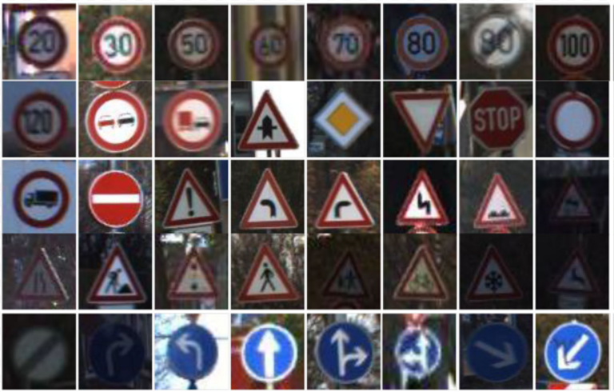
Dataset
The dataset used for this project is provided by the German Traffic Sign Recognition Benchmark(GTSRB) is available on Kaggle.
Reference - https://www.kaggle.com/datasets/meowmeowmeowmeowmeow/gtsrb-german-traffic-sign/

Slide 11
Data preprocessing
Shuffling
Splitting
One hot encoding
Normalization
Grayscaling

Slide 12
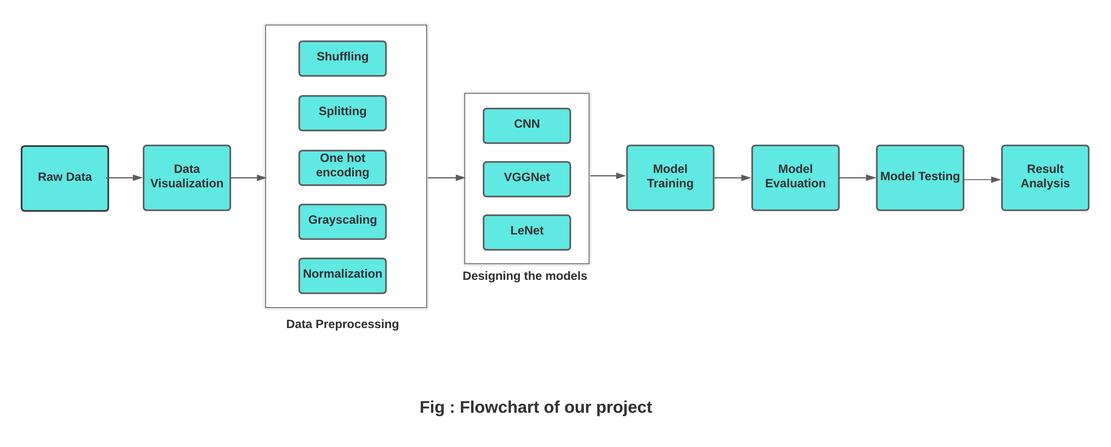
Methodology

Slide 13
Model training
Deep Learning Models :
CNN
VGGNet
LeNet
Functions :
Relu
Softmax
Adam Optimizer
Categorical Cross Entropy

Slide 14
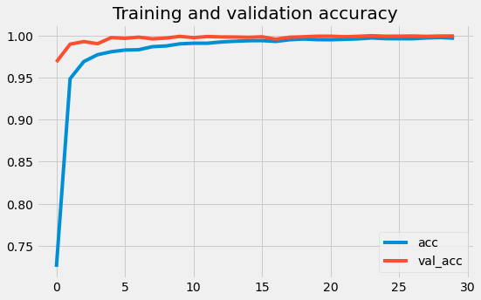
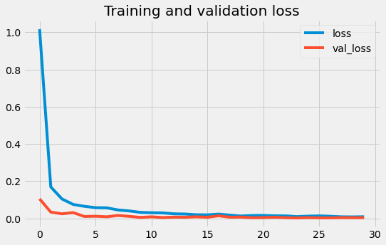
After model training, Training accuracy comes to 99.92% and loss comes to .3%.And also validation accuracy is found to be 99.59% as best and validation loss is 1.2%
RESULT ANALYSIS

Slide 15
From the chart, we see that the best performer model is CNN which gives 98.7% accuracy.
RESULT ANALYSIS
Model | Accuracy | Precision | Recall | F1-score
CNN | 98.7 | 98 | 98 | 98
VGGNet | 97.4 | 97 | 97 | 97
LeNet | 88.1 | 89 | 88 | 88

Slide 16
Traffic sign classification mainly classifies the traffic sign features to read the traffic sign by using the GTSRB dataset. CNN-based pre-train models are used in traffic sign classification. The pre-train models are such that CNN, LeNet, VGGNet etc. There are also use some activation functions such that ReLU, ELU, and FELU. The pre-train models capture images and predict them accurately. The images of the dataset are pre-processed and enhanced the image by histogram equalization. The accuracy rate is almost 98% by using a convolutional neural network.
COnclusion

Slide 17
Thank You

