Slide 1
reZ1
A simple compression algorithm tester

Slide 2
Presentation Outline
Project Overview
Limitations
Future Plan

Slide 3
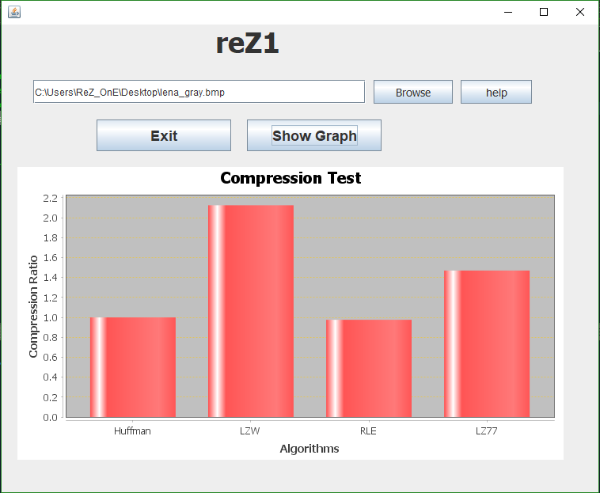
User Interface

Slide 4
UML Diagram
LZWCompression
+some variables
+compress():void +getLZWSize(): double
HuffmanCompression
+some variables
+compress():void +getHuffSize(): double
LZ77Compression
+some variables #some variables
+compress():void +getLZ77Size(): double
RLECompression
+some variables
+compress():void +getRLESize(): double
Main
+interface():void
+Object of ther class

Slide 5
Working Procedure
Compressed file using four different algorithm
Find size
Get ratio
Create bar diagram

Slide 6
Software Ability
This tool can find compression Ratio of those four algorithm
from any type of file :
1.Lampel Ziv Welch
2.Huffman Encoding
3.Lampel Ziv 77
4.Run Length Encoding

Slide 7
Limitations
Huffman Encoding. :|
Only Four Algorithms

Slide 8
Future Plan
I will add some more algorithms.
I will add a zipping option In
this project.

Slide 9
Thanks

