Slide 1


Monte Carlo Simulation for Reliability Worth Assessment of Distribution System Considering Momentary Interruptions
Authors
Md. Tanjil Ahmed, Md. Rezuwan Hassan, Palash Chandra Ghosh,
Mohammad Saiful Huq, Mohaiminul Islam, Dr A. S. Nazmul Huda

Slide 2
OVERVIEW
Why do we need MC method?
What is MC method?
How accurate MC method will be?
Analytic Method & MC method
RBTS BUS4 Distribution System
What is momentary interruption?
Indices (EENS & ECOST)
Different effects on RBTS BUS4 Distribution System
1

Slide 3

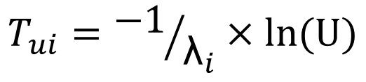
Modeling of EENS & ECOST
Operation & Restoration Mode
$$T_{ui}={−1}/{{\text{λ}}_{i}}×ln(U)$$
TTF & TTR
$$T_{di}=−r_{i}×ln(V)$$
2

Slide 4
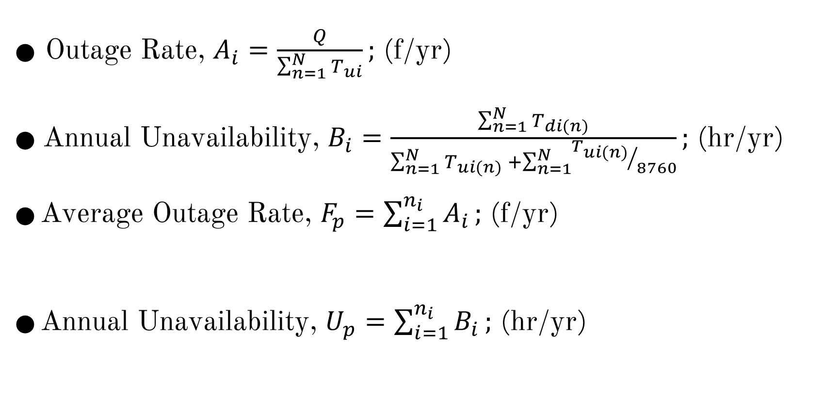
Modeling of EENS & ECOST
⚫ Outage Rate, $A_{i}=\frac{Q}{\sum_{n=1}^{N}{T_{ui}}};$ (f/yr)
⚫ Annual Unavailability, $B_{i}=\frac{\sum_{n=1}^{N}{T_{di(n)}}}{\sum_{n=1}^{N}{T_{ui(n)}} +\sum_{n=1}^{N}{{T_{ui(n)}}/{8760}}};$ (hr/yr)
⚫ Average Outage Rate, $F_{p}=\sum_{i=1}^{n_{i}}{A_{i}};$ (f/yr)
⚫ Annual Unavailability, $U_{p}=\sum_{i=1}^{n_{i}}{B_{i}};$ (hr/yr)
3

Slide 5
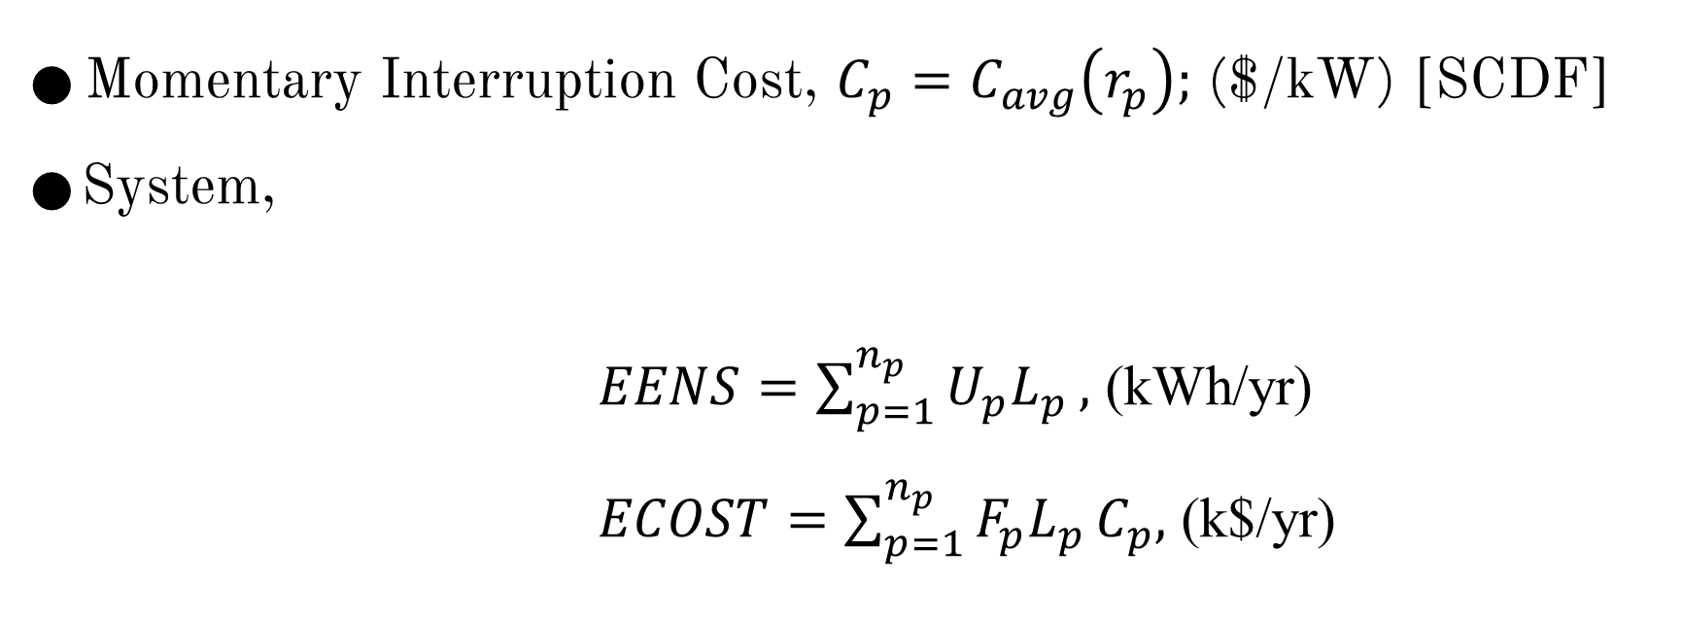
Modeling of EENS & ECOST
⚫ Momentary Interruption Cost, $C_{p}=C_{avg}\left(r_{p}\right);$ ($/kW) [SCDF]
⚫ System,
$EENS=\sum_{p=1}^{n_{p}}{U_{p}L_{p}},$ (kWh/yr)
$ECOST=\sum_{p=1}^{n_{p}}{F_{p}L_{p}}C_{p},$ (k$/yr)
4

Slide 6
Effect Of Feeder Design Configuration
Case | Disconnecting switch | Fuses | Alternative supply
A | Yes | Yes | Yes
B | No | No | No
C | No | Yes | No
D | Yes | No | No
Case | EENS(kWh/yr) |  | ECOST(k$/yr)
 | Analytic | MC | Analytic | MC
A | 28.95 | 28.92 | 0.4523 | 0.4371
B | 188.59 | 188.57 | 1.4739 | 1.4213
C | 60.56 | 59.38 | 0.7192 | 0.6971
D | 122.18 | 121.18 | 1.3231 | 1.2718
5

Slide 7
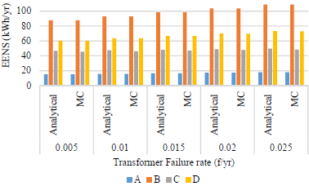
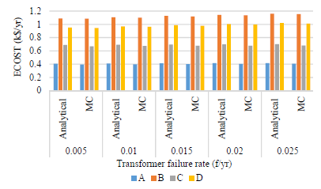
Effect of Transformer Failure Rate
6

Slide 8
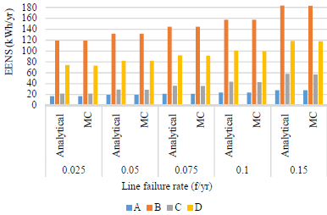
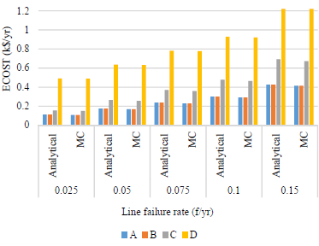
Effect of Line Failure Rate
7

Slide 9
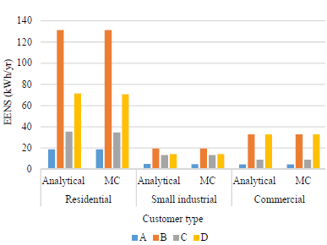
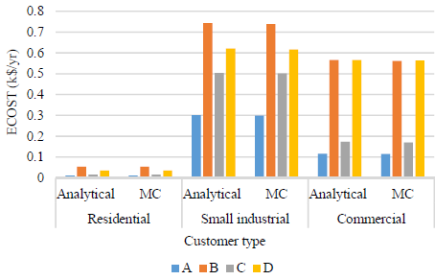
Effect of Customer Type
4700
70
9
8

Slide 10
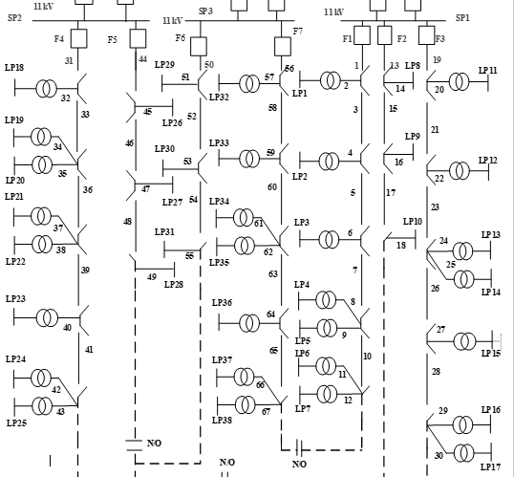
Effect of Customer Type (ECOST)
Part of RBTS BUS4 Distribution System
9

Slide 11
Conclusion
⚫ Momentary interruption
⚫ Effects of different faults in RBTS distribution System
⚫ Importance of different protective elements
⚫ MC Method
10

Slide 12


