Slide 1
A Learning Platform with an Integrated Companion Approach for Educators of Pupils in Compulsory Education, Including SEN/D and Neurodiverse Pupils
Student Number: 180200421
Student Name: Mohammed Rezwan Ahmed
Supervisor Name: Eranjan Udayanga Padumadasa

Slide 2
Background
Around 12.6% of pupils in England have special educational needs (GOV UK, 2022a).
A pupil has SEN if they have "significantly greater difficulty in learning" compared to their same-age peers (Department for Education, 2015: p.285).
On March 9, 2022, the UK Government faced a petition (with almost 30,000 signatures) on UK schools needing to make SEN/D training mandatory for all teaching staff (UK Government and Parliament, 2022).

Slide 3
Background (2)
Neurodiversity covers "cognitive disabilities such as Dyslexia, … Autistic Spectrum disorder, … and Attention Deficit Hyperactivity Disorder (ADHD)" (Dalton, 2013).
It covers the contrasts in how pupils' brains govern their learning and social behaviour.
Teaching standards stress reacting to pupil’s "strengths and needs" (Department for Education, 2021: p.11).
Teachers are urged to “guide pupils to reflect on … their emerging needs” (Department for Education, 2021: p.10).

Slide 4
Background (3)
Ofsted (2022a) asks for tools that are "designed to give … those with special educational needs … cultural capital they need to succeed in life" (Ofsted, 2022a).
Ofsted (2022b) encourages presenting to pupils "end points" or how they are "to be able to reach those end points".

Slide 5
Project Aims
Aim: Allow teachers to reach a greater range of pupils
Aim: Understand how learning can be differentiated without creating gaps between pupils
Aim: Understand restrictions made by teaching standards
Aim: Explore Design frameworks for improving or helping with managing learning
Consider the case of pupils not having a lot in common (variation) and how teachers may address this

Slide 6
Project SMART Objectives
This project involved having seven SMART objectives.
Objective One (neurotypical and neuroatypical):
• Specific: I must research about neurotypical and neuroatypical pupils.
• Measurable: Two or more profiles of neuroatypical pupils should be looked at.
• Achievable: I must read about how profiles affect learning (not general daily tasks).
• Realistic and Relevant (scope): My focus will be on what having certain information may mean for teachers reaching their pupils. I need insight into distinct profiles.
• Time-bound: This must be completed before presenting research-based requirements.

Slide 7
Project SMART Objectives (2)
Objective Two (learning, design, and accessibility):
• Specific: Besides understanding profiles, I must research the relationship between learning, design, and accessibility.
• Measurable: My research must address both learning design and learning accessibility.
• Achievable: I must value existing research on altering teaching method over changing pupils.
• Realistic and Relevant (scope): A focus must be placed on understanding adjustments to user-specific experiences.
• Time-bound: This must be done before determining project requirements and logical design.

Slide 8
Project SMART Objectives (3)
Objective Three (data analysis):
• Specific: While this project may not use data on SEN/D pupils in any solution, I must analyse one or more datasets from a trusted source. This will be to appreciate the environment teachers work in and their pupils’ varied primary needs.
• Measurable: I must produce visualisations and gain insight from them. Any dataset must have more than 150,000 data points for sufficient representation.
• Achievable: I must access related columns when writing code and use data analysis libraries.
• Realistic and Relevant (scope): Any chosen dataset must relate to UK SEN/D pupils.
• Time-bound: Some analysis may only be needed to decide requirements (conscious of time).

Slide 9
Project SMART Objectives (4)
Objective Four (project requirements):
• Specific: I must set requirements to guide design choice, implementation, and testing. I must know what is beyond my project scope.
• Measurable: I will look at four components of a learning platform. I aim to have 10 to 15 requirements (priority valued using MoSCoW) for each component.
• Achievable: If research objectives are met (requirements’ MoSCoW priority can be justified).
• Realistic and Relevant (scope): Using the MoSCoW method will help with determining the need for meeting requirements in logical designs.
• Time-bound: I must only spend time thinking about requirements that fall under “won’t have” if they could be mistaken for being in another priority section.

Slide 10
Project SMART Objectives (5)
Objective Five (design):
• Specific: I must creäte logical design iterations (including database schema) and UI design.
• Measurable: Four key components must be designed for. Two or more design iterations should be made for each. The latest design iterations must meet 65% or more of requirements.
• Achievable: I will create structural (class, component) and behavioural (sequence, use-case) diagrams. Consideration must be given to data schemas.
• Realistic and Relevant (scope): I will be looking at the Model-View-Controller pattern. This will help with dividing code by purpose (view for GUI and model for logic).
• Time-bound: Requirements must be known. I may need time to revisit UML documentations.

Slide 11
Project SMART Objectives (6)
Objective Six (implementation):
• Specific: I must document implementation of any solution based on final design. This must be done with screenshots and respective code snippets.
• Measurable: I must refer to four key components from my designs and project requirements.
• Achievable: My full project code will be submitted. I must show mainly key code snippets.
• Realistic and Relevant (scope): Testing may reveal implementation and it may not be required to show aspects of my solution twice.
• Time-bound: This can be done during (show gradual change) or at the end of development.

Slide 12
Project SMART Objectives (7)
Objective Seven (testing):
• Specific: I must test my implementation. This must involve test plans that focus on the type and aim of each test. I must write and run test scripts.
• Measurable: I must cover four of the following: API, URL, Unit, Integration, Usability, and Security testing. I must have at least 25 short test cases and 40 thorough test cases.
• Achievable: I must learn how to write test scripts.
• Realistic and Relevant (scope): It may not be required to test every aspect of any solution.
• Time-bound: Test cases may be needed and used during implementation.

Slide 13
Research Questions
1. How can a system help teachers reach both neurotypical and neuroatypical pupils without causing learning loss for either type (O1, O2, O6)?
a. How is the learning process like for neurotypical pupils?
b. How is the learning process like for neuroatypical pupils?
c. What differences are there in the learning process between the two?
2. How can a system offset pupils facing modest troubles with cognitive domains (O1, O2, O6)?
3. Alongside UX guidelines and accessibility standards, are there other factors to consider when designing for pupils with distinct neurotypes (O1, O2, O6)?
4. How might analysis of the UK learning environment inform design choices and project requirements (O3, O4, O5)?

Slide 14
Programme of Study
BSc Computer Science (3 Years):
My project objectives set the need for UML design (design of a system, A1).
My project considers specific pupils (SEN/D and Neurodiverse) for a small scale implementation (A2).
My project considers Computer Science in Education, a major application (A3).
My report covers implementation code and objectives (communicate technical details, B5, apply project management techniques, B2)

Slide 15
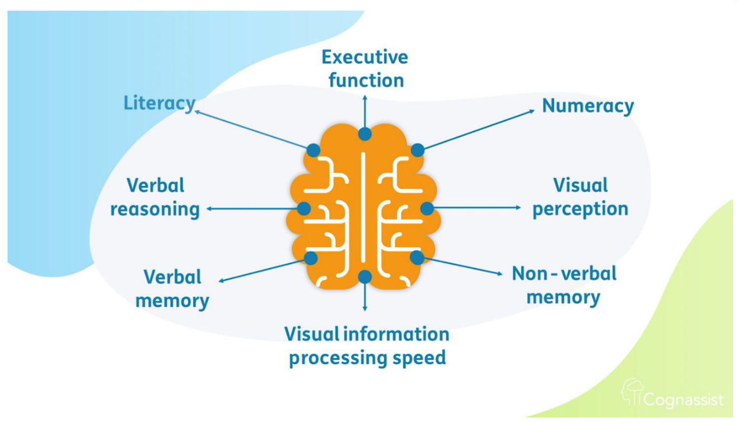
Literature Review Findings
Cognitive Domains:
Eight domains of thinking and learning, with a focus on neuroatypical (neurodiverse) pupils.
Domains may come into play and take over at any time if others fail
Some domains' solutions included dividing tasks into "small chunks”, summarising tasks, and upholding a "consistent visual structure" in resources (Cognassist, 2021).
Figure 1: Eight Cognitive Domains (Cognassist, 2021)

Slide 16
Literature Review Findings (2)
Dyslexia:
According to Blue (2021), dyslexia, a neurodevelopmental condition, affects pupils' word comprehension.
Importantly mentioned is that teachers should guarantee pupils a platform in which they receive feedback, which inspires their self-efficacy and encourages them to "recap and review" (Blue, 2021).

Slide 17
Literature Review Findings (2)
Nonverbal Learning Disorder:
Miller (2022) highlights that pupils with nonverbal learning disorder (NVLD) can have difficulties that lie in "social" and "visual" patterns and structuring information, which in turn impacts their ability to plan and schedule. Broitman, et al. (2020) explore strategies (for NVLD pupils) that draw attention to managing learning by not overwhelming individuals and by facilitating, where possible, "structure, routine, and rote".
It would help if a teacher could automatically add to a pupil’s learning area when necessary to remove the burden on the pupil to schedule or plan themselves.

Slide 18
Literature Review Findings (2)
Universal Design for Learning (UDL) and Accessibility
With regards to assigning tasks, it may be essential to be able to "modify them on the fly" (World, 2022).
"some cognitive accessibility user needs are not addressed in existing W3C standards" (Accessibility Initiative, 2019).
(CAST, 2018), the learning brain: Affective networks (“why”), Strategic networks (“how”), Recognition networks (“what”)
(CAST, 2018), three individual classes of pupils teachers must support: those who are "purposeful and motivated", "resourceful and knowledgeable", and "strategic and goal-directed".

Slide 19
Data Analysis
A large dataset (more than 200,000 data points, or anonymised pupils) was analysed to form conclusions.
'sen_ncyear_.csv' from the UK government collection was used (GOV UK, 2022a)
Using Pandas, NetworkX, Seaborn, and Matplotlib.
“pupil_sen_status” and school type or “phase_type_grouping” considered
Various primary needs discovered (Moderate learning difficulty, Multi-sensory impairment)

Slide 20
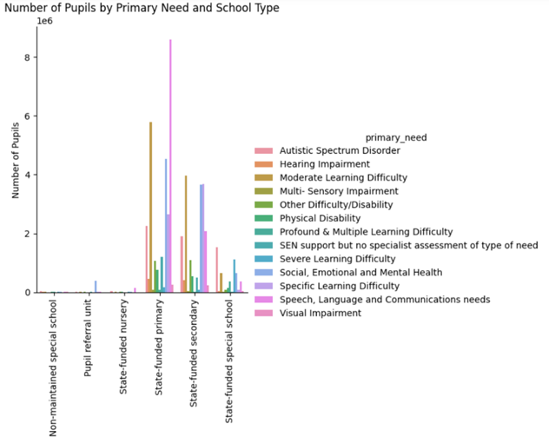
Data Analysis (2)
Figure 2: – Bar chart produced using Matplotlib to depict link between School Types, Primary Need of pupils and Primary Need(s) popularity, sen_ncyear_.csv (Gov UK, 2022a)

Slide 21
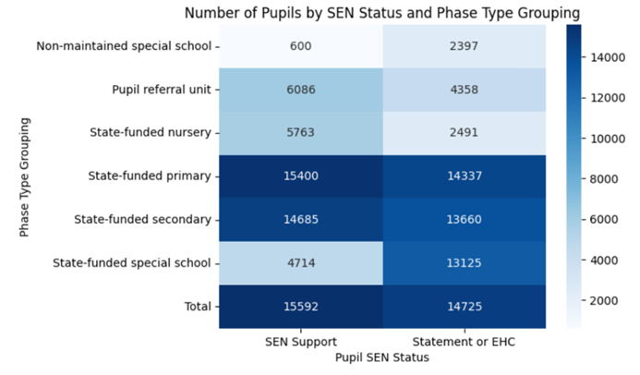
Data Analysis (2)
EHCP covers pupils’ long-term life ambitions and objectives (Waltham Forest, 2022)
Importance of teacher and student review
Figure 3: Heatmap produced using Seaborn to depict students with support plans and those without, sen_ncyear_.csv (Gov UK, 2022a)

Slide 22
What is your solution?
Web application focusing on Four key components: Overview, Manage Teaching, Learning Workspace, and Student Profile
Used MoSCoW to prioritise requirements (Must have, should have, could have, will not have)
General requirements focused on authentication token use, secure API requests (security of data), role-based access (teacher/student), user-friendly front-end, Dyslexia-friendly font face, colour intensity preference, learning and accessibility dates, no third-party authentication (giving out permissions)

Slide 23
What is your solution? (2)
Manage Teaching requirements focused on:
Accessing and generating data about specific pupils’, cognitive domains visualisations
Teachers updating CD values to generate learning activity fragments
Unique weight of relevant CD values for each learning activity
Viewing, commenting and setting up pupil’s EHCP sections
Multiple teachers commenting on pupil’s EHCP sections (views, interests, and aspirations)
Adding to pupil-specific learning workspace (help with scheduling)
Have a record of pupil’s desired engagement type (selected in their profile)

Slide 24
What is your solution? (3)
Student Profile requirements focused on:
Allowing pupils to select their desired engagement type (similar to online, offline, busy status)
Allowing pupils to see their current DET selection
Allow pupils to see three sections of their EHCP with multiple teachers’ comments

Slide 25
What is your solution? (4)
Learning Workspace requirements focused on:
Allowing users to add their own information
Allowing teachers to add to student’s workspace
Segmented or broken down information
Tell apart student-added and teacher-added content
Show which teacher added information
Automatically generate default information
Restrict teacher access to all information
Allow teachers to give specific insight to pupils and encourage reflection

Slide 26
What is your solution? (5)
Overview requirements focused on:
Both teachers and pupils accessing associated with subject areas
Showing user-specific targets based on CD levels and concerning learning activity
Subject-specific debating activity (pupils adding posts to sides/views)
Integrated management options for teachers only
Subject-specific communication area for access to channels based on needs (according to Manage Teaching)
Segmented or broken down information
Focus on subjects by category and one at a time (toggle)

Slide 27
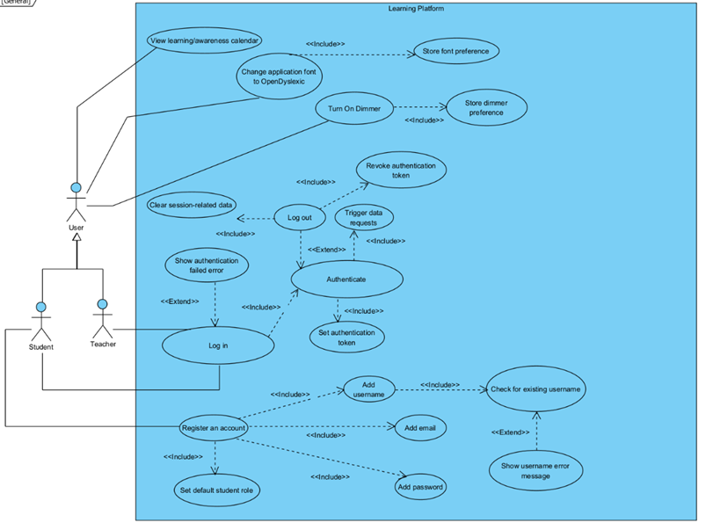
Design Work - final iterations
Looked at behavioural (use-case/sequence) and structural (component) UML diagram
Design to meet General requirements

Slide 28
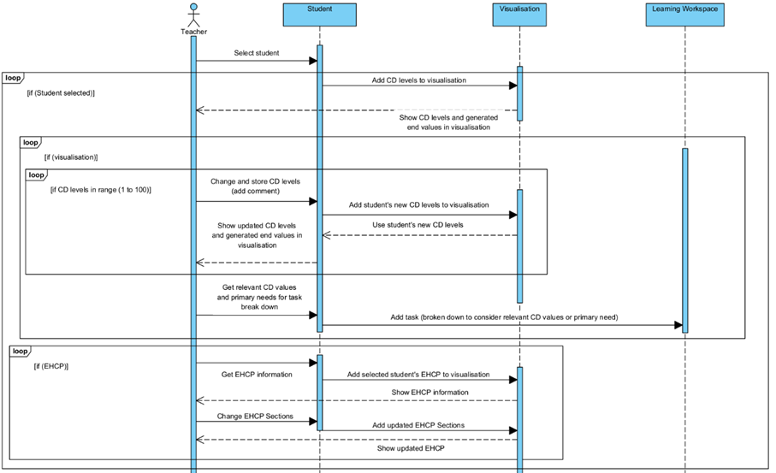
Design Work - final iterations (2)
Design to meet Manage Teaching requirements

Slide 29
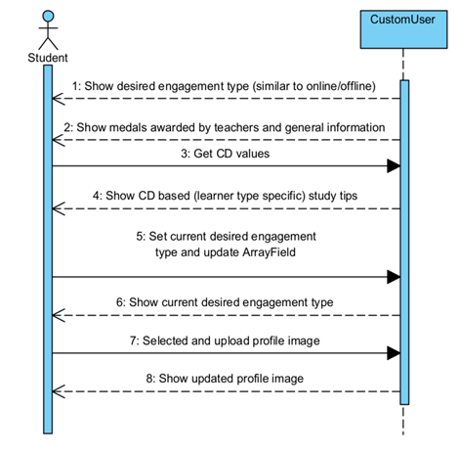
Design Work - final iterations (3)
Design to meet Student Profile requirements

Slide 30
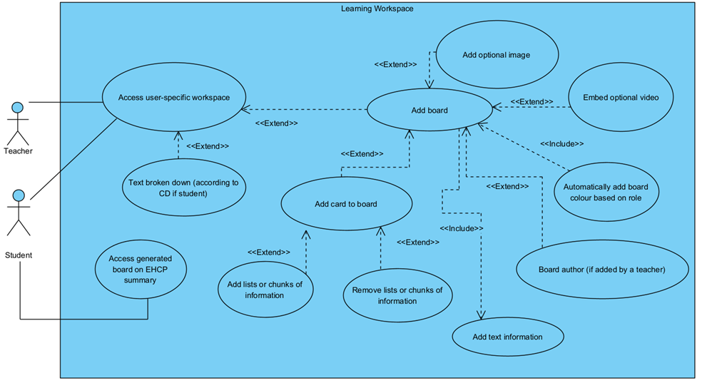
Design Work - final iterations (4)
Design to meet Learning Workspace requirements

Slide 31
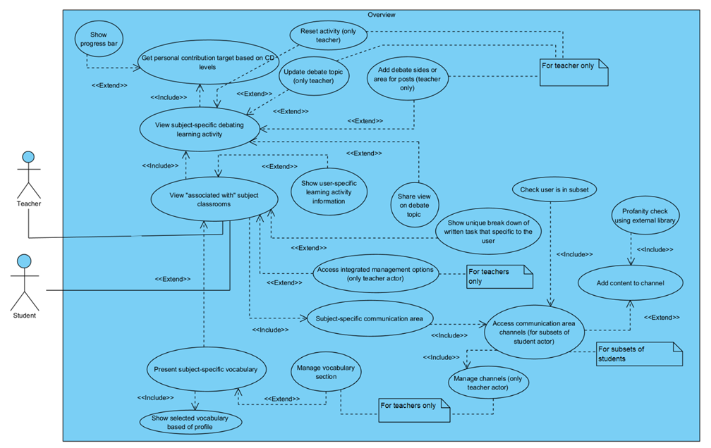
Design Work - final iterations (5)
Design to meet Overview requirements

Slide 32
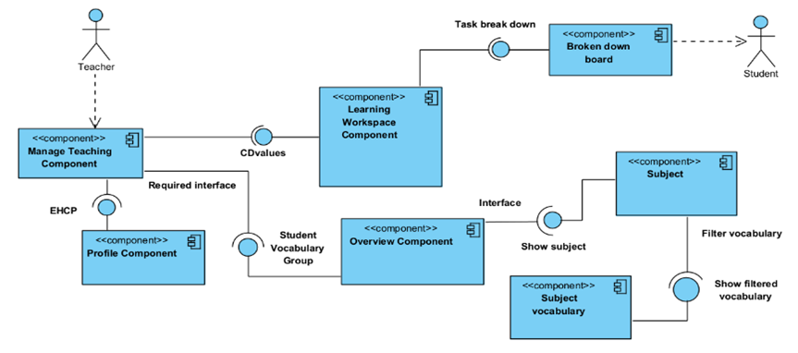
Design Work - final iterations (6)
Design to meet General (structural) requirements

Slide 33
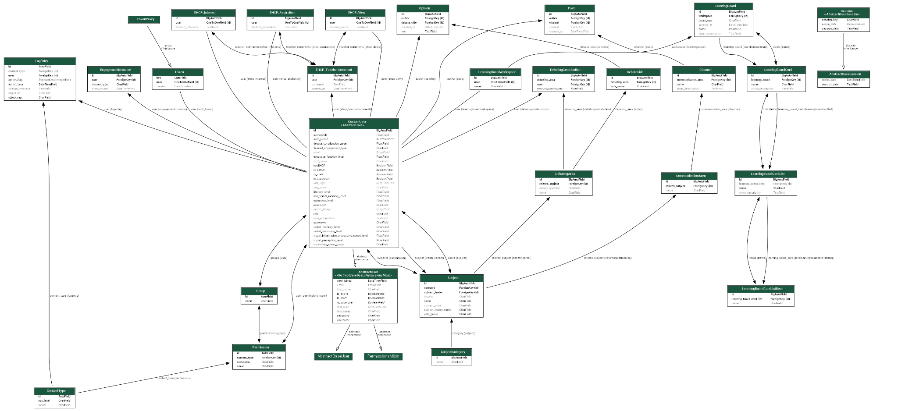
Design Work - final iteration - Database Schema

Slide 34
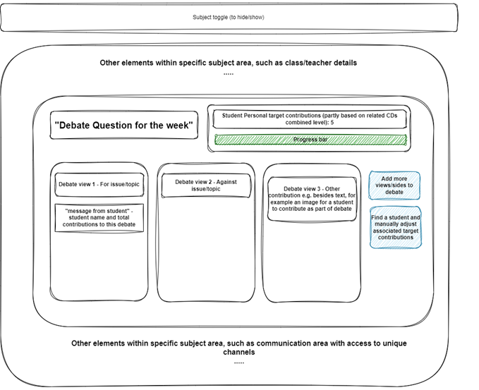
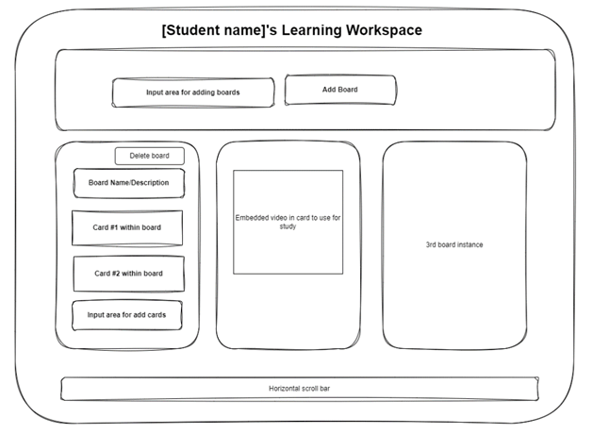
Consideration of UI Design

Slide 35
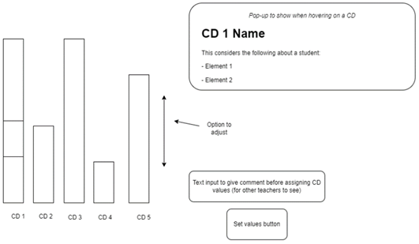
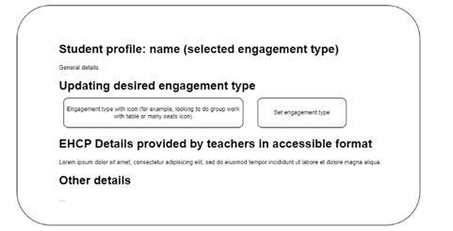
Consideration of UI Design (2)

Slide 36
Evaluating Solution (1)
Limitations in terms of Chapter 1 Objectives (and future recommendations):
Objective One: Delving into more than two profiles, and a teacher focus could have been placed by reading about inclusive pedagogies for each profile.
Objective Two: Pre-instruction, post-instruction, and differentiated learning may have been explored further for my research question on learning loss (neurotypical/neuroatypical).
Objective Three: This project may have benefited from using multiple datasets to observe patterns regarding SEN/D pupils and check if there has been a rise in EHCP use.
Objective Four: While MoSCoW was used, "Must Have" requirements depended on "Could Have" requirements. In future, requirements may be grouped beyond related component.
Objective Five: This project may have benefited from primary research on teachers to build on design as opposed to better meeting research-based requirements.
Objective Six: Implementation was a lot on creating an environment for a learning tool for helping teachers. CD levels may in future be determined by an activity for pupils. Research may be done to grasp link between CDs and activities, how CDs fluctuate, and DET use.
Objective Seven: Conducting more security testing and other types such as performance

Slide 37
Evaluating Solution (2)
Personal Development:
Mindful and aware of those who have SEN/D or identify as being neurodiverse.
Taking the initiative to, for example, listen to online events during QMUL’s March Neurodiversity Celebration Week for insight.
Valuing project management, specifically knowing the scope and ranking requirements.
Valuing importance of design ensures use-cases are judged to their fullest extent.
Conclusions:
Key to continue creating learning environments tailored for pupils with distinct profiles and raising pupil awareness of support plan reviews.
For teachers there are barriers to accessing or reaching every pupil with a distinct profile
Armstrong (2012): "there is no typical mental capacity—no normal brain to which all other brains are compared".
My findings showed that teaching standards may need to better guide teachers
more consideration may be needed on what encompasses SEN/D or neurodiverse pupils from Ofsted

Slide 38
References
GOV UK (2022a). Special educational needs in England. Available from: https://explore-education-statistics.service.gov.uk/find-statistics/special-educational-needs-in-england. [Accessed 14th November 2022].
Department for Education (2015). SEND code of practice: 0 to 25 years. Available from: https://www.gov.uk/government/publications/send-code-of-practice-0-to-25. [Accessed 14 November 2022].
UK Government and Parliament (2022). Petition: Make SEND training mandatory for all teaching staff. Available from: https://petition.parliament.uk/petitions/607849 [Accessed 14 November 2022].
Dalton, Nick S. (2013). Neurodiversity HCI. Available from: https://dl.acm.org/doi/10.1145/2427076.2427091 [Accessed 14th November 2022].
Department for Education (2021). Teachers’ Standards. Available from: https://www.gov.uk/government/publications/teachers-standards. [Accessed 14 November 2022].
Ofsted. (2022a). Education Inspection Framework. Available from: https://www.gov.uk/government/publications/education-inspection-framework/education-inspection-framework [Accessed: 24 November 2022].
Ofsted. (2022b) School inspection handbook. Available from: https://www.gov.uk/government/publications/school-inspection-handbook-eif/school-inspection-handbook [Accessed: 24 November 2022].
Cognassist (2021). How to support neurodiverse learners. Available from: https://cognassist.com/insights-hub/how-to-support-neurodiverse-learners/ [Accessed 21 November 2022].

Slide 39
References (2)
Blue, J. (2021). 10 Ways to Support Learners with Dyslexia. Available from: https://www.cambridgeenglish.org/blog/ten-ways-to-support-learners-with-dyslexia/#:~:text=Dyslexia%20is%20a%20learning%20difficulty,greatly%20from%20person%20to%20person. [Accessed 24 November 2022].
Miller, C. (2022). What Is Non-Verbal Learning Disorder? - Child Mind Institute. Available from: https://childmind.org/article/what-is-non-verbal-learning-disorder/ [Accessed: 24 November 2022].
Broitman, Jessica, and Miranda Melcher, Amy Margolis, and Jack M. Davis. (2020). NVLD and Developmental Visual-Spatial Disorder in Children: Clinical Guide to Assessment and Treatment. Springer.
World, P. (2022). Neurodiversity in the Classroom. Available from: https://www.prometheanworld.com/gb/resource-centre/blogs/neurodiversity-in-the-classroom-tips-for-teachers/ [Accessed: 24 November 2022].
Accessibility Initiative. (2019). Cognitive Accessibility at W3C. Available from: https://www.w3.org/WAI/cognitive/ [Accessed: 24 November 2022].
UDL. (2022). UDL: The UDL Guidelines. Available from: https://udlguidelines.cast.org/ [Accessed: 24 November 2022].
CAST. (2018). UDL and the learning brain. Wakefield, MA: Author. Available from: http://www.cast.org/products-services/resources/2018/udl-learning-brain-neuroscience [Accessed: 24 November 2022].
Waltham forest. (2022). Education Health and Care plans (EHCP). https://www.walthamforest.gov.uk/schools-education-and-learning/local-offer-special-educational-needs-and-disability-send/education-health-and-care-plans-ehcp#:~:text=What%20is%20an%20Education%2C%20Health,young%20person%20stays%20in%20education).

