Slide 1
Bookmarking

Slide 2
Input WidgetS
https://shiny.rstudio.com/gallery/widget-gallery.html
Section 4

Slide 3
Numeric Inputs

Slide 4
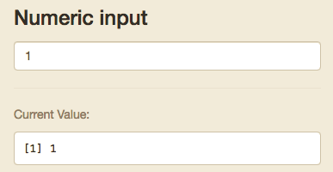
Numeric Input
Goes up and down based off clicks
Stored as single numeric input

Slide 5
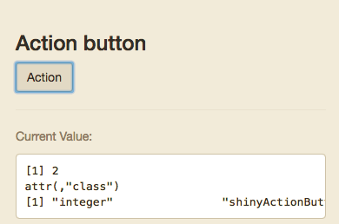
Action Button
+1 each time it is clicked
Stored as single numeric input

Slide 6
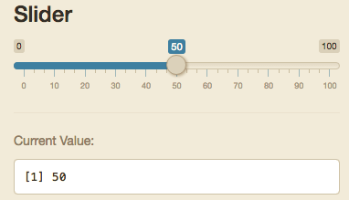
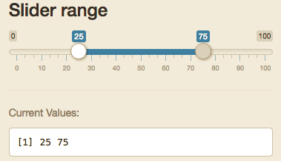
Slider/Range
Either a single integer or list of 2 called separately by input$“inputId”[1] and input$“inputId”[2]

Slide 7
Text Inputs

Slide 8
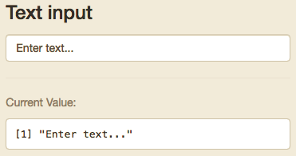
Text Input
Can be tied to action button or enter to initialize input.

Slide 9
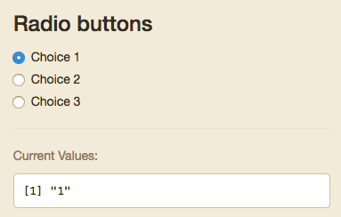
Radio Buttons
Only one option
Value can be dictated in your code, but will default to the value of the text in the choices field

Slide 10
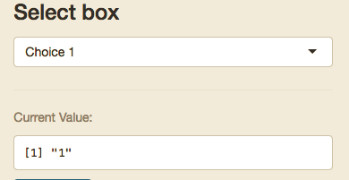
Select input
Can be set to only one selected option or multiple
Value can be dictated in your code, but will default to the value of the text in the choices field
Stored either as a single object or as a list

Slide 11
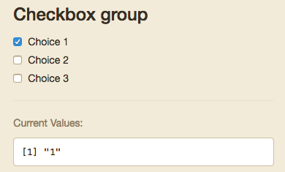
Checkbox Group
Multiple can be selected
Value can be dictated in your code, but will default to the value of the text in the choices field
Stored either as a single object or as a list

Slide 12
Other Inputs

Slide 13
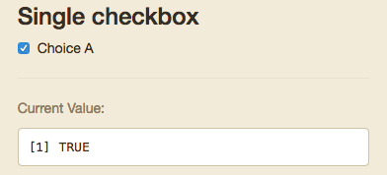
Single Checkbox
Boolean

Slide 14
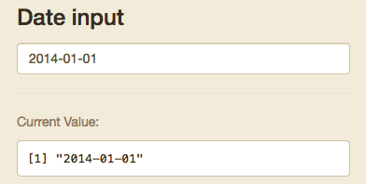
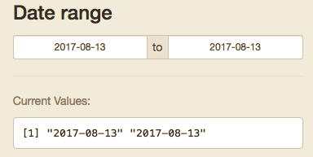
Date/Range
Either a single integer or list of 2 called separately by input$“inputId”[1] and input$“inputId”[2]
R will see these as Dates

Slide 15
Single Checkbox
Boolean

Slide 16
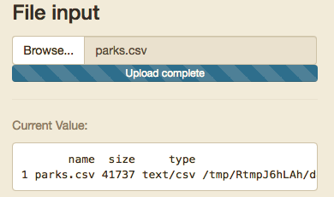
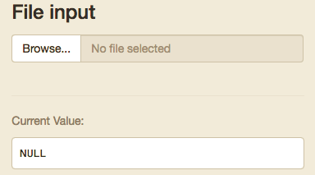
File Input
You should make sure your code checks the format and end of the file
All input references:
https://shiny.rstudio.com/tutorial/written-tutorial/lesson3/

Slide 17
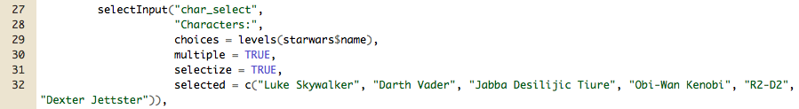
How are inputs stored?
Inputs are stored as a list of lists
For example:
Below the input is called using: input$char_select
Since multiple values can be selected, it has a length equal to the number of characters selected.
input$char_select[1] returns “Luke Skywalker”
Therefore A date range or two sided slide bar input is always a length 2

Slide 18
How do Input Widgets Work?
Inputs are sent to the server function as a list.
Each are called by input$inputId
Value and length of the input depends on the widget
Inputs can even be entire files, images, urls etc.

