Slide 1
Input Widgets
https://shiny.rstudio.com/gallery/widget-gallery.html
Section 4

Slide 2
Agenda
ggplot2 cheat sheet: https://www.rstudio.com/wp-content/uploads/2015/03/ggplot2-cheatsheet.pdf
Numeric Inputs
Text Inputs
Other Inputs
Reactive Outputs
Turning in HW Part 2: Creating a Branch in GitHub

Slide 3
Numeric Inputs

Slide 4
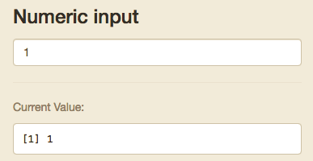
Numeric Input
Goes up and down based off clicks
Stored as single numeric input

Slide 5
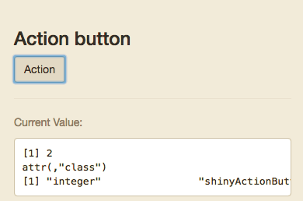
Action Button
+1 each time it is clicked
Stored as single numeric input

Slide 6
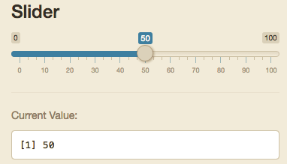
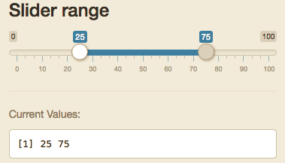
Slider/Range
Either a single integer or list of 2 called separately by input$“inputId”[1] and input$“inputId”[2]

Slide 7
Text Inputs

Slide 8
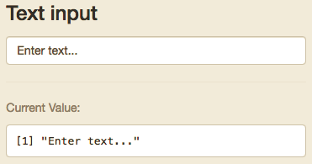
Text Input
Can be tied to action button or enter to initialize input.

Slide 9
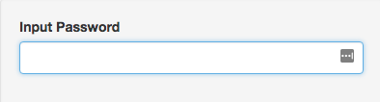
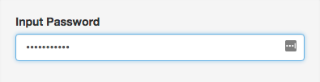
Input Password
Never stored in bookmarks
Works like Text Input

Slide 10
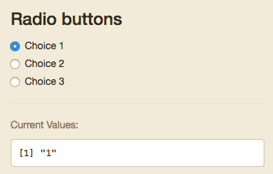
Radio Buttons
Only one option
Value can be dictated in your code, but will default to the value of the text in the choices field

Slide 11
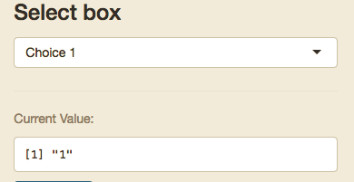
Select input
Can be set to only one selected option or multiple
Value can be dictated in your code, but will default to the value of the text in the choices field
Stored either as a single object or as a list

Slide 12
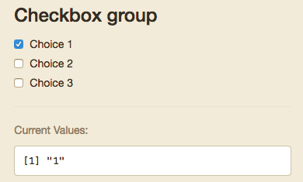
Checkbox Group
Multiple can be selected
Value can be dictated in your code, but will default to the value of the text in the choices field
Stored either as a single object or as a list

Slide 13
Other Inputs

Slide 14
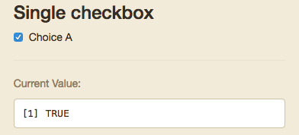
Single Checkbox
Boolean

Slide 15
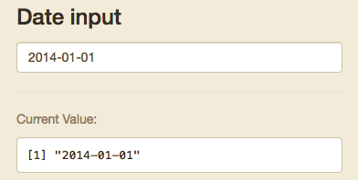
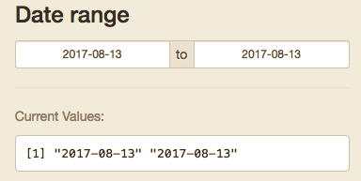
Date/Range
Either a single integer or list of 2 called separately by input$“inputId”[1] and input$“inputId”[2]
R will see these as Dates

Slide 16
Single Checkbox
Boolean

Slide 17
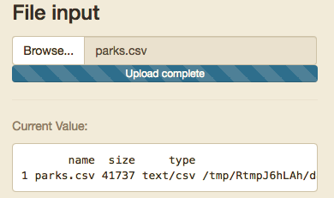
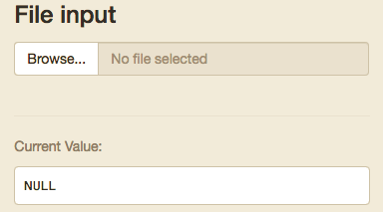
File Input
You should make sure your code checks the format and end of the file
All input references:
https://shiny.rstudio.com/tutorial/written-tutorial/lesson3/

Slide 18
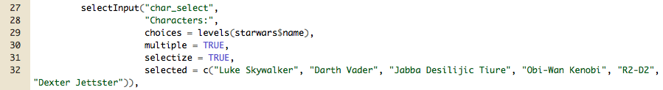
How are inputs stored?
Inputs are stored as a list of lists
For example:
Below the input is called using: input$char_select
Since multiple values can be selected, it has a length equal to the number of characters selected.
input$char_select[1] returns “Luke Skywalker”
Therefore A date range or two sided slide bar input is always a length 2

Slide 19
How do Input Widgets Work?
Inputs are sent to the server function as a list.
Each are called by input$inputId
Value and length of the input depends on the widget
Inputs can even be entire files, images, urls etc.

Slide 20
reactive

Slide 21
Everything in R is a Function
Reactive Datasets are a functions you can call whenever you need a set of actions to occur based off of filters in your application
They should be used whenever you are using the same inputs/filters on the same data for multiple outputs/visuals.
You can call reactive functions within other reactive functions for simple
These go in the server function/files
They are called as any function but with no arguments
Caches results to speed up loading
Ensures your visuals are all showing the same information
Shorter more legible code

Slide 22
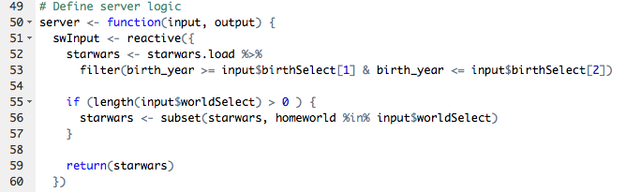

Reactive Example
Using our Shiny Dashboard from last week we have a bunch of plots and info boxes using the same data and filters.
If we add reactive functions we can call the filtered data automatically in each output.

Slide 23
The example in this folder is going to be insufficient
Why?
Because the way you filter the data is going to depend on your data source, what you want to show the users, and how “explorable” you want your application to be
Resources:
How reactivity works: https://shiny.rstudio.com/articles/reactivity-overview.html
Filtering: https://dplyr.tidyverse.org/

Slide 24
Turning in Homework
A real walkthrough this time

