Slide 1
Updates inputs and more
Week 3

Slide 2
Updates

Slide 3
Updates & Observe Events
Any time you wish to update part of your UI you will need to include an event observer.
Here you will be observing an input that your user can interact with
Observers can be done in one of two ways. Event observers or generic observer function
observeEvent() when you are observing a particular input
observe() works if you want to observe multiple things, or non-input based object such as the output or content of a reactive function.

Slide 4
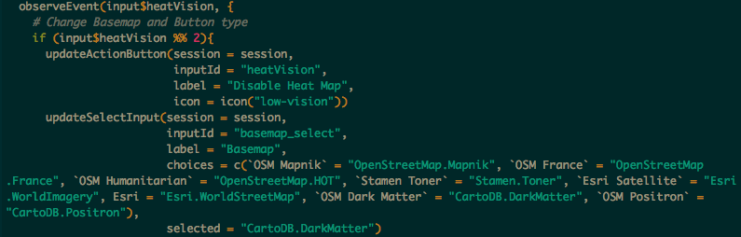
Event Observer Example
Here we will look at how I use this in the Burgh’s Eye View

Slide 5
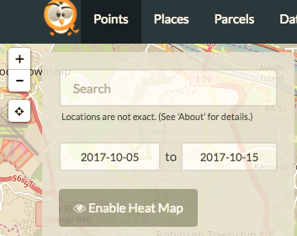
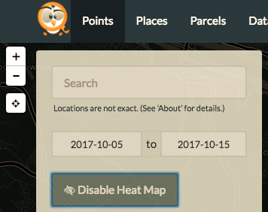
Before: After:

Slide 6
Notifications

Slide 7
Bookmarking

