Slide 1
Integer Programming and Network Analysis
Term Project Introduction
2026/5/7

Slide 2
Term Project
Presentation date: 6/4
Weight: 20% of the final grade
Please upload your:
Output files (3 in total) and code (deadline: 6/1 9:00)
Presentation slides (deadline: 6/3 23:59)
Please use CPLEX or Gurobi as solver. However, you can employ any techniques that may enhance the quality of the solution.

Slide 3

Background
In manufacturing systems, production scheduling plays an important role in improving machine utilization and reducing delivery delays. In this project, multiple orders may be assigned to limited machines and molds. We need to consider the scheduling restrictions, such as machine capacity, molds limit, sequence-dependent setup times and so on. In addition, some orders may share the cavities of the same machine by using a special production strategy called partial cavity production. The goal of this project is to generate a feasible production schedule that maximizes the total number of scheduled orders.
$$\max{\sum_{i=1}^{n}{z_{i}}}$$
$$z_{i}=\left\{\begin{aligned}1, if order i is scheduled \\ 0, otherwise \end{aligned}\right.$$

Slide 4
Problem Description
Elements | Description
Orders | Each order includes its material, type, due date, processing time, and batch size.
Machines | Each scheduled order must be assigned to a feasible machine through a production group.
Molds | Each scheduled order requires a fixed mold type and a fixed number of molds.
Machine Capacity | An order can be assigned to a machine only if its batch size does not exceed the machine capacity.

Slide 5
Problem Description
Elements | Description
Machine Cavities | Each machine has a fixed number of cavities, and each mold occupies one cavity during processing.
Setup Time | Setup time depends on the sequence of orders and may include mount, clean, tune, and unmount operations.
Maintenance | Machines may have unavailable time intervals during which neither processing nor setup operations can be performed.
Due Date | A scheduled order must be completed before or at its due date; otherwise, it is treated as unscheduled.

Slide 6
Partial Cavity Production
Partial cavity production is an optional production strategy. When several orders use different molds, they may be scheduled consecutively on the same machine as a production group by blocking part of the cavities. Within the same production group, additional mount and unmount operations are not required between consecutive orders. Meanwhile, clean and tune operations are still determined by the type and material relationship between consecutive orders. However, this strategy increases the processing time of every orders in the group.

Slide 7

Partial Cavity Production
A partial cavity production group can be assigned to a machine only if:
This machine is feasible for all orders in the group.
The total number of molds required in the group $≤$ the machine cavities.
If $n$ orders are grouped together as a partial cavity production group, the processing time of each order becomes:
$$p_{i}^{′}=p_{i}×n$$

Slide 8

Partial Cavity Production
Example:
Order A needs 2 mold $q_{1}$when scheduling.
Order B needs 3 mold $q_{2}$ when scheduling.
Machine M has 6 cavities.
If M is feasible both for order A and order B, and $q_{1}≠q_{2}$, then these two orders may be scheduled consecutively as a group and assigned to M. While the processing time of each order becomes:
$$p_{i}^{′}=p_{i}×2$$

Slide 9
Criteria of Setup Time Required
Criteria of setup time required between two consecutive orders:
Different type
Clean, Tune
Setup | Processing time(min)
Mount | 30
Unmount | 20
Clean | 15
Tune | 10
Same material
No setup required
Same type
Different material
Tune
Setup time required between two consecutive groups: Mount, Tune, Unmount
Each group may contain one(an order itself) or multiple orders.

Slide 10
Assumptions
All orders are available at time 0. (2026/5/1 08:00:00)
Each order has a predefined processing time and due date.
Once an order starts processing, it cannot be interrupted.
All machines and molds are initially available. (2026/5/1 08:00:00)
Each order uses one fixed mold type and a fixed required mold quantity.
Each mold used during processing occupies one cavity of the assigned machine.
Partial cavity production is optional, not mandatory.

Slide 11
Assumptions
If partial cavity production is used, the processing time of each order in the group is increased according to the number of orders in that group.
Setup time is sequence-dependent and determined by the type, and material between consecutive orders.
For the first production group assigned to a machine, mount and tune setup operations are required before processing starts.
For the last production group assigned to a machine, an unmount setup operation is required after processing is completed.

Slide 12
Constraints
Each scheduled order must be assigned to exactly one feasible machine–mold combination.
Unscheduled orders are not assigned to any machine or mold.
Each scheduled order must be completed before or at its due date.
The batch quantity of a scheduled order cannot exceed the capacity of the assigned machine.
A machine can process at most one production group at any time.
Processing times of production groups assigned to the same machine cannot overlap.

Slide 13
Constraints
A machine cannot be used during its maintenance period, including processing and setup operations.
The number of molds of the same type used at the same time cannot exceed the available quantity of that mold.
For each production group, the total required mold quantity cannot exceed the number of cavities of the assigned machine.
Orders using the same mold type cannot be assigned to the same partial cavity production group.

Slide 14
Constraints
Between two consecutive production groups on the same machine, unmount, tune and mount setup operations are required.
If a maintenance is occurred between two consecutive production groups on the same machine, unmount and tune operations need to be operated before maintenance, and mount operation needs to be operated after maintenance.
Each machine has a maximum limit on the number of mold change operations.
One complete mount and unmount operation is counted as one mold change operation.

Slide 15
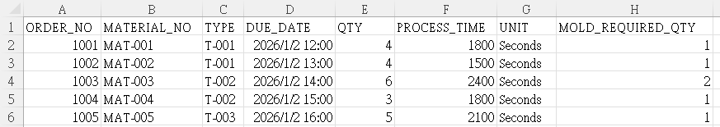
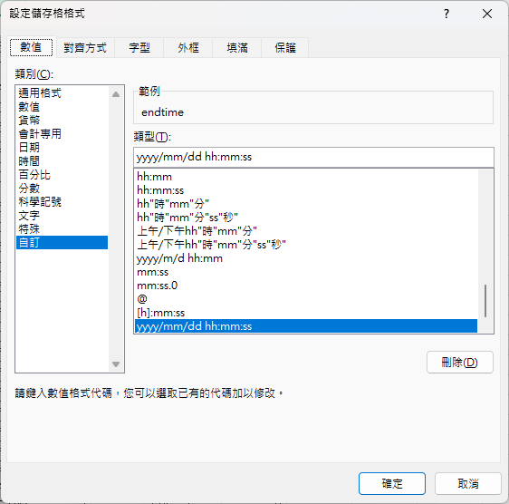
Input Data (ORDER.csv)

Slide 16
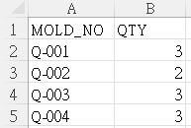
Input Data (MOLD.csv)
MOLD_NO | The identifier of mold.
QTY | The number of available mold.

Slide 17
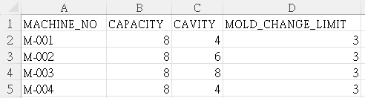
Input Data (MACHINE.csv)
MACHINE_NO | The identifier of machine.
CAPACITY | The number of available capacity of machine.
CAVITY | The number of available cavity of machine.
MOLD_CHANGE_LIMIT | The limitation of mold changing setup. (mount + unmount count as once)

Slide 18
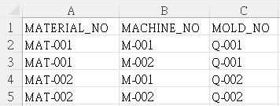
Input Data (MATERIAL_ROUTE.csv)
MATERIAL_NO | The identifier of the material.
MACHINE_NO | The identifier of the feasible machine of the corresponding material.
MOLD_NO | The identifier of the feasible mold of the corresponding material.

Slide 19
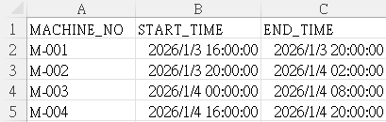
Input Data (MAINTENANCE.csv)
MACHINE_NO | The identifier of machine.
START_TIME | Start time of the maintenance.
END_TIME | End time of the maintenance.

Slide 20
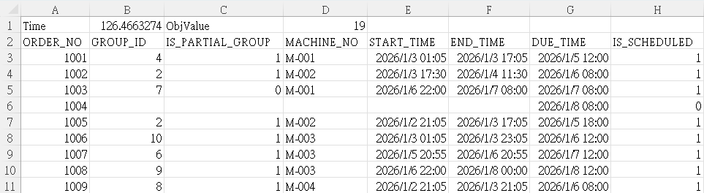
Output File (result.csv)
Output the runtime, objective value and the schedule result.
If IS_SCHEDULED = 0, then column B to column F should not be output.

Slide 21
Grading policy
Presentation (30%):
Content (model design, result analysis, PPT layout): 18%
Oral presentation: 9%
Time control (10 min presentation + 3 min QA): 3%
Solution quality (70%):
We will test 3 instances for your computing times and objective values.
Small data: 30%, Medium data: 20%, Big data:20%
Bonus: efficient algorithm designed by your team (optional)
The limit of computing time is 2 minutes.
Your results will be ranked for grading.

Slide 22

Grading (Input 1)
Computing time |  | Grade (10%)
CPLEX | Gurobi
< 5s | < 5s | 10%
5 ~ 20s | 5 ~ 20s | 8%
20 ~ 40s | 20 ~ 40s | 7%
> 40s | > 40s | 5%
We achieved the above solution by C#
Objective value: 12 / 12
Objective value | Grade (20%)
Reach optimality | 20%
Top 25% if not optimality | 16%
26% - 50% if not optimality | 13%
51% - 100% if not optimality | 10%
Your source code will be run at the following environment: Windows, AMD Ryzen 9 5950X CPU @ 4.00GHz and 64 GB of memory

Slide 23
Grading (Input 2)
Computing time |  | Grade (10%)
CPLEX | Gurobi
< 12 min | < 2 min | 10%
12 ~ 18 min | 2 ~ 5 min | 8%
18 ~ 25 min | 5 ~ 10 min | 7%
> 25 min | > 10 min | 5%
We achieved the above solution by C#
Objective value: 21 / 21
Objective value | Grade (10%)
Reach optimality | 10%
Top 25% if not optimality | 7%
26% - 50% if not optimality | 6%
51% - 100% if not optimality | 5%
Your source code will be run at the following environment: Windows, AMD Ryzen 9 5950X CPU @ 4.00GHz and 64 GB of memory

Slide 24
Grading (Input 3)
Computing time |  | Grade (10%)
CPLEX | Gurobi
< 20 min | < 3 min | 10%
20 ~ 25 min | 3 ~ 8 min | 8%
25 ~ 30 min | 8 ~ 15 min | 7%
> 30 min | > 15 min | 5%
We achieved the above solution by C#
Objective value: 24 / 24
Objective value | Grade (10%)
Reach optimality | 10%
Top 25% if not optimality | 7%
26% - 50% if not optimality | 6%
51% - 100% if not optimality | 5%
Your source code will be run at the following environment: Windows, AMD Ryzen 9 5950X CPU @ 4.00GHz and 64 GB of memory

Slide 25
Bonus (Input 2)
Objective value | Grade (10%)
Top 20% | 5%
21% - 40% | 4%
41% - 60% | 3%
61% - 80% | 2%
81% - 100% | 1%
For Input 2 instance (5%):
The limit of computing time is 2 minutes.
You should submit 1 output csv files, e.g.
Team0_bonus_output_ Input2.csv
Your source code will be run at the following environment: Windows, AMD Ryzen 9 5950X CPU @ 4.00GHz and 64 GB of memory

Slide 26
Bonus (Input 3)
Objective value | Grade (10%)
Top 20% | 5%
21% - 40% | 4%
41% - 60% | 3%
61% - 80% | 2%
81% - 100% | 1%
For Input 3 instance (5%):
The limit of computing time is 2 minutes.
You should submit 1 output csv files, e.g.
Team0_bonus_output_ Input3.csv
Your source code will be run at the following environment: Windows, AMD Ryzen 9 5950X CPU @ 4.00GHz and 64 GB of memory

Slide 27
TA’s contact info
If you have any problem concerning about the term project, feel free to discuss with TAs.
Email one of us in advance.
鄭巧昀：shinee910319@gmail.com
江松儒：stephjustin56@gmail.com

Slide 28
Thanks for listening

