Slide 2
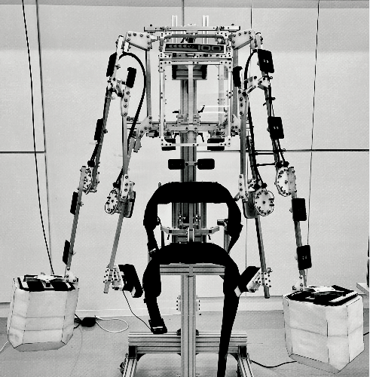
Sensor Layout
RU
HD
LU
RL
BDY
LL

Slide 3
Pinout
Sensor Location | read order | ADC 1 Channel | Pin#
LL | 1 | ADC_10 | PC0
LU | 2 | ADC_5 | PA5
RL | 3 | ADC_6 | PA6
RU | 4 | ADC_9 | PB1
Bdy | 5 | ADC_7 | PA7
Hd | 6 | ADC_13 | PC3

Slide 4
Design of Head sensors
Vsens (should be connected
to Hd terminal)
Vdd (3.3V)

Slide 5
Message Byte Code
Error Code |  | Hit count
7 | 6 | 5 | 4 | 3 | 2 | 1 | 0
Hd | Bdy | Hd | Bdy | RU | RL | LU | LL
8 Bytes
Error Code explanation:
There is no implelention of the error code at this time. However, this is one possible implemention of the error code script.
Communcation error |  | Error On Sensor (0 = okay, 1 = error)
7bit | 6bit | 5bit | 4bit | 3bit | 2bit | 1bit | 0bit
Comm error code |  | Hd | Bdy | RU | RL | LU | LL
0b00 = okay
0b01 = BT connection Lost
wired Connection Okay
0b10 = Low battery
0b11 = Bt connection lost and wired connection lost

Slide 6
Software Used in Project Creation
STM32 CUBE MX (Free)
(Configure Header files and create project template, takes care of initializing the peripherals and doing all the difficult stuff)
RealTerm (Free)
A good terminal program debugger
Fritzing (Free)
Draws good software diagrams
Visual Studio Community edition 2019 (Free)
2019 edition
VisualGDB
The primary software for developing and debugging the project. Note: needs specific JAVA SDK to be installed as well
Agent Ransack (Free)
Very powerful search program to find functions or other things in files
WinMerge (Free)
Good software for moving files to new projects without having to use git merge

Slide 7
Chest Sensor Development
CU1 (top)
CU1
CU2
VeloStat
CU2 (bottom)
Velostat

Slide 8
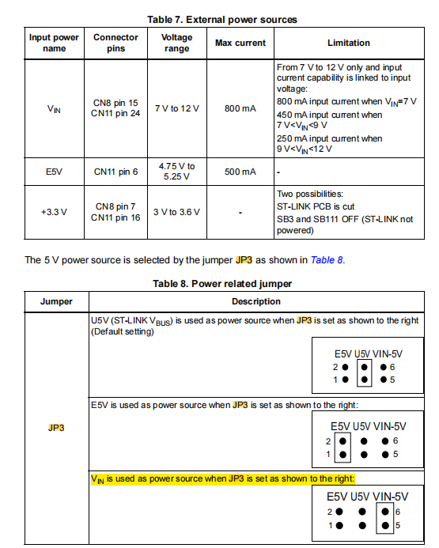
Notes About Battery
If using Battery Power change Jumper JP3 from U5 to VIN

