Slide 1
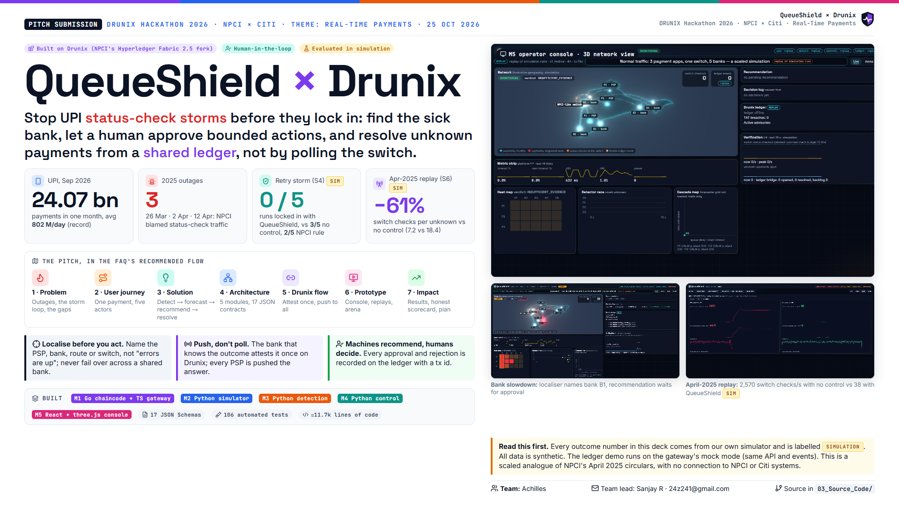
Notes:
QueueShield stops UPI status-check storms before they lock in. Three ideas: localise the sick bank, let a human approve bounded actions, and resolve unknown payments from a shared Drunix ledger instead of polling the switch. Every outcome number is from our simulator.

Slide 2
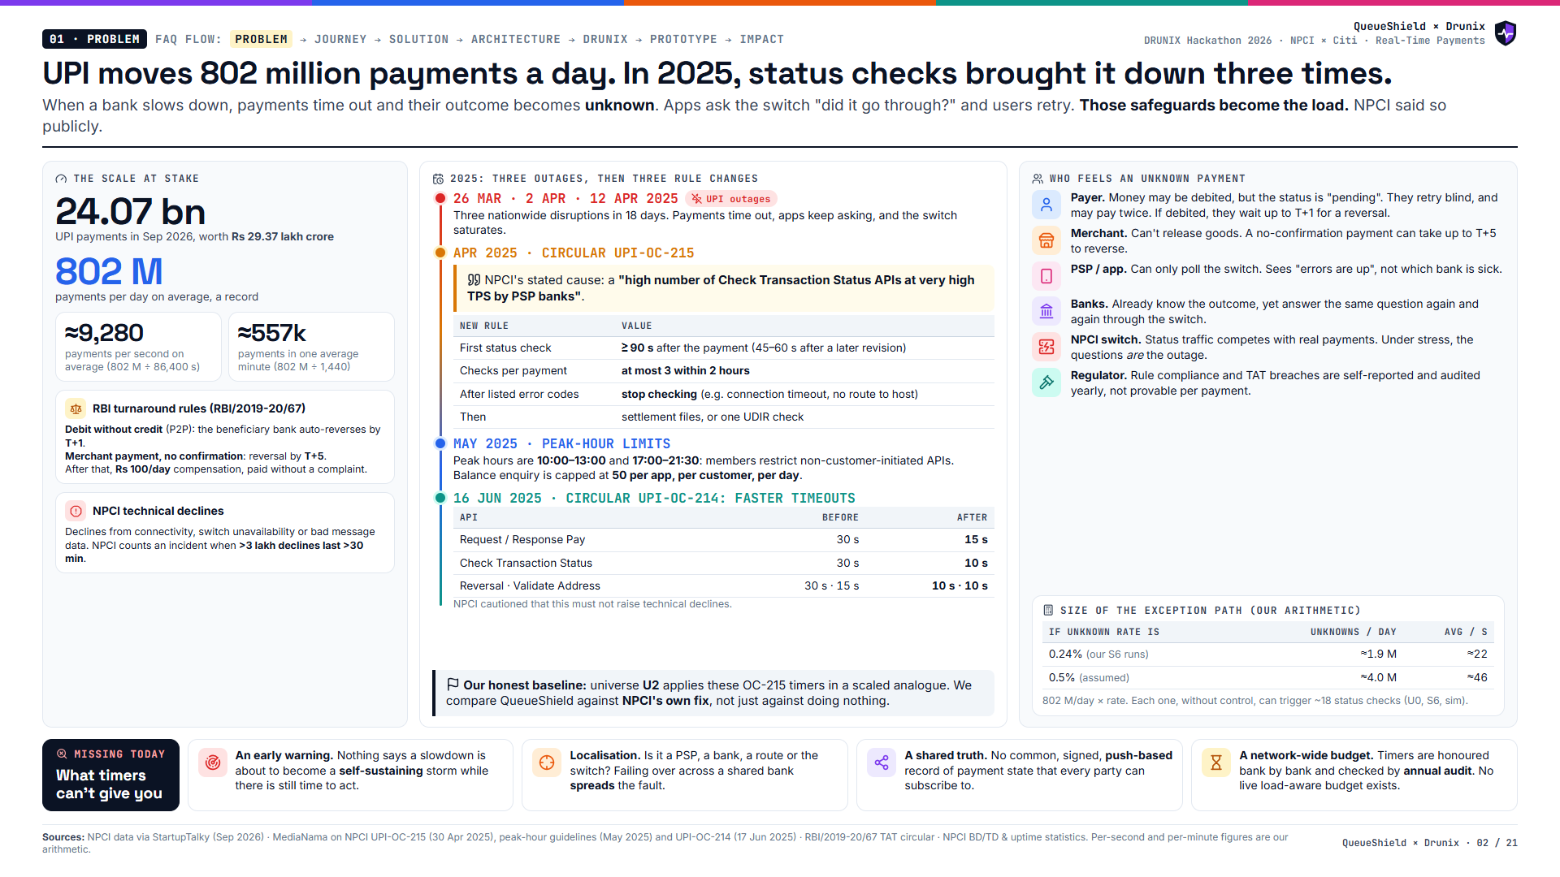
Notes:
UPI is huge: 24 billion payments a month. In March and April 2025 it went down three times, and NPCI publicly blamed status-check traffic. Its fixes were timers and faster timeouts, honoured bank by bank and audited yearly. What's still missing: an early warning, localisation, a shared push-based truth, and a live network-wide budget.

Slide 3
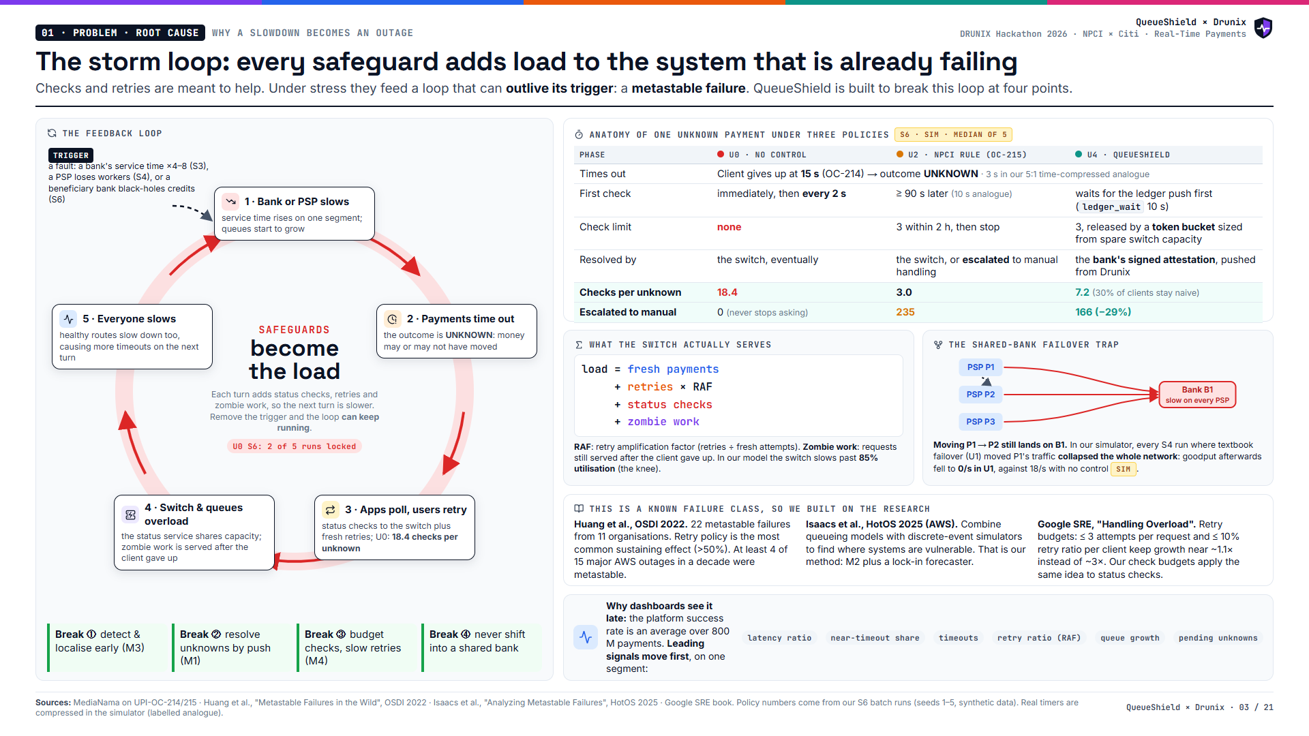
Notes:
The loop: a bank slows, payments time out and become unknown, apps poll and users retry, the switch overloads, and everyone slows down. It can keep going after the trigger ends. The table shows one unknown payment under three policies, with numbers from our S6 runs. Textbook failover makes things worse when the bank is shared.

Slide 4
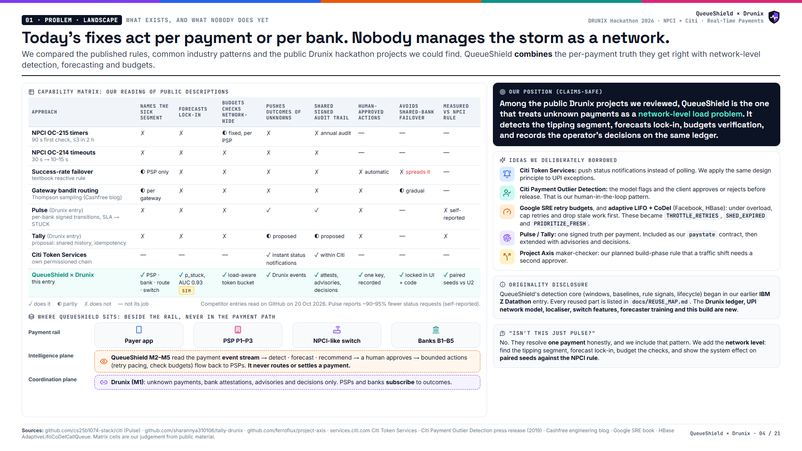
Notes:
Rules and gateways act per payment or per bank. Per-payment ledgers like Pulse fix the truth for one payment. QueueShield adds the network level and measures itself against NPCI's own rule.

Slide 5
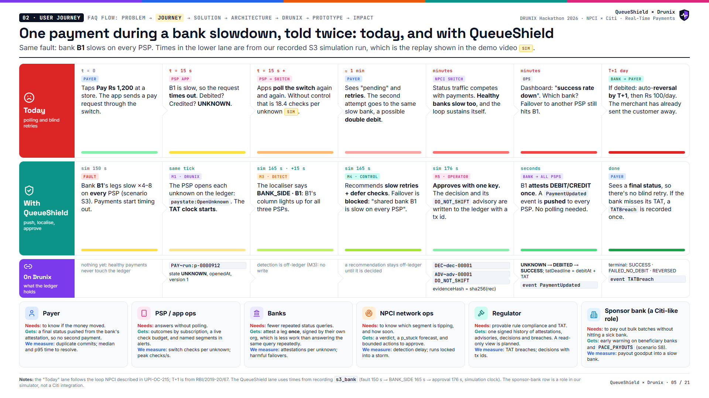
Notes:
Walk one payment. Today: timeout, polling, blind retry, a dashboard that can't name the bank, and a T+1 reversal. With QueueShield: the unknown is on the ledger with its TAT clock, the bank is named 15 seconds after the fault, failover is blocked, a human approves, and the bank's single attestation is pushed to everyone.

Slide 6
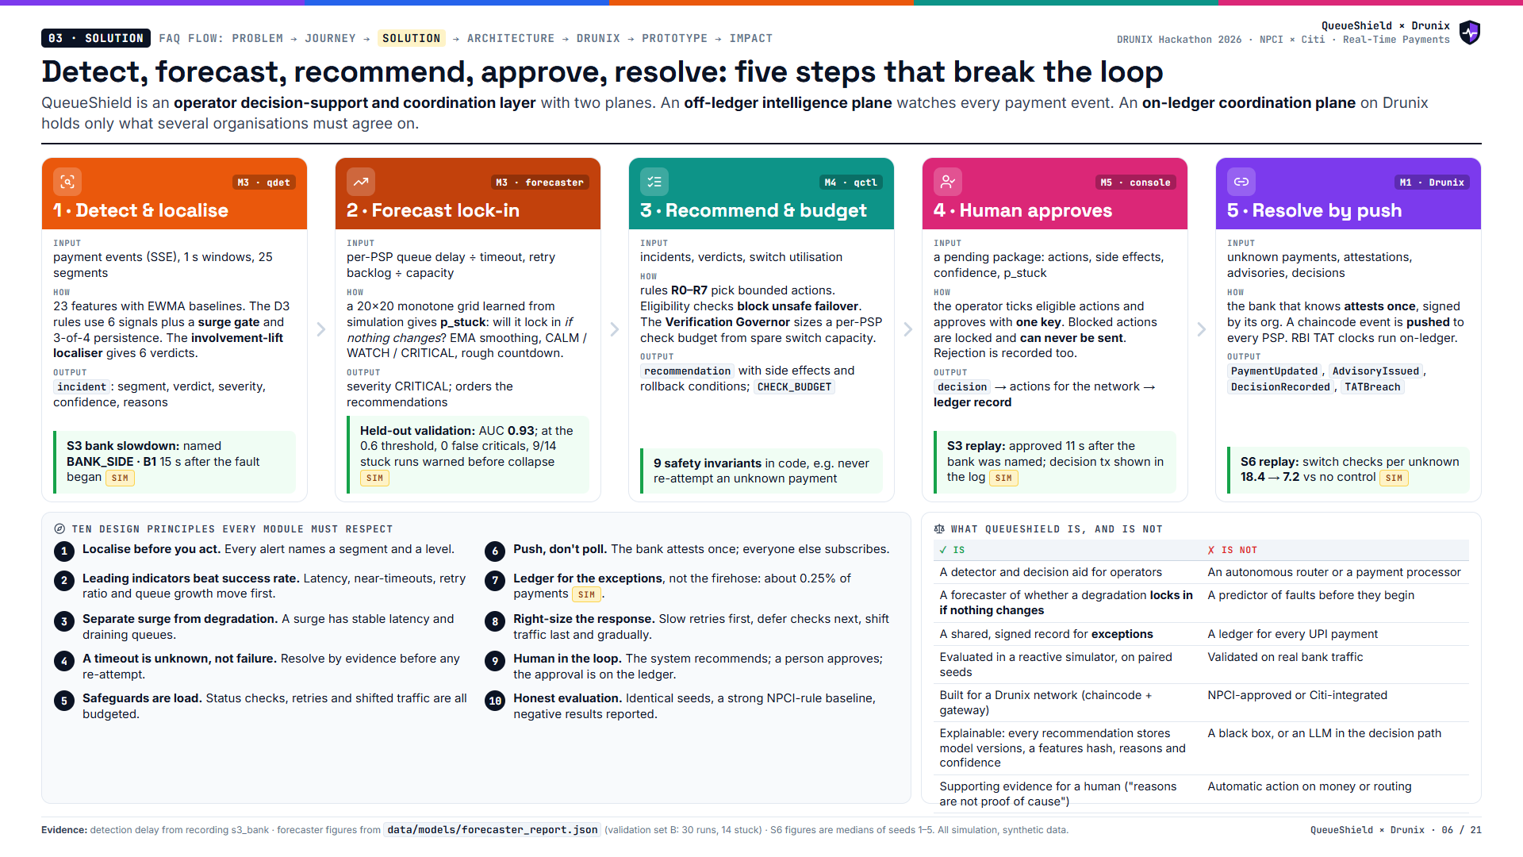
Notes:
Five steps. Detect and localise, forecast lock-in, recommend bounded actions with a check budget, a human approves, and the bank's attestation is pushed from the ledger. Each step names its module, inputs, method, outputs and one measured result from our simulator.

Slide 7
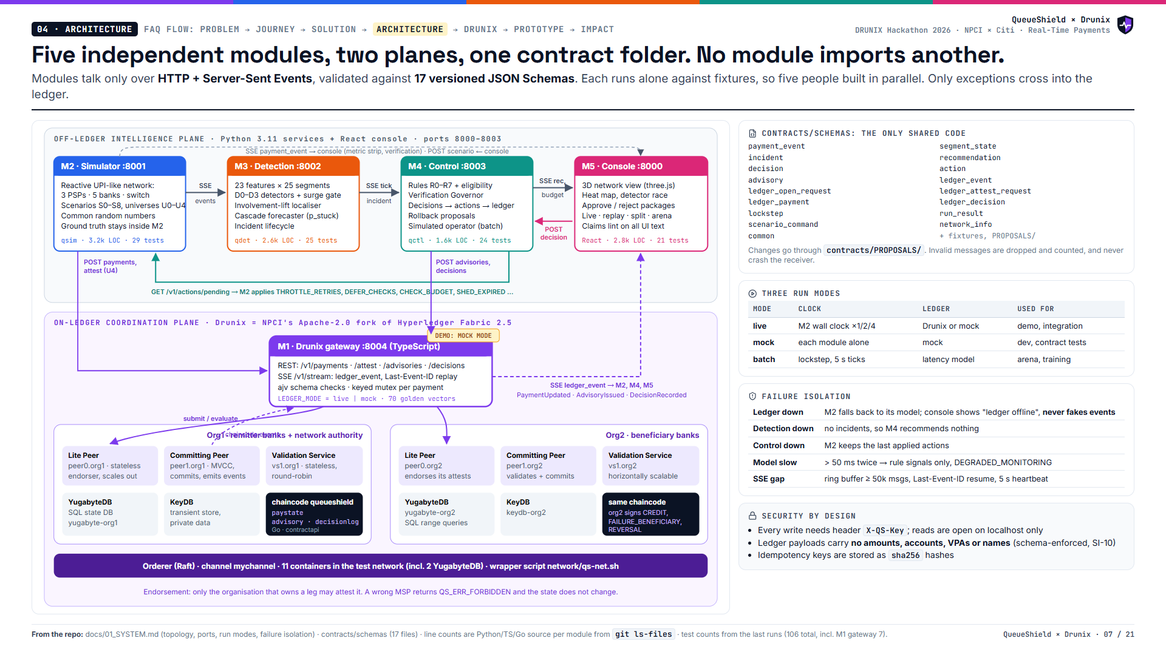
Notes:
Two planes. The intelligence plane is the simulator, detection, control and console, talking over SSE and REST. The coordination plane is Drunix behind one TypeScript gateway, with two orgs, Lite Peers, Committing Peers, the Validation Service and YugabyteDB. The demo runs the gateway in mock mode with the same API and events.

Slide 8
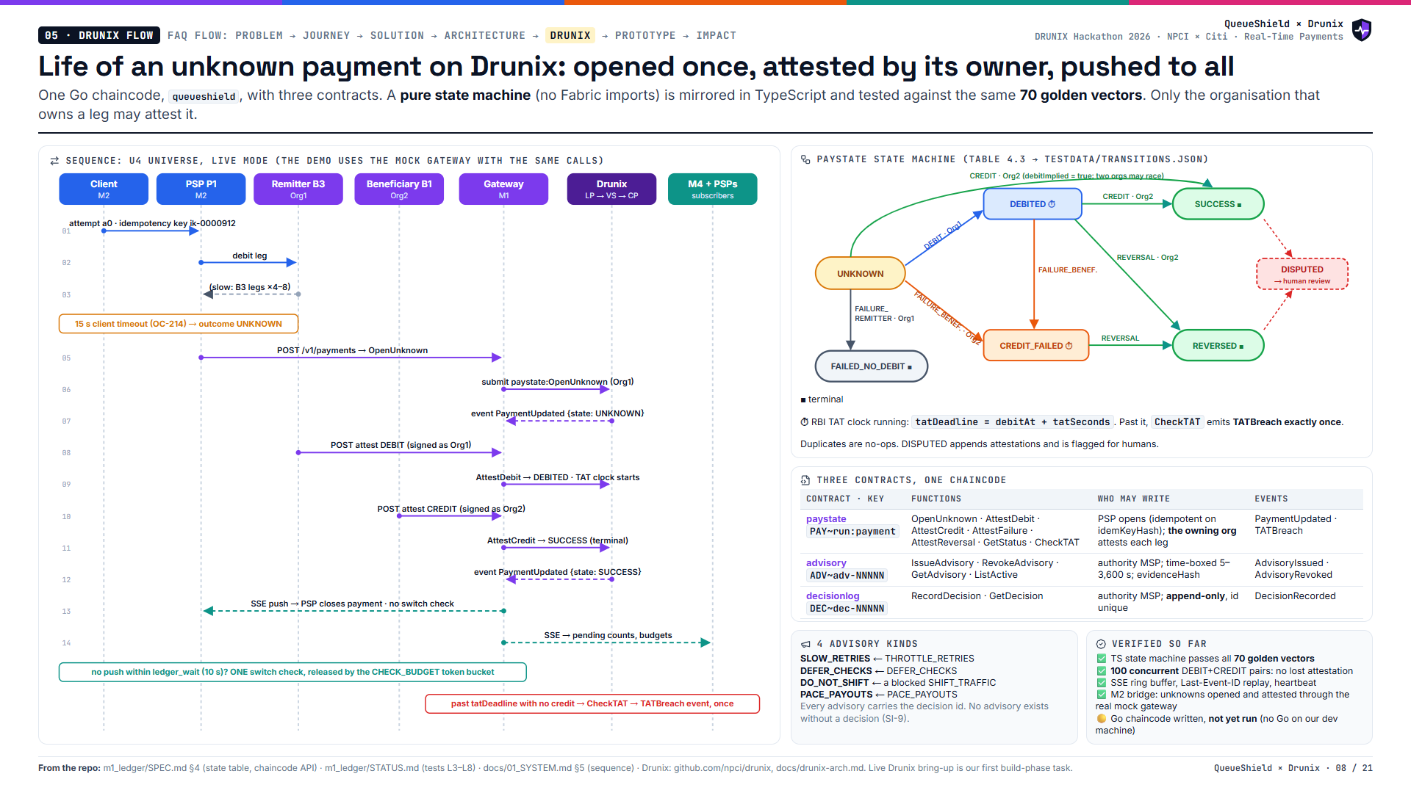
Notes:
Follow one unknown payment. The PSP opens it on the ledger. The remitter bank attests the debit as Org1, the beneficiary bank attests the credit as Org2, and the chaincode emits PaymentUpdated, which the gateway pushes to every PSP. If nothing arrives within the ledger wait, one budgeted switch check is released. Past the TAT deadline, a breach is recorded exactly once.

Slide 9
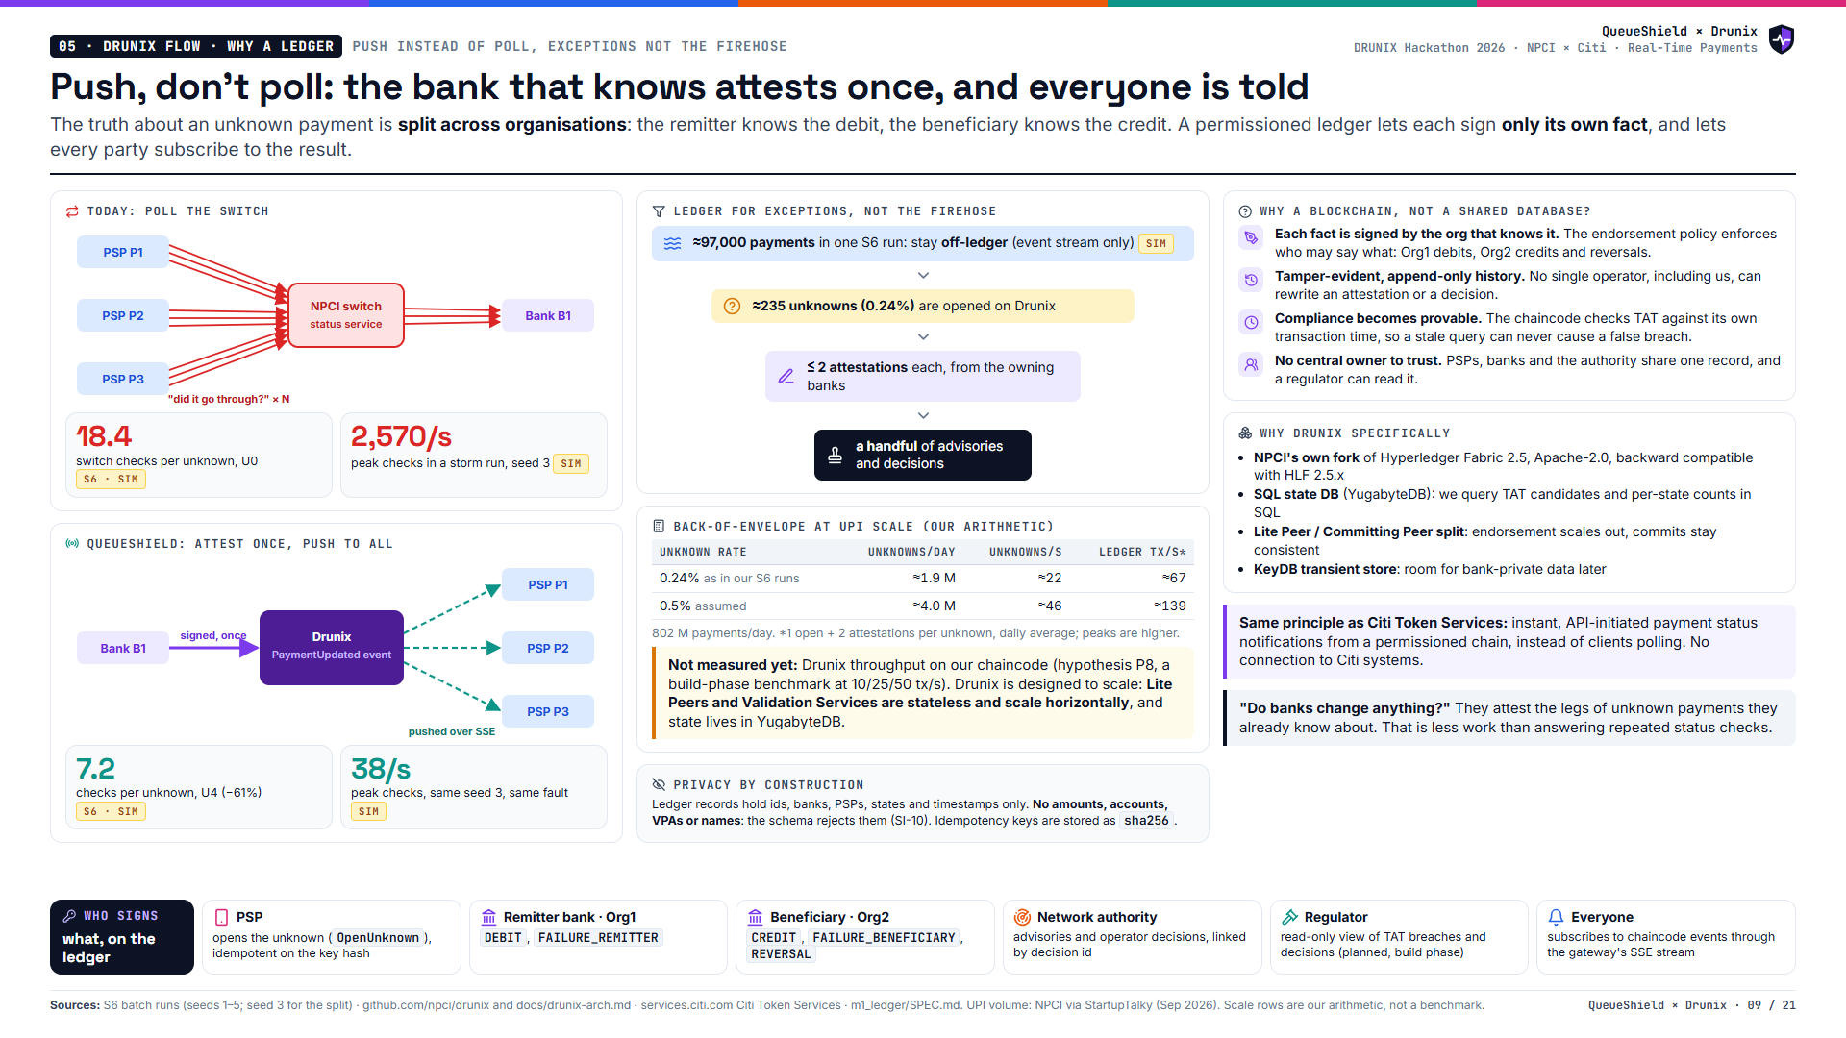
Notes:
Polling makes every PSP ask the switch, which asks the bank. Pushing has the bank attest once and the ledger notify everyone. Only about a quarter of one percent of payments touch the ledger in our runs. We show the scale arithmetic and say clearly that the Drunix throughput benchmark is still to do.

Slide 10
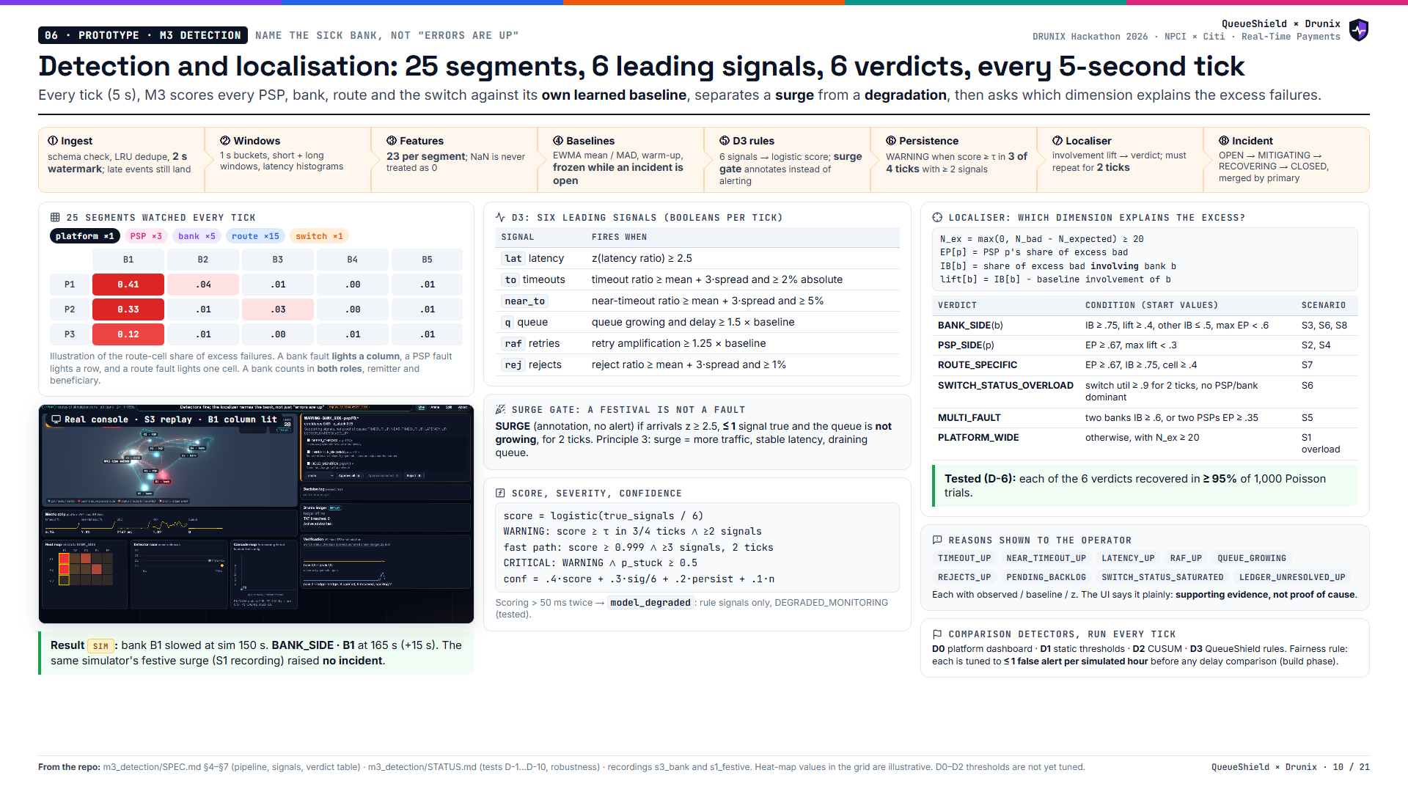
Notes:
M3 watches 25 segments. Six leading signals, a surge gate so festivals don't alarm, persistence so one bad tick doesn't either, and an involvement-lift localiser that names a bank, a PSP, a route or the switch. In the bank-slowdown replay it named B1 fifteen seconds after the fault.

Slide 11
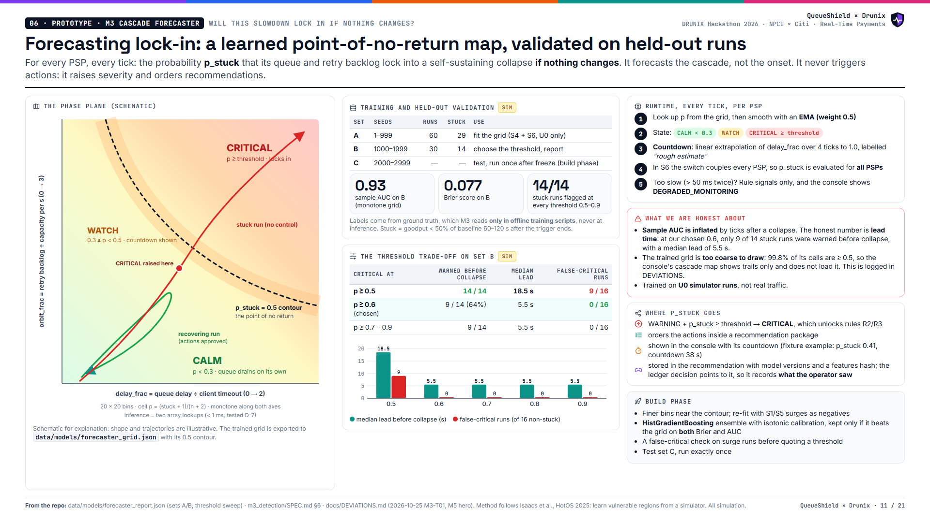
Notes:
The forecaster answers one question: if nothing changes, will this lock in? It's a 20 by 20 grid learned from simulator runs, validated on held-out seeds. We're honest about the trade-off: a lower threshold warns earlier but raises false alarms. At the chosen threshold there were no false alarms, but only 9 of 14 stuck runs were warned before collapse.

Slide 12
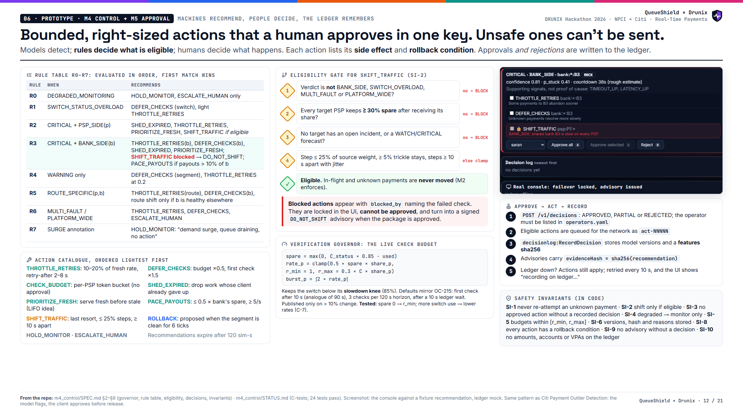
Notes:
Rules decide what's eligible, a human decides what happens, and the ledger remembers. A bank-side fault can never trigger failover, because every PSP shares that bank. The console locks it, and approving the package issues a signed DO_NOT_SHIFT advisory instead. The check budget is sized from spare switch capacity so verification never becomes the load.

Slide 13
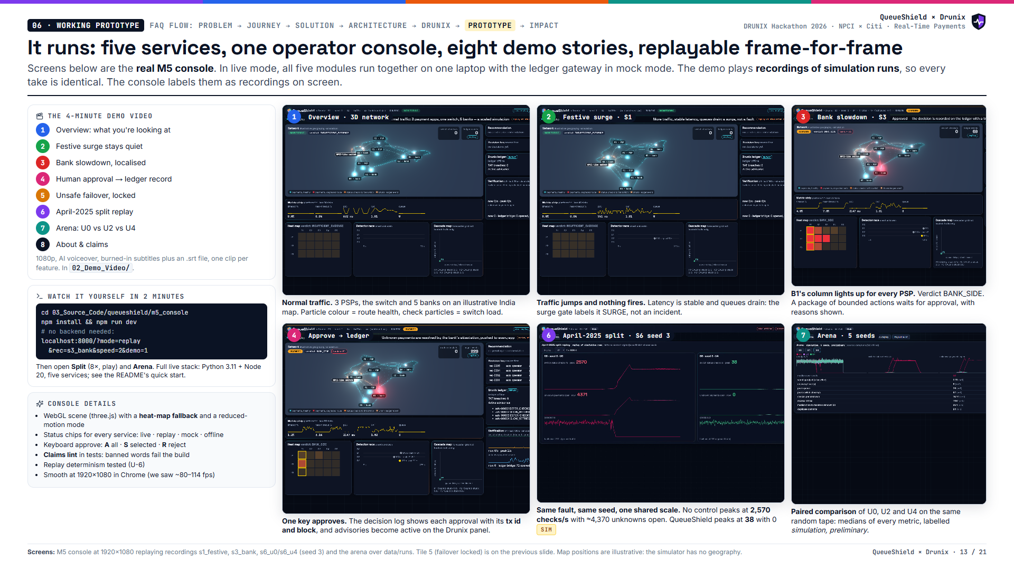
Notes:
This is the working prototype. Six screens from the real console: overview, the festive surge staying quiet, the bank slowdown localised, approval recorded with a tx id, the April-2025 split replay, and the arena. A judge can run the replay with no backend in two minutes.

Slide 14
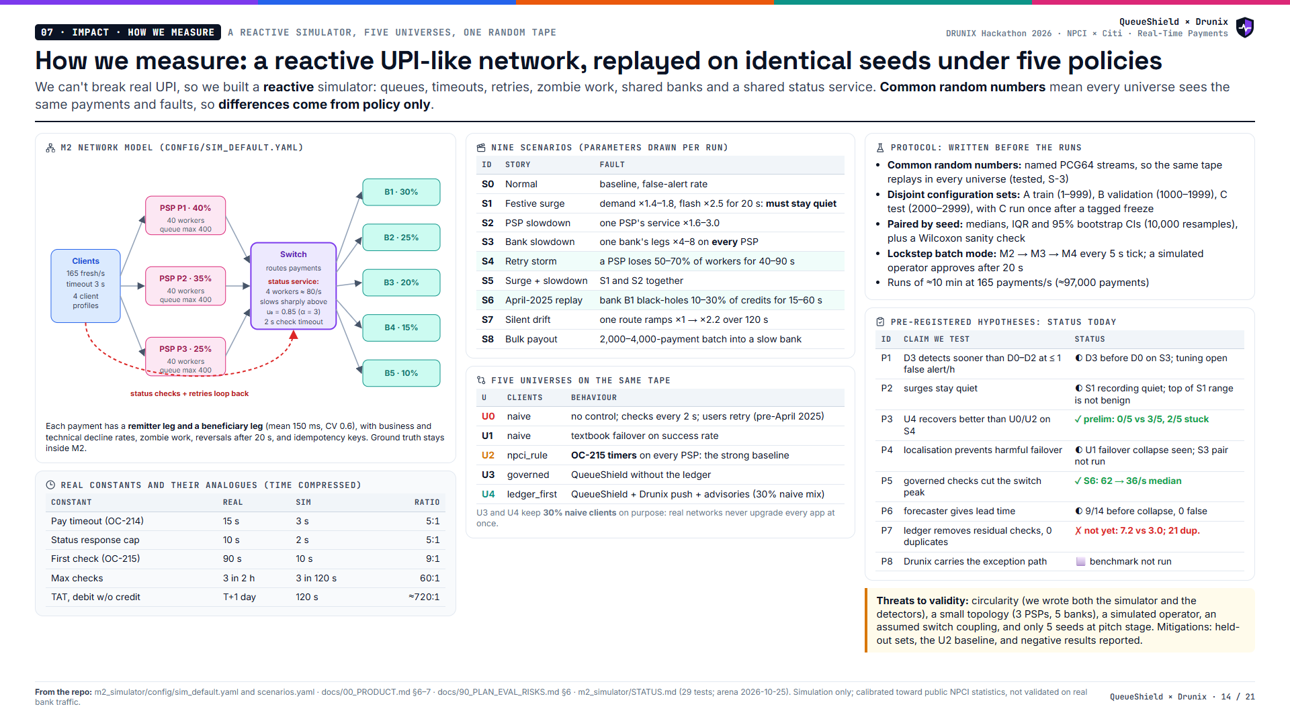
Notes:
We can't break real UPI, so we built a reactive simulator and replay the same seeds under five policies. The table on the right is our pre-registered hypothesis list, with today's honest status, including the one that doesn't hold yet.

Slide 15
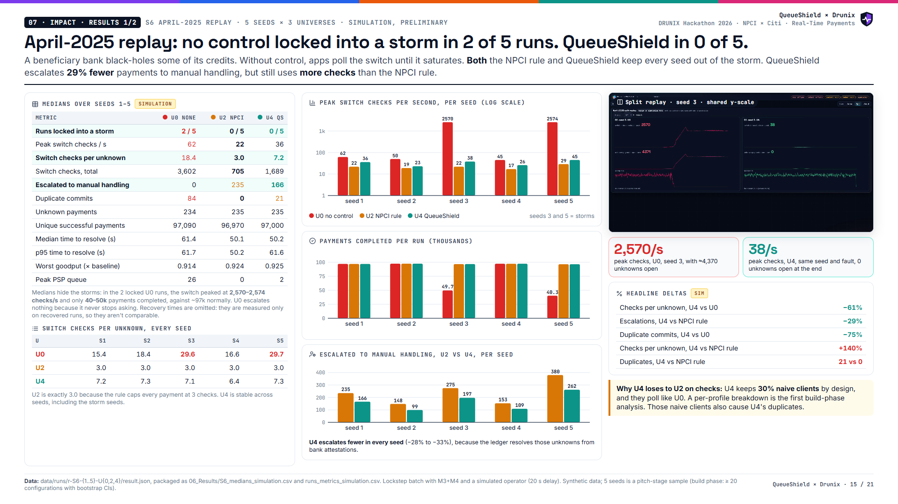
Notes:
In the April-2025 replay, no control locks in on two of five seeds, with the switch at about 2,570 checks a second. Both the NPCI rule and QueueShield keep every seed safe. QueueShield escalates fewer payments to manual handling in every seed, but it still uses more checks than the NPCI rule. We say so here, and explain why.

Slide 16
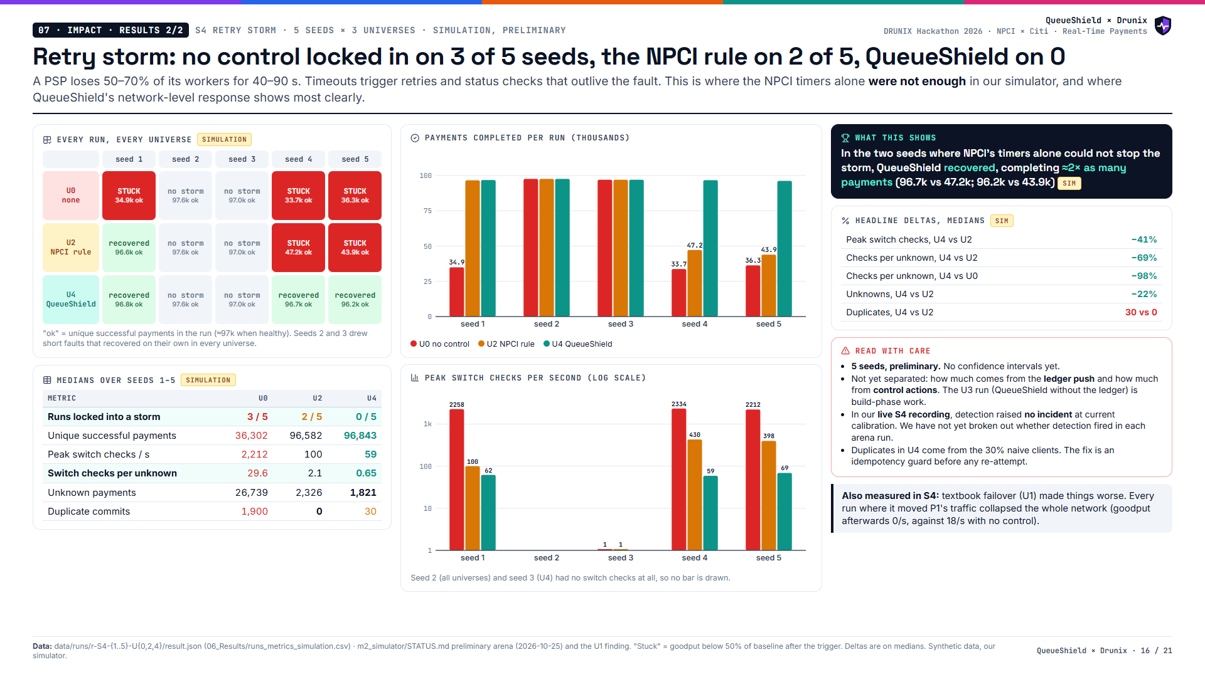
Notes:
The retry storm is where QueueShield stands out. No control locks in on three of five seeds, the NPCI rule on two, QueueShield on none. In the two seeds where NPCI's timers weren't enough, QueueShield completed about twice as many payments. We don't yet know how much of that is the ledger and how much is control; that's the first ablation in the build phase.

Slide 17
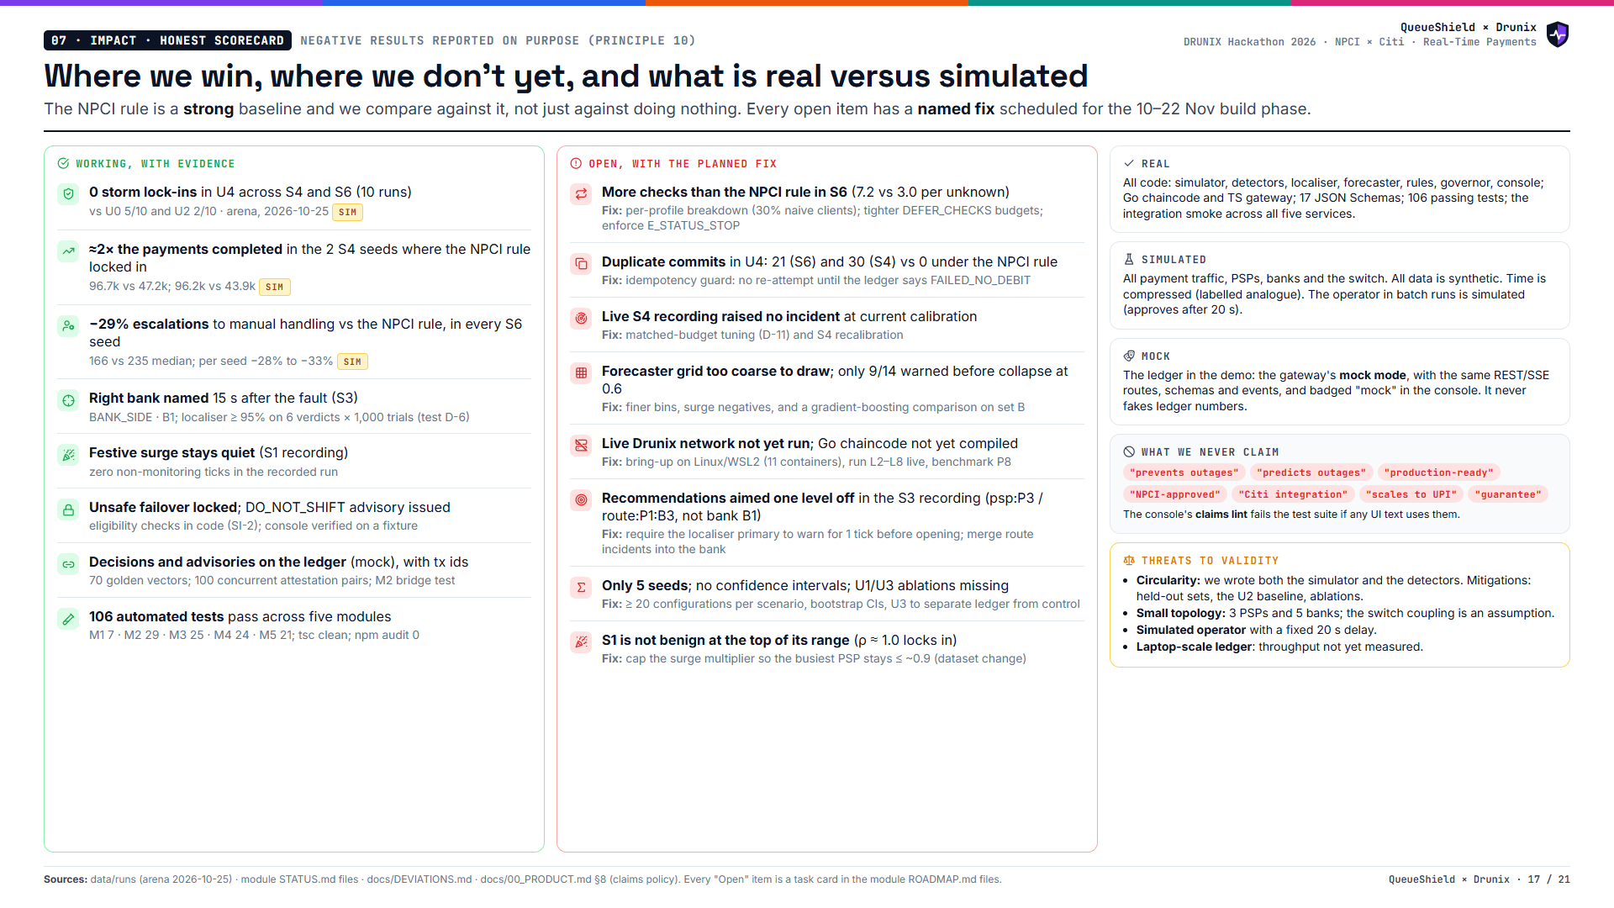
Notes:
We're honest on purpose. QueueShield never locked into a storm, and it beats the NPCI rule on escalations and on the retry storm. But it still uses more checks than the NPCI rule in the April replay, it has a duplicate-commit gap, and the live Drunix network hasn't been brought up yet. Each of those has a fix scheduled.

Slide 18
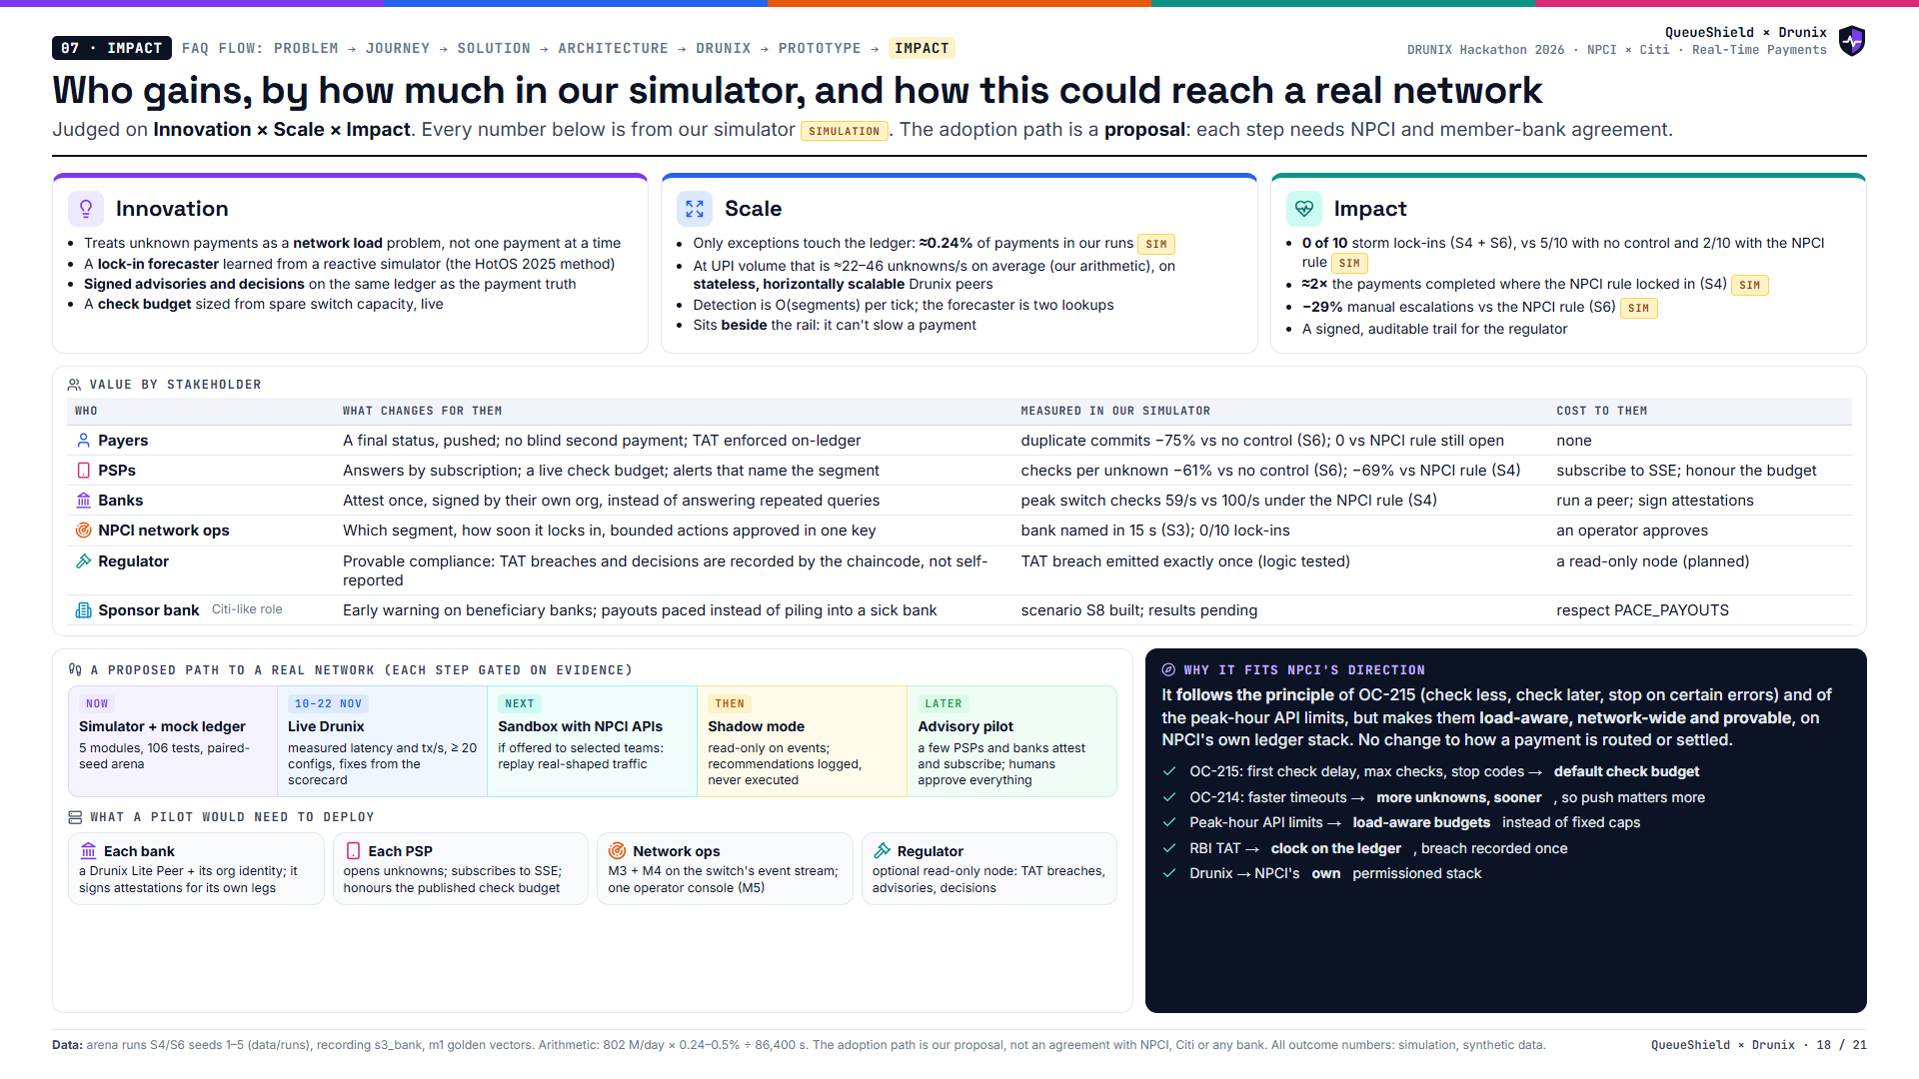
Notes:
Innovation: unknown payments as a network-level load problem, with a lock-in forecaster and signed decisions. Scale: only exceptions go on-chain. Impact, in our simulator: no storm lock-ins, about twice the completed payments where the NPCI rule locked in, and fewer manual escalations. The path to a real network is a proposal: shadow mode first, and humans approve everything.

Slide 19
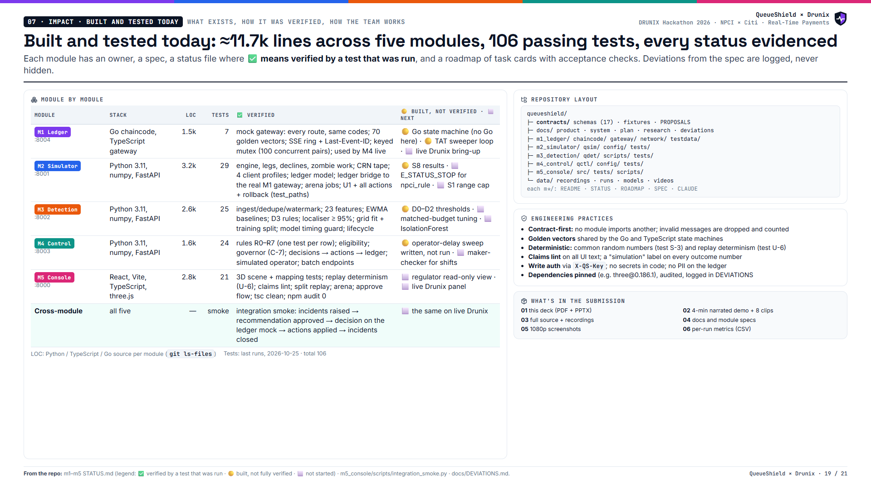
Notes:
This is the engineering state, evidenced. Five modules, about 11,700 lines, 106 tests passing. Every module's status file separates verified from merely built. The biggest unverified piece is the live Drunix network, because our dev machine has no Go or Docker.

Slide 20
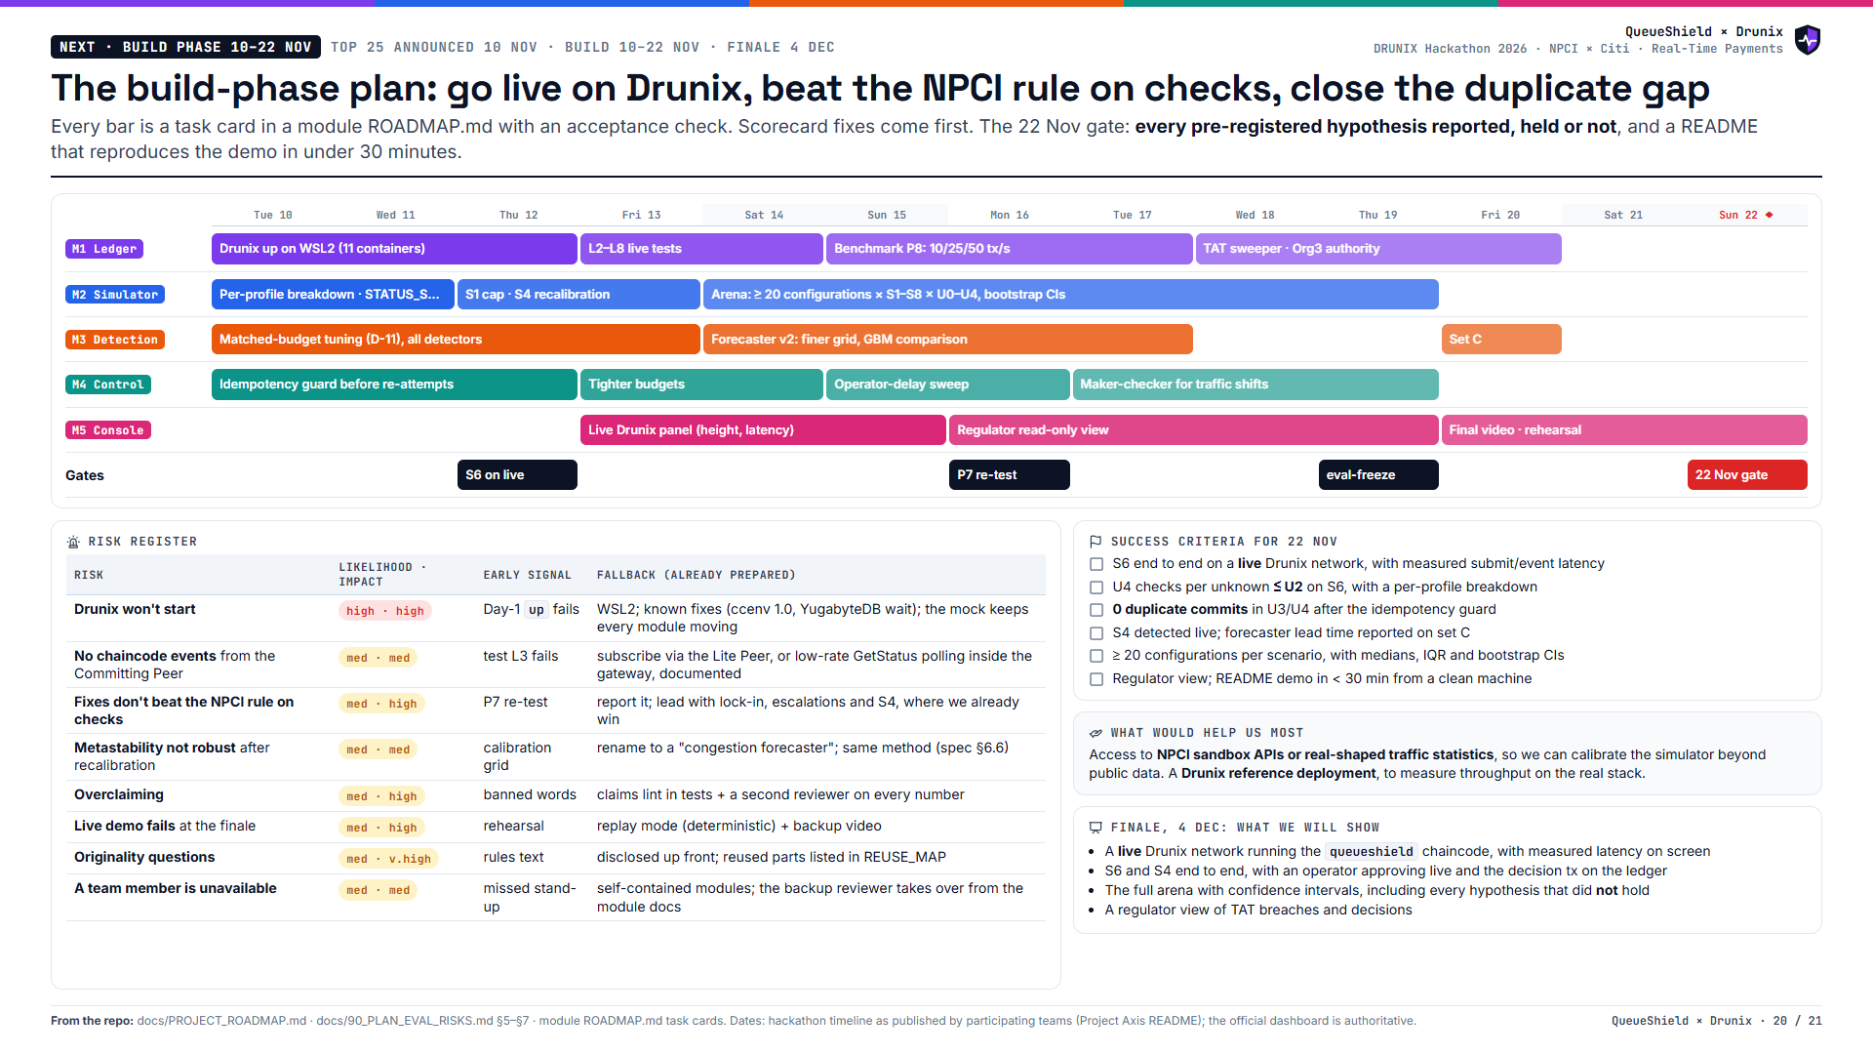
Notes:
The plan for the build phase. Bring up live Drunix first, then fix what the scorecard says: checks against the NPCI rule, duplicates, and S4 detection. Then scale the evaluation to at least 20 configurations with confidence intervals. The risks are known and each has a fallback ready.

Slide 21
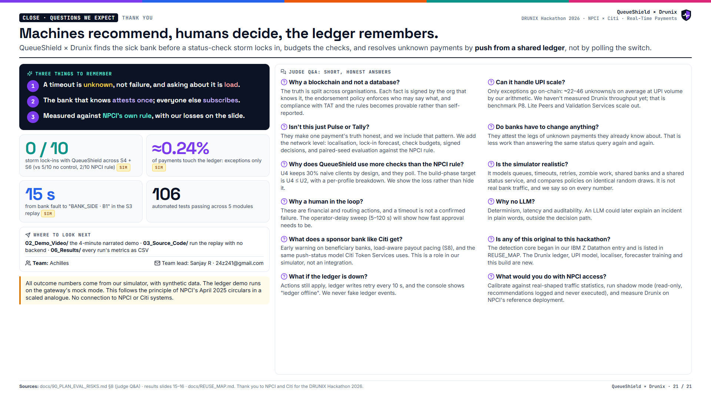
Notes:
Close on the one-liner: machines recommend, humans decide, the ledger remembers. Three things to remember. Then take questions; the likely ones are answered here.

