Slide 1
Parallelizing processes in R – What it means and how to do it
Matthew Dzievit
Rgronomist meeting
9/21/2018

Slide 2
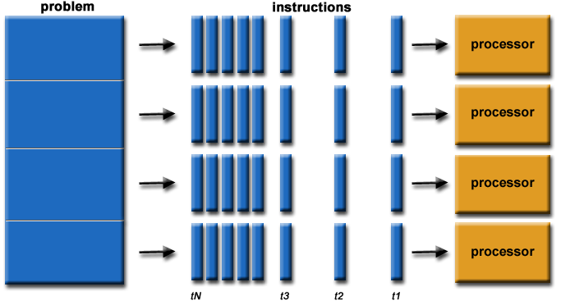
What is parallel computing?
Define your problem. What do you want to do?
Simulations w/ different parameters
Repeat some process over different inputs, sequence alignments, etc.
Define the set of instructions to repeat across input
Send an input and instructions to a processor to execute
Compile results
Image source: https://computing.llnl.gov/tutorials/parallel_comp/images/parallelProblem.gif

Slide 3
Simple example
A | B | C | D | E | F | G | H | I | J
96 | 38 | 19 | 73 | 31 | 19 | 68 | 49 | 92 | 39
20 | 16 | 34 | 98 | 46 | 34 | 77 | 82 | 94 | 2
30 | 67 | 4 | 65 | 79 | 19 | 100 | 5 | 7 | 50
88 | 100 | 46 | 82 | 81 | 11 | 31 | 22 | 6 | 55
3 | 58 | 86 | 23 | 64 | 28 | 45 | 51 | 11 | 84
22 | 76 | 57 | 55 | 70 | 5 | 71 | 57 | 10 | 57
67 | 19 | 93 | 57 | 46 | 12 | 1 | 89 | 94 | 85
Define problem:
- Large matrix of data points. Want to calculate the mean for each column and return a list of means
Send instructions:
- Summation of all values given, divide by total
Execute instructions:
- Execute mean function for each column (i) on a separate processor
Compile results
- Bind results from each processor into a list

Slide 4
How to do it
Code walkthrough
Check Rstudio version – update if necessary
Clone/download files
Check for required packages
Go through script and what it does
Run script line by line
Run script from command line to see the magic!

