Slide 2
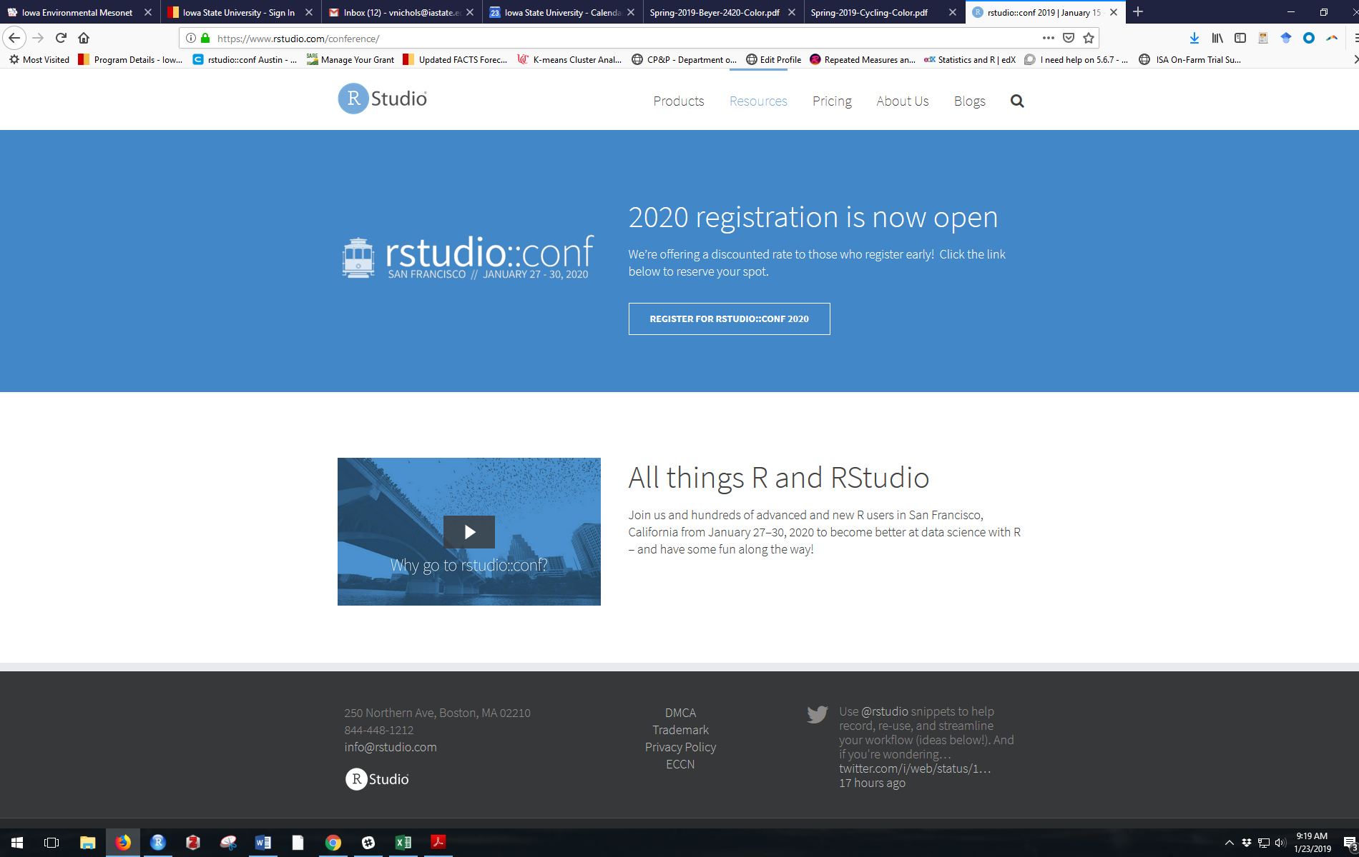
rstudio Workshop + Conference
It was great
1700 people
(in 2016 it was 200 people)
Fantastic food
Good scheduling
Diverse people

Slide 3
rstudio
50% development staff = open-source projects
50% = rstudio products
Lots of dudes ☹
But attendees were diverse!

Slide 4
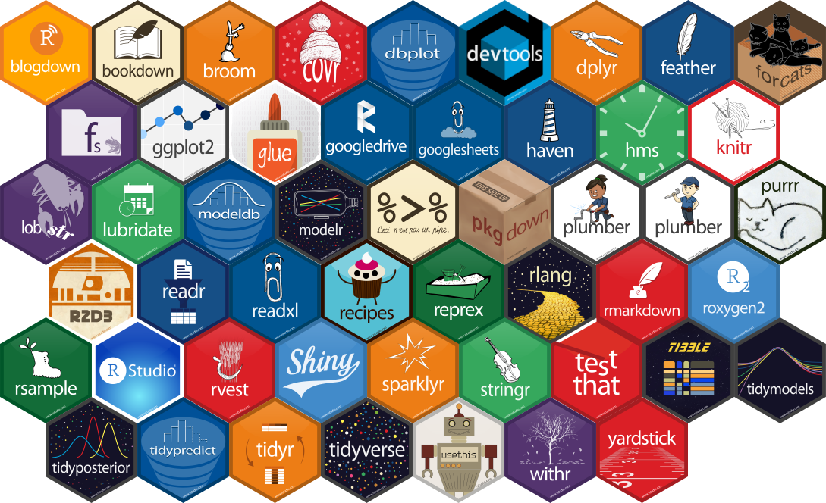
rstudio
50% development staff = open-source projects
50% = rstudio products

Slide 5
gt package for tables
gganimate for moving figures (updated package is completely different from old one, and is on CRAN)
here package for working directory things
https://malco.io/2018/11/05/why-should-i-use-the-here-package/
tidymodels package
Akin to the tidyverse, which loads a family of packages
rsample, recipes, caret, parsnip, yardstick, etc…
https://github.com/topepo/rstudio-conf-2019
rayshader package for elevation mapping

Slide 6
Felienne
@Felienne
Programmers can be snotty (Excel IS coding).
We have no idea how to teach coding.
Exploratory learning in coding doesn’t work.
Making you read your code out loud helps you learn it better

Slide 7
Brooke Watson, ACLU Analytics
The data we collect (and how we handle it) reflects our values
No central database to keep track of children separated from their parents at the border (?!?)

Slide 8
Reproducibility
Companies have it figured out.
Academia and the government, not so much.
Getting better!

