Slide 1
Some Take-aways From the 2019 rstudio conference
Gina Nichols
Jan 25 2019

Slide 2
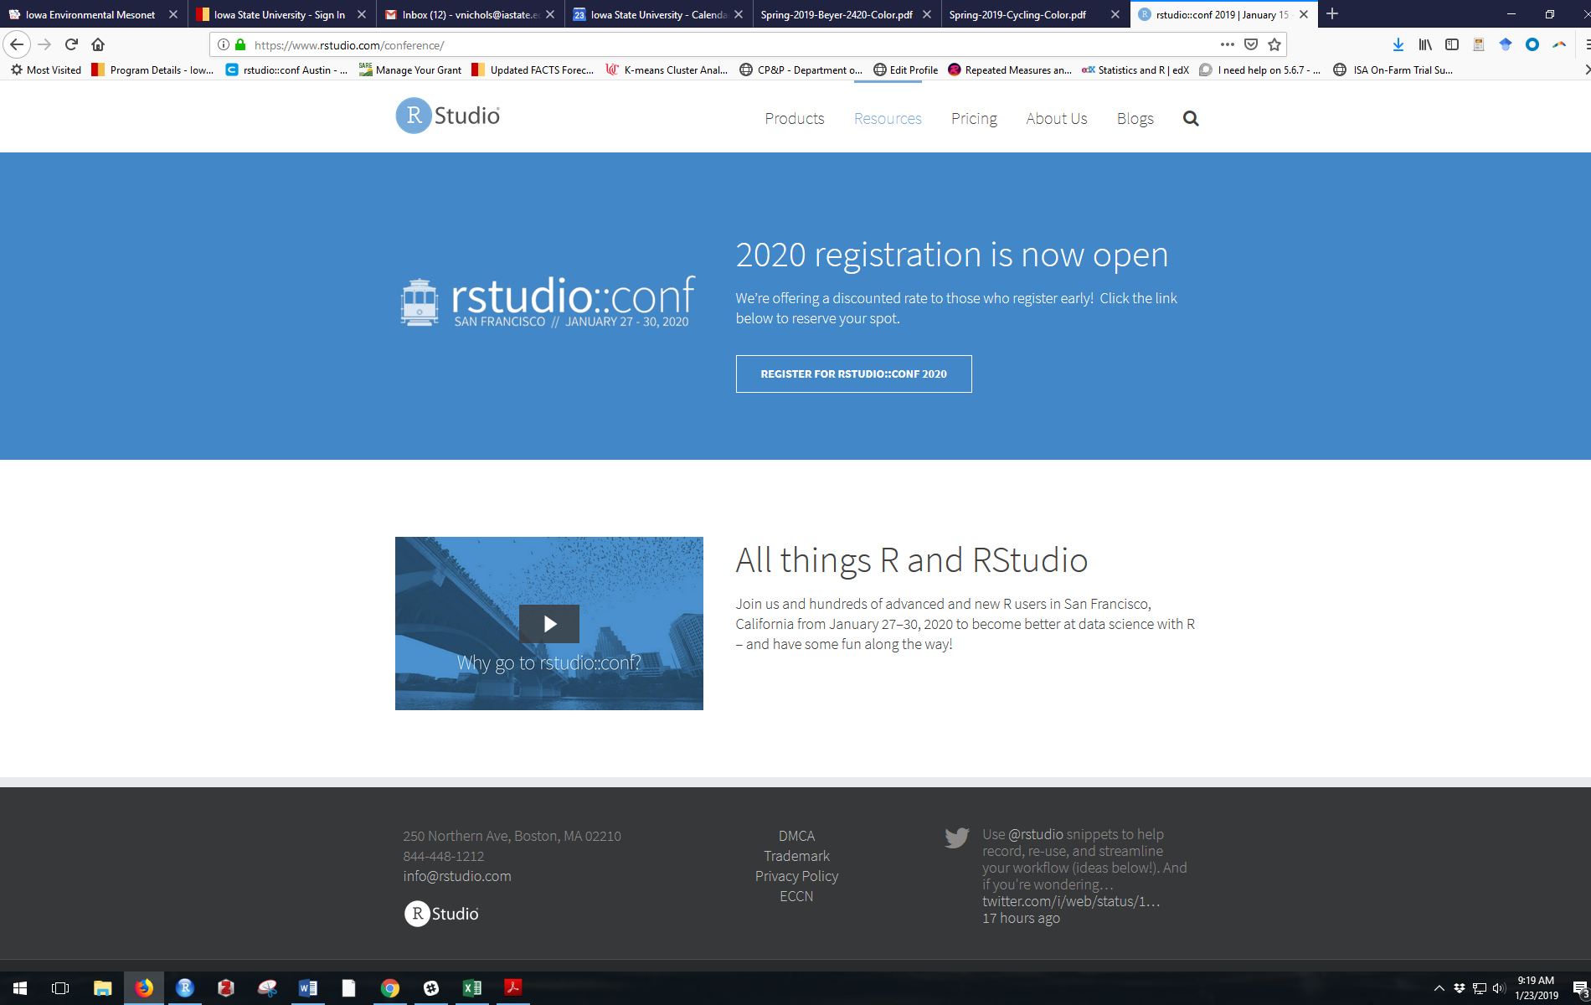
rstudio Workshop + Conference
It was great
1700 people
(in 2016 it was 200 people)
Fantastic food
Good scheduling
Diverse people

Slide 3
rstudio
50% development staff = open-source projects
50% = rstudio products
Lots of dudes ☹
But attendees were diverse!

Slide 4

Have you drank the tidyverse Koolaid?
You should.

Slide 5
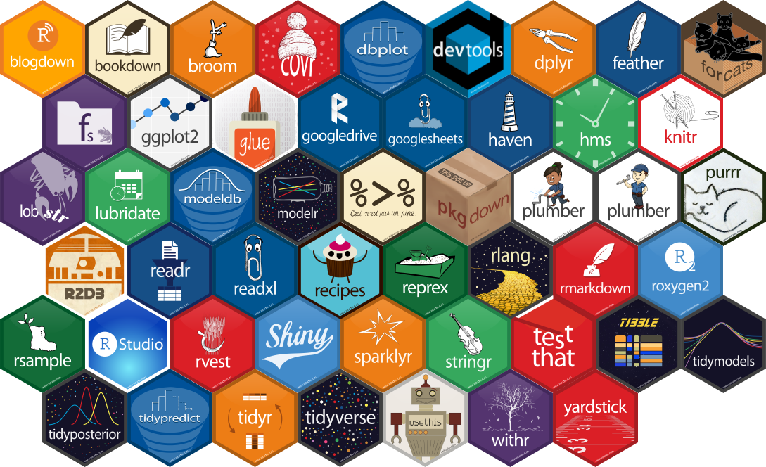
rstudio
50% development staff = open-source projects
50% = rstudio products

Slide 6
R for Data Science
Mutate
Summarise
Filter
Select
Group_by
%>%

Slide 7
Readability, reproducibility
dat %>%
mutate_if(is.numeric, log) %>%
filter(sex == “F”)
Versus
Dat2 <- log(dat[, (5:13)])
Dat3 <- subset(dat2, sex == “F”)

Slide 8
rstudio
50% development staff = open-source projects
50% = rstudio products

Slide 9
gt package for tables
gganimate for moving figures (updated package is completely different from old one, and is on CRAN)
here package for working directory things
https://malco.io/2018/11/05/why-should-i-use-the-here-package/
tidymodels package
Akin to the tidyverse, which loads a family of packages
rsample, recipes, caret, parsnip, yardstick, broom, etc…
In the github repo
rayshader package for elevation mapping

Slide 10
Split and do have fallen out of favor nest and map are preferred
dat %>%
group_by(crop, pos) %>%
nest() %>%
mutate( myres = map(data, myfun)) %>%
unnest()

Slide 11
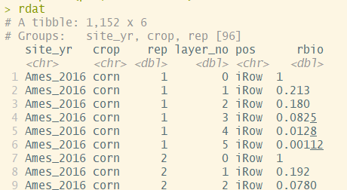
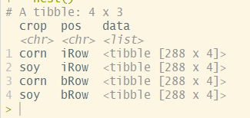
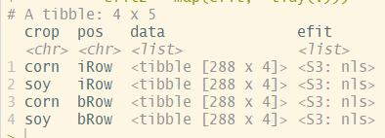
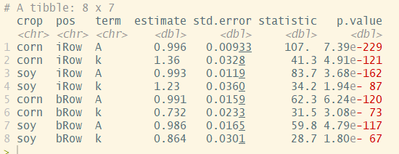
dat %>%
group_by(crop, pos) %>%
nest() %>%
mutate( myres = map(data, myfun)) %>%
unnest()

Slide 12
dat %>%
group_by(crop, pos) %>%
nest() %>%
mutate( myres = map(data, myfun)) %>%
unnest()

Slide 13
dat %>%
group_by(crop, pos) %>%
nest() %>%
mutate( myres = map(data, myfun)) %>%
unnest()

Slide 14
dat %>%
group_by(crop, pos) %>%
nest() %>%
mutate( efit = map(data, myfun)) %>%
unnest()

Slide 15
dat %>%
group_by(crop, pos) %>%
nest() %>%
mutate( efit = map(data, myfun)) %>%
unnest()

Slide 16

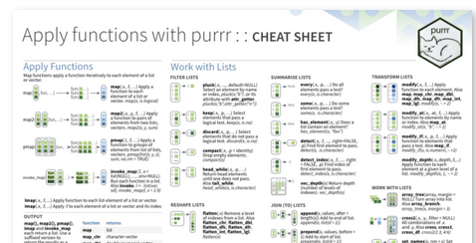
purrr package
Chapter 17 of R4DS book
Great cheatsheet
https://www.rstudio.com/resources/cheatsheets/

Slide 17
Felienne
@Felienne
Programmers can be snotty (Excel IS coding).
We have no idea how to teach coding.
Exploratory learning in coding doesn’t work.
Making you read your code out loud helps you learn it better

Slide 18
Brooke Watson, ACLU Analytics
The data we collect (and how we handle it) reflects our values
No central database to keep track of children separated from their parents at the border (?!?)

Slide 19
$500 for academics

