Slide 1
TypeScript

Slide 2
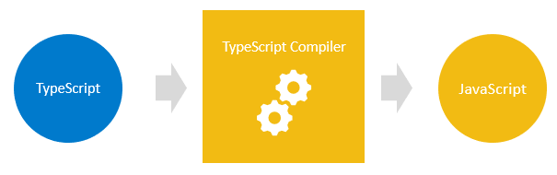
What is TypeScript?
TypeScript is a super set of JavaScript.
TypeScript builds on top of JavaScript.
First, you write the TypeScript code. Then, you compile the TypeScript code into plain JavaScript code using a TypeScript compiler.
Once you have the plain JavaScript code, you can deploy it to any environments that JavaScript runs.
TypeScript files use the .ts extension rather than the .js extension of JavaScript files.

Slide 3
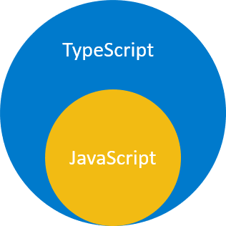
What is TypeScript?
TypeScript uses the JavaScript syntaxes and adds additional syntaxes for supporting Types.
If you have a JavaScript program that doesn’t have any syntax errors, it is also a TypeScript program. It means that all JavaScript programs are TypeScript programs. This is very helpful if you’re migrating an existing JavaScript codebase to TypeScript.
The following diagram shows the relationship between TypeScript and JavaScript:

Slide 4
Why TypeScript?
The main goals of TypeScript are:
Introduce optional types to JavaScript.
Implement planned features of future JavaScript, a.k.a. ECMAScript Next or ES Next to the current JavaScript.

Slide 5
TypeScript improves your productivity while helping avoid bugs
Types increase productivity by helping you avoid many mistakes.
By using types, you can catch bugs at the compile-time instead of having them occurring at runtime.
The following function adds two numbers x and y:
function add(x, y) {
return x + y;
}
If you get the values from HTML input elements and pass them into the function, you may get an unexpected result:
let result = add(input1.value, input2.value);
console.log(result); // result of concatenating strings
For example, if users entered 10 and 20, the add() function would return 1020, instead of 30.
The reason is that the input1.value and input2.value are strings, not numbers. When you use the operator + to add two strings, it concatenates them into a single string.

Slide 6
TypeScript improves your productivity while helping avoid bugs
When you use TypeScript to explicitly specify the type for the parameters like this:
function add(x: number, y: number) {
return x + y;
}
In this function, we added the number types to the parameters. The function add() will accept only numbers, not any other values.
When you invoke the function as follows:
let result = add(input1.value, input2.value);
… the TypeScript compiler will issue an error if you compile the TypeScript code into JavaScript. Hence, you can prevent the error from happening at runtime.

Slide 7
TypeScript brings the future JavaScript to today
TypeScript supports the upcoming features planned in the ES Next for the current JavaScript engines.
It means that you can use the new JavaScript features before web browsers (or other environments) fully support them.
Every year, TC39 releases several new features for ECMAScript, which is the standard of JavaScript.
The feature proposals typically go through five stages:
Stage 0: Strawperson
Stage 1: Proposal
Stage 2: Draft
Stage 3: Candidate
Stage 4: Finished
And TypeScript generally supports features that are in the stage 3.

Slide 8
Set up TypeScript
Install Node.js
https://nodejs.org/en/download/
Download the node.js version that suits your platform i.e., Windows, macOS, or Linux.
Execute the downloaded node.js package or execution file. The installation is quite straightforward.
Verify the installation by open the terminal on macOS and Linux or command line on Windows and type the command node -v. If you see the version that you downloaded, then you have successfully installed the node.js on your computer.
Install TypeScript compiler
npm install -g typescript
Check the current version of the TypeScript compiler
tsc --v
To install the ts-node module globally, you run the following command from the Terminal on macOS and Linux or Command Prompt on Windows:
npm install -g ts-node

Slide 9
Set up TypeScript
Install VS Code
https://code.visualstudio.com/download
Download the latest version of VS Code that suits your OS (Windows, macOS, or Linux)
Execute the downloaded package or the installer file to launch the setup wizard. The installation process is also quite straightforward.
Launch the VS Code.
Install the Live Server extension
Click the Extensions tab to find the extensions for VS Code.
Type the live server to search for it.
Click the install button to install the extension.

Slide 10
TypeScript “Hello, World!”
First, create a new folder to store the code, e.g., helloworld.
Second, launch VS Code and open that folder.
Third, create a new TypeScript file called app.ts. The extension of a TypeScript file is .ts.
Fourth, type the following source code in the app.ts file:
let message: string = 'Hello, World!';
console.log(message);
Fifth, launch a new Terminal within the VS Code by using the keyboard shortcut Ctrl+` or follow the menu Terminal > New Terminal
Sixth, type the following command on the Terminal to compile the app.ts file:
tsc app.ts
If everything is fine, you’ll see a new file called app.js is generated by the TypeScript compiler
To run the app.js file in node.js, you use the following command:
node app.js

Slide 11
TypeScript “Hello, World!” in Web Browser
First, create a new file called index.html and include the app.js as follows:
<!DOCTYPE html>
<html lang="en">
<head>
<meta charset="UTF-8">
<meta name="viewport" content="width=device-width, initial-scale=1.0">
<title>TypeScript: Hello, World!</title>
</head>
<body>
<script src="app.js"></script>
</body>
</html>
Second, change the app.js code to the following:
let message: string = 'Hello, World!';
// create a new heading 1 element
let heading = document.createElement('h1');
heading.textContent = message;
// add the heading the document
document.body.appendChild(heading);

Slide 12
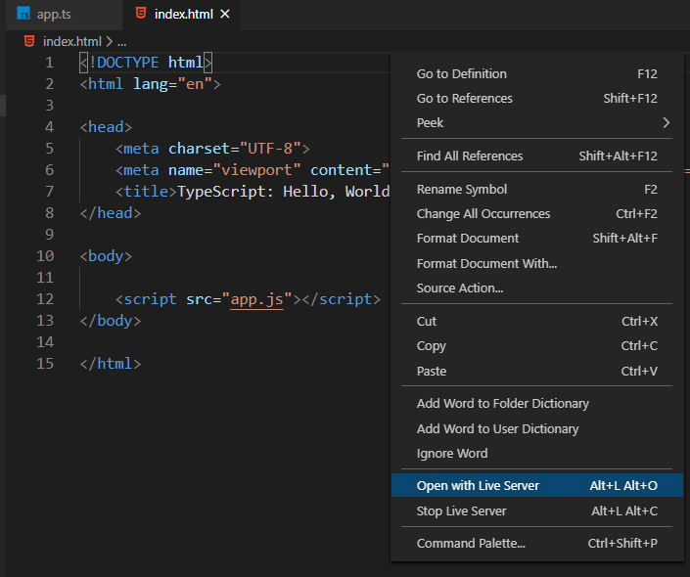
TypeScript “Hello, World!” in Web Browser
Third, compile the app.ts file:
tsc app.ts
Fourth, open the Live Server from the VS code by right-mouse click the index.html and select the Open with Live Server option:

Slide 13
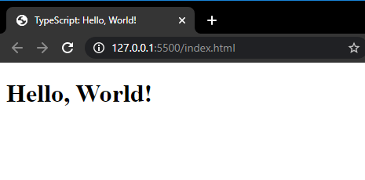
TypeScript “Hello, World!” in Web Browser
The Live Server will open the index.html with the following message:

Slide 14
Why TypeScript?
There are two main reasons to use TypeScript:
TypeScript adds a type system to help you avoid many problems with dynamic types in JavaScript.
TypeScript implements the future features of JavaScript a.k.a ES Next so that you can use them today.
Our focus is on the first reason.

Slide 15
Understanding dynamic type in JavaScript
JavaScript is dynamically typed.
Unlike statically-typed languages such as Java or C#, values have types instead of variables.
For example:
"Hello“
From the value, you can tell that its type is string.
Also, the following value is a number:
2022

Slide 16
Understanding dynamic type in JavaScript
See the following example:
let box;
box = "hello";
box = 100;
The type of the box variable changes based on the value assigned to it.
To find the type of the box variable at runtime, you use the typeof operator:
let box;
console.log(typeof(box)); // undefined
box = "Hello";
console.log(typeof(box)); // string
box = 100;
console.log(typeof(box)); // number
In this example, the first statement defines the variable without assigning a value. Its type is undefined.
Then, we assign "Hello" to box variable and show its type. The type of the box variable now changes to string.
Finally, we assign 100 to the box variable. This time, the type of the box variable changes to number.
As you can see, as soon as the value is assigned, the type of the variable changes.
And you don’t need to explicitly tell JavaScript the type. JavaScript will automatically infer the type from the value.
Dynamic types offer flexibility. However, they also leads to problems.

Slide 17
Problems with dynamic types
Suppose you have a function that returns a product object based on an id:
function getProduct(id){
return {
id: id,
name: `Awesome Gadget ${id}`,
price: 99.5
}
}
The following uses the getProduct() function to retrieve the product with id 1 and shows its data:
const product = getProduct(1);
console.log(`The product ${product.Name} costs $${product.price}`);
Output:-
The product undefined costs $99.5
It isn’t what we expected.
The issue with this code is that the product object doesn’t have the Name property. It has the name property with the first letter n in lowercase.
However, you can only know it until you run the script.
Referencing a property that doesn’t exist on the object is a common issue when working in JavaScript.

Slide 18
Problems with dynamic types
The following example defines a new function that outputs the product information to the Console:
const showProduct = (name, price) => {
console.log(`The product ${name} costs ${price}$.`);
};
And the following uses the getProduct() and showProduct() functions:
const product = getProduct(1);
showProduct(product.price, product.name);
Output:
The product 99.5 costs $Awesome Gadget 1
This time we pass the arguments in the wrong order to the showProduct() function. This is another common problem that you often have when working with JavaScript.
This is why the TypeScript comes into play.

Slide 19
How Typescript solves the problems of dynamic types
To fix the problem of referencing a property that doesn’t exist on an object, you do the following steps:
First, define the “shape” of the product object using an interface. Note that you’ll learn about the interface in a later tutorial.
interface Product{
id: number,
name: string,
price: number
};
Second, explicitly use the Product type as the return type of the getProduct() function:
function getProduct(id) : Product{
return {
id: id,
name: `Awesome Gadget ${id}`,
price: 99.5
}
}
When you reference a property that doesn’t exist, the code editor will inform you immediately:
const product = getProduct(1);
console.log(`The product ${product.Name} costs $${product.price}`);
The code editor highlighted the following error on the Name property:

Slide 20
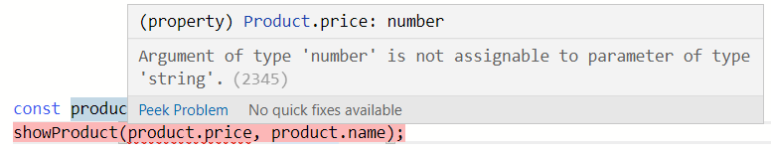
How Typescript solves the problems of dynamic types
To solve the problem of passing the arguments in the wrong order, you explicitly assign types to function parameters:
const showProduct = (name: string, price:number) => {
console.log(`The product ${name} costs ${price}$.`);
};
And when you pass the arguments of the wrong types to the showProduct() function, you’ll receive an error:
const product = getProduct(1);
showProduct(product.price, product.name);

Slide 21
Type Script types and their purposes

Slide 22
What is a type in TypeScript
TypeScript inherits the built-in types from JavaScript.
TypeScript types is categorized into:
Primitive types
Object types

Slide 23
Primitive Types
Name | Description
string | represents text data
number | represents numeric values
boolean | has true and false values
null | has one value: null
undefined | has one value: undefined. It is a default value of an uninitialized variable
symbol | represents a unique constant value

Slide 24

Object Types
Object types are functions, arrays, classes, etc. Later, you’ll learn how to create custom object types.
Purposes of types in TypeScript
There are two main purposes of types in TypeScript:
First, types are used by the TypeScript compiler to analyze your code for errors
Second, types allow you to understand what values are associated with variables.
Examples of TypeScript types
The following example uses the querySelector() method to select the <h1> element:
const heading = document.querySelector('h1’);
The TypeScript compiler knows that the type of heading is HTMLHeadingElement:

