Slide 1
MVC Design Pattern

Slide 2
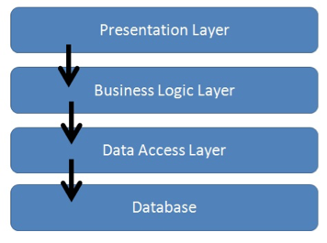
N-Tier Architecture
Divide applications into Presentation, Business, and Integration tiers
Control always in one direction to avoid cyclic dependencies
Often 3 tiers but can have more

Slide 3
N-Tier Discussion
Is N-Tier a good thing and when should it be used?
Where do stored procedures fit into this?
This topic can start major battles!

Slide 4
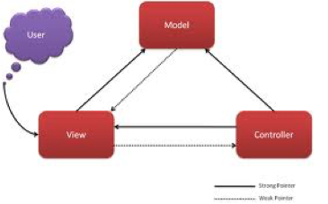
Model View Controller (MVC)
A pattern residing in the presentation tier
It decouples user interface components
There are variants on the theme
Let’s look at the components in turn

Slide 5
Model View Controller
The model represents the business data required to build the view
It can be tested in isolation
It is required to create and update the view
It is updated by the controller

Slide 6
Model View Controller
The view represents the display and user interaction
It is difficult to test in isolation—it is often kept very thin
It renders the model—it sometimes needs its own version of the model
It is created or updated by the controller

Slide 7
Model View Controller
The controller processes user interaction events and other updates
It can be tested in isolation—may require HTTP emulation
It updates the model
It creates or updates the view
The controller is often built using a framework—Struts, Spring MVC

Slide 8
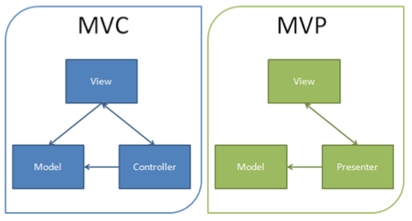
Model View Presenter (MVP)
The model view presenter completely decouples the model from the view
The presenter is decoupled from the view using an interface—allows the view to be mocked for test purposes

Slide 9
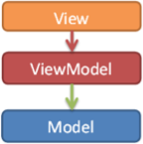
Model View ViewModel (MVVM)
MVVM is an MVC variant used by Microsoft
It is also used by AngularJS
The ViewModel is
An interface between model and view
Provides data binding between view and model data
It is also easier to test
Handles all UI actions

