Slide 1

OPTIMIZING RIDE-HAILING FARES WITH PREDICTIVE ANALYTICS
Advances in Data Science Architecture[INFO 7370]
Tanuj Verma (002726506)
Kumar Mehul (002761391)
Rhea Bajpai (002702927)
Krutik Kanakia (002787847)

Slide 2



Significance and Goals
Business Optimization
Operational Efficiency
Customer Satisfaction
Enhanced dynamic fare management for increased profitability and competitive advantage
Insights from the model inform better resource allocation and route optimization
Greater transparency in fare calculation boosts customer trust and retention

Slide 3

Project Outline
Data Preprocessing and Exploration
Feature Engineering
Exploratory Data Analysis (EDA)
Interactive Dashboard Development
Conclusion and Reporting
Brownie Points Integration
Future Directions

Slide 4

Dataset Features
key: Unique identifier for each trip, derived from ride timestamps or generated hashes.
fare_amount: Total fare charged, serving as the target variable for prediction.
pickup_datetime: Start date and time of the ride, key for analyzing fare trends.
pickup_longitude: Longitude of the pickup point, crucial for location-based analysis.
pickup_latitude: Latitude of the pickup point, determines the ride's starting location.
dropoff_longitude: Longitude of the drop-off point, aids in calculating travel distances.
dropoff_latitude: Latitude of the drop-off point, completes the route data for analyses.
passenger_count: Count of passengers, affects fare due to different pricing for passenger numbers.

Slide 5
Packages Used
Data Handling
NumPy: Numerical operations
Pandas: Data manipulation
SciPy: Advanced computations
Visualization Tools
Matplotlib & Seaborn: Plotting and statistical charts
GeoPandas & Contextily: Geospatial data analysis and map overlays
Plotly Express: Interactive graphs
Machine Learning Frameworks
Scikit-learn: Preprocessing, modeling, and metrics
XGBoost: Gradient boosting framework
Statsmodels: Statistical modeling
Interactive Applications
Dash: Web application framework for Python
Utility Libraries
Datetime: Managing dates and times
TQDM: Progress bars for loops
Geopy: Geocoding services
Configuration
Matplotlib.rcParams: Pre-set for plot dimensions
Warnings: Hide or show warning messages

Slide 6
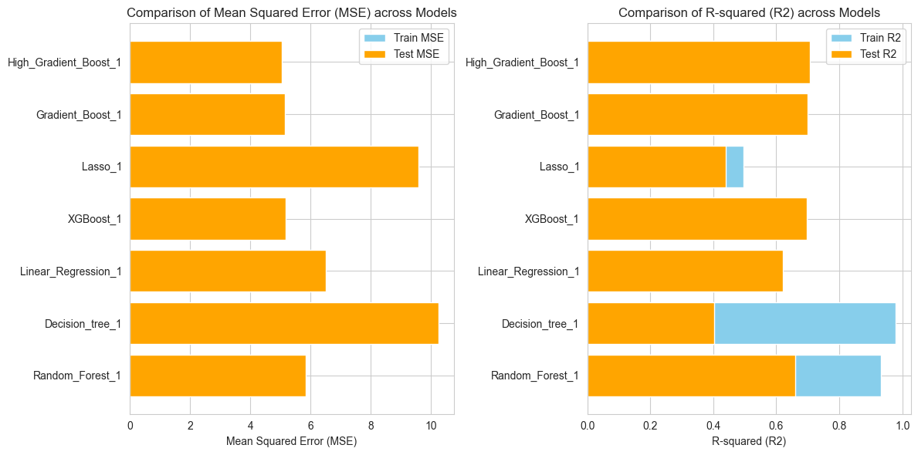
Comparison of Algorithms

Slide 7
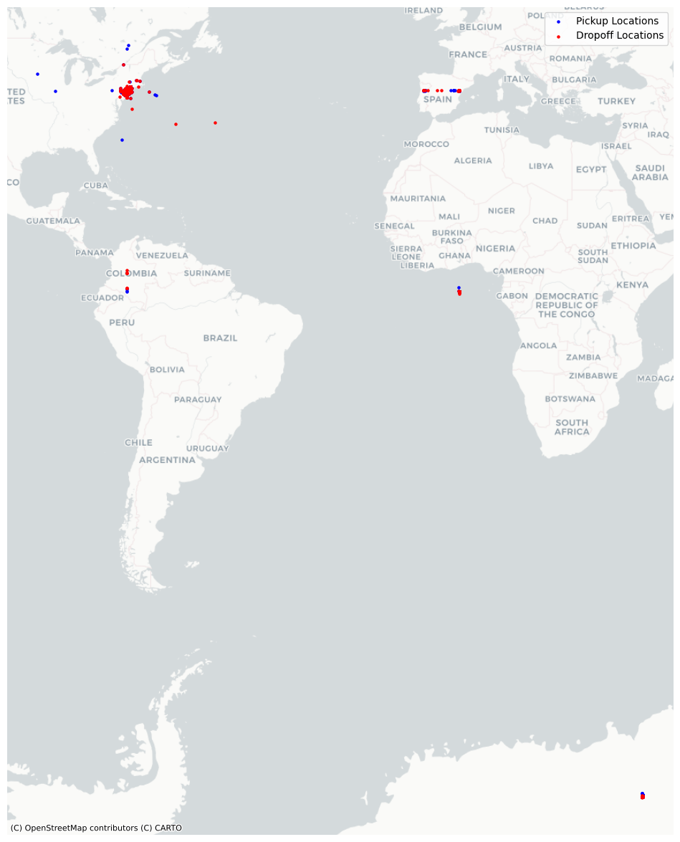
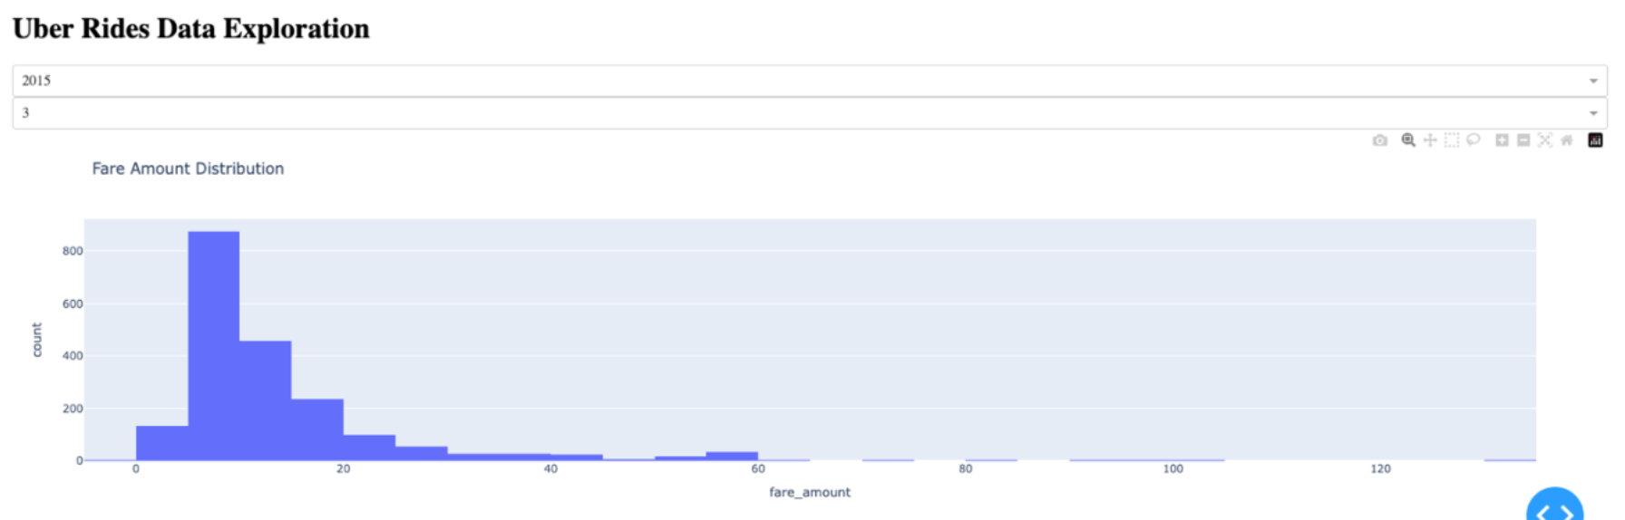
Brownie Points
Geographic Visualization using Folium
Interactive Dashboard

Slide 8

Conclusion
Model Performance on Test Data: The Gradient Boost and High Gradient Boost models demonstrate the best performance on the test set, with the lowest Mean Squared Error (MSE) of approximately 5.03 and 5.06 respectively, and the highest R-squared (R2) scores of about 0.705 and 0.704. These metrics indicate that these models are likely to perform well with new, unseen data.
Overfitting Analysis: There is evidence of overfitting in the Random Forest and Decision Tree models, shown by a larger discrepancy between training and testing MSE values (train MSE of around 4.17 and 4.29 versus test MSE of about 5.12 and 5.36, respectively). In contrast, the Gradient Boost models have a more consistent performance between training and testing datasets, suggesting they are better at generalizing without overfitting.
Balance Between Bias and Variance: The Linear Regression and Lasso models exhibit high bias, as indicated by the highest test MSEs (6.51 and 6.64, respectively) and the lowest test R2 values (approximately 0.62 for both), which points to potential underfitting. On the other hand, the XGBoost, Gradient Boost, and High Gradient Boost models show a good balance between bias and variance, performing well on both training and testing sets. This is reflected in their lower MSE and higher R2 values, indicating a better predictive ability without overfitting or underfitting.
Thank You!

