Slide 1

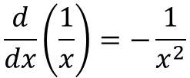
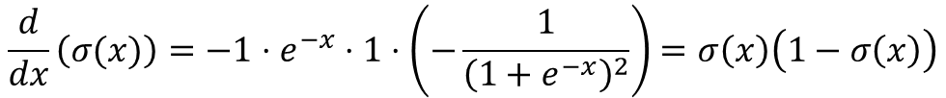


-1
1
$$\frac{d}{dx}\left(e^{x}\right)=e^{x}$$
x
*
exp
+
1/x
$$\frac{d}{dx}\left(−x\right)=−1$$
$$\frac{d}{dx}\left(x+1\right)=1$$
$$\frac{d}{dx}\left(\frac{1}{x}\right)=−\frac{1}{x^{2}}$$
$$\frac{d}{dx}\left(σ(x)\right)=−1⋅e^{−x}⋅1⋅\left(−\frac{1}{{\left(1+e^{−x}\right)}^{2}}\right)=σ\left(x\right)\left(1−σ\left(x\right)\right)$$

Slide 2
