Slide 1

AIRTEL SYNC 2026 · TRACK A · PROJECT UDYAM DIGITAL
Your business online, in one sitting.
A phone-first advisor, one transparent price, 30-second KYC and a live tracker for India's MSMEs, in their own language.
Team Kernel
Thapar Institute of Engineering & Technology (TIET)
Notes:
Traces to docs/PROBLEMS.md: Cover. Team Kernel, TIET.

Slide 2

Only 7.4% activate: leads leak before the first call and at the quote
FUNNEL, APR–JUN 2026 · % OF PREVIOUS STAGE
17.6 days
₹20k vs ₹2.5k
Leads
5,000
Contacted
3,406 68%
lead → activation; install alone takes 10–14 days
cost to win a micro shop vs its monthly bundle: field sales loses money
Needs assessed
1,974 58%
Quote accepted
861 44%
KYC complete
588 68%
6% → 28%
68 of 368
Activated
368 63%
6-month churn at 1 vs 5 “where is my order?” calls (3 on average)
past activations broke a catalogue or GST rule (22 on cancelled GSTINs)
Quote-stage drops: price too high 414 · competitor cheaper 207 · too complex 206 · too slow 179.
GSTIN matters: 9.6% activate with one vs 2.0% without.
TODAY'S JOURNEY
Rep visits, pitches this month's target
3–5 days for a PDF of product codes
KYC on paper or email
10–14 day install, 3–4 chase calls
Separate bills and helplines per product
›
›
›
›
Notes:
Traces to docs/PROBLEMS.md: Problem and data: C1–C8, D1–D4.

Slide 3
Lead with professional offices; serve micro shops without a visit
1 · BEACHHEAD
2 · VOLUME
3 · VALUE
4 · ASSISTED
Professional offices
Micro retail & services
Small multi-site
Small manufacturers
25% of base · clinics, CA firms
11.1% conversion · ₹10.7k CAC
55% of base · kirana, salon
4.1% conversion · ₹20.0k CAC
15% of base · 3–10 outlets
11.0% conv. · ₹28k median bill
5% of base · auto-parts, textile
12.8% conversion · 8.1% churn
Channel: 100% self-serve
Channel: Self-serve + partner assist
Channel: Advisor → field sales
Channel: Advisor → field / partner
Biz Fibre 300
Cloud Email ×5 + Backup 1 TB
Endpoint Security ×5
Biz Fibre 100 + Cloud POS
No GSTIN needed, ≈ micro median
+ SIM + WhatsApp: ₹4,440
Per site: Fibre 300 + failover
SD-WAN + CCTV + POS
One bill for 4 outlets
Textile unit, 40 workers:
Leased Line 100 + Machine IoT ×5
Endpoint Security ×12
₹4,712 /mo incl. GST
₹2,476 /mo incl. GST
₹34,904 /mo incl. GST
₹44,879 /mo incl. GST
12-month price from the rules engine
24-mo: ₹4,198 · ready in ~5 days
12-month price from the rules engine
24-mo: ₹2,181 · ready in ~5 days
12-month price from the rules engine
24-mo: ₹32,780 · ready in ~14 days
12-month price from the rules engine
24-mo: ₹44,525 · ready in ~30 days
VS. THE ALTERNATIVES AN OWNER HAS TODAY
Local reseller
Cheap, nearby; one product each, no single bill or support number
Single-product digital sign-up
Instant, but one product, no advice, no bundle or GST-aware KYC
Accel field sales (today)
Advice, but 17.6 days, ₹15k per activation, 3 chase calls
Udyam Digital
Advice + bundle + one bill, priced instantly on a phone, in 10 languages
Notes:
Traces to docs/PROBLEMS.md: Segments and bundles: Q1, D2, D3.

Slide 4
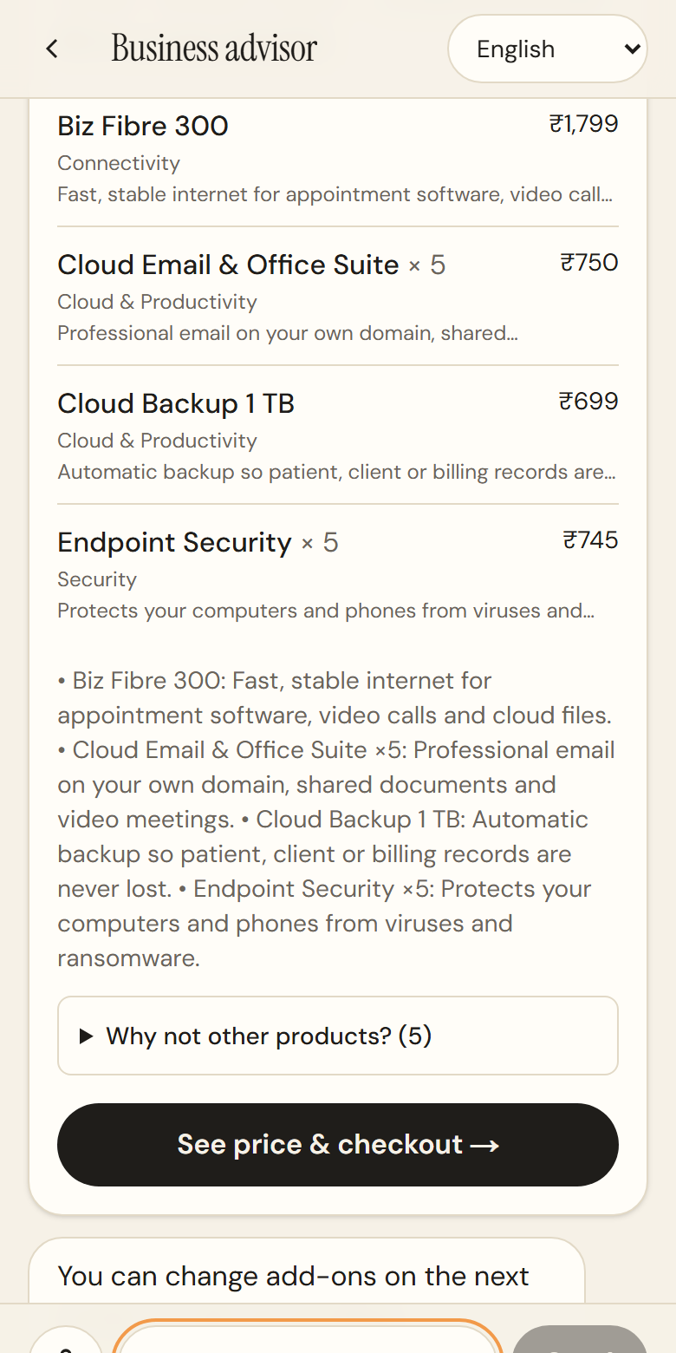
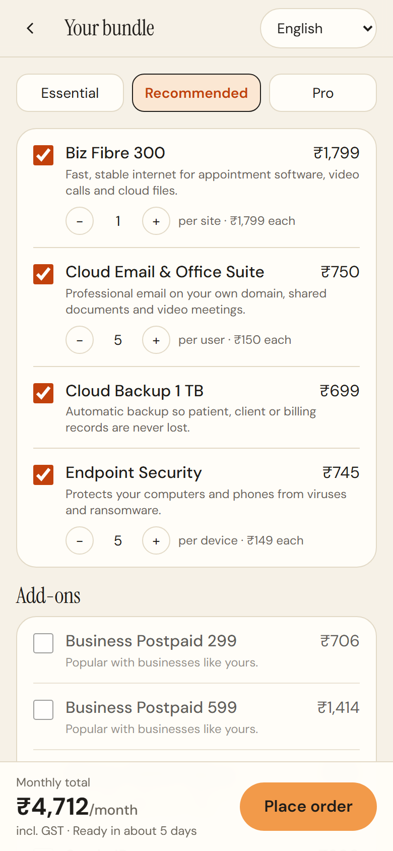
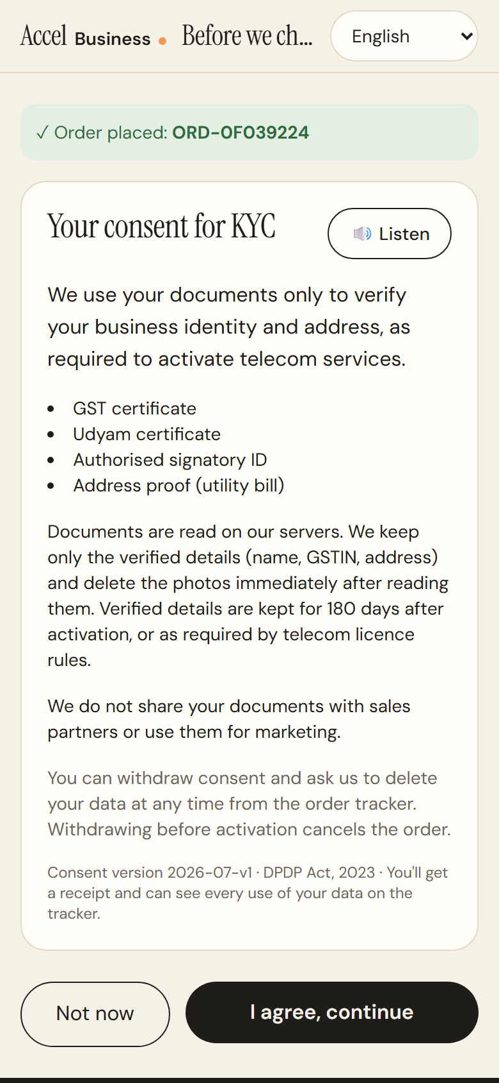
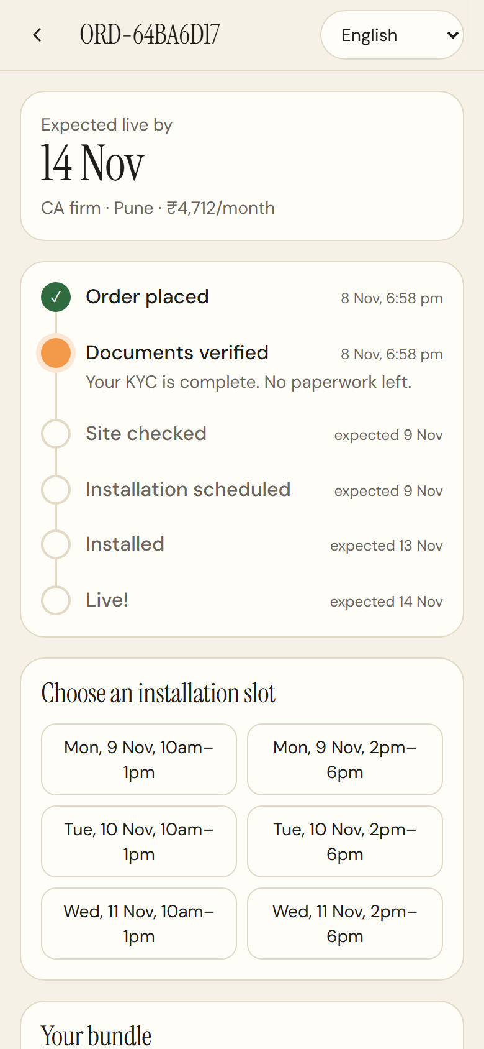
One sitting on a phone: advise, price, verify, track
BUILT ✓ Advisor ✓ Quote & checkout ✓ Smart KYC ✓ Tracker STRETCH ✓ Voice & WhatsApp ✓ Back-office ✓ Propensity score 16/16 advisor test scenarios
01 Advise
02 Price
03 Verify
04 Track
10 languages, voice and WhatsApp. Asks only what's missing (3 turns on average); the rules engine picks the bundle.
One GST-inclusive monthly price. Toggle add-ons and 12/24/36 months; re-priced live, re-validated on order.
DPDP consent read aloud, then a receipt. GSTIN lookup, OCR, DigiLocker and e-Sign; 12 of 12 specimen verdicts right.
Dated stages from install times, a self-booked slot and WhatsApp updates instead of chase calls. One bill after.
Notes:
Traces to docs/PROBLEMS.md: Journey and prototype: Q2, Q3, B1–B4, S1.

Slide 5
The LLM talks, code decides, and the field gets a better brief
N1
Fact guard
N2
Data passbook
N3
Recovery playbook
LLM: “Only ₹1/month + a free laptop!” ✕ blocked
Receipt
CR-ORD-64BA6D17-C12E5904
“Price too high” → 36-month re-quote
₹3,679/mo ₹1,033 less, same bundle
Owner sees: ₹4,712/month incl. GST ✓ engine
Purpose
KYC verification only
Kept until
2027-05-13 · live + 180 days
Every LLM sentence is checked against the engine's output; an untraced ₹ amount, product or “discount” falls back to the template.
Consent receipt hashed to the exact notice, listen-aloud consent, and a log of every access. Zero photos stored; one tap withdraws.
Each lost lead gets an engine-priced offer and a call brief in the owner's language: re-quote, DigiLocker link or AirFiber, by drop reason.
Tested: invented prices (Hindi digits too), unlisted products and promos are blocked; the owner sees the engine's line.
Tested: receipt hash matches the notice shown, retention runs from activation, withdraw wipes the fields.
Tested: every drop reason in smb_leads.csv maps to a play; every call-list row carries an engine-priced offer.
FIELD FORCE AND PARTNERS: DIGITAL FEEDS THEM, NOT REPLACES THEM
A REAL BRIEF FROM THE BACK-OFFICE
Field sales: multi-site (6+ outlets) and manufacturers, with the advisor's profile and brief.
Channel partners: micro shops via partner mode on the owner's phone; partner keeps credit.
Telesales: everyone else, ranked by a propensity model (hold-out AUC 0.73).
Self-serve absorbs ~1,950 leads lost to unreachable numbers and unscheduled visits.
CA firm, Pune · saw offer, didn't buy · score 62
Re-quote on a 36-month contract: same bundle at ₹3,679/month incl. GST, ₹1,033 less than the 12-month quote.
Priced by the engine, so a rep can't promise a price the rules wouldn't give.
Notes:
Traces to docs/PROBLEMS.md: Novelty and field force: N1–N3, Q4, S2, S3, D5.

Slide 6
Architecture and privacy, by design
Principle: the LLM talks, deterministic code decides price, eligibility and KYC verdicts
DPDP Act 2023, built in
CHANNELS
FASTAPI CORE
DATA & SERVICES
Consent you can prove: receipt with notice hash, purpose, retention date.
Purpose-limited: KYC only; never shared with partners or used for marketing.
Minimised: GSTIN pre-fill and DigiLocker; raw images never stored.
Masked: GSTIN, Udyam and ID numbers in UI, API and logs.
Transparent: owner sees every access; one tap withdraws and deletes.
Accurate: checksum, registry status, cross-document and 90-day checks.
AI-safe: the LLM never sets price or eligibility; the fact guard logs every blocked reply.
Phone PWA (Next.js)
Advisor dialogue + NLU
product_catalogue.csv
N1 Fact guard
smb_leads.csv
WhatsApp Cloud API
Rules & pricing engine
GSTIN / Udyam registry (mock)
Partner mode
Smart KYC · DigiLocker · e-Sign
Orders & tracker · coverage
LLM, optional (OpenAI-compatible)
Back-office
SQLite: fields only, masked log
Propensity · N3 recovery · audit
DATA FLOWS
1
Advise: chat or voice → NLU builds the profile → engine prices the bundle → fact guard checks the reply
2
Verify: consent receipt → OCR or DigiLocker → registry checks → verdict; photo dropped
3
Track: order → plan from catalogue install days → tracker and WhatsApp update at every stage
4
Recover: lost lead → propensity score + N3 engine-priced brief → back-office call list
SCALES BY SWAPPING MOCKS FOR INDIA STACK RAILS
Stateless API behind a load balancer · Postgres with row-level security · GSTN via a GSP · DigiLocker & Aadhaar e-Sign · Bhashini for 22 languages · UPI AutoPay
Notes:
Traces to docs/PROBLEMS.md: Architecture and privacy: E2, E4.

Slide 7
Conservatively, activations double and cost per activation falls 64%
Metric | Today | Simulated* | Target
Lead → activation | 7.4% | 15.6% | ≥ 12%
Cost per activation | ₹15,053 | ₹5,499 | ≤ ₹6,000
Days to activate | 17.6 | 8.6 | ≤ 9
Status chases / customer | 3.0 | 2.0 | ≤ 1
6-month churn | 15.2% | 14.3% | ≤ 10%
Rollout
0–3 mo
Pilot: professional offices, 2 tier-1 cities, web + WhatsApp, real GSTN via a GSP, DigiLocker.
3–9 mo
Scale: micro via 200 channel partners on partner mode; Hindi + 4 regional languages; UPI AutoPay.
6–12 mo
Assist: multi-site and manufacturers; advisor qualifies, field closes with the brief.
Risks covered: wrong price live (engine + fact guard + 16 QA scenarios), KYC fraud (DigiLocker, registry checks), channel conflict (partner attribution), no fibre (AirFiber re-plan).
*Impact simulator, conservative preset: each fix recovers a share of the matching drop reasons in smb_leads.csv; recovered leads convert at today's later-stage rates. Days = bundle install time + same-day KYC (today's 10–14 days include queueing).
Targets: conversion and CAC are pilot gates set inside the conservative case; chases and churn are tracker goals read from the data (1 chase → 5.9% churn).
Explore the code & implementation →
github.com/RheaSinghal/airtel
Backend, frontend, 63 tests and full docs
Ask: a 3-month pilot with professional offices in Pune and Bengaluru, gated on ≥ 12% conversion and ≤ ₹6k CAC.
Prize: annual bundle revenue from 5,000 leads a quarter grows from ₹18.5 cr to ₹39.6 cr.
Notes:
Traces to docs/PROBLEMS.md: Business case and metrics: Q5, E3.

