Slide 1
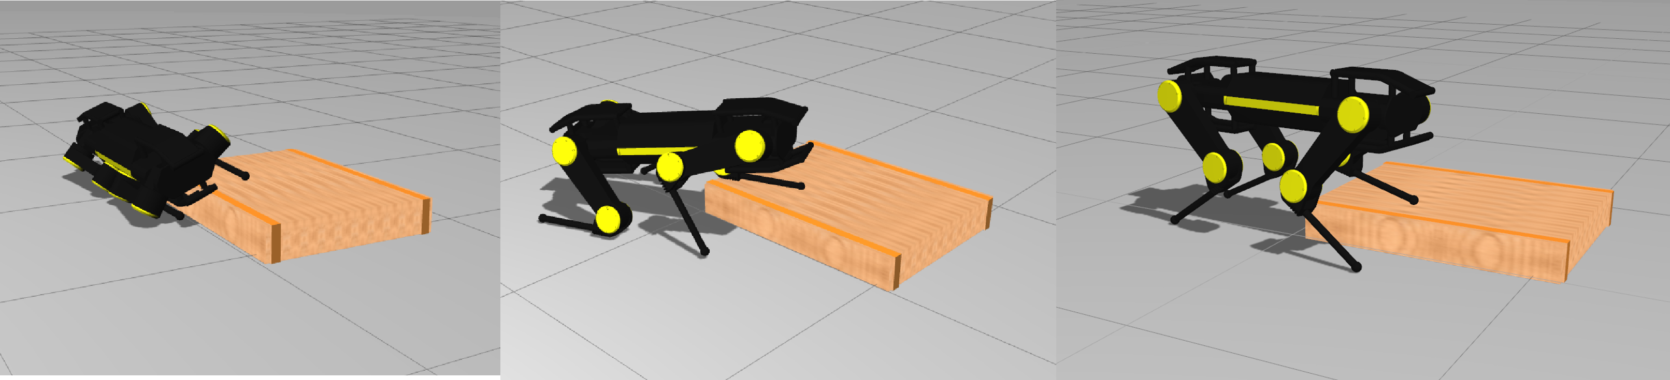
Whole-body Trajectory Optimization for
Non-periodic Dynamic Motions
on Quadrupedal Systems
A. Radulescu^{1,} I. Havoutis^{2,3}, D. G. Caldwell¹ , C. Semini¹
¹Department of Advanced Robotics, Istituto Italiano di Tecnologia, Italy
²Robot Learning and Interaction, Idiap Research Institute, Switzerland
³Oxford Robotics Institute, Department of Engineering Science, University of Oxford, UK
Whole body optimization methodology for non-periodic dynamic movements
Trajectory solutions involve multiple contacts, without any predefined feet placement heuristics (e.g., contact points, timing or order of succession)
Realistic simulation of the hydraulically actuated HyQ2Max quadruped for rearing and posture recovery task

