Slide 1
RWS 290
Creating Professional
Business Presentations
presentation strategy | slide design | delivery
Matt Feigner
1

Slide 2
RWS 290
Common Business Presentation Pitfalls
• Too much material on the slide
• Slides compete with the speaker
• Weak organization and transitions
• Delivery problems: volume, pacing, filler words, notes
• Robotic performance or no audience contact
2

Slide 3
RWS 290
Why Presentation Matters
“
As much time as college-educated workers spend writing, they generally spend more in oral communication.
Paul Anderson, “What Research Tells Us About Writing at Work.”
3

Slide 4
RWS 290
Four Development Tips for RWS 290
1
Outline the presentation
2
Prepare basic text slides
3
Prepare visuals
4
Craft and practice the performance
4

Slide 5
RWS 290
1. Outline the Presentation
Start with structure before you start building slides.
5

Slide 6
RWS 290
Outline the Presentation
• Use the report structure as the foundation
• Focus on the background and the factors you will discuss
• End with recommendations supported by research
• Decide who owns each section before building the deck
6

Slide 7
RWS 290
2. Prepare Basic Text Slides
Slides should support the speaker, not replace the speaker.
7

Slide 8


RWS 290
Text Slide Example: Cut the Noise
ORIGINAL
REDESIGN
Condense the slide to the essential ideas and make the main point visible.
8

Slide 9
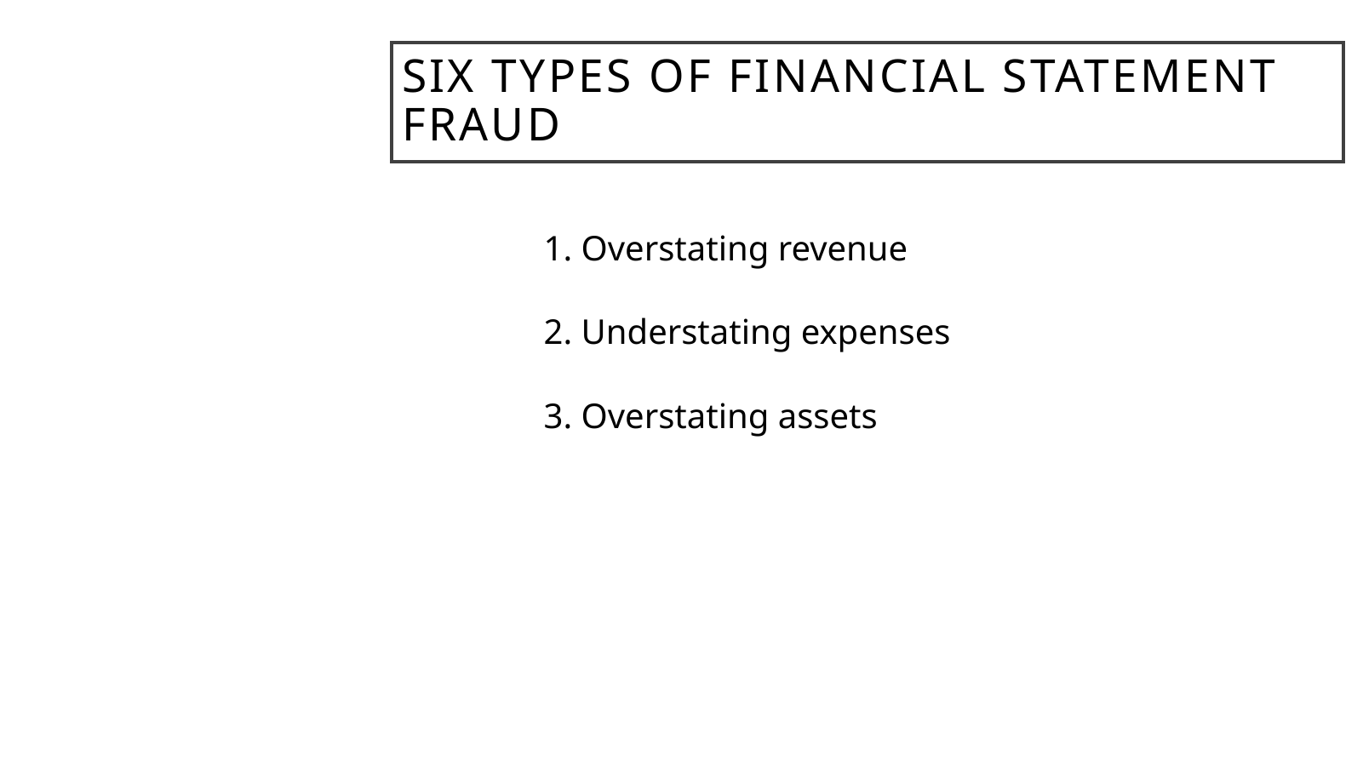
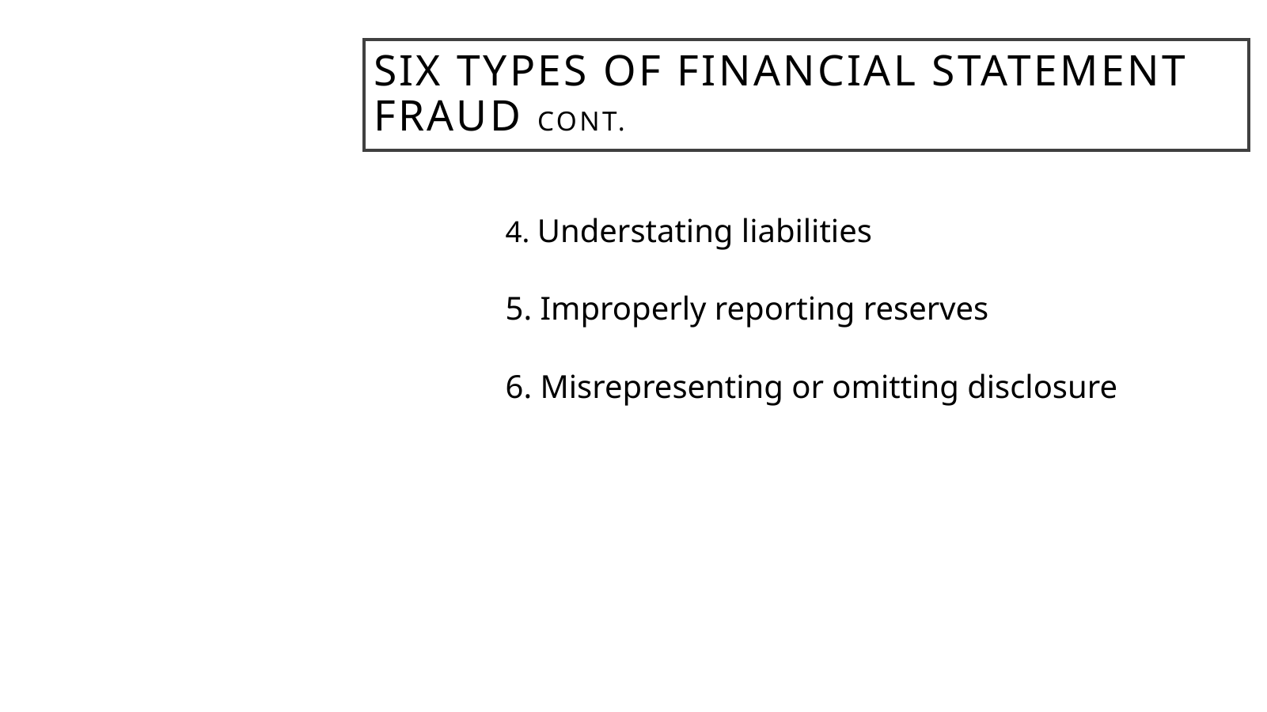
RWS 290
Text Slide Example: Split Crowded Content
SLIDE 1
SLIDE 2
If one slide has too much material, split it into a controlled sequence.
9

Slide 10

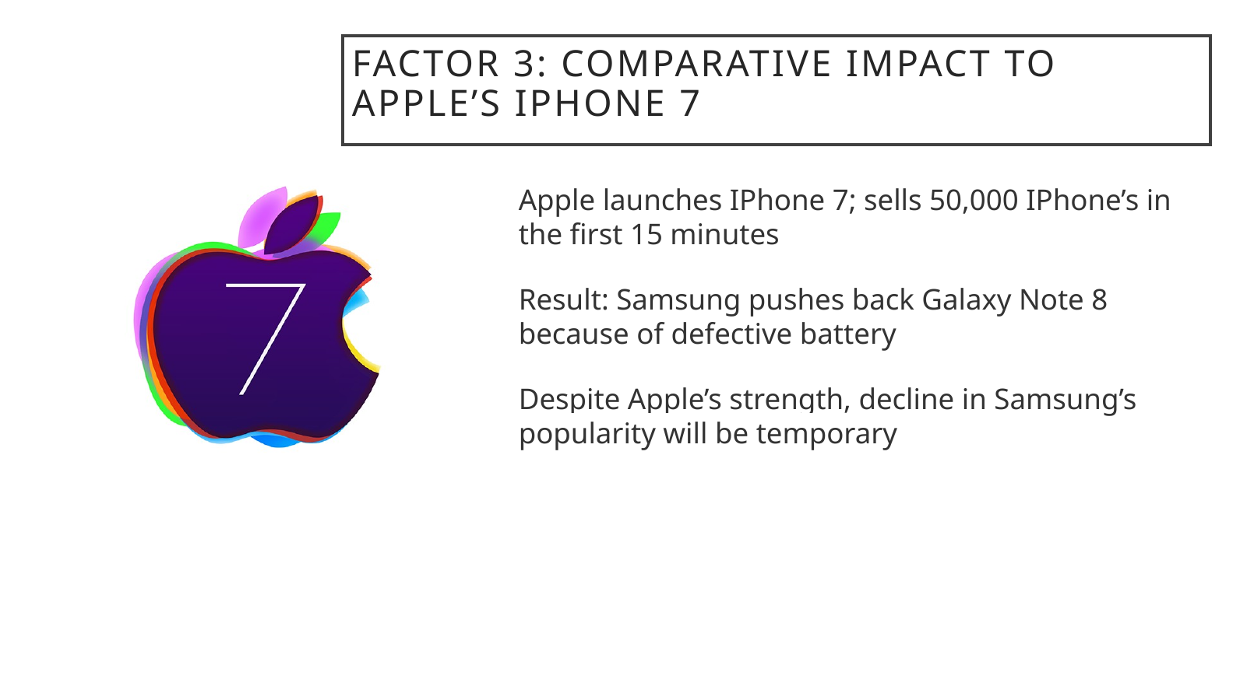
RWS 290
Text Slide Example: Edit the Sentence
ORIGINAL
REDESIGN
Convert sentence-heavy slides into short, speaker-friendly claims.
10

Slide 11
RWS 290
Preparing Basic Text Slides: Summary
Understand the relationship between background, text color, and text size.
Keep text to a minimum: split crowded slides or combine thin ones.
Edit bullets to their essential elements.
The audience should be listening, not reading.
11

Slide 12
RWS 290
3. Prepare Slides with Visuals
Visuals should clarify the point, not decorate the slide.
12

Slide 13
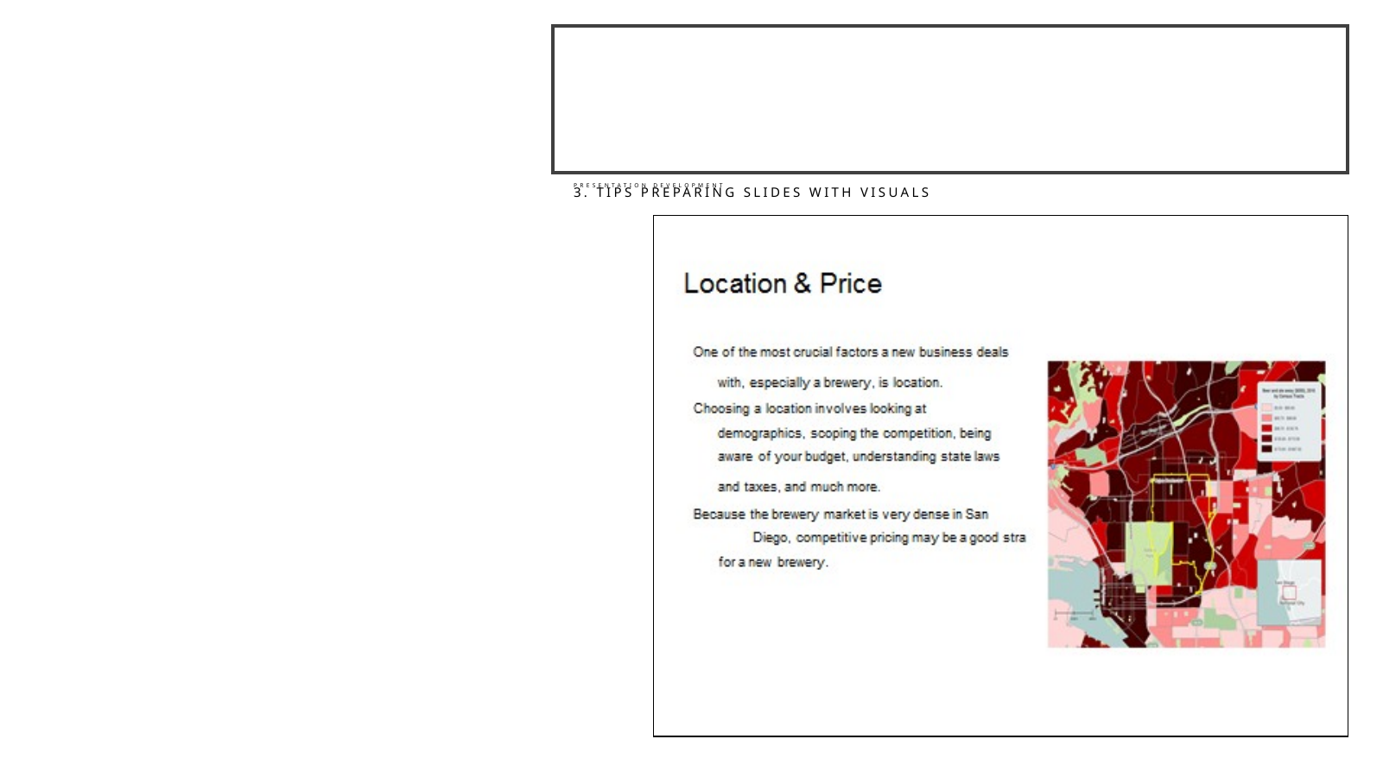

RWS 290
Visual Example: Explain the Important Image
ORIGINAL
REVISION
Introduce and interpret important visuals so the audience knows what to see.
13

Slide 14

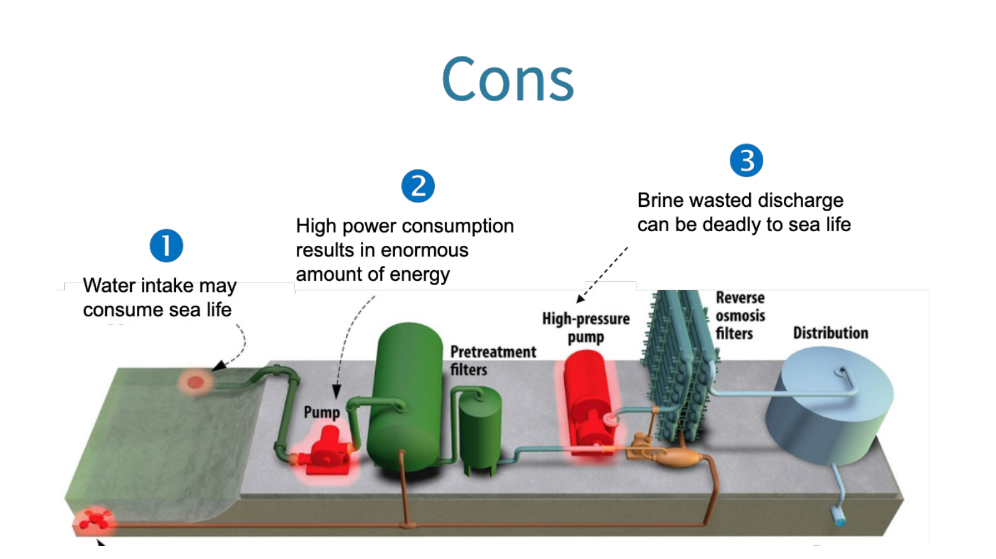
RWS 290
Visual Example: Connect Text to the Image
ORIGINAL
REVISION
When the visual carries the evidence, link the text directly to the visual.
14

Slide 15


RWS 290
Visual Example: Remove Visual Clutter
ORIGINAL
REVISION
Delete graphics that do not support the point.
15

Slide 16
RWS 290
Preparing Slides with Visuals: Summary
Explain or interpret important visuals on the slide itself.
Make sure visuals are integrated into the text.
Avoid overusing visuals: do not crowd the slide.
Visuals should supplement the speaker and the slide text.
16

Slide 17
RWS 290
4. Craft and Practice the Performance
Planning the deck is not the same thing as preparing the presentation.
17

Slide 18
RWS 290
Craft and Practice the Performance
• Visualize the presentation from beginning to end
• Crafting means rehearsing and revising
• Practice creates familiarity
• Familiarity creates confidence
18

Slide 19
RWS 290
Managing Presentation Style
Problem
What to do instead
Project confidence
Practice the material and dress in a way that supports professional confidence.
Do not read slides
Use slides as cues; the explanation comes from the speaker.
Use eye contact
Look at the audience before you begin and throughout the presentation.
Control voice
Slow down, breathe, articulate, and speak to the back of the room.
Cut filler words
Avoid “um,” “like,” “you know,” and other noise in the signal.
19

Slide 20
RWS 290
Using Nervousness: Before the Presentation
• Know the opening especially well
• Prepare physically: food, water, breathing, sleep
• Keep water nearby
• Remember that the audience is not a monolithic mass
20

Slide 21
RWS 290
Using Nervousness: During the Presentation
• Do not announce that you are nervous
• Move naturally and point to the slide when useful
• Slow down when nerves push your pace
• Remember: no one knows your project better than you
21

Slide 22
RWS 290
Student Presentation Pitfalls
Taken from prior RWS 290 presentation evaluations.
• Spoke too softly or too quickly
• Stood in front of the screen
• Spent too much time on the introduction
• Seemed robotic or unprepared
• Slides had visible mistakes
22

Slide 23
RWS 290
The Point
Your slides should make the presentation easier to hear, not harder to survive.
23

