Slide 1
Jungle Adventure
Ruby Terminal Program

Slide 2
Introduction
Project overview:
Simple text-based RPG adventure game
Originally going to be fantasy based but changed to jungle theme to be less serious and more humorous
The game involves navigating around a map and interacting with randomly selected elements, trying to find the exit

Slide 3
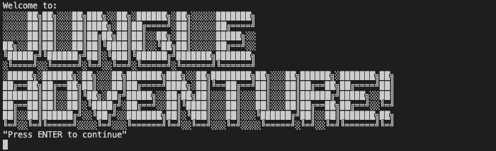
Walk-through P1

Slide 4
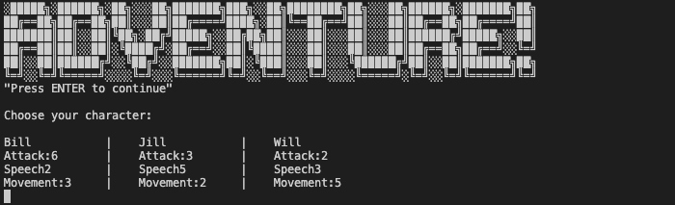
Walk-through P2
3 separate characters with differing stats

Slide 5
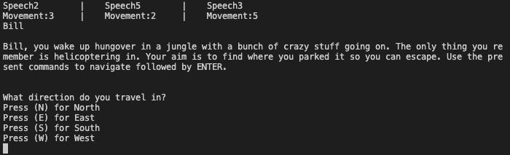
Walk-through P3
Setting text followed by direction prompt

Slide 6
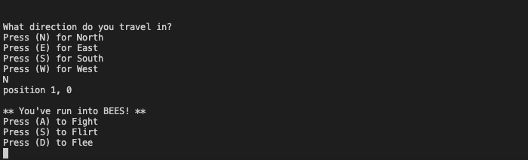
Walk-through P4
Randomly selected enemy interaction followed by the 3 stat based interaction options

Slide 7
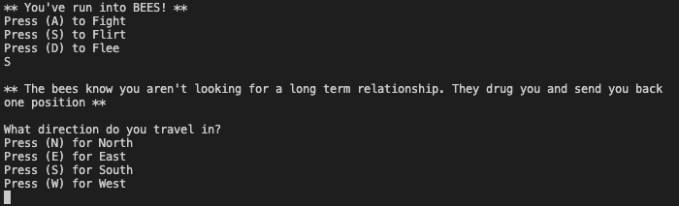
Walk-through P5
Depending on stat comparison, text based outcome presented

Slide 8
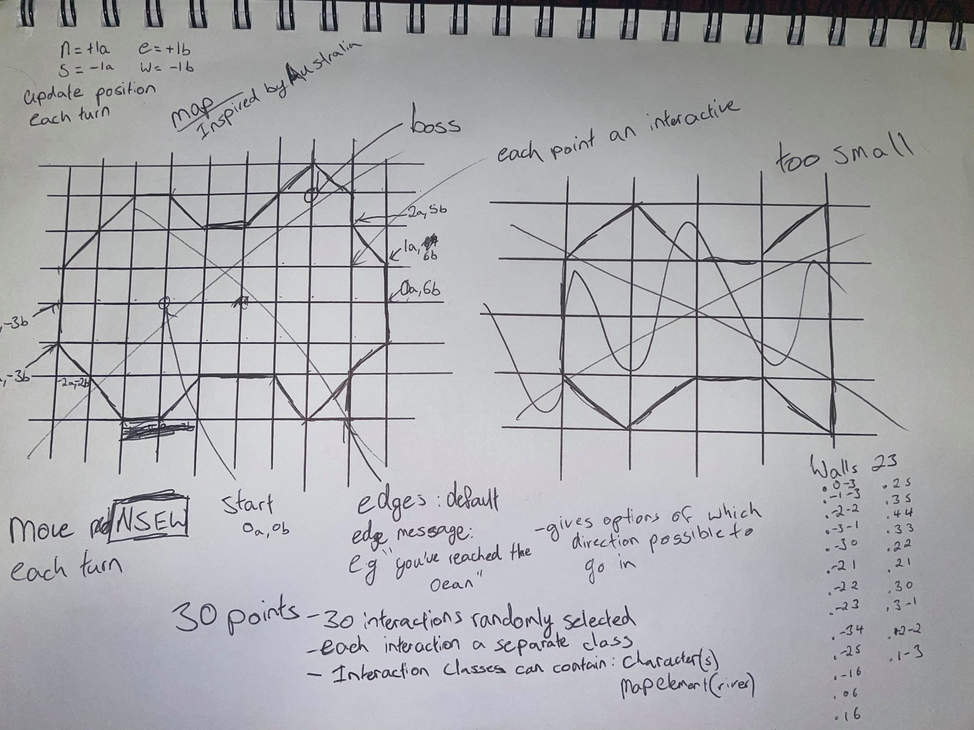
Logic and development
Map based on “x” and “y” variables
“x” and “y” interacted with throughout program
If N
y += 1
If S
y += -1

Slide 9
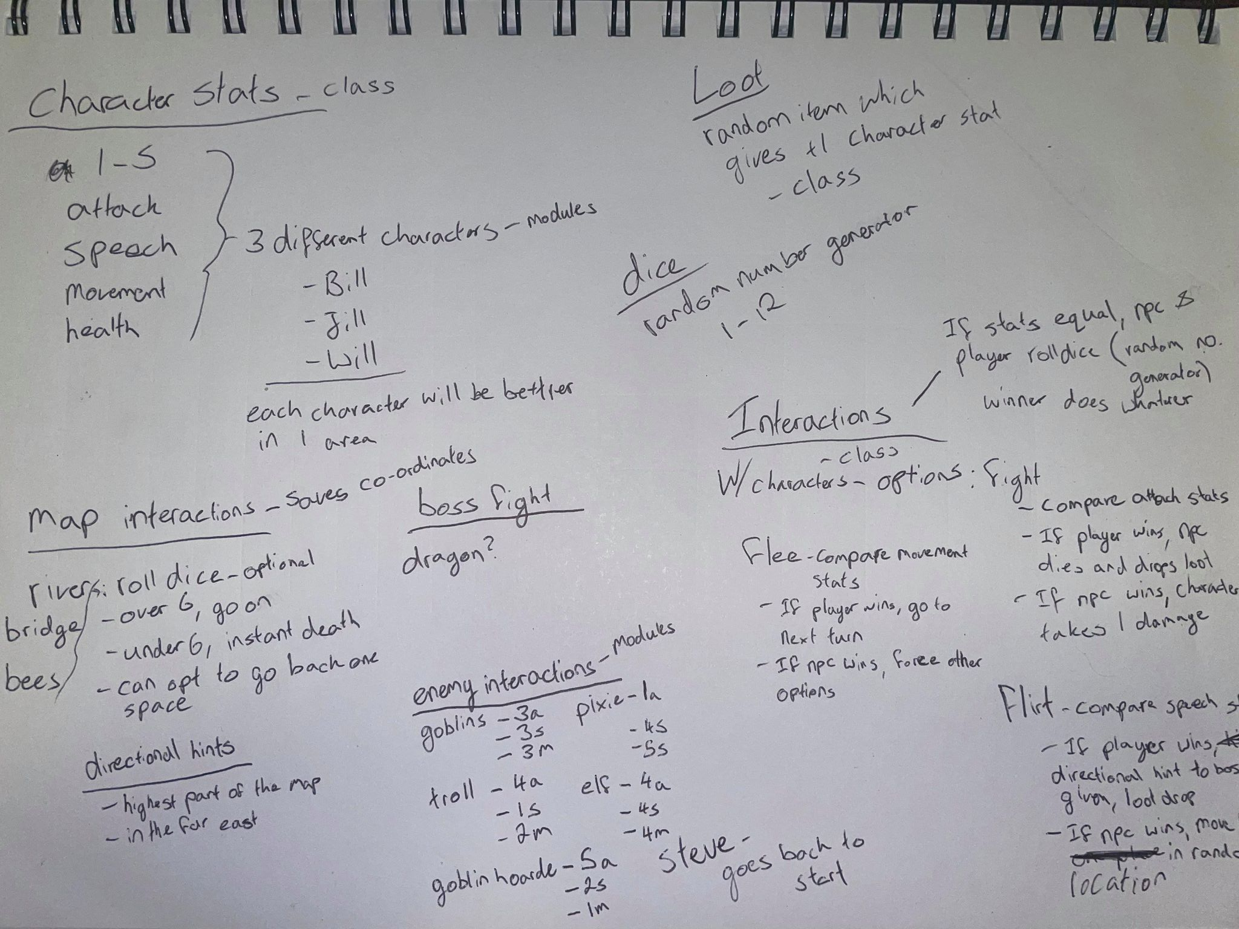
Logic and development
Character class with their stats
Array with the 3 different characters
Interactions class with stats and text based interactions
Array with at least 3 different interactable elements

Slide 10
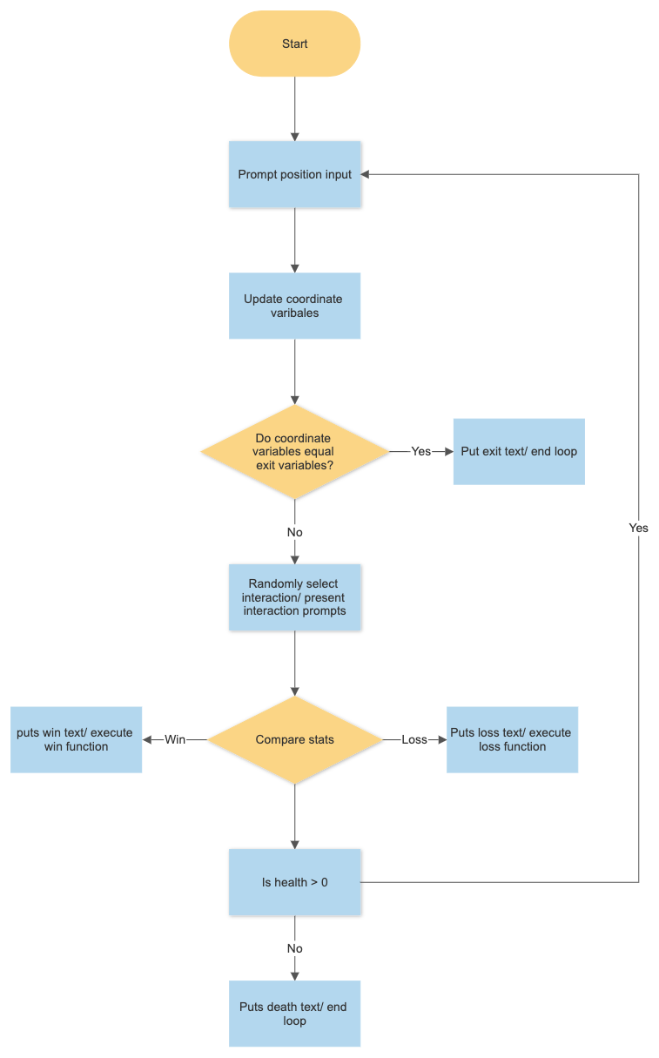
Logic and development
Control flow:

Slide 11
Challenges/ favorite parts
Challenges
The whole project
Challenging to get the first interaction working, then all the others are rinse and repeat
Favourite parts:
Text interactions which enables engaging humor
Developing the navigation and the map

Slide 12
To-do
Fix small bugs in program
Add gems, particularly TTY::prompt to make the prompts look better
Add other interactable elements

Slide 13
Thanks for listening!

