Slide 1
Project Assignment 2
BiteSize
Muhammad Warrad , Rhett Hill

Slide 2
DDL QUERIES
Instructions:
- must include ALL queries listed in Queries.sql
- must follow the exact format provided in the template slide

Slide 3
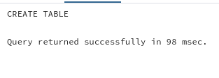
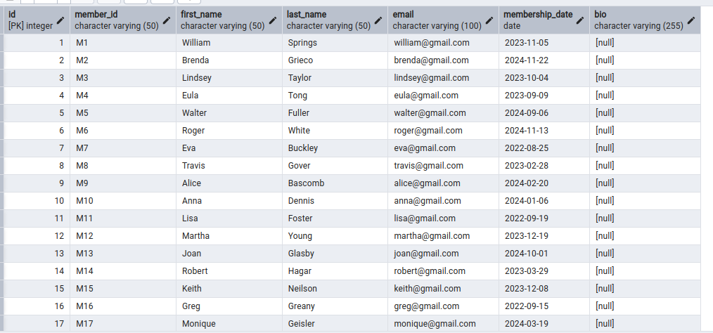
Q1 CreateMemberTable
Snapshot of the query output:
Description: Creates a table to store library member information, such as ID, name, email, and membership date, with a default value for the join date and a unique member ID. This supports tracking member accounts. DDL
SQL Query:
CREATE TABLE Member ( id Serial PRIMARY Key, member_id VARCHAR(50) UNIQUE NOT NULL, first_name VARCHAR(50), last_name VARCHAR(50) NOT NULL, email VARCHAR(100) UNIQUE, membership_date DATE DEFAULT CURRENT_DATE, Bio VARCHAR(255) );

Slide 4
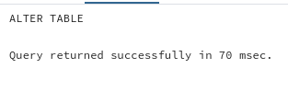
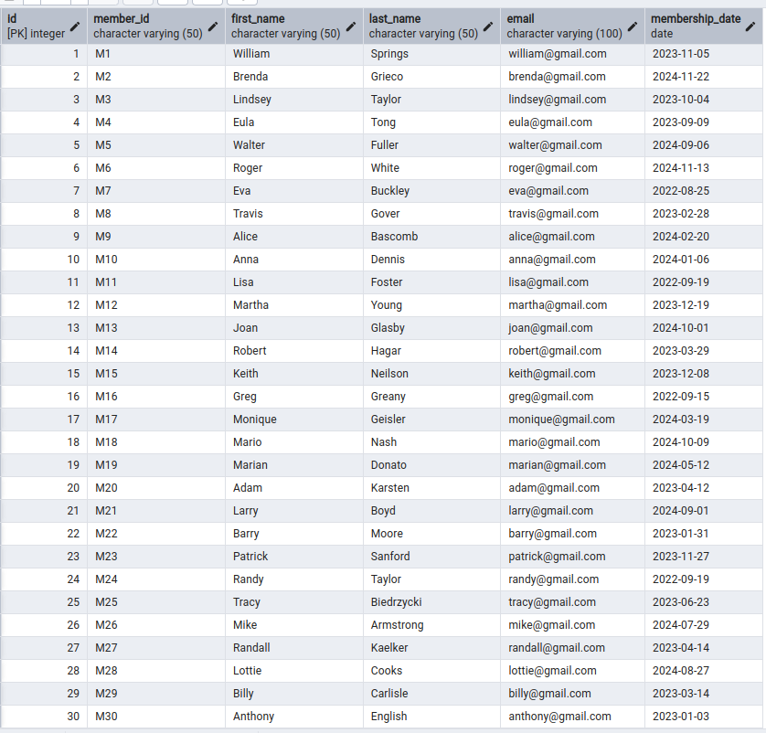
Q2 DropBioColumn
Snapshot of the query output:
Description: Removes the unnecessary "Bio" column from the Member table, streamlining the database by eliminating unneeded member details.
DDL
SQL Query:
ALTER TABLE Member DROP COLUMN Bio;

Slide 5

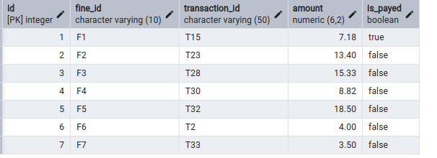
Q3 AddFineCheckConstraint
Snapshot of the query output:
Description: Adds a check constraint to the Fine table to ensure fines are at least $0.50, enforcing a minimum penalty for overdue books
DDL
SQL Query:
ALTER TABLE Fine ADD CONSTRAINT check_fine_amount CHECK (amount >= 0.5);

Slide 6

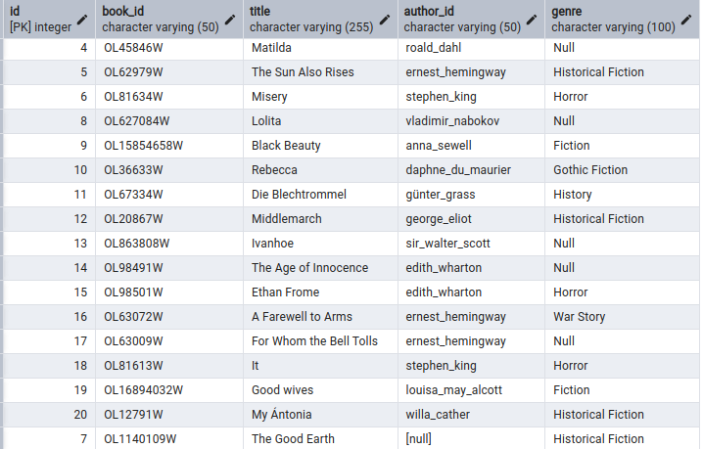
Q4 AddBookAuthorFK
Snapshot of the query output:
Description: Establishes a foreign key relationship between the Book and Author tables, setting the author ID to NULL if an author is deleted, maintaining data integrity in the catalog. DDL
SQL Query:
ALTER TABLE Book ADD CONSTRAINT fk_author FOREIGN KEY (author_id) REFERENCES Author(author_id) ON DELETE SET NULL;

Slide 7

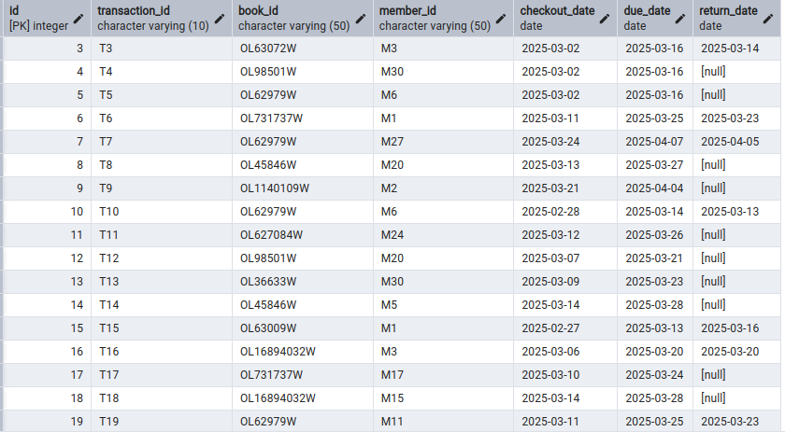
Q5 CreateOverdueFineTrigger
Snapshot of the query output:
Description: Creates a trigger that calculates and applies a fine (50 cents per overdue day) when a book is returned late, automating penalty enforcement in transactions.
SQL Query:
CREATE OR REPLACE FUNCTION apply_fine_if_overdue()RETURNS TRIGGER AS $$DECLARE overdue_days INT; fine_amount NUMERIC;BEGIN -- Check if return_date is after due_date, and if it's not NULL IF NEW.return_date IS NOT NULL AND NEW.return_date > NEW.due_date THEN -- Calculate overdue days overdue_days := NEW.return_date - NEW.due_date; fine_amount := overdue_days * 0.50; INSERT INTO Fine (fine_id, transaction_id, amount, is_payed) VALUES ('F' || nextval('fine_seq'), NEW.transaction_id, fine_amount, FALSE); END IF;
RETURN NEW;END;$$ LANGUAGE plpgsql;
CREATE TRIGGER check_overdue_fineAFTER INSERT OR UPDATE ON TransactionFOR EACH ROWWHEN (NEW.return_date IS NOT NULL AND NEW.return_date > NEW.due_date)EXECUTE FUNCTION apply_fine_if_overdue();

Slide 8
DML QUERIES
Instructions:
- must include ALL queries listed in Queries.sql
- must follow the exact format provided in the template slide

Slide 9

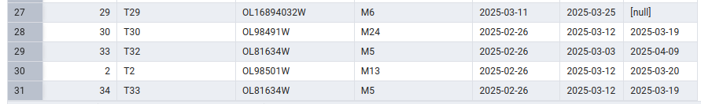
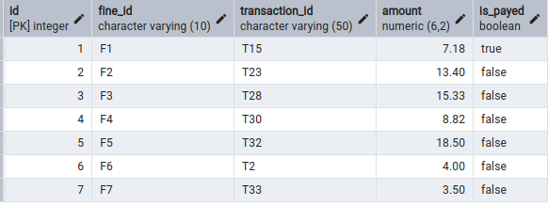
Q1:InsertOverdueTransaction
Snapshot of the query output:
Description: : Inserts a transaction for a book returned late (March 19 vs. due March 12), testing the overdue fine trigger by simulating a real borrowing scenario
SQL Query:
INSERT INTO Transaction(book_id, member_id, checkout_date, due_date, return_date) VALUES ('OL81634W', 'M5', '2025-02-26','2025-03-12','2025-03-19');

Slide 10
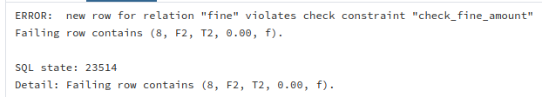
Q2: InsertInvalidFine
Snapshot of the query output:
Description: Attempts to insert a fine with an amount below the minimum ($0.00), testing the check constraint to ensure it rejects invalid penalties
SQL Query:
INSERT INTO Fine (fine_id, transaction_id, amount, is_payed) VALUES ('F2', 'T2', 0.00, FALSE)

Slide 11
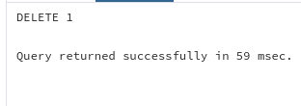
Q3:DeleteAuthorTestFK
Snapshot of the query output:
Description: Deletes an author to test the foreign key constraint, ensuring the author ID in the Book table is set to NULL, verifying referential integrity.
SQL Query:
DELETE FROM author WHERE author_id = 'pearl_s._buck';

Slide 12
Credits and References
SQL Shack

