Slide 1
CMPS 4390 PROJECT
Team Name: Byte Size

Slide 2
Requirements
Develop a database system with the requirements listed below.
At least, 6 tables, at least 20 attributes in total.
Each table must have some tuples with NULL.
The total number of records must be no less than 100. The data must have diversity.
The data in tables must utilize cardinality of 1:1, 1:N, and the structural constraints of (0,N) and (1,1).
ER diagram must specify structural constraints (min, max).
Weak entity and binary or ternary relations must be used.
All drawing must be done professionally
Submit
Presentation file. Use the template PPT file Project.pptx.
Data in an Excel file. The Excel file must have single table per sheet. The first line must have attributes. Use the template Excel file Tables.xlsx.
The SQL-query file Queries.sql. Use the template file.
Backup of your database as CMPS439_<team name> and submit as "CMPS439_< team name>.bak" file.

Slide 3
TEAM MEMBERS & ROLES
Rhett Hill
Muhamad Warrad

Slide 4
DESCRIPTION OF BUSINESS
<describe what type of products or services are aimed to be delivered. At least, 5 operations and 5 requirements must be listed.>
Business operations:
Book Details
Transaction Management
Fine Managment
Staff Management
Member Identification
Business requirements:
Store book details, including title, author, genre, and availability statu
Keep track of transaction details including user, date, and books
Manage the users who have fines linked to them
Manage staff members who handle book checkouts and returns
Keep track of user info including name, email, and date of membership

Slide 5
REFERENTIAL-RELATIONS
FOREIGN TABLE (REFERENCING TABLE) | REFERENCED TABLE | FOREIGN KEY | PRIMARY KEY
Book | Author | author_id | author_id
Transaction | Book | book_id | book_id
Transaction | Member | member_id | member_id
Fine | Transaction | transaction_id | transaction_id

Slide 6
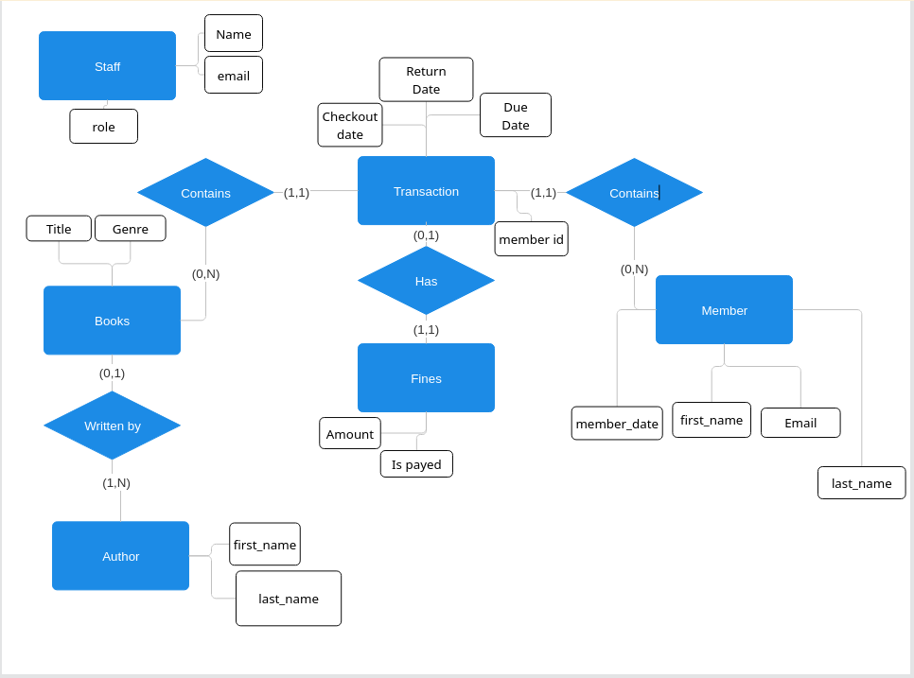
ER-Diagram

Slide 7
DDL QUERIES
Instructions:
- must include ALL queries listed in Queries.sql
- must follow the exact format provided in the template slide

Slide 8
Q#: <Query Name>
Snapshot of the query output:
Description:
SQL Query:
THIS IS A TEMPLATE SLIDE.
USE THIS TEMPLATE AS IS. DO NOT CHANGE THE FORMAT.
JUST ENTER or COPY/PASTE YOUR ANSWER.
The snapshot should include the output message, the table(s) created/affected/related; if table(s) are too big, then just show partially.
You may need to show table(s) before and after executing the query.

Slide 9
DML QUERIES
Instructions:
- must include ALL queries listed in Queries.sql
- must follow the exact format provided in the template slide

Slide 10
Q#: <Query Name>
Snapshot of the query output:
Description:
SQL Query:
THIS IS A TEMPLATE SLIDE.
USE THIS TEMPLATE AS IS. DO NOT CHANGE THE FORMAT.
JUST ENTER or COPY/PASTE YOUR ANSWER.
The snapshot should include the output message, the table(s) created/affected/related; if table(s) are too big, then just show partially.
You may need to show table(s) before and after executing the query.

Slide 11
ANALYSIS OF DATA
Discuss Functional Dependencies

Slide 12
2NF
Instructions:
Discuss functional dependencies. Use the form “FD-type: X → Y”; show how you normalized tables in your database by means of 2NF procedure. Provide some sample tuples of your database before and after applying 2NF normalization. MUST be in the format below.
Full Dependency:
{A1, A2, A3} → {A5}
BEFORE NORMALIZATION
Partial Dependency:
{A1, A2}→ {B4, B8}
AB_TABLE
A_TABLE
B_TABLE
A1 | A2 | A3 | B4 | A5 | B8
V11 | V21 | v31 | V41 | V51 | V81
V11 | V21 | v32 | V41 | V52 | V82
V12 | V22 | V31 | V42 | V52 | V83
V12 | V22 | V34 | V42 | V51 | V83
V12 | V22 | V35 | V42 | V54 | V83
A1 | A2 | A3 | A5
V11 | V21 | v31 | V51
V11 | V21 | v32 | V52
V12 | V22 | V31 | V52
V12 | V22 | V34 | V51
V12 | V22 | V35 | V54
A1 | A2 | B4 | B8
V11 | V21 | V41 | V81
V12 | V22 | V42 | V83

Slide 13
3NF
Instructions:
Discuss functional dependencies. Use the form “FD-type: X → Y → Z”; show how you normalized tables in your database by means of 3NF procedure. Provide some sample tuples of your database before and after applying 3NF normalization. MUST be in the format below.
Transitive FD: {A1, A2} → {A5} → {B8}
BEFORE NORMALIZATION
AB_TABLE
A_TABLE
B_TABLE
A1 | A2 | A5 | B8
V11 | V21 | V51 | V81
V11 | V21 | V51 | V81
V12 | V22 | V52 | V83
V12 | V22 | V52 | V83
V12 | V22 | V52 | V83
A1 | A2 | A5
V11 | V21 | V51
V11 | V21 | V51
V12 | V22 | V52
V12 | V22 | V52
V12 | V22 | V52
A5 | B8
V51 | V81
V52 | V83

Slide 14
ANALYSIS OF DATA
Discuss Possible Anomalies and Remedies
Instructions:
Provide some sample tuples of your database to discuss possible anomaly issues related to data insertion, update, delete anomalies existing in your database. If does not exist, then add some sample tuples to your tables in your database so that an insertion, an update, and a delete anomaly exist.
Propose remedies with some examples for anomalies existing in the database.

Slide 15
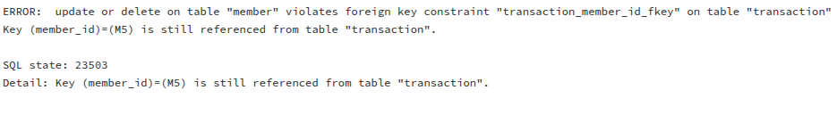
Update Anomaly
This causes a problem for the foreign key in the transaction table since M5 no longer exists in the members table
UPDATE Member
SET member_id = 'M50'
WHERE member_id = 'M5';

Slide 16
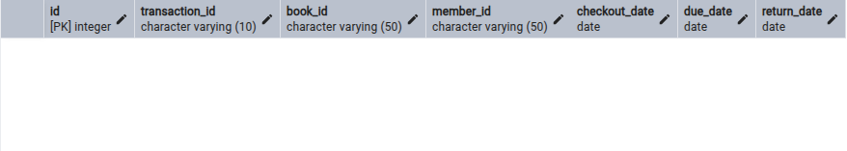
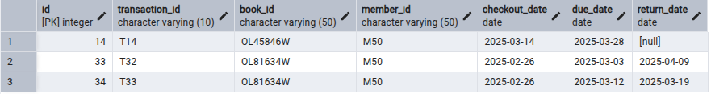
Remedy for the Update Anomaly
Example Illustration:
Explanation: Add foreign constraint to cascade the update to the transaction table when the key is changed.
Searching for member_id = ‘M50’ before update
Searching for member_id =’M50’ after update

Slide 17
Insertion Anomaly
Manually inserting fines into the fine table can cause some transactions to have a fine for books that have yet to be returned.
insert into fine(transaction_id,amount,is_payed)
values('T9',2.00,False)

Slide 18

Remedy for the Insertion Anomaly
Example Illustration:
Create a trigger that validates a fine before it is inserted into the table.

Slide 19
Deletion Anomaly
This causes transactions in the transaction table to have a show null for the member_id which is against the participation constraint.
DELETE FROM Member WHERE member_id = 'M3';

Slide 20
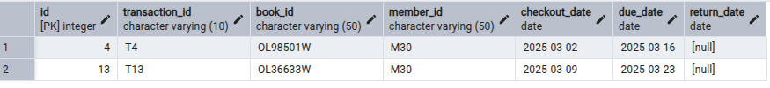
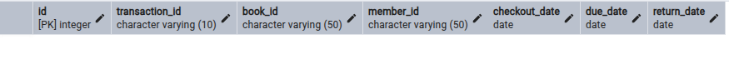
Remedy for the Deletion Anomaly
Example Illustration:
Explanation:
We can use On delete Cascade to also delete any transactions that the member is related to to avoid anomalies.
Before member is deleted
After member is deleted

Slide 21
Credits and References

