Slide 1
PROJECT REPORT CMPS 4700
ChatBLT
Rhett Hill, Zachary Gros

Slide 2
DESCRIPTION
Goal: Identify objects’ class labels by means of Machine Learning algorithms KNN, Decision Trees, ANN, and SVM.
Tasks:
Visualize data
Preprocess Data
Design Representation
Extract Features
Explore Feature Distributions
Design and create the model
Conduct Model Assessment

Slide 3
Project Description
Problem: Too many spam emails flood users’ inboxes.
Solution: Our goal is to utilize various machine learning algorithms to create a “spam filter” to filter out legitimate emails from spam emails.

Slide 4
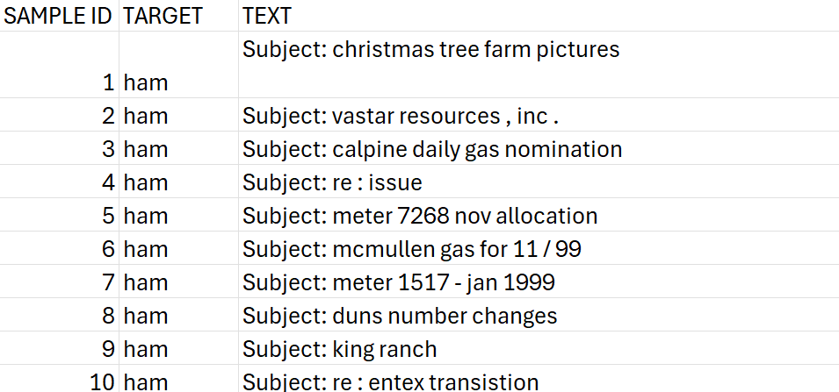
Description of the Data
All data is collected from this Kaggle repository: https://www.kaggle.com/datasets/wanderfj/enron-spam/data
The data is comprised of strings containing the email content with the class label of either ‘ham’ or ‘spam’ with ‘ham’ being the negative class and ‘spam’ being the positive class.

Slide 5
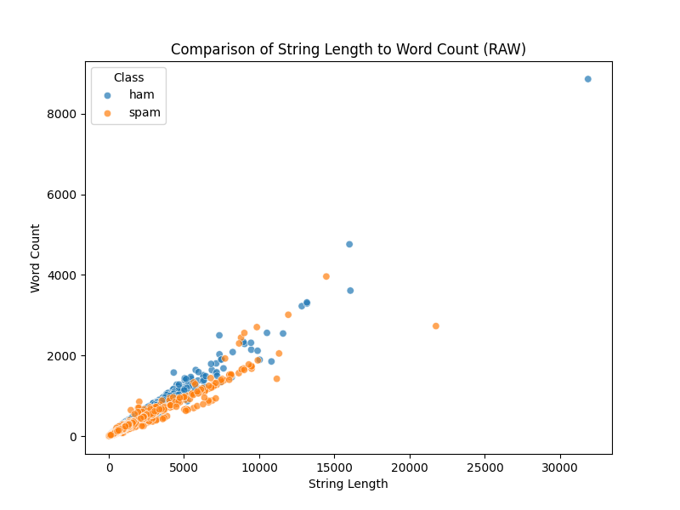
Raw Data Visualization
Given that the raw data is in string format, the best way method we found to visualize it is to plot the comparison of the string length to the total word count for each data point in the dataset. This plot can be seen to the right. Looking at the plot, we can see that the string length and word count have a linear relationship with word count increasing at a similar rate to string length.

Slide 6
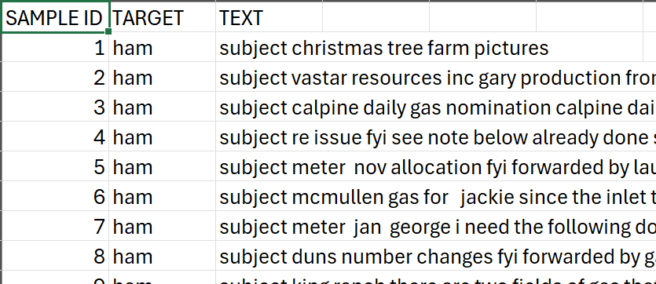
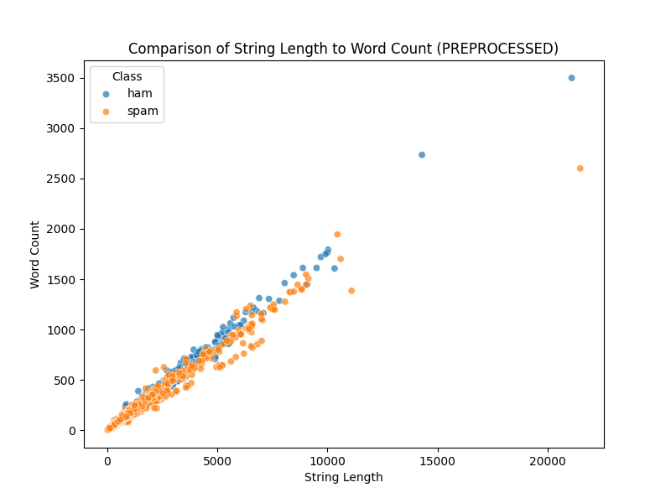
Preprocessing
To better work with the dataset, we decided to remove any unnecessary characters in the strings including numbers, stopwords, and special characters. The result of our preprocessing was that the maximum word count reduced by around half of the original value, and the maximum string length was cut to around two-thirds of the original value. The preprocessed dataset and a visualization of the dataset can be seen to the right.

Slide 7
Feature Extraction
For the extraction of features for this specific dataset, we chose to use scikit-learn’s TfidfVectorizer (Term Frequency-Inverse Document Frequency) function to calculate the frequency of every word each datapoint compared to the frequency of the word in the entire dataset with each word being given a TF-IDF score. We chose to use the 1,000 most important words in the dataset to remove needless complexity and to make the data easier to work with.

Slide 8
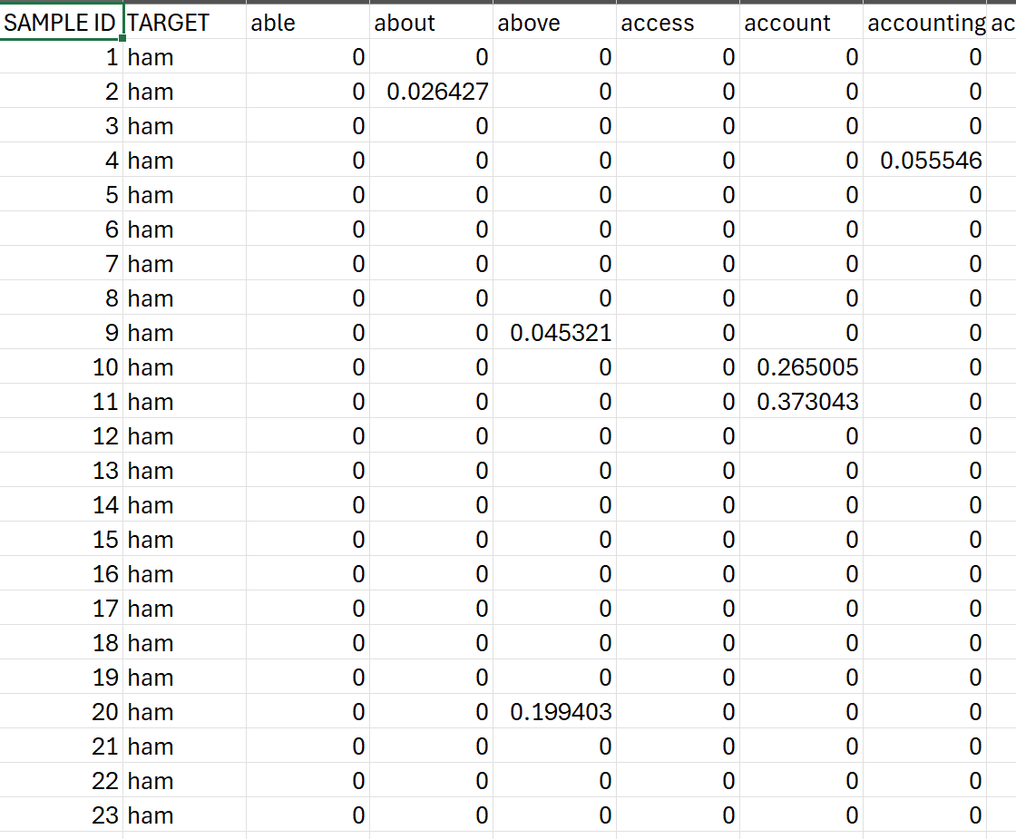
Feature Extraction (cont.)
A snapshot of the dataset can be seen to the right. As seen in the table, the attributes of the dataset are floats containing the TF-IDF scores of each word in each datapoint. This will allow us to classify new data by comparing the new data’s TF-IDF scores to the training data’s TF-IDF scores.

Slide 9
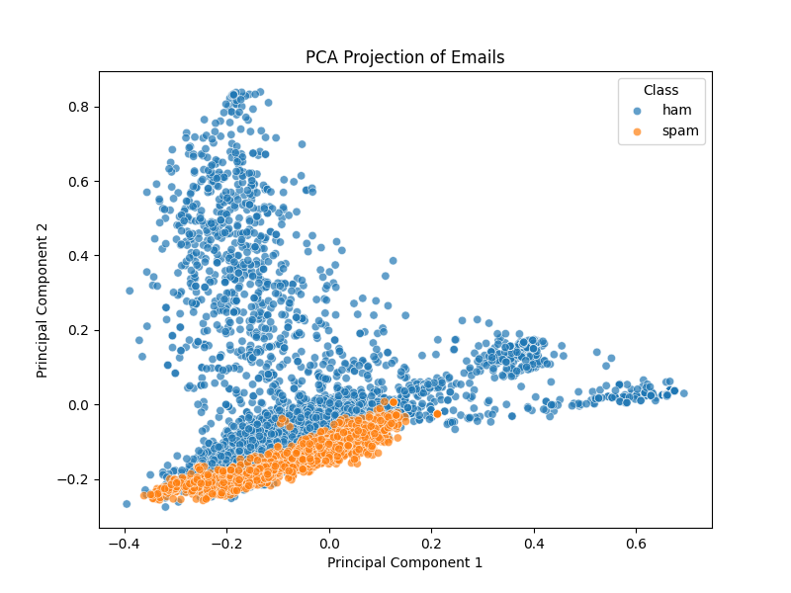
Feature Extraction (cont.)
Since our dataset contains a large number of attributes, we used PCA to visualize the data using 2 principal components. The plot can be seen to the right. By looking at the plot, we can very clearly see that while the legitimate email are very spread out, the spam emails are condensed into a small area. This gives us great confidence that machine learning will be very effective in detecting spam emails.

Slide 10
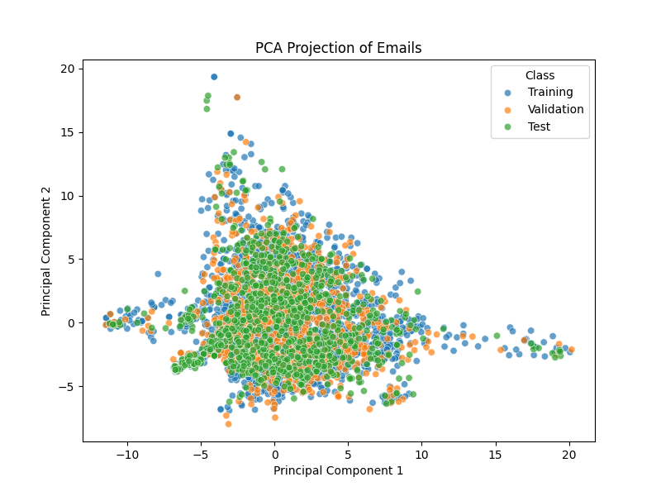
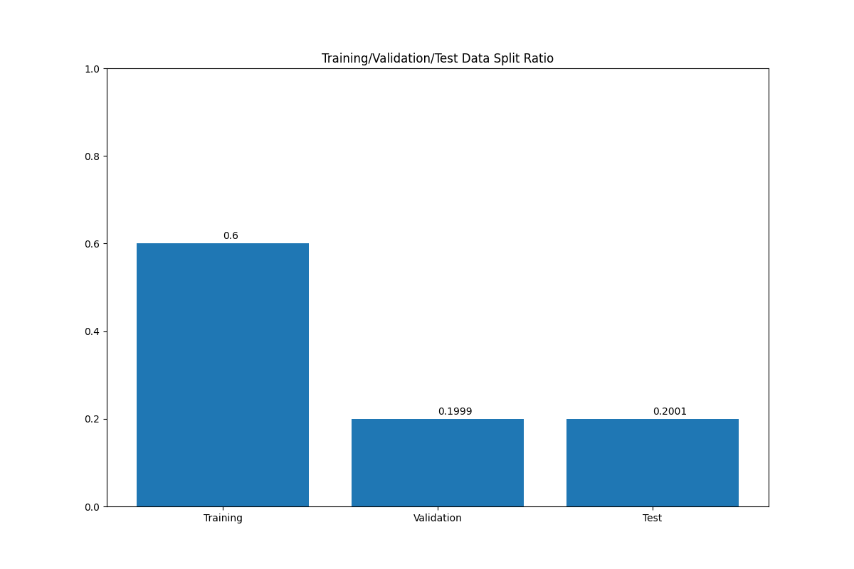
Training/Validation/Test Split
For each of the four algorithms, we used a Training/Validation/Test data split with a ratio of 6:2:2. A visualization of the data separation can be seen to the right. With the scatter plot, it can be determined that the split is purely random with no bias towards either class meaning that predictions with the test data will not be skewed. A visualization of the split ratio as a bar chart can also be seen to the right.

Slide 11
KNN
The first algorithm tested for this dataset was KNN. To get the best result possible, we used hyperparameter tuning to search for the best k value which ended up being a k value of 11. For the Training/Validation/Test data split, we used a ratio of 6:2:2.

Slide 12
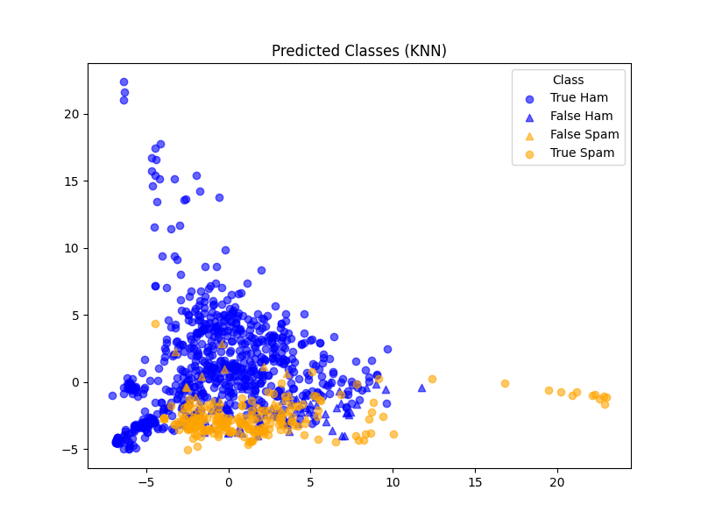
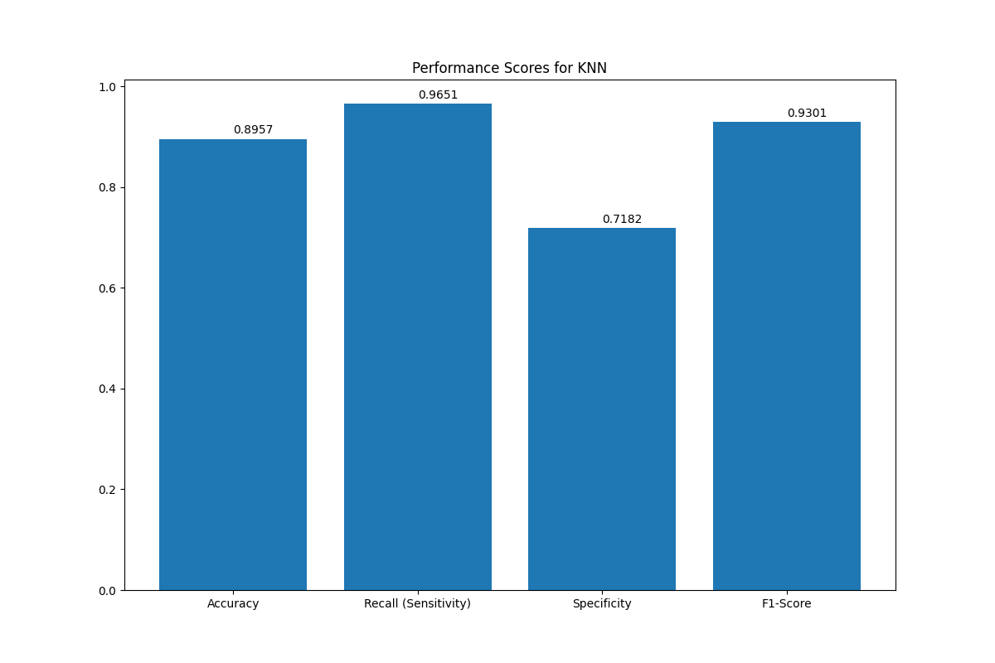
KNN Performance
The performance of the KNN algorithm was fairly good, with the best k of 11 giving an accuracy of 89.57%. The specificity, however, is considerable low at 71.82%. These scores can be seen in the bar graph to the right. As for the overall shape of the plot, we can notice fairly easily the datapoint that were predicted incorrectly in the scatter plot to the right, but the overall shape of the graph is consistent with the true values.

Slide 13
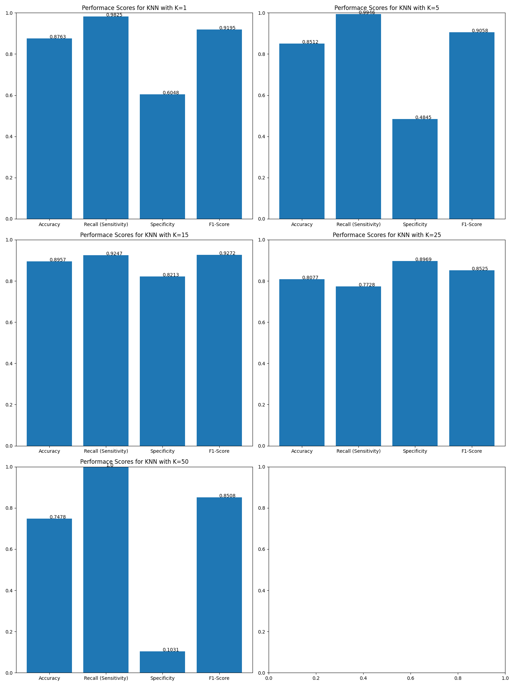
KNN Performance (cont.)
By using arbitrary K values of 1, 5, 15, 25, and 50, we can further test the model’s performance by comparing the performance scores of each K value. Looking at the figure to the right, we can notice that accuracy seems to drop overall as K increases. Additionally, as K increases, specificity initially rises but starts to drop drastically.

Slide 14
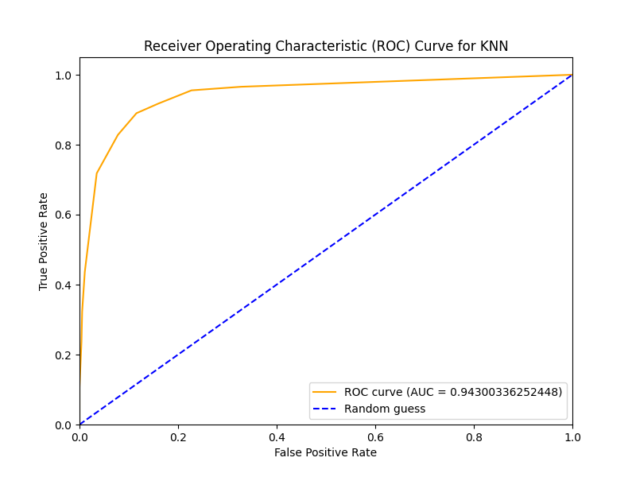
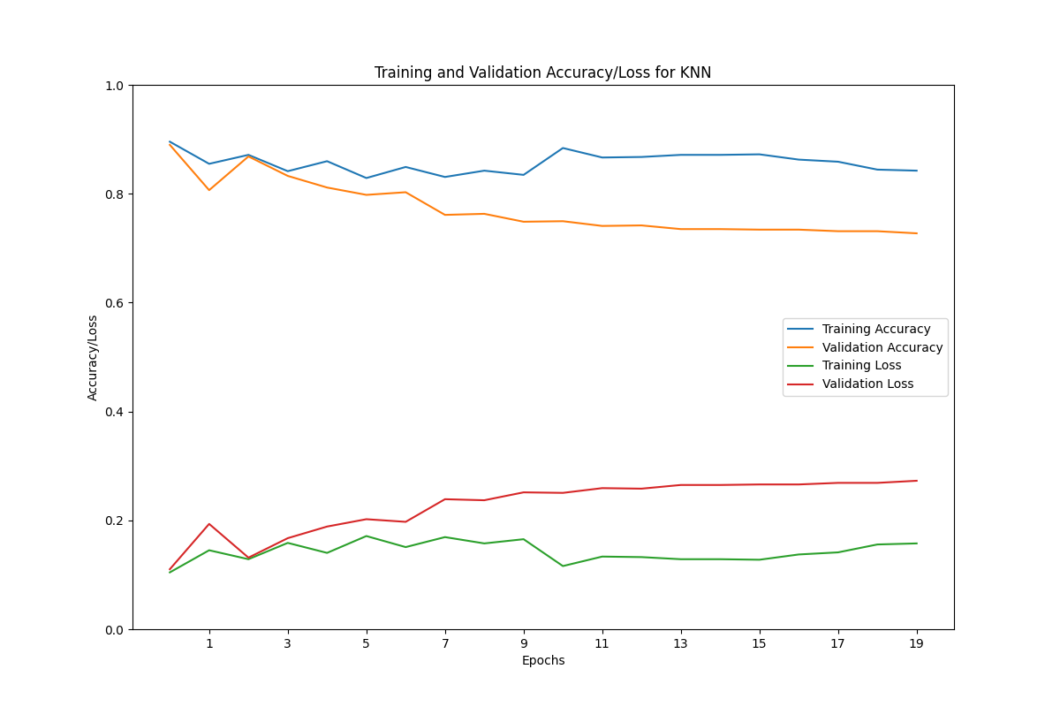
KNN Error Curves
Looking at the ROC curve for our KNN model, we can notice that the TPR and FPR are equal along the entirety of the plot with the AUC being 0.943 meaning that our model is very accurate. As for the loss curves, we can notice that the training accuracy/loss fluctuate, but it stays in the same general range. The validation accuracy seems to slowly decline rather than fluctuate like the training accuracy. There is also a very clear divergence between the training and validation curves as the number of Epochs increase, so it is best to use lower parameter values to ensure the best results as seen with the distance between the curves at epoch=2 being very small.

Slide 15
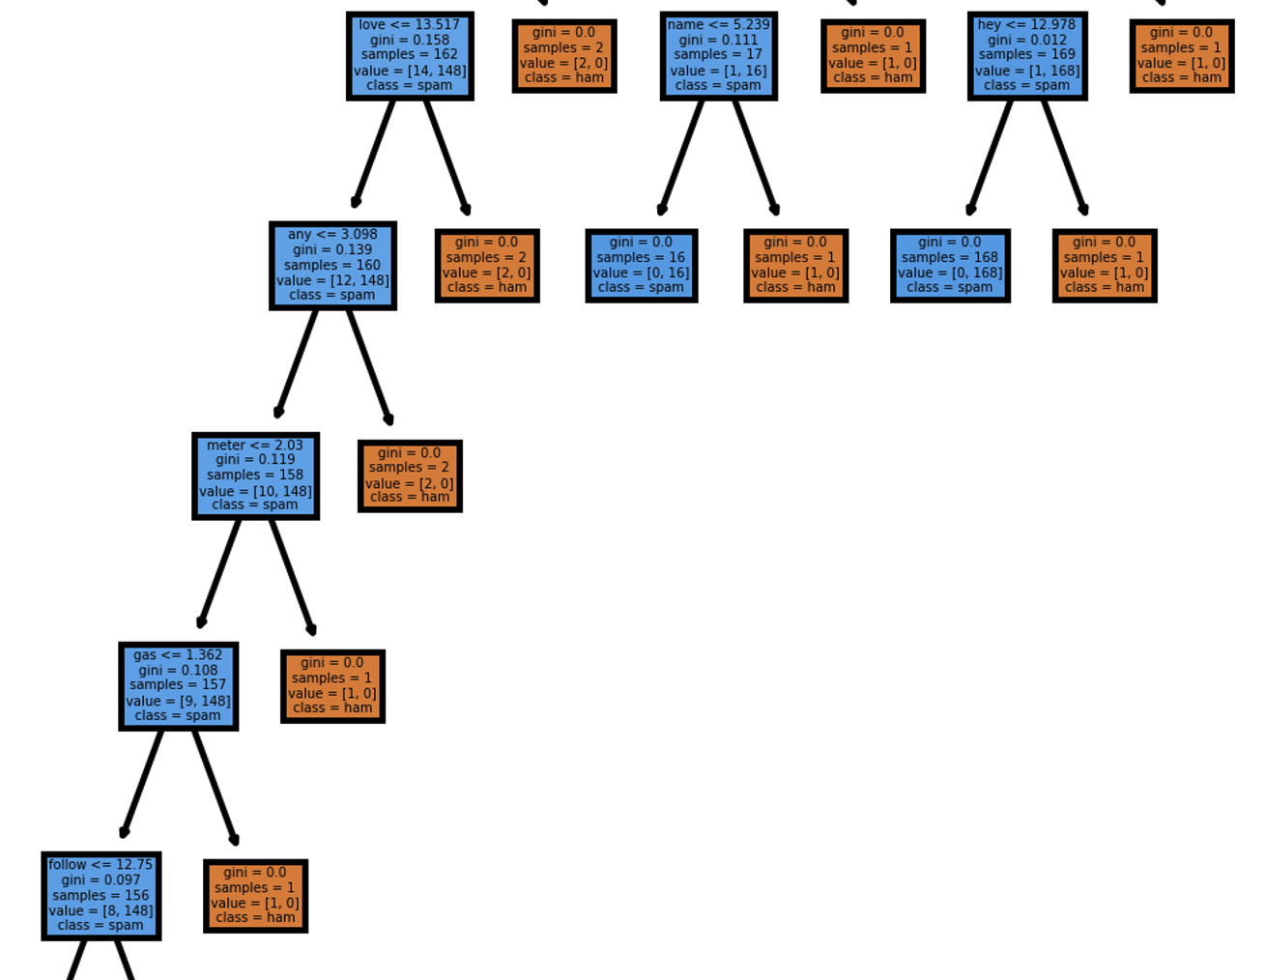
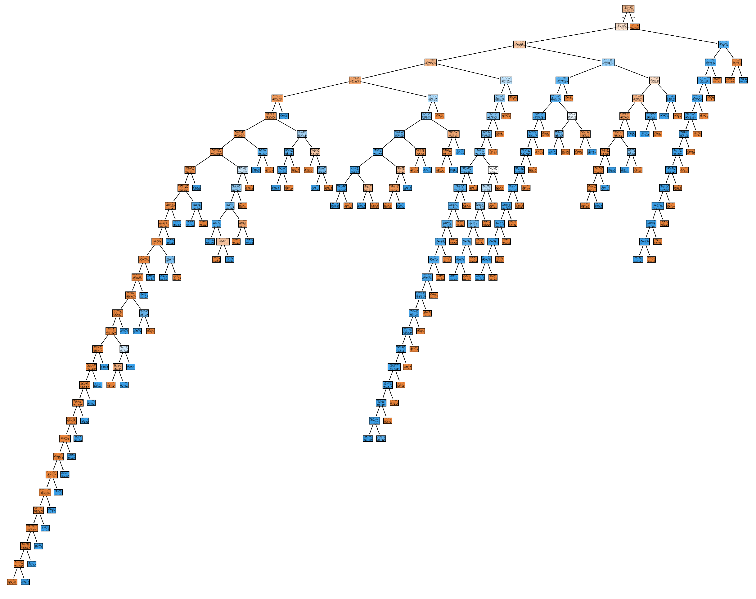
DT
The second algorithm tested for this dataset was Decision Trees. For the depth, we chose not to limit the tree to a maximum in order to ensure that all values are used. Our full tree can be seen below along with a small snapshot of a section of the tree.

Slide 16
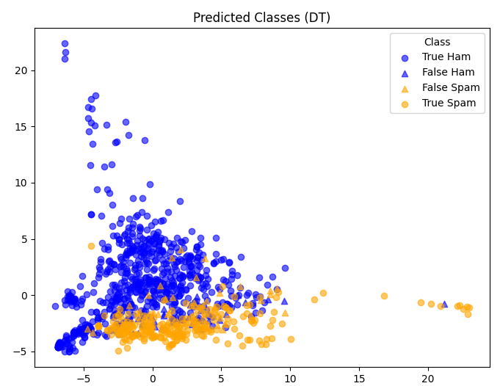
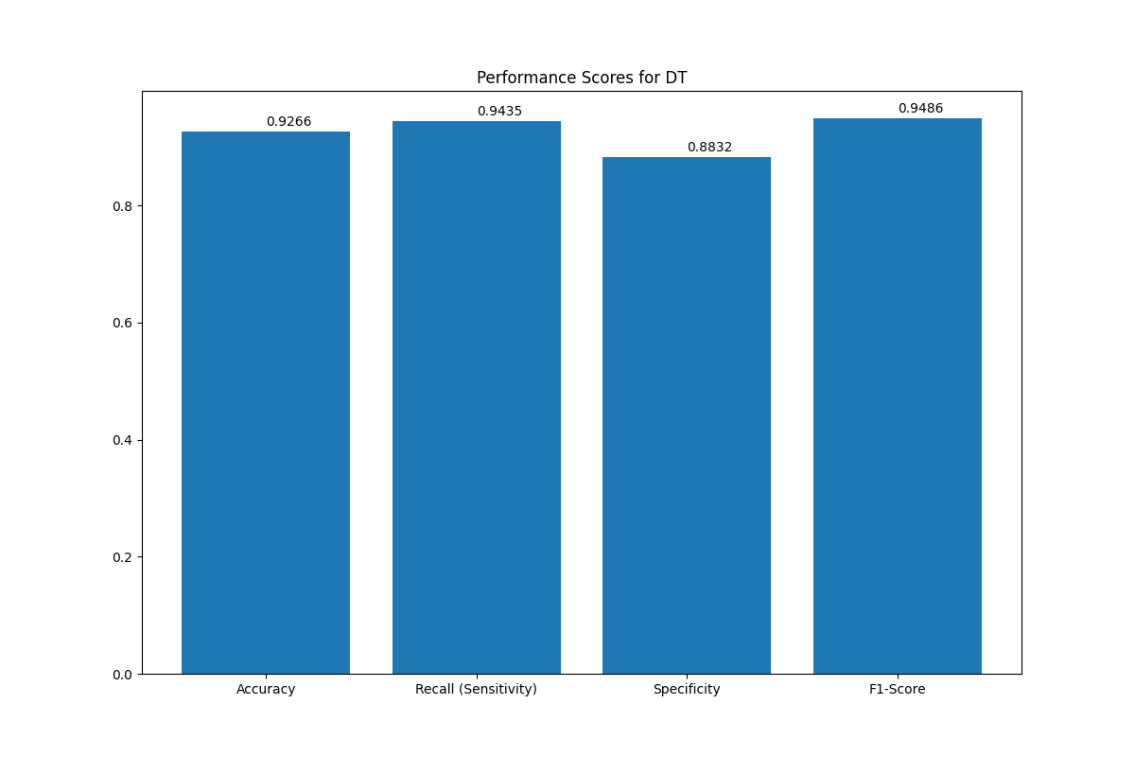
Decision Tree Performance
The performance of the decision tree was very good. As seen in the bar chart, the accuracy, recall, and F-1 Scores were all above 90% with specificity not far behind at 88.32%. On the scatter plot, we can notice some misclassified datapoints, but the overall shape is consistent with the truth values.

Slide 17
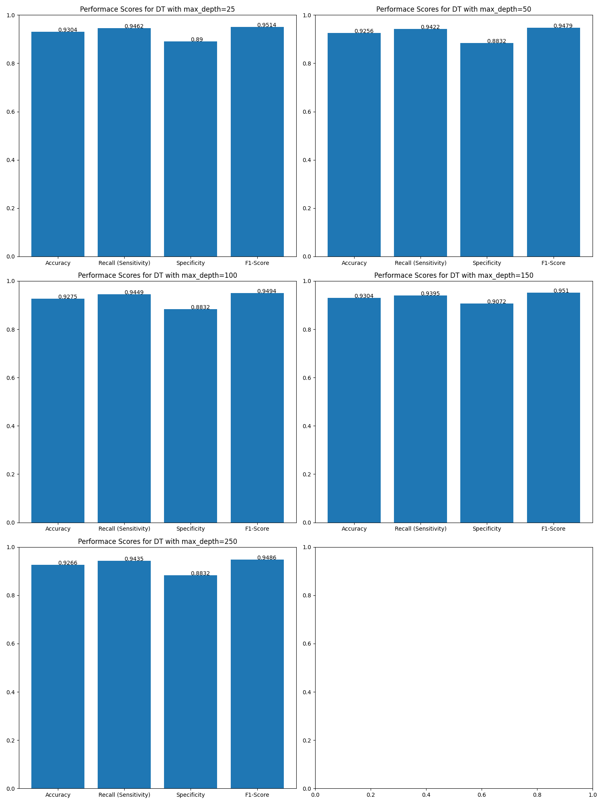
DT Performance (cont.)
Using arbitrary depth values of 25, 50, 100, 150, and 250, we can further test the tree’s performance as depth increases. As depth increased, however, there was little to no change between the performance scores with each score falling within a similar range of around a 0.02 difference. This shows that the depth of the tree has little to no effect on the accuracy of our data.

Slide 18
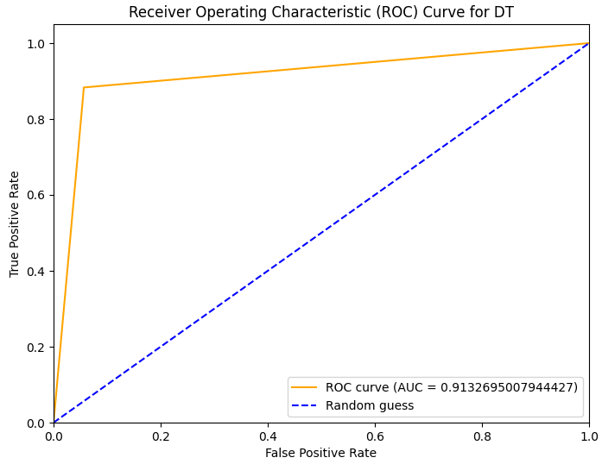
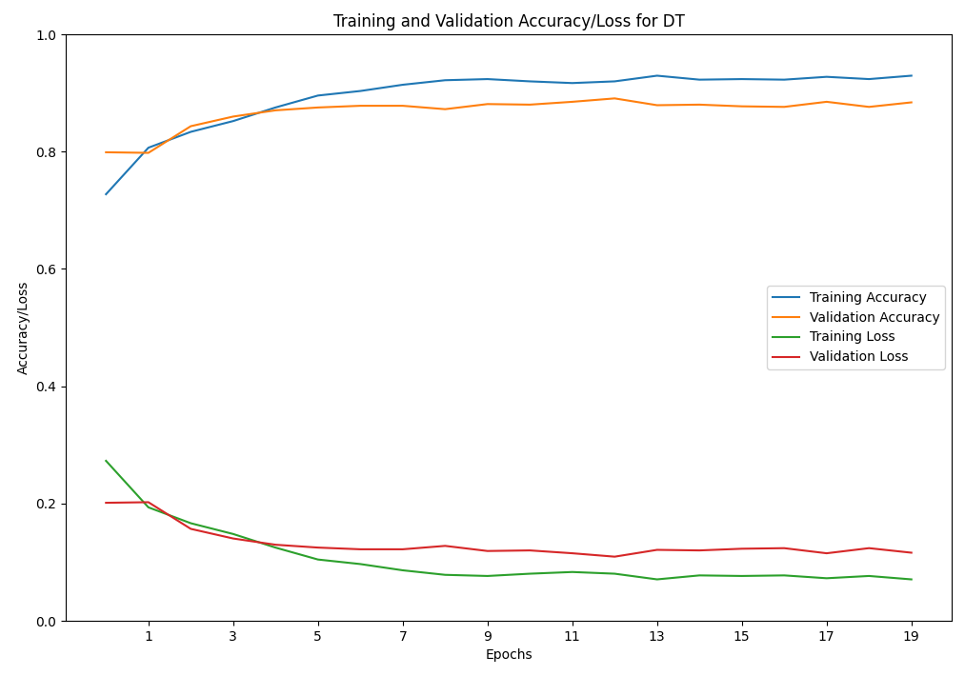
DT Error Curves
Looking at the ROC curve for the decision tree, we can notice that there is only one bend. A single sharp bend on an ROC curve usually implies that the model has near perfect separation. The AUC score of 0.913 also implies that the model is really good. Looking at the Accuracy/Loss plot, we can notice that the training and validation curves cross over in the lower epoch values and begin to spread out slightly as the epoch value increases, however, the accuracy scores get better as the epoch value increases. Additionally, the separation is very small with the two curves seeming to plateau. This implies that higher valued parameters do not have much effect on accuracy.

Slide 19
ANN
The third algorithm tested for this dataset was ANN. For the parameters, we chose to use 64 units for the first layer, 32 units for the hidden layer, and 1 output unit for the last layer. We used ‘relu’ activation for the model and ‘sigmoid’ for the output. The loss function used was ‘binary_crossentropy.’ For our optimizer, we are using ‘Adam’.

Slide 20
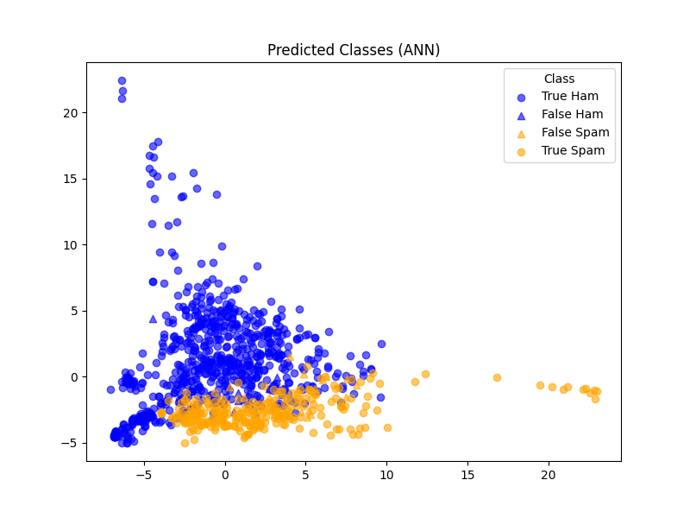
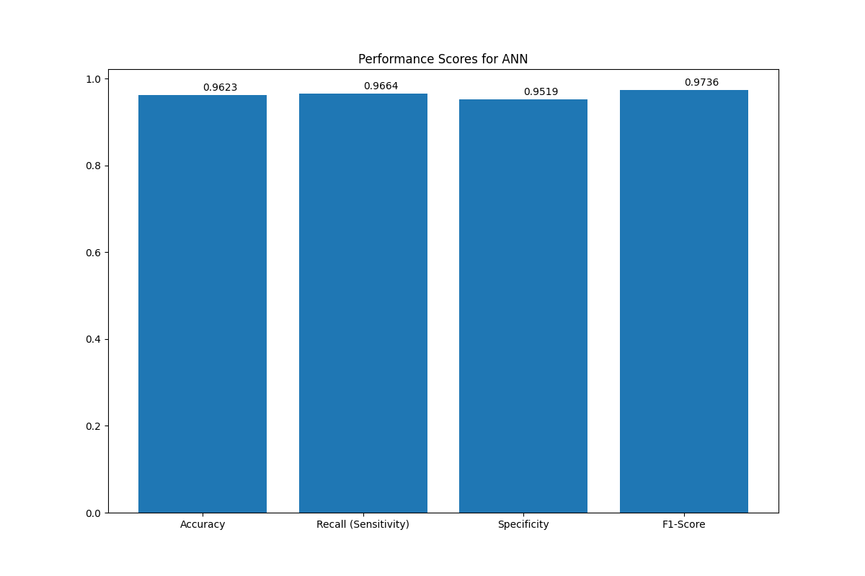
ANN Performance
The performance of the ANN model was very good with the lowest of the performance scores—shown to the right—being specificity with a value of 95.19%. The scatterplot, while similar to the plots shown previously, also has less noticeable misclassification—though some can still be seen.

Slide 21
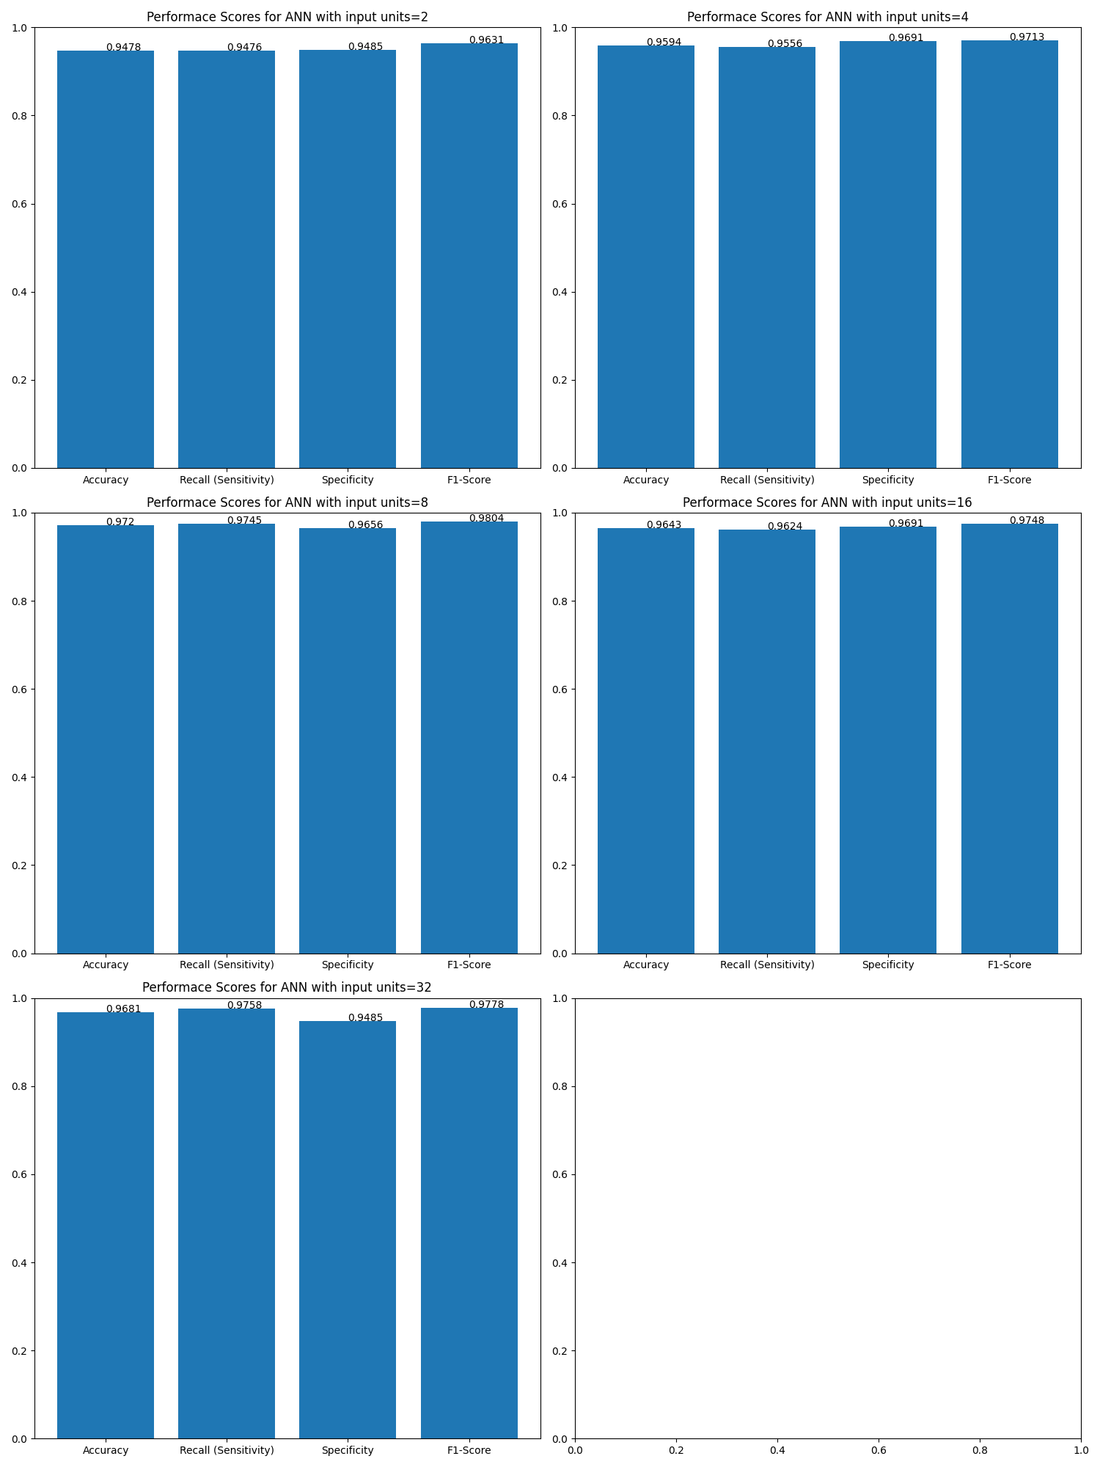
ANN Performance (cont.)
Using arbitrary input sizes of 2, 4, 8, 16, and 32 for the initial layer and input sizes of double the initial layer’s input size for the hidden layer, we can further test the model’s performance. Initially, we can see that all 5 tests were very accurate with best performing model being the one with an input size of 8. It had the best accuracy and F1-Scores of 97.2% and 98.04%, respectively, with the recall and specificity scores not far behind the highest values.

Slide 22
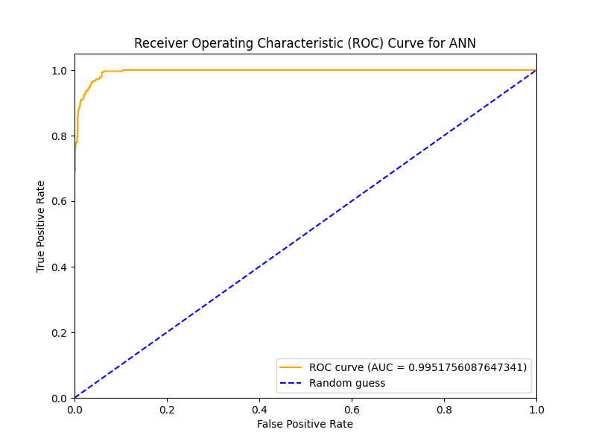
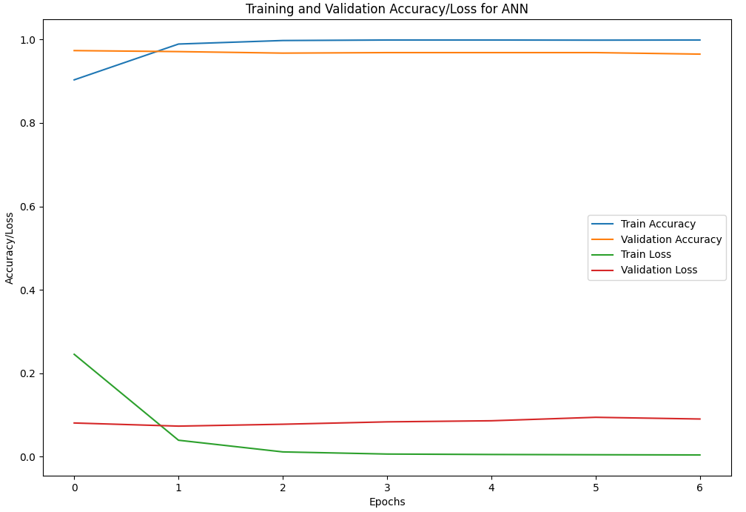
ANN Error Curves
The ROC curve for the ANN model is very good with the curve nearly resembling a perfect right angle. Additionally, the AUC score of the model is 0.9952 which is very close to being a perfect score of 1. For the Accuracy/Loss curve, we can first make note of the epoch range being shorter due to using the built-in model history since our model stops at epoch 6. As for the curves, we can see that the validation curves don’t decrease much at all staying very close to 1.0. The training accuracy does not drop at all, implying that higher epochs give better results.

Slide 23
SVM
The fourth and final algorithm tested for this dataset was SVM. For the model we used SVC linear regression model with a random state of 42 and the default C value of 1.0.

Slide 24

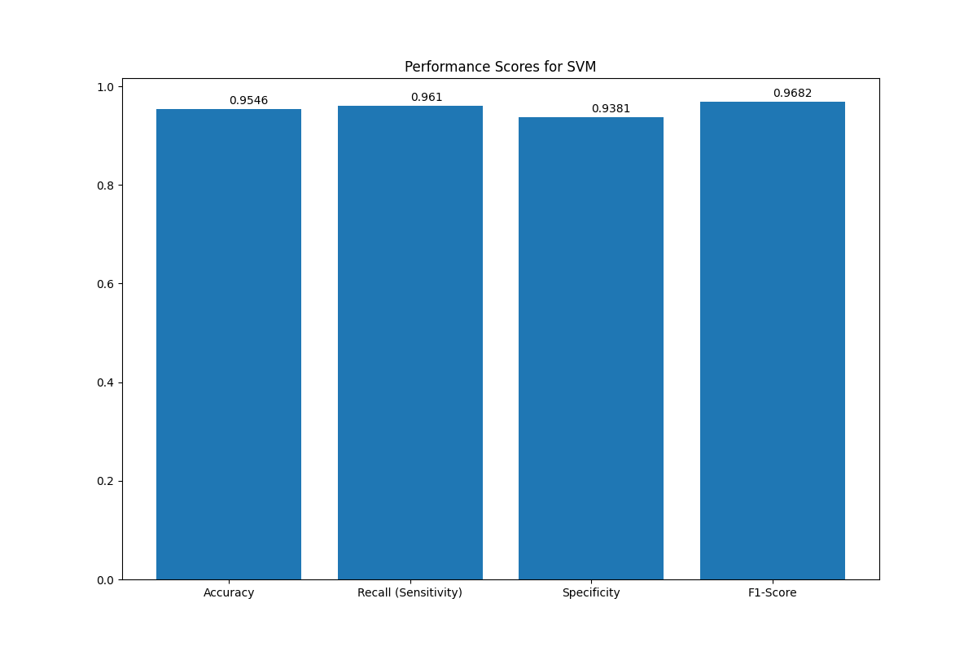
SVM Performance
The performance of our SVM model was very good, with the performance scores all lying in the 0.93-0.97 range. Like the other models, the overall class separation of the scatterplot is consistent with the truth values with few visible misclassifies datapoints.

Slide 25
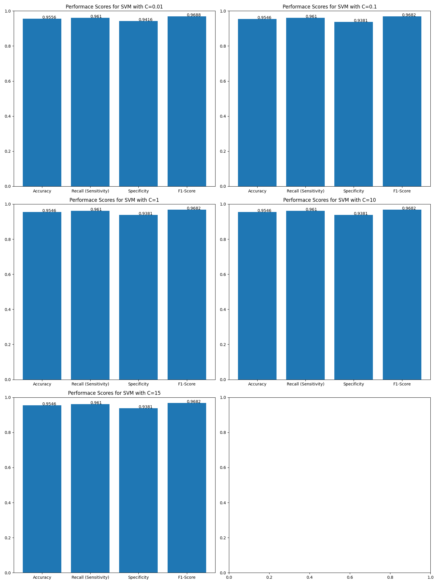
SVM Performance (cont.)
Using arbitrary C values of 0.01, 0.1, 1, 10, and 15, we can test the performance of the model as C—the trade-off between achieving a low error and a large margin—increases. From looking at the 5 plots to the right, we can see that changing the C value has very little effect on our data. In fact, the only plot that has different performance scores is the plot with C = 0.01, though the scores did not change much. This implies that our data’s separation is very good.

Slide 26
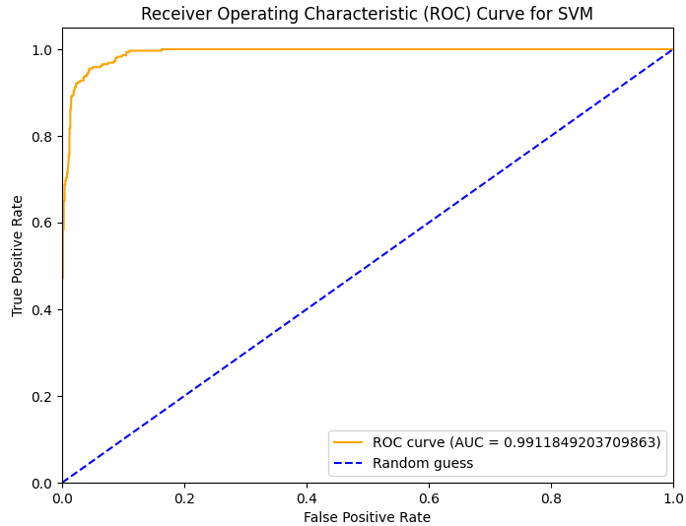
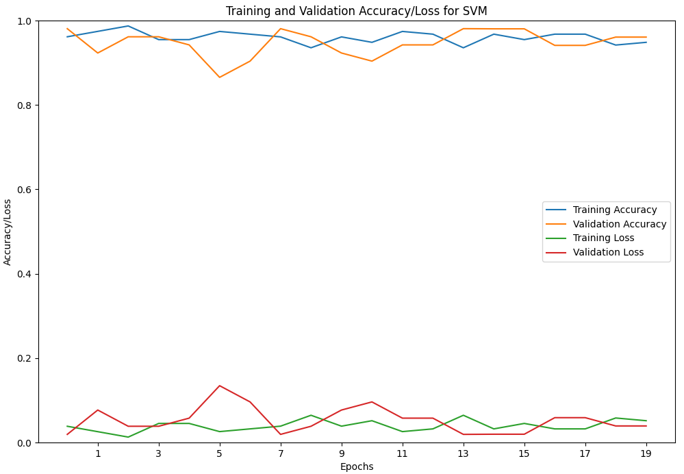
SVM Error Curves
Similar to our ANN model, the ROC curve for our SVM model is really good with the curve resembling a near-perfect right angle and having a near-perfect AUC score of 0.9912. The Accuracy/Loss curves, however, fluctuate very much with no noticeable pattern to the fluctuation. Additionally, the accuracy values seem to stay in the same general range between 0.85 to 0.9. Considering the results of the random tests in the previous slide, this makes sense as for our data, changing the parameters makes little to no difference.

Slide 27
Model Comparison
Looking at the performance scores for each of the four models, we can very clearly see that the worst performing model was KNN and that the best performing model was ANN. SVM takes second place with its performance being very close to ANN’s, but the DT falls closer to KNN in its accuracy.

Slide 28

Best/Worst Models’ Plots Compared to the Truth Values
For the best (ANN) and worst (KNN) models’ plots, we can notice some data points being classified differently between the two models. For example, ANN misclassified the datapoint at around (-5, 5) while KNN classified it accurately. ANN, however, has less noticeable misclassified datapoints than KNN does. This is to be expected since by looking at the original data’s plot, we can see that there is a clear overlap between the classes, so a distance-based algorithm like KNN will likely misclassify datapoints in the overlapping regions

Slide 29
2nd/3rd Ranked Models’ Plots Compared to the Truth Values
For the 2nd (SVM) and 3rd (DT) ranked models’ plots, we can see that there is not much difference between the two plots with both plots having some error in their classifications of some datapoints. For example, both models classified the datapoint near (22, 0) differently with SVM classifying it correctly. Little difference between the two is expected since their accuracy scores only differed by around 0.03.

Slide 30
Model ROC/AUC Comparison
By comparing the ROC curves—more specifically, the AUC scores—of the four models, we can further determine which models performed better than others. For example, our best model, ANN, has the highest AUC score of 0.995 with our 2nd best model, SVM, following behind ANN with an AUC score of 0.991. Curiously, our DT, although performing better overall than our KNN model, has the lowest AUC score of 0.913 following behind KNN’s AUC score of 0.943. It is best to note, however, that all four of these scores are excellent.

Slide 31
Model Training/Validation Accuracy/Loss Curve Comparison
By comparing the Training/Validation Accuracy/Loss curves of all four models, we can discuss how the changing of parameters affected each model differently. For starters, we can see that as the parameter values increase, DT performed better, ANN and SVM stayed relatively consistent, and KNN performed worse overall. Additionally, we can see that our best model, ANN, had little fluctuation in its accuracy/validation values compared to the other models, and our worst performing model, KNN, had a large separation between the training and validation curves. Additionally, while most models had little crossover, SVM had multiple points at which the curves intersected showing visually that its change in parameters hod little to no effect on its performance compared to the other three models. Still, ANN performed the best out of the four models.

Slide 32
Conclusion
While all four models performed great, there were some that clearly worked better on our dataset. The models’ performance score showed us that the ranking of the four models used on our data is ANN in 1st place, SVM in 2nd place, DT in 3rd place, and KNN in 4th place. The ROC/AUC and Training/Validation curves further enforced this ranking as shown previously. This ranking, however, is specifically for our data, so it does not imply that these are better overall. While ANN performed the best on our data, it may struggle on other datasets where the other models may be superior.

Slide 33
Task Completion Report
Date | Task Name | Status | Person
03/28/2025 | Preprocessing | Done | Rhett Hill
03/28/2025 | Preprocessing | Done | Zachary Gros
04/13/2025 | Feature Extraction | Done | Rhett Hill
04/13/2025 | Feature Extraction | Done | Zachary Gros
05/04/2025 | KNN | Done | Rhett Hill
05/04/2025 | KNN | Done | Zachary Gros
05/04/2025 | Decision Tree | Done | Rhett Hill
05/04/2025 | Decision Tree | Done | Zachary Gros
05/04/2025 | ANN | Done | Rhett Hill
05/04/2025 | ANN | Done | Zachary Gros
05/04/2025 | SVM | Done | Rhett Hill
05/04/2025 | SVM | Done | Zachary Gros

