Slide 1


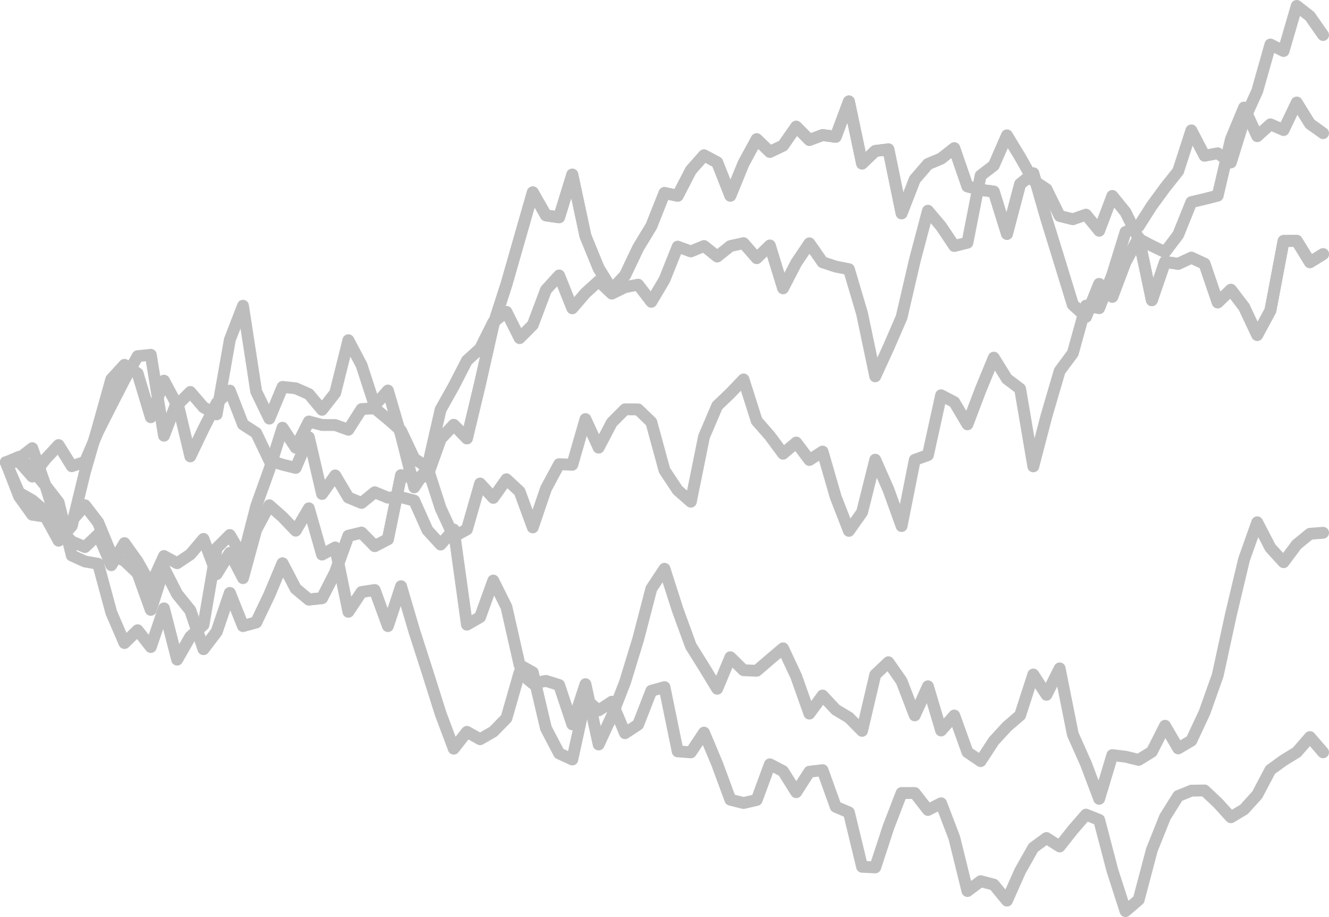


POP. GENETICS
EVOLUTION
BIOINFORMATICS
ECOLOGY
GENOMICS
CONSERVATION
SPECIES
INTERACTIONS

Slide 2
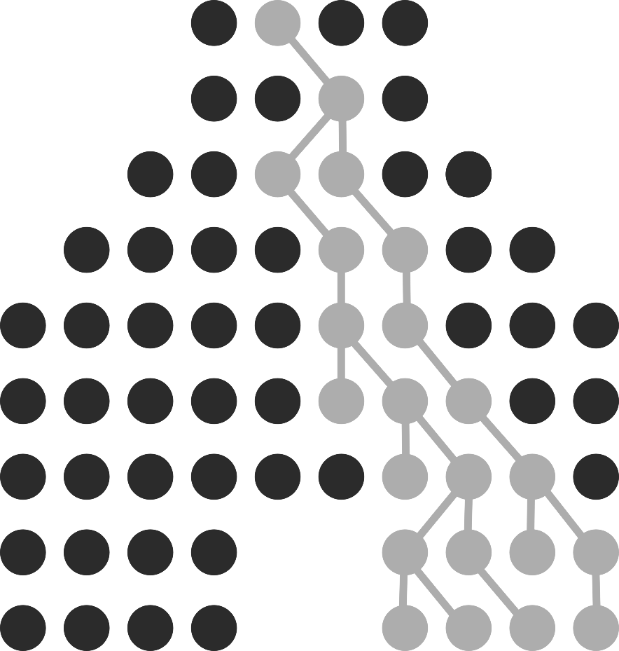
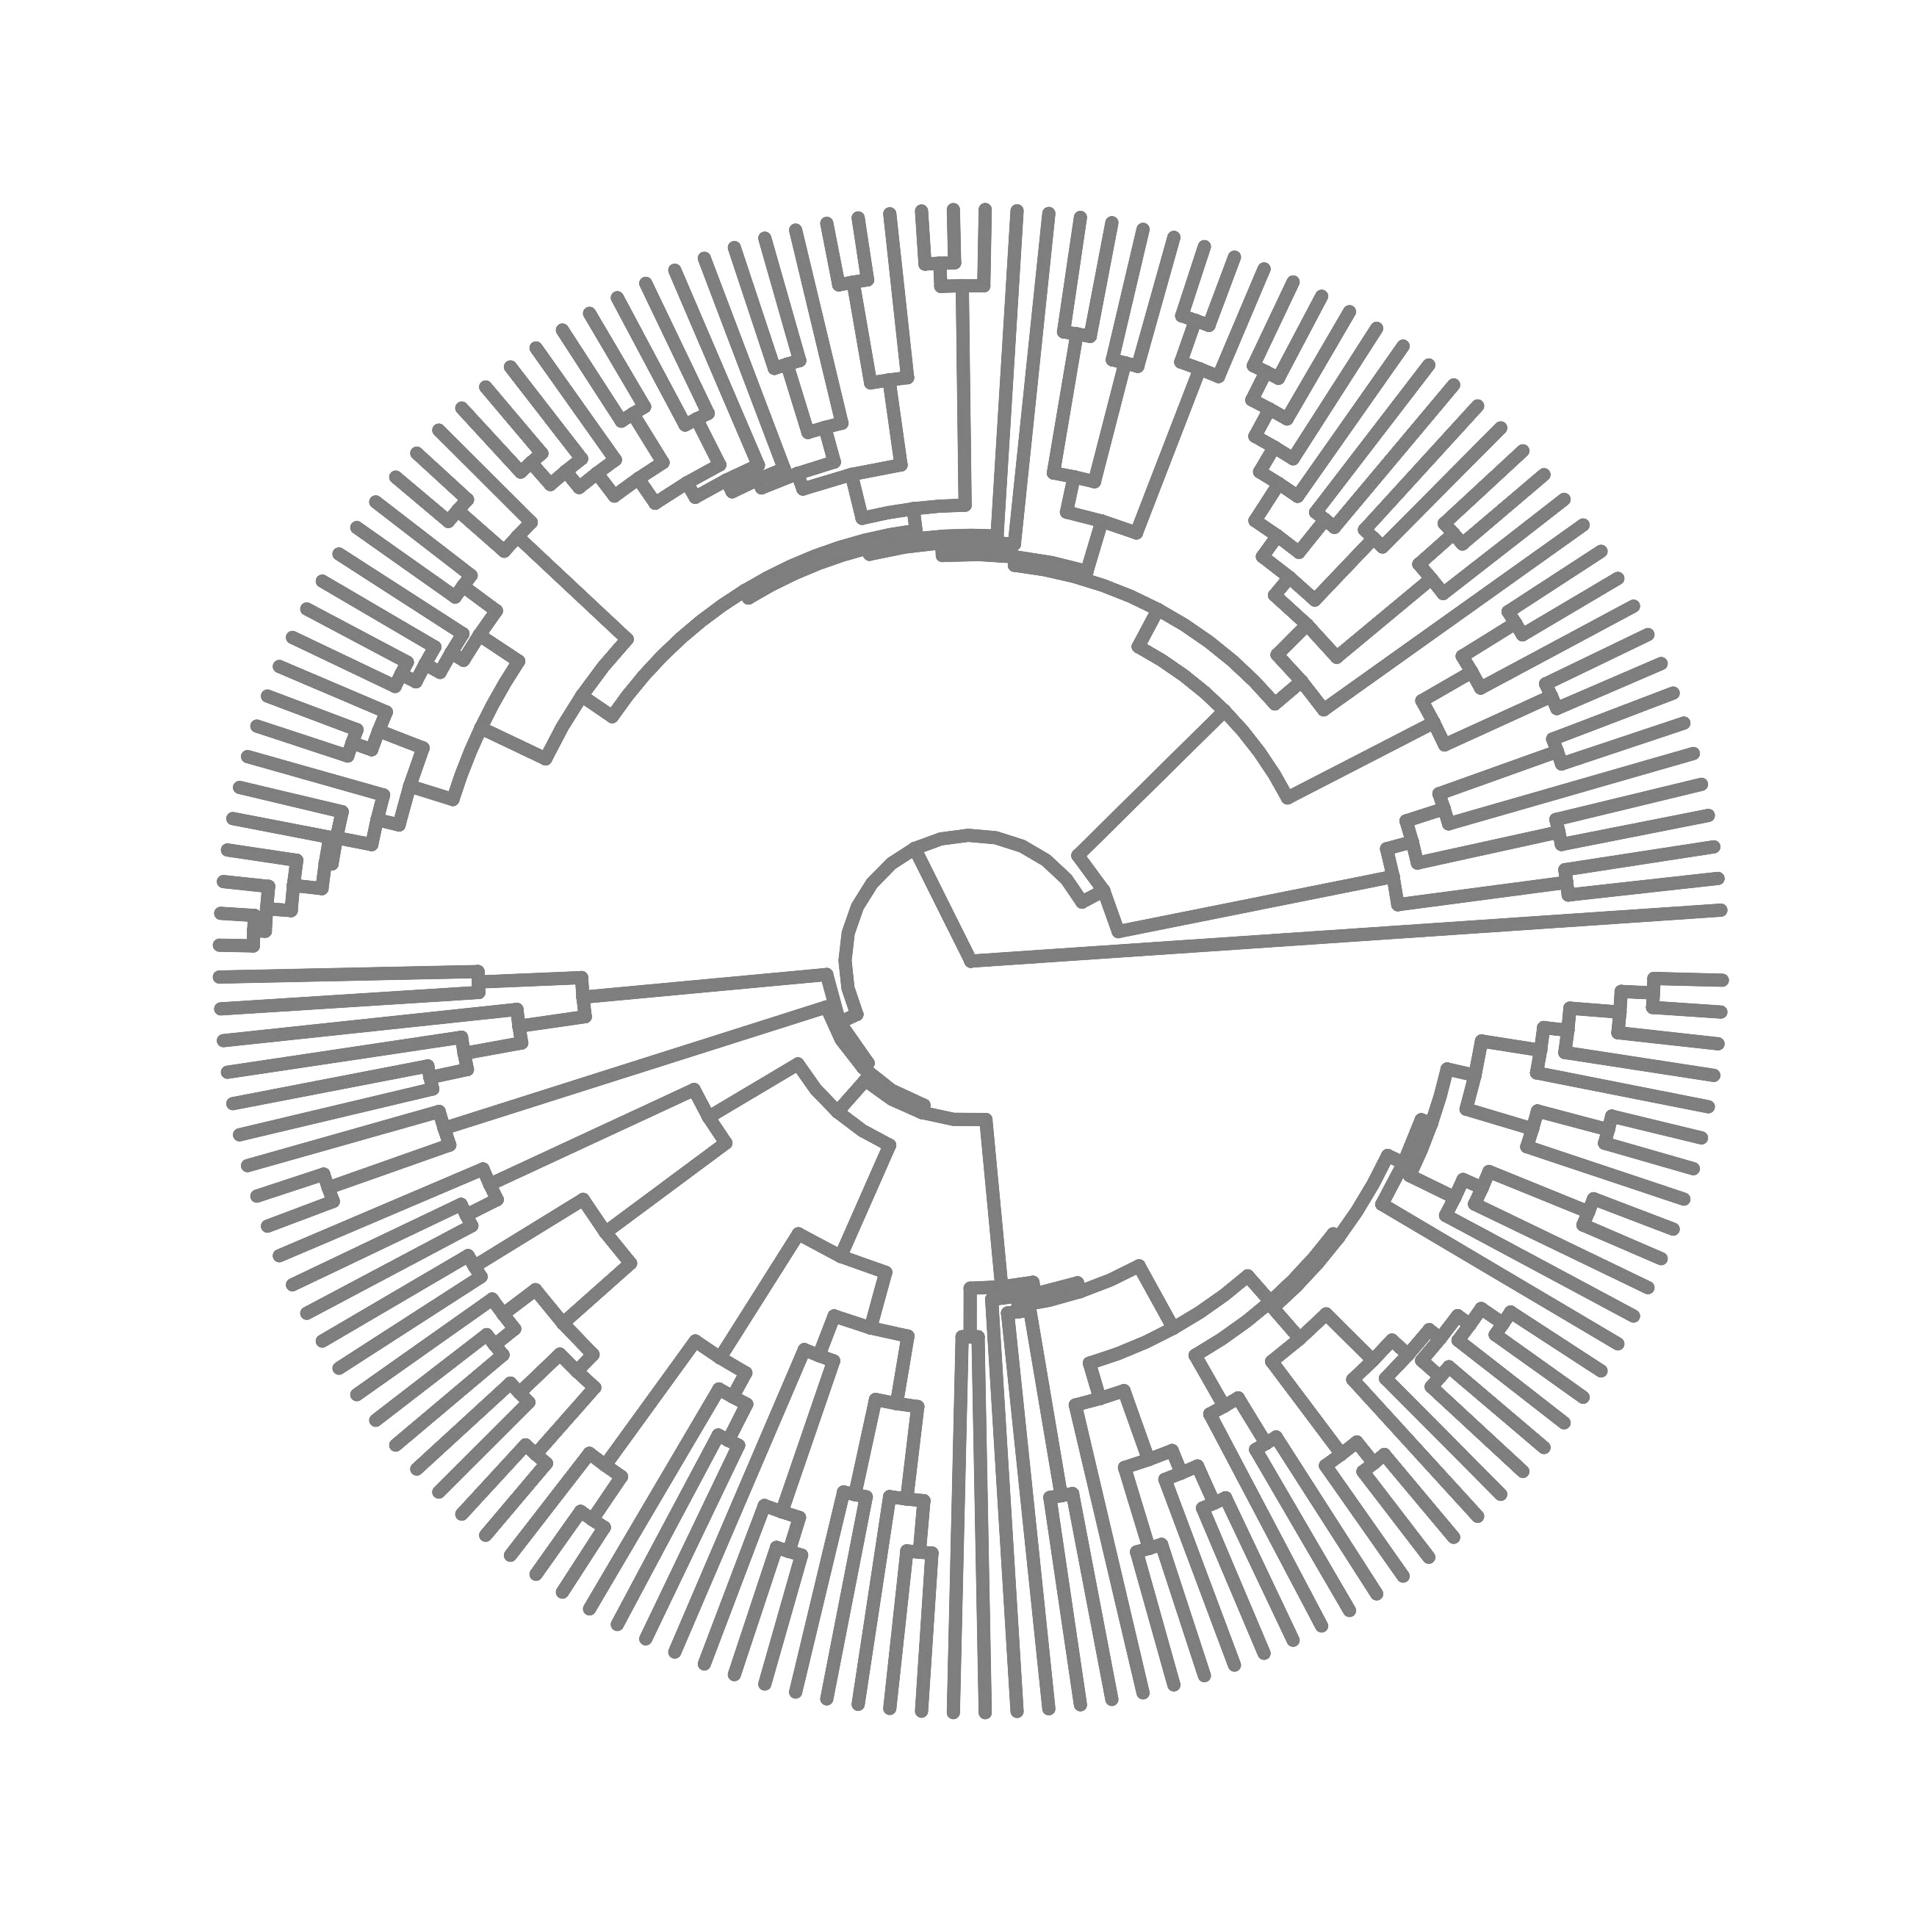

POP. GENETICS
EVOLUTION
BIOINFORMATICS
ECOLOGY
GENOMICS
CONSERVATION
SPECIES
INTERACTIONS

