Slide 1
IU International Hochschule – Fernstudium Modul : DLBDSOOFPP01 OBJECT ORIENTED AND FUNCTIONAL PROGRAMMING WITH PYTHON Tutor : Prof. Dr. Max Pumperla Semester : 3. semester Vollzeit Habit Tracking App Conception Phase
Mohamed safa Ben rhouma
Bachelor of Elektrotechnik
Matrikelnummer : 32205321

Slide 2
Introduction
In this Presentation we will introduce the “Habit Tracker” Python app designed to help maintain good habits and be able to track them in your journey .
We will list the method and concept used to build it as well as how we will make it easy for the user to try it

Slide 3
Tools and concepts
To make The Habit Tracker Application we need to use several tools and technics .
Classes and objects
Modules and libraries

Slide 4
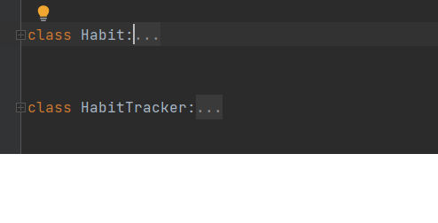
Classes
To make our code according to the OOP concept we will use Classes and objects
We will use two Classes :
Habit Class : it contains function that are used to represent the habit by it´s name , periodicity and the dates of creation and completion.
HabitTracker : here we will make the functions that manages the habits , such as creating them , deleting , getting the list of habits according tour options and saving them

Slide 5
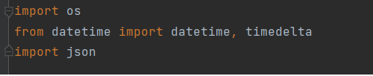
Modules and Libraries
To handle the time managementand the periodicity we will import the datetime library which simplify the entry of the date to the user as well that the machine can comprend it easily
JSON is used to store the data of the user in a separate json file , the app will check if there is already an existing file while launching to load the data from it , if not it will create a new one when the user saves his progress , for this case we did import the os module to be able to interact with the computer

Slide 6
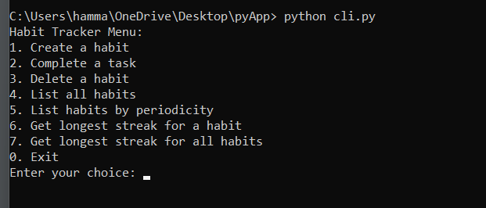
CLI Interface
Navigating the app is easy and understandable to the user thanks to the simplified CLI interface
When launched , the app will show a menu presenting a list of the options that the user can interact with . the user can easily navigate by entering the number or the command according to the option he chose

Slide 7
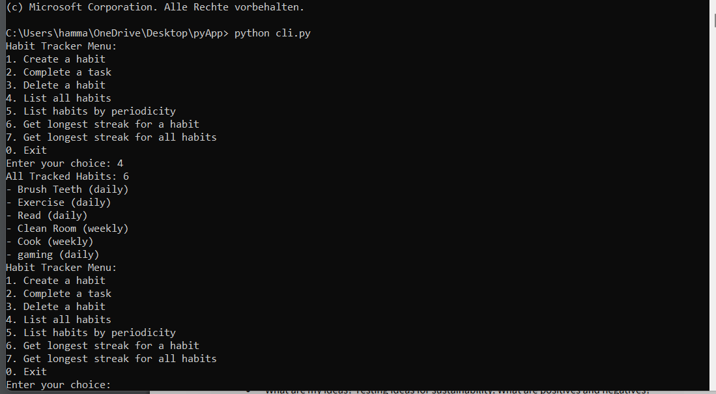
Example of interracting with the Cli
in this example we listed all the registered habit by entering number 4 in the CLI

