Slide 1

Agnel Charities’
Fr. C. Rodrigues Institute of Technology, Vashi
(An Autonomous Institute & Permanently Affiliated to University of Mumbai)
Computer Engineering Department
Major Project Progress Presentation-II
B.Tech in Computer Engineering Sem - VII
2026-27
Notes:
Presenter: Pratham. Good morning. We are Group 28 from the Computer Engineering Department. This is our Major Project Progress Presentation-II for Semester VII. Our project is an Intelligent Diabetes Clinical Decision Support System. It helps a doctor choose the second medicine for an adult with type 2 diabetes who already takes metformin.

Slide 2
Intelligent Diabetes Clinical
Decision Support System
Group No. 28
Pratham Pawar
1023226
Graceton Santhmayor
1022246
Rhian Roy Kuttikadan
1023268
Advik Saxena
1023245
Guide: Mr. Rahul Jadhav
Notes:
Presenter: Pratham. We are Pratham Pawar, Graceton Santhmayor, Rhian Roy Kuttikadan and Advik Saxena, and our guide is Mr. Rahul Jadhav. Each of us will present one part of today’s review.

Slide 3
Presentation Outline
Problem Statement
Proposed System
Hardware & Software Requirements
Timeline / Gantt Chart
System Design
Datasets (synthetic and real Indian data)
Implementation and screens
Initial Results / Demo
Work Completed vs Planned, progress
Conclusion
Notes:
Presenter: Pratham. We begin with the problem statement. Then the proposed system with our block diagram and flowchart, the requirements, timeline and system design. Next, the datasets: the synthetic cohort we train and grade on, and the real Indian data we check it against. Then what is implemented, with screens, our results for the causal engine and the evidence search, a short demo, work completed versus planned with our progress, and the conclusion.

Slide 4
Problem Statement
After metformin, doctors choose between SGLT2 inhibitors, DPP-4 inhibitors and sulfonylureas
Question: which option lowers HbA1c most for this patient?
Old records mislead: different patients get different drugs
Starting HbA1c | Got SGLT2 inhibitor | Got sulfonylurea | Difference
High | 300 patients, −1.2 | 100 patients, −1.0 | −0.2
Lower | 100 patients, −0.6 | 300 patients, −0.5 | −0.1
All patients (naive) | −1.05 | −0.625 | −0.425
Naive difference −0.425 vs fair difference −0.15 (about 3× too big)
Fair = compare like with like, then average: ½ × (−0.2) + ½ × (−0.1)
Illustrative synthetic numbers; HbA1c change in %
Notes:
Presenter: Rhian. When metformin alone does not control blood sugar, the doctor adds a second medicine: an SGLT2 inhibitor, a DPP-4 inhibitor or a sulfonylurea. Which one will help this particular patient most? Old records mislead, because sicker patients were given different drugs. In this made-up example the naive difference is minus 0.425, but comparing like with like gives minus 0.15, about three times smaller.

Slide 5


Proposed System – How DiaCausal Works
1
Patient details
2
Safety rules (cited drug labels)
3
Propensity and overlap check
6-month HbA1c change, weight and low-sugar risk (95% ranges), or “insufficient evidence”
Every request is logged
4
request ID, versions and decisions; no patient values
5
Cost (INR/month)
6
Evidence with citations (RAG: quoted, cited passages)
7
Doctor decides
Dashed = built separately; joins the chat app in October
Notes:
Presenter: Rhian. Every request follows the same order. We take the patient’s details. Safety rules from cited drug labels remove unsafe options. A propensity model checks whether enough similar patients received each drug. If so, we estimate the six-month HbA1c change, the weight change and the low-sugar risk, each with a 95 percent range; if not, we say insufficient evidence. Then cost, then cited evidence from our RAG search, which is built and runs on the website; in October it joins the chat app. The doctor decides, and every request is logged.

Slide 6
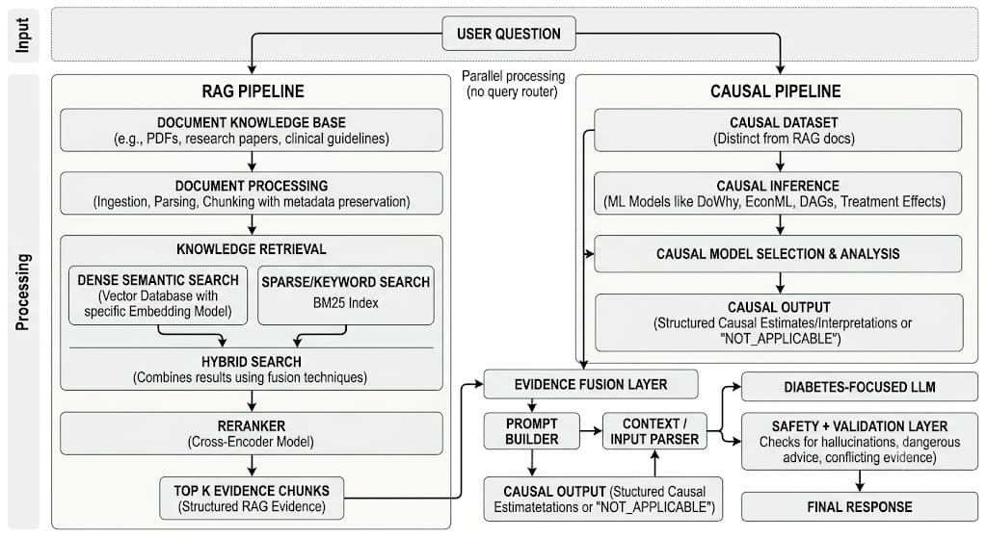
Proposed System – Block Diagram
RAG and causal pipelines run in parallel, then meet in evidence fusion
Notes:
Presenter: Rhian. This block diagram shows the whole system. A user question goes to two pipelines at the same time, with no query router. The RAG pipeline searches documents such as guidelines and research papers, and returns the top evidence chunks. The causal pipeline uses its own dataset and returns structured causal estimates, or NOT_APPLICABLE. Both meet in the evidence fusion layer, which feeds the diabetes-focused LLM and the safety and validation layer.

Slide 7
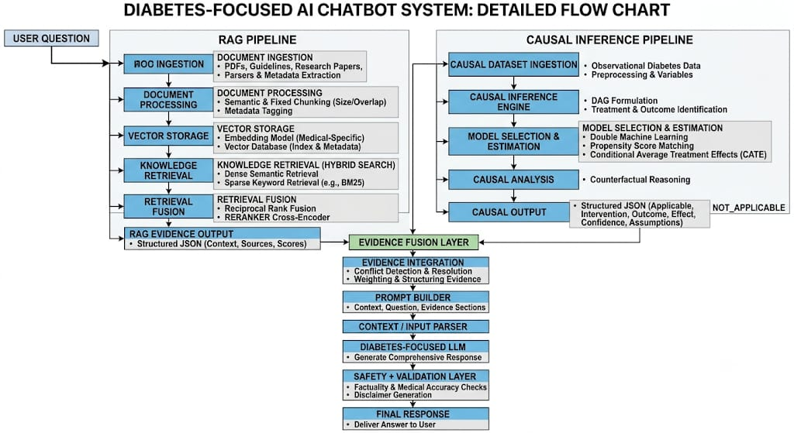
Proposed System – Flowchart
Every stage from ingestion to final response, with safety checks
Notes:
Presenter: Rhian. The flowchart shows each stage in order. In the RAG pipeline: document ingestion, chunking, vector storage, hybrid retrieval with dense search and BM25, then reciprocal rank fusion and a cross-encoder reranker. In the causal pipeline: dataset ingestion, the DAG, model selection and estimation, and counterfactual analysis. Evidence integration resolves conflicts, the prompt builder and LLM write the answer, and the safety layer checks accuracy and adds a disclaimer.

Slide 8
Proposed System – Safety Rules
1
The doctor always decides
2
Safety rules run before any estimate
3
Doses and thresholds only from cited tables, never from AI
4
Refuse to guess (“insufficient evidence”)
5
Every estimate has a 95% range
6
Every request is logged
Intended use: Research prototype for clinician evaluation; not a marketed medical device; not for unsupervised clinical use.
Notes:
Presenter: Advik. These six rules are never broken, and automated tests check them. The doctor always decides; the system only supports the decision. Safety rules run before any estimate, so an unsafe drug never gets a number. Doses and thresholds come only from cited tables, never from AI. When evidence is thin we refuse to guess. Every estimate carries a 95 percent range, and every request is logged.

Slide 9
Hardware & Software Requirements
Tier | Hardware | Software
Development | Laptop with 8 GB+ RAM (MacBook Air, Apple silicon) | Python 3.12, NumPy, pandas, scikit-learn, Matplotlib, pytest, Git/GitHub, Claude Code
Demo | Same laptop, offline; or the website (diacausal.netlify.app) | Streamlit, FastAPI, Uvicorn; website on Netlify with Supabase accounts
Client | Laptop or phone | Any modern web browser
RAG (built) | Same laptop | PDF text, BM25 + TF-IDF search, quoted cited answers; optional Gemini or Ollama
Minimum: 8 GB RAM and 5 GB free disk · the demo runs fully offline
Notes:
Presenter: Advik. Everything runs on an ordinary laptop with at least 8 GB of RAM; we use a MacBook Air. Development uses Python 3.12 with NumPy, pandas, scikit-learn, Matplotlib and pytest, plus Git, GitHub and Claude Code. The demo runs offline on the same laptop, or on our website, diacausal.netlify.app, which has accounts with an authenticator app. The RAG part is built: PDF text extraction, a hybrid BM25 and TF-IDF search, and quoted explanations; Gemini online or Ollama offline can rewrite them, always checked for citations.

Slide 10
System Requirements
Functional
Non-functional
Requirement | Status
Patient input with unit checks | Built
Safety rules with cited reasons | Built
Estimate with 95% range, or “insufficient evidence” | Built
Hypoglycaemia risk and weight change | Built
Cost lookup (INR/month) | Built*
Audit log | Built
REST API | Built
Evidence with citations (RAG) | Built
Website with accounts (MFA) | Built
Quality | Target
Speed | Under 3 s per request
Logging | 100% of requests logged
Testing | At least 80% test coverage
Reproducible | Fixed random seeds
Intended use | Statement on every screen
Accessible | WCAG 2.1 AA
Measured: about 12 ms per request. Coverage and WCAG not yet measured.
*Prices show “unavailable” until confirmed
Notes:
Presenter: Advik. Functional requirements say what the system does, and all of them are now built: patient input with unit checks, cited safety rules, estimates with ranges or insufficient evidence, hypoglycaemia risk and weight change, cost lookup, the audit log, the REST API, evidence with citations and the website with accounts. Prices stay unavailable until confirmed. Non-functional requirements say how well: fast replies, full logging, test coverage, fixed seeds, the intended-use statement and accessibility.

Slide 11
Timeline / Gantt Chart
July
August
September
October
November
December
Topic and proposal
Jul – mid-Aug
Literature and dataset research
Aug – 11 Sep
Dataset decision
12–14 Sep
Causal engine, RAG core, mid-sem
15–30 Sep
RAG upgrades and engine fixes
1–9 Oct
Results frozen and doctor review
10–16 Oct
Chat-app integration, paper draft
17–23 Oct
Final report, paper, viva
24–30 Oct
Practical exams
31 Oct – 7 Nov
Theory exams
18–30 Nov
Final submission
December
Today: 30 Sept
Done
In progress
Planned
Exams
Notes:
Presenter: Advik. Navy bars are done, the blue bar is in progress and grey bars are planned. The dashed line marks today, 30 September. Topic, literature, dataset research and the dataset decision are complete. The causal engine, the core of the RAG evidence search and this mid-sem review are finishing now. October covers a medical embedding model and reranker for RAG, frozen results with a doctor’s review, joining everything in the chat app, the paper and the final report. Exams follow in November, and final submission is in December.

Slide 12








System Design – Architecture
User interface (website, chat app)
FastAPI service
Audit log
POST /api/v1/recommend
no patient values
Safety rules engine (rules.csv)
RAG layer (built)
Causal engine
Approved guideline documents
propensity, overlap, AIPW, DR-learner
licence-cleared sources only
Cost lookup (prices.csv)
Dashed = built separately; joins the API in October
Notes:
Presenter: Graceton. This is the layered architecture. The clinician uses the website, the Streamlit demo or the chat app, which call our FastAPI service. The API sends each request to the safety rules engine first, then to the causal engine for the propensity and overlap check, AIPW and the DR-learner, and then to cost lookup. The RAG layer is built and reads only licence-cleared documents, today WHO 2018 and seven FDA safety notices; it runs on the website now and joins the API in October. Every request is written to the audit log.

Slide 13
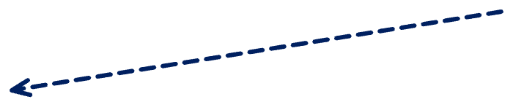
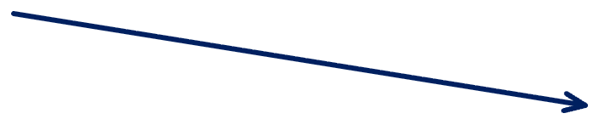









System Design – Data Flow
DFD Level 0
passages
Guideline documents
patient details
0
Clinician
DiaCausal
options, 95% ranges, sources
request ID, versions
Audit store
DFD Level 1
Clinician
1 Validate input
2 Safety rules
3 Causal engine
fitted models
rules.csv
results
6 Log and display
5 RAG explanation
4 Cost lookup
prices.csv
Audit log
Guidelines
Dashed = built separately; joins in October
Notes:
Presenter: Graceton. Level 0 shows the context: the clinician sends patient details and receives options with 95 percent ranges and sources. Guideline documents feed passages, and every request is recorded in the audit store. Level 1 opens the box into six processes: validate the input, apply safety rules, run the causal engine, look up cost, add the RAG explanation, then log and display. Each process reads its own data store.

Slide 14









System Design – Use Case and Sequence
DiaCausal
Enter patient
Review logs
View comparison
Run benchmark
Evaluator
View evidence
Clinician
Export summary
Manage rules
and sources
Admin
Sequence: one consultation
Clinician
UI
API
Safety rules
Causal engine
RAG
Audit log
enter details
POST /recommend
apply rules
rule results
allowed options only
estimate ± 95% range
cite evidence
log request
Causal Output
doctor decides
Notes:
Presenter: Graceton. Three actors use the system. The clinician enters a patient, views the comparison and evidence, and exports a summary. The evaluator reviews logs and runs the benchmark. The administrator manages rules and sources. The sequence shows one consultation: the API checks the safety rules first, sends only allowed options to the causal engine, asks RAG for evidence, logs the request and returns the result. The doctor decides.

Slide 15
System Design – Data and API
rules.csv – safety rules (R01–R10, each cited)
rule id | drug class | condition | action | message | source | section | status
R01 | SGLT2i | eGFR < 45 | EXCLUDE | Not recommended to improve glycaemic control when eGFR < 45 | FARXIGA label; KDIGO 2022 | Sec 1, 2.2 | VERIFIED
R05 | DPP-4i | past pancreatitis | CAUTION | Not studied in patients with a history of pancreatitis | JANUVIA label | Sec 1; 5.1 | VERIFIED
R08 | SU | age ≥ 65 | CAUTION | Higher hypoglycaemia risk; age cut-off 65 is team-set | Glimepiride label | Sec 2.1; 8.5 | UNVERIFIED
prices.csv
drug | INR per month | as-of date | source
dapagliflozin (SGLT2i) | price unavailable | — | to be confirmed (Jan Aushadhi list)
POST /api/v1/recommend
Input: patient details
Output: Causal Output
{"age": 60, "sex": "female",
Each option: estimate with 95% range, or “insufficient evidence”
Exclusions and cautions, each with its source
Versions and a request ID
"duration_years": 8, "hba1c": 8.2,
"egfr": 40, "bmi": 25.5,
"pancreatitis_history": true}
Notes:
Presenter: Graceton. The safety rules live in a table, rules.csv: ten rules, each with a source, a section and a status. Unverified cut-offs are flagged for the doctor to confirm. Prices live in prices.csv and stay unavailable until confirmed with a date and source. The API takes the patient’s details and returns each option’s estimate with its 95 percent range, or insufficient evidence, with exclusions, versions and a request ID.

Slide 16
Datasets – What We Use
Dataset | Real or synthetic | Size | Used for
Synthetic patient cohort | Synthetic, India-calibrated | 5,000 patients × 20 cohorts | Train and grade the causal engine (true answer known)
Safety rules (rules.csv) | Real: drug labels, KDIGO | 10 rules | Remove unsafe options before any estimate
Generator parameters (params.yaml) | Each number: source + status | 117 numbers | How the synthetic patients are made
Evidence sources (RAG) | Real: WHO 2018, 7 US FDA notices | 26 listed, 8 in the search | Cited evidence and quoted answers
Evidence test questions | Written by the team | 60 questions | Measure the evidence search
NMB-2017 survey (new) | Real Indian data, CC0 | 7,496 adults (1,986 diabetic) | Check that synthetic patients look real
No public Indian dataset records which add-on drug each patient got and their HbA1c 6 months later, so the engine is trained and graded on synthetic data, where the true effect is known.
Notes:
Presenter: Graceton. These are all the data DiaCausal uses. The causal engine is trained and graded on a synthetic, India-calibrated cohort, because only there do we know the true effect of each drug. The safety rules and the evidence sources are real documents: drug labels, KDIGO, WHO 2018 and seven FDA safety notices. Every number that makes the synthetic patients has a source and a status. And a real Indian survey, NMB-2017, checks that our synthetic patients look like real Indian patients.

Slide 17
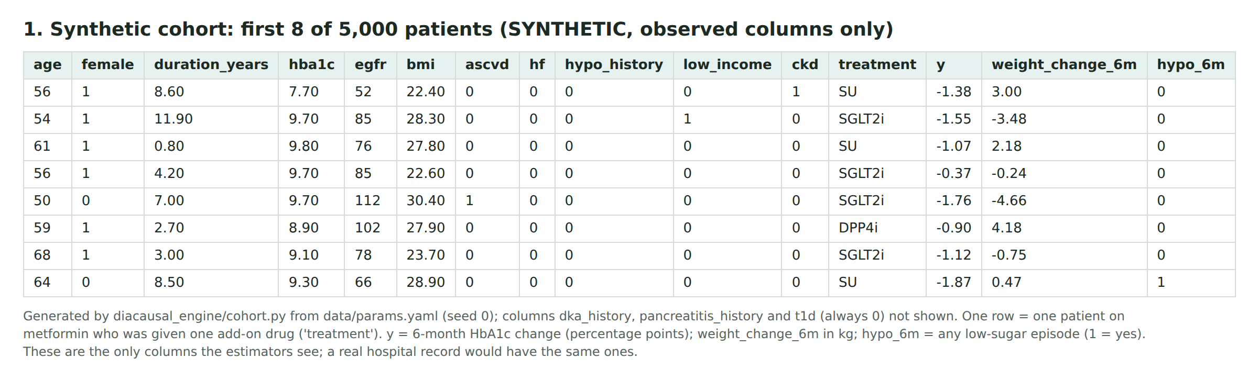
Dataset – Synthetic Cohort (How It Is Made)
1 Draw 5,000 adults on metformin with HbA1c ≥ 7%: age, sex, years with diabetes, HbA1c, eGFR, BMI, history
2 Give each a drug the way doctors tend to (sicker or heavier patients get different drugs = confounding)
3 Work out each patient’s 6-month HbA1c change under all 3 drugs (directions from published studies)
4 Keep only the drug they got; the other two stay hidden, and that hidden truth lets us grade every method
5 Weight change and low-sugar risk made the same way, from a separate random stream
Notes:
Presenter: Graceton. The generator works in five steps. It draws realistic Indian adults on metformin whose HbA1c is still 7 percent or more. It gives each one a drug the way doctors tend to, which builds in the same bias real records have. It works out what would have happened under all three drugs, using directions from published studies, then keeps only the drug each patient got. The picture shows the first eight patients: only these columns reach the estimators, the same columns a hospital record would have.

Slide 18
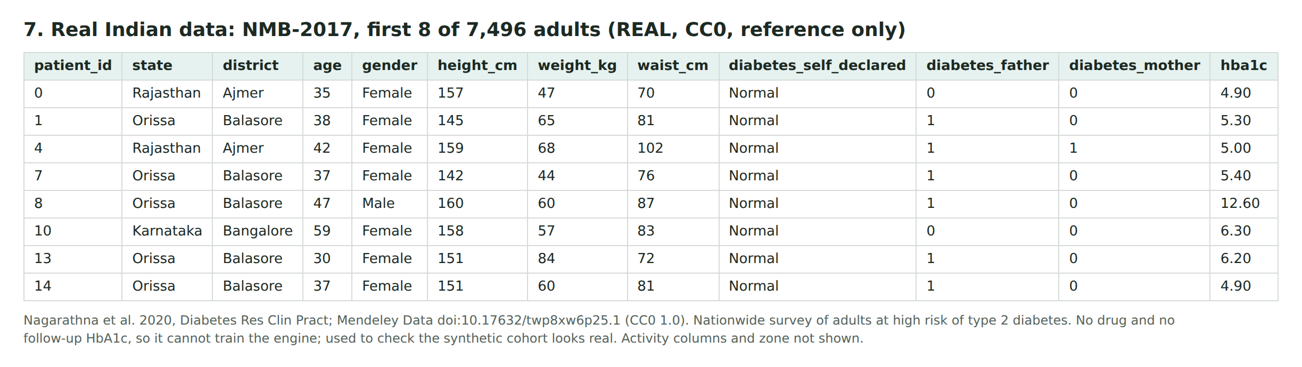
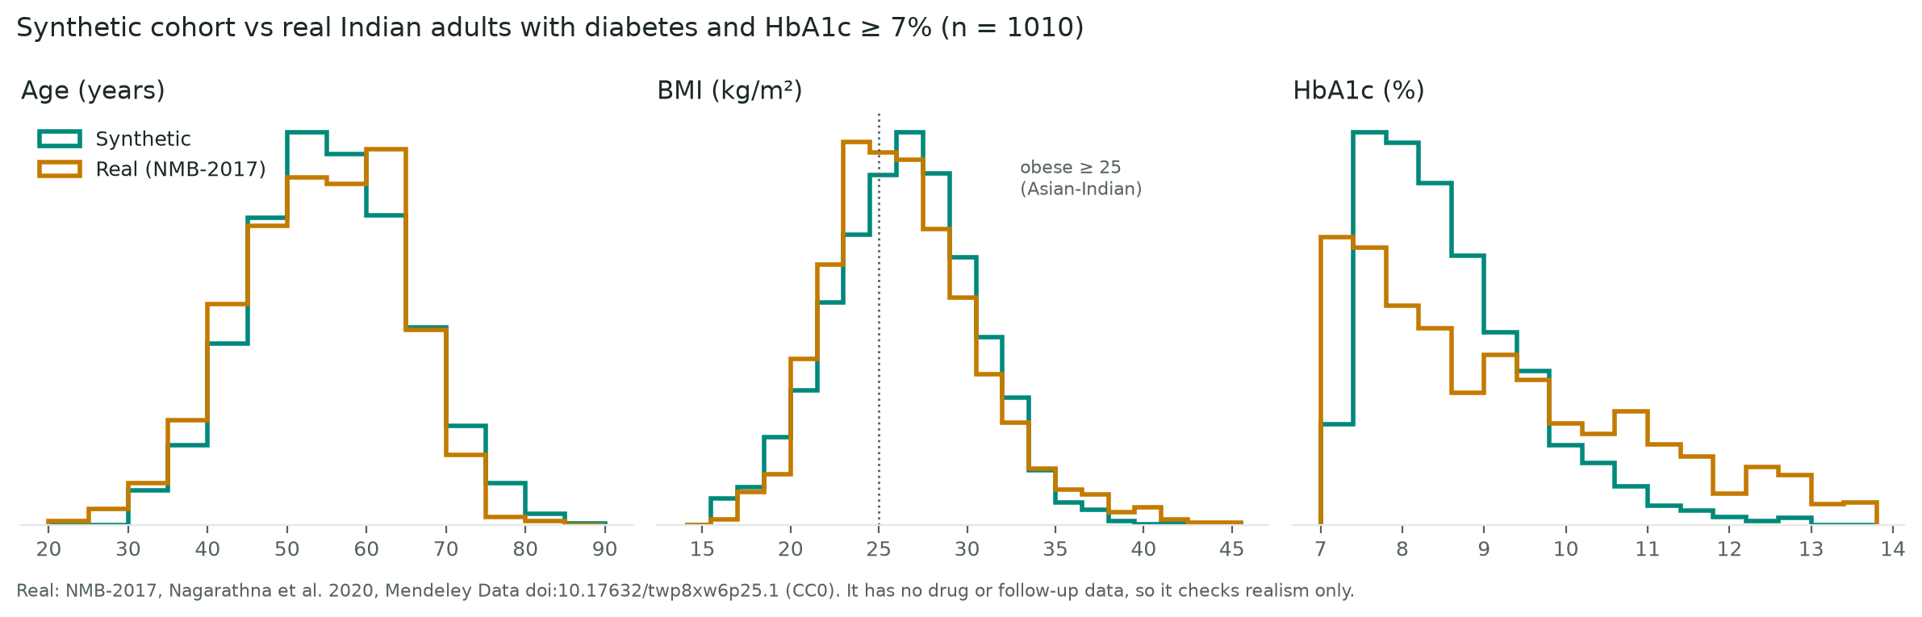
Dataset – Real Indian Data (NMB-2017) vs Synthetic
Matches real Indian adults:
age 55 vs 54, BMI 26.4 vs 26.6, women 45% vs 41%
Differs: HbA1c 8.6 vs 9.2
ours is narrower → widen it next
No drug or follow-up HbA1c:
realism check only, never used to train
Nagarathna et al. 2020, Diabetes Res Clin Pract; Mendeley Data doi:10.17632/twp8xw6p25.1 (CC0) · comparison: diabetes + HbA1c ≥ 7%, n = 1,010
Notes:
Presenter: Graceton. For real Indian data we use NMB-2017, a nationwide survey of 7,496 adults with HbA1c, free to use. It has no drug choice and no follow-up HbA1c, so it cannot train a causal engine; no public Indian dataset has that. We use it to check realism: our synthetic patients match real Indian adults with diabetes on age, BMI and sex. Our HbA1c is a little lower and narrower than the real data, which we will fix and cite.

Slide 19
Implementation – What’s Built
Module | Status | Evidence
Synthetic patient generator | Done | cohort.py; every number sourced in params.yaml
Safety rules | Done | rules.csv: R01–R10, each with a source
Propensity and overlap check | Done | Abstains when propensity is below 0.05
Naive / IPW / AIPW | Done | estimators.py (plus matching); results table
DR-learner | Done | Per-patient estimate with a 95% interval
Metrics; weight and low-sugar risk | Done | Bias, RMSE, coverage, regret; weight and low-sugar risk
Benchmark | Done | 20 cohorts × 5,000 patients; refutation 9 of 9
Demo app and website | Done | Streamlit; diacausal.netlify.app with accounts and MFA
API | Done | POST /api/v1/recommend
Automated tests | Done | 150 engine, 33 RAG, 19 website; chat app 392 + 238
RAG pipeline | Done | WHO 2018 + 7 FDA notices; hybrid search; cited quoted answers
Causal engine v0.3.0 · RAG v1 · synthetic India-calibrated data only
Notes:
Presenter: Rhian. Much more than 25 percent is built and tested. The synthetic patient generator, safety rules, propensity and overlap check, all estimators, the DR-learner, the metrics, the new weight and low-sugar outcomes and the benchmark are done. The Streamlit demo, the website with accounts and the API work. 150 engine tests, 33 RAG tests and 19 website tests pass, plus 630 in the chat app. The RAG pipeline is built: WHO 2018 and seven FDA safety notices, hybrid search, and answers that only quote cited sentences.

Slide 20
Implementation – How the Code Works
AIPW score (doubly robust) – estimators.py
def aipw_scores(Y, T, e, mu):
# phi_a = mu_a(X) + 1{T=a} (Y - mu_a(X)) / e_a(X)
got = (T[:, None] == np.arange(len(ARMS))[None, :]).astype(float)
return mu + got * (Y[:, None] - mu) / e
DR-learner: this patient’s estimate with a 95% interval (condensed)
bread = np.linalg.pinv(B.T @ B)
self.beta_ = bread @ B.T @ pseudo # regress AIPW scores on details
value = B @ self.beta_[:, k] # this patient’s estimate
se = np.sqrt(np.einsum("ij,jk,ik->i", B, self.cov_[k], B)) # HC3 SE
low, high = value - z * se, value + z * se # z = 1.96
Safety thresholds live only in rules.csv, each with a source
Output check refuses any dose, or an estimate without its 95% range
Notes:
Presenter: Rhian. Two short pieces of our real code. The AIPW score starts with the outcome model’s guess, then corrects it using patients who really got that drug, weighted by one over the propensity. If either model is right, the average is right, which is why it is called doubly robust. The DR-learner regresses these scores on patient details, and a robust standard error gives each patient’s 95 percent interval.

Slide 21
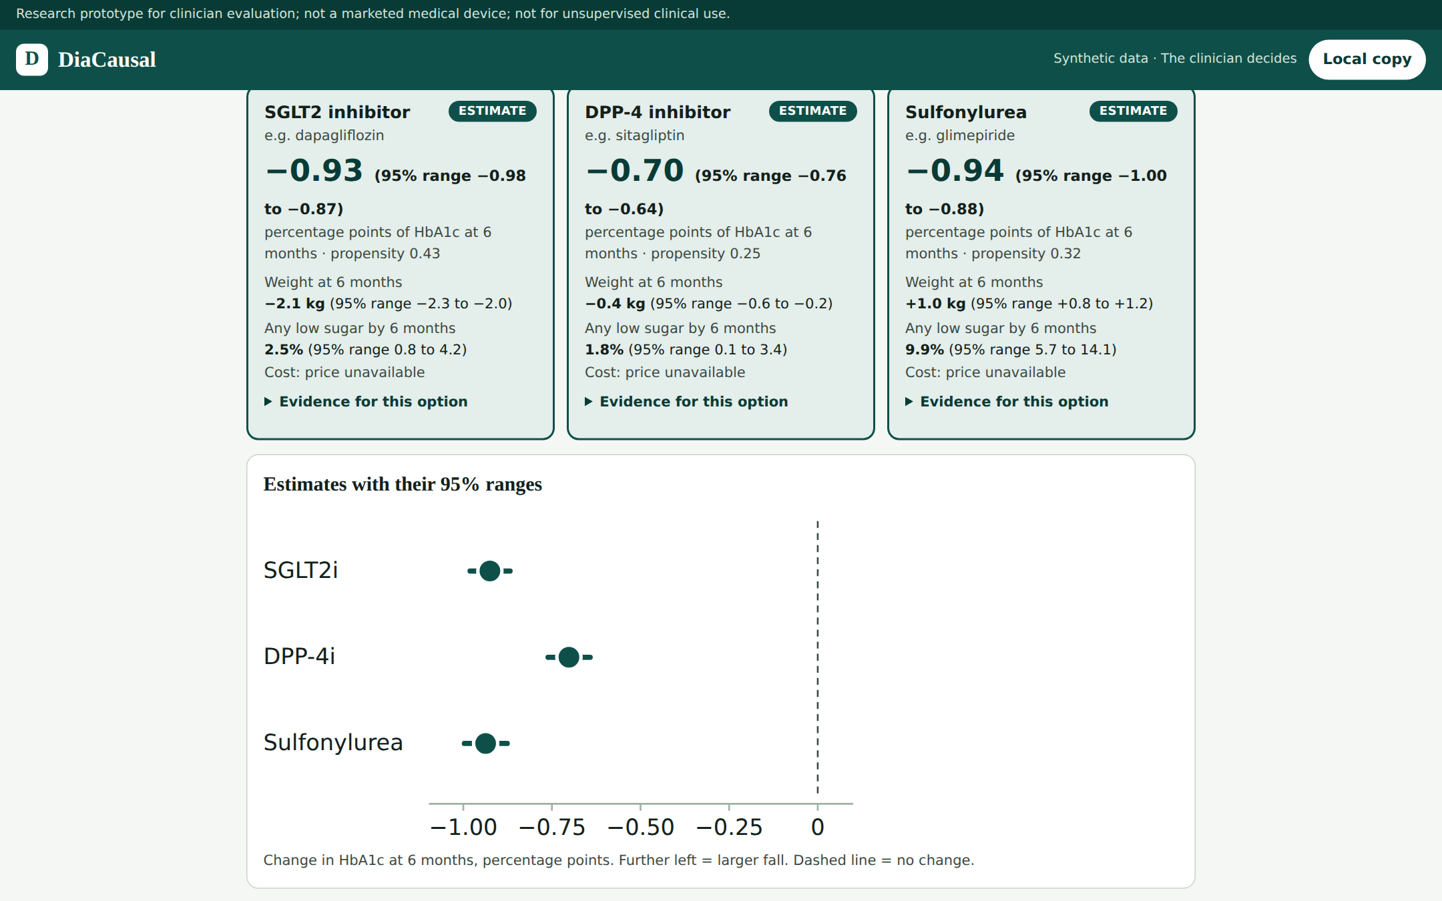
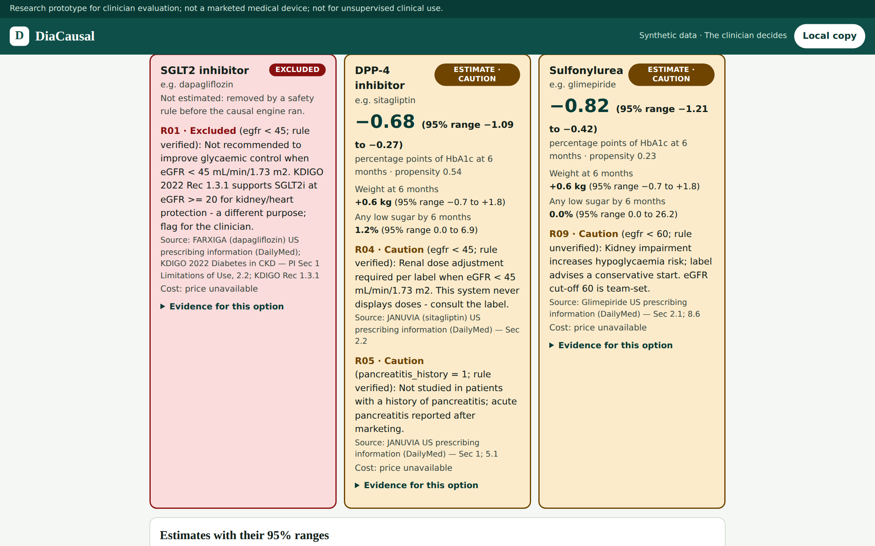
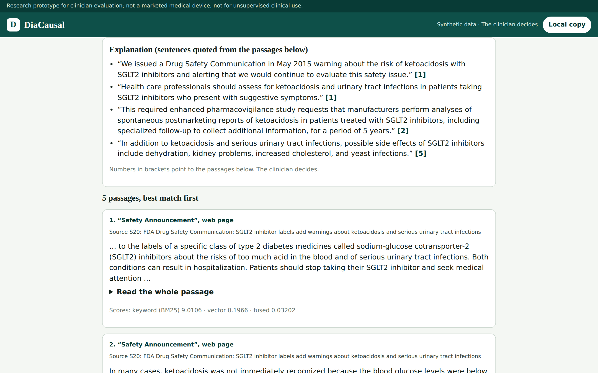
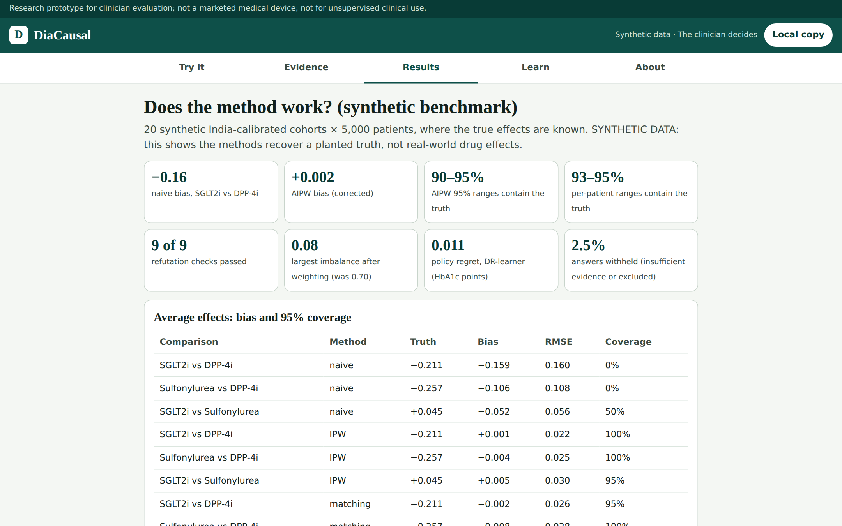
Implementation – Website Screens
Try it: 3 options with 95% ranges, weight, low-sugar risk
Safety rules: excluded (red) and caution (amber), with sources
Evidence: quoted sentences with citations [1][2]
Results: the benchmark, on synthetic data
Notes:
Presenter: Advik. The website, diacausal.netlify.app, runs the same engine in the browser and works offline. Try it shows the three options with their 95 percent ranges, plus weight change and low-sugar risk. Safety rules exclude or caution options, always with the source. The Evidence tab answers only with quoted, cited sentences, and refuses dose questions. Results shows the benchmark. Sign-in needs an approved account and an authenticator app.

Slide 22
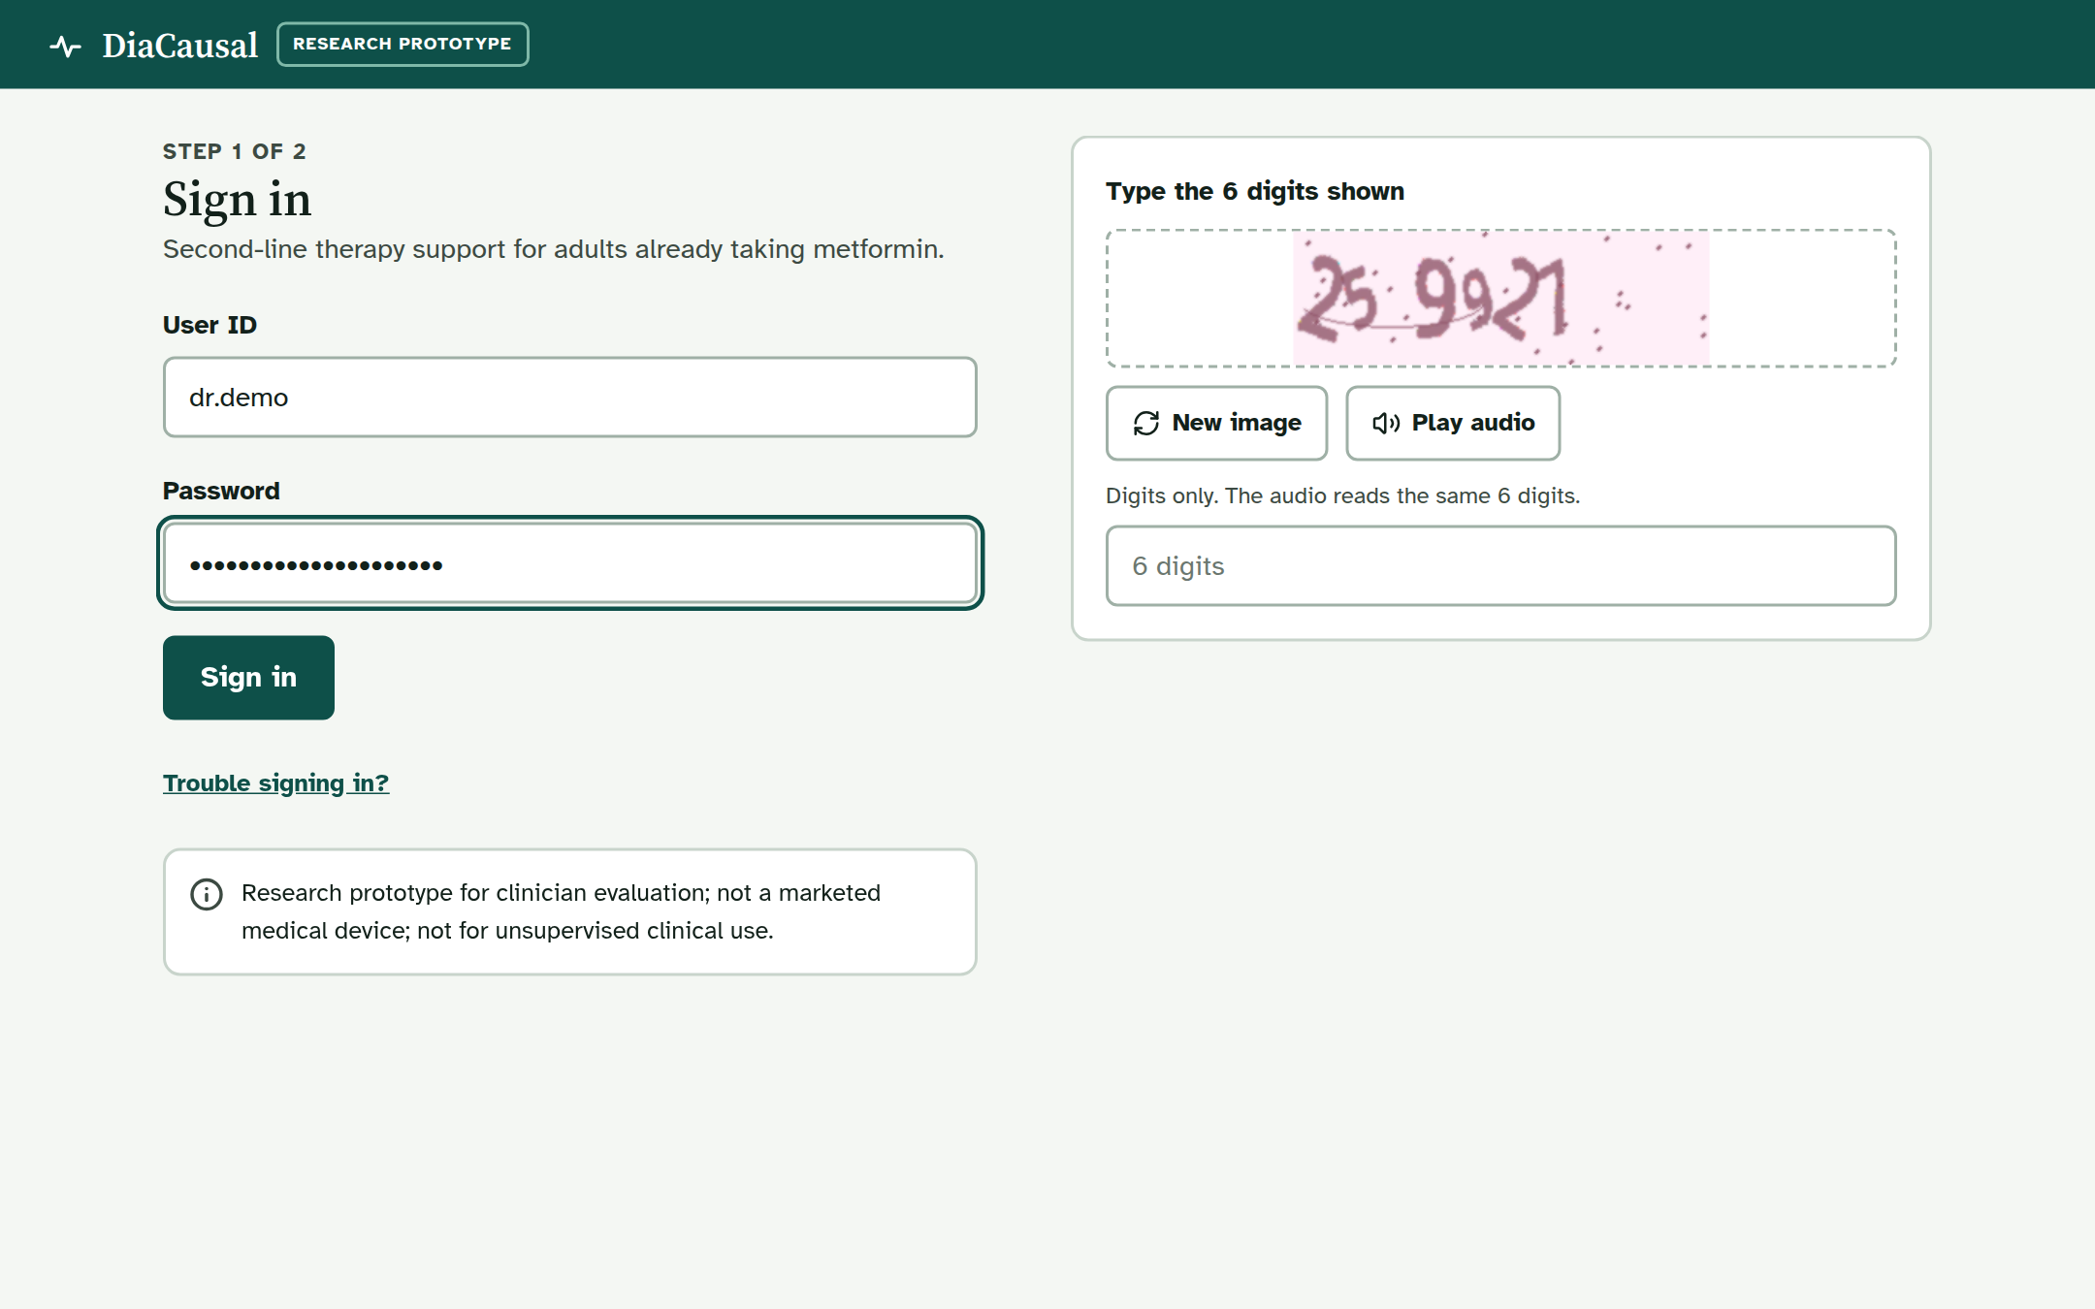
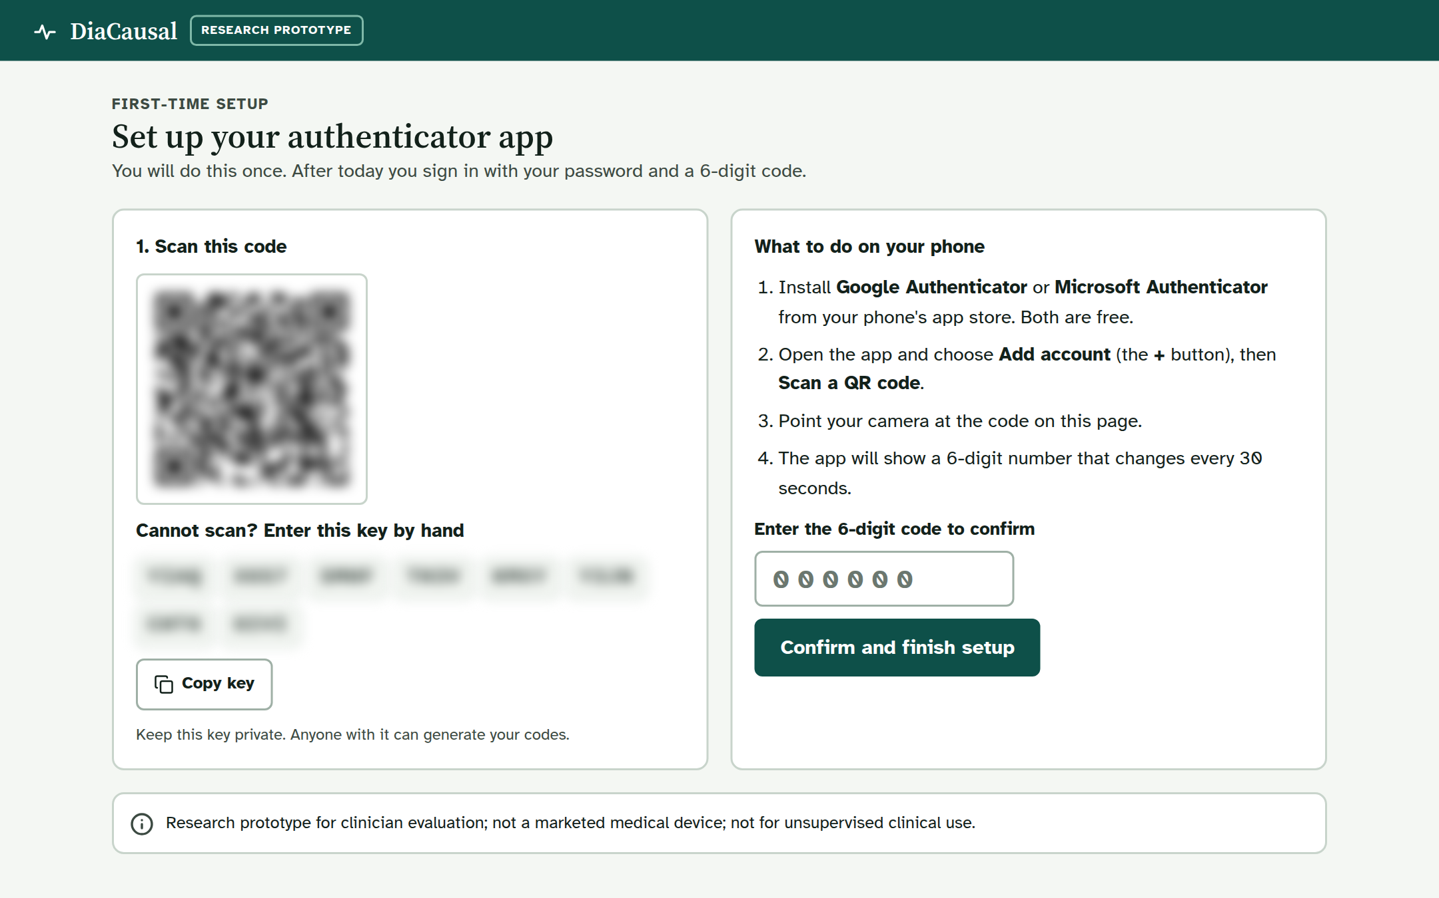
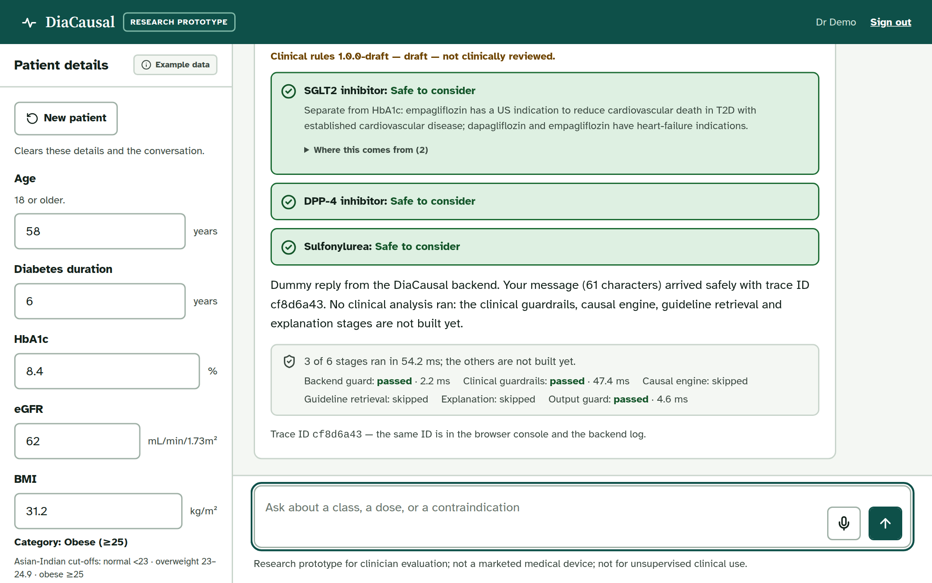
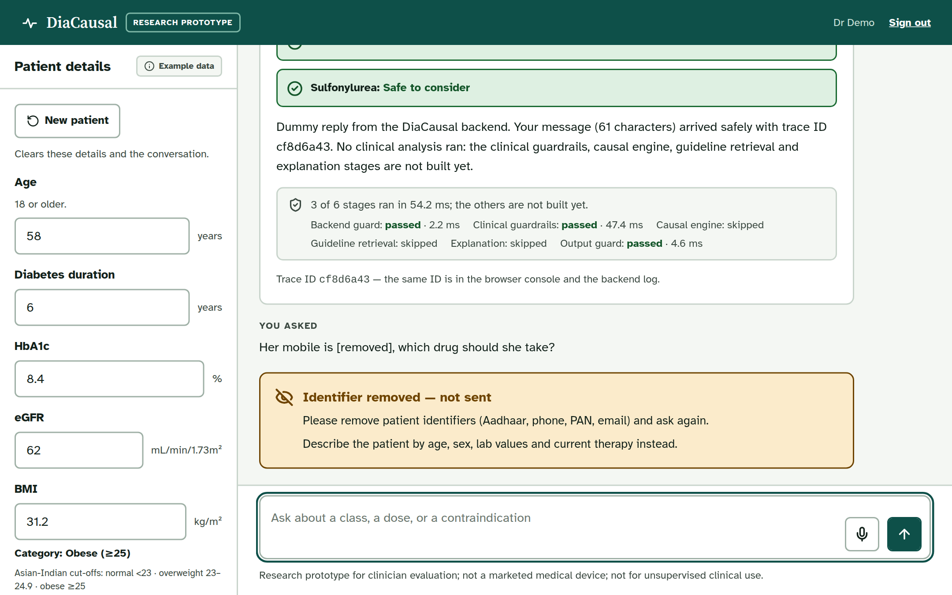
Implementation – Chat App Screens
Sign in: password + CAPTCHA (image or audio)
Authenticator app (TOTP) set-up; key hidden here
Patient panel + reply: 6 pipeline stages, trace ID
Guards: phone number removed, never sent
Notes:
Presenter: Advik. The chat app is FastAPI with React. Sign-in uses a password, a CAPTCHA with an audio option, and an authenticator app. The patient panel sends values alongside the question; the reply lists the six pipeline stages, and today three of them run. Guards remove identifiers such as phone numbers before anything is sent, and refuse out-of-scope questions such as pregnancy. The causal engine and RAG join these stages in October.

Slide 23
Initial Results – Accuracy
Bias vs truth: SGLT2i minus DPP-4i (HbA1c points)
−0.159 → +0.002
0.05
Bias: naive → AIPW
+0.001
+0.002
0.00
−0.002
90–95%
−0.05
AIPW 95% interval coverage
−0.10
92.7–94.7%
DR-learner per-patient coverage
−0.15
−0.159
0.011
−0.20
Policy regret (naive: 0.062)
Naive
IPW
Matching
AIPW
20 synthetic India-calibrated cohorts × 5,000 patients; true effect −0.211. Balance: largest SMD 0.70 → 0.08. Refutation: 9 of 9 checks passed.
Synthetic data: shows the methods recover a planted truth, not real-world drug effects.
Notes:
Presenter: Rhian. On synthetic data we know the true answer. The naive comparison overstates the SGLT2 inhibitor’s benefit over the DPP-4 inhibitor, with a bias of minus 0.159. AIPW cuts the bias to 0.002. Its 95 percent intervals contain the truth 90 to 95 percent of the time, and the DR-learner’s per-patient intervals 92.7 to 94.7 percent. All nine refutation checks passed.

Slide 24
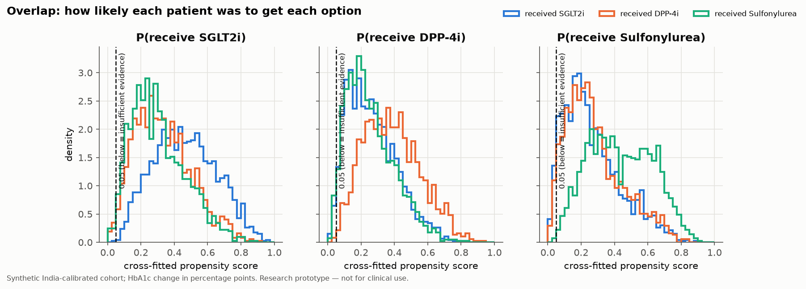
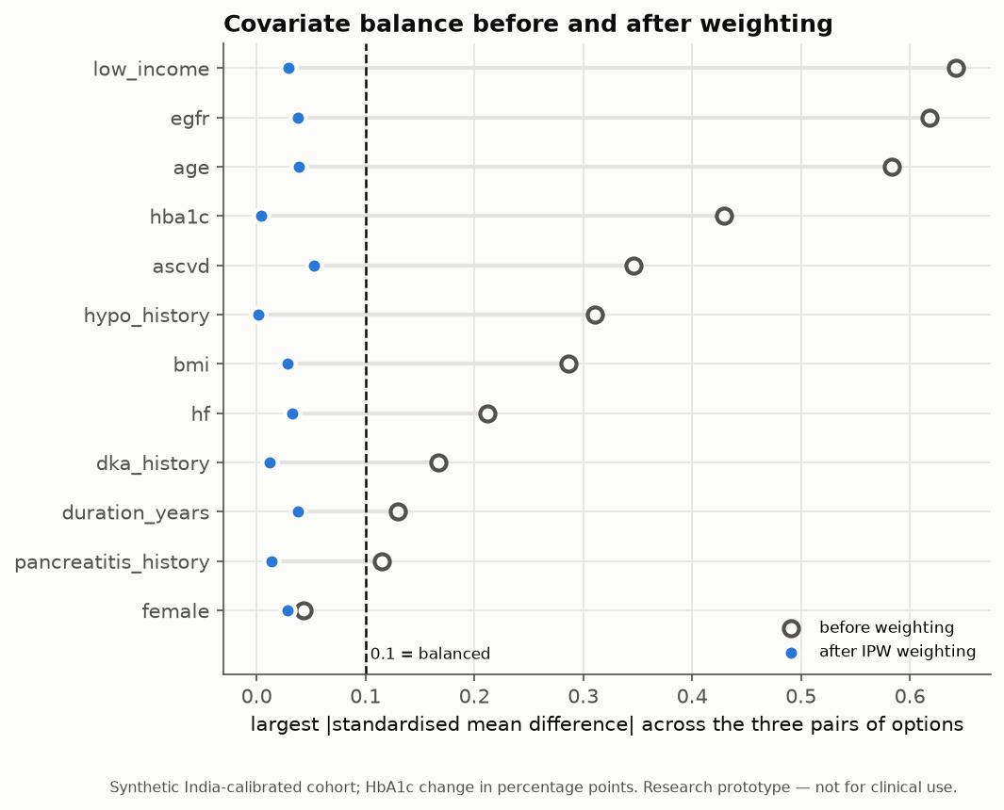
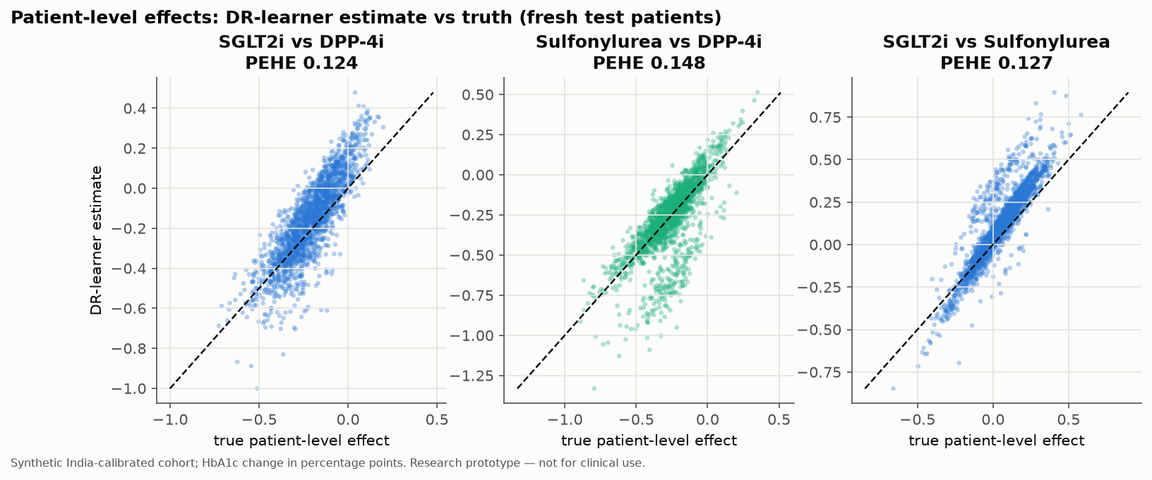
Initial Results – Plots
Overlap: below 0.05, the system abstains (“insufficient evidence”)
Balance: largest SMD 0.70 → 0.08
Per-patient effects vs truth on fresh test patients
Notes:
Presenter: Pratham. Top: overlap. The dashed line at 0.05 is where the system refuses to estimate, because too few similar patients got that drug. Top right: balance. After weighting, every patient detail sits below the 0.1 line, so the three drug groups look alike. Bottom: each dot is a fresh test patient, and the estimates lie close to the diagonal, so per-patient effects are recovered.

Slide 25
Initial Results – Evidence Search (RAG)
0.933
Recall@5: right source in the top 5
1.000 · 0 leaks
Citation precision · dose leaks
0.800
Abstention when not covered (target 0.9)
0.978
Answerable questions answered
60 test questions (45 answerable, 10 out of scope, 5 dose) · results/rag_eval_summary.csv · 20 questions await a doctor’s review
Notes:
Presenter: Rhian. We test the evidence search on 60 questions. The right source is in the top five for 93 percent of answerable questions. Every quoted sentence cites a passage that really contains it, and all five dose questions are refused: no dose ever leaks. It correctly says insufficient evidence for 80 percent of out-of-scope questions; our target is 90, so this is what the medical embedding model in October must improve.

Slide 26
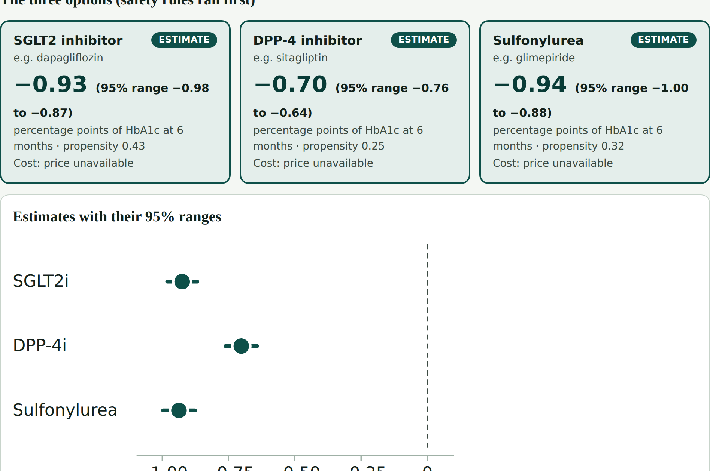
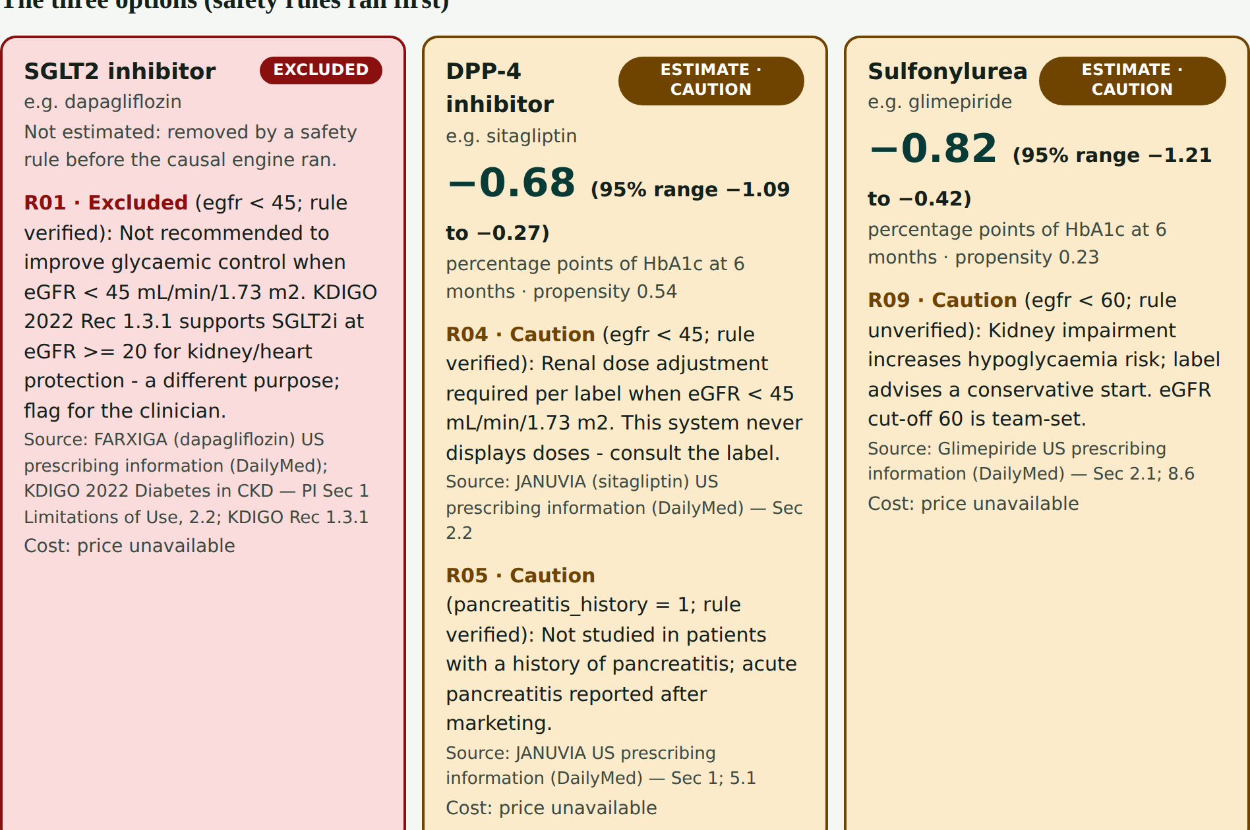
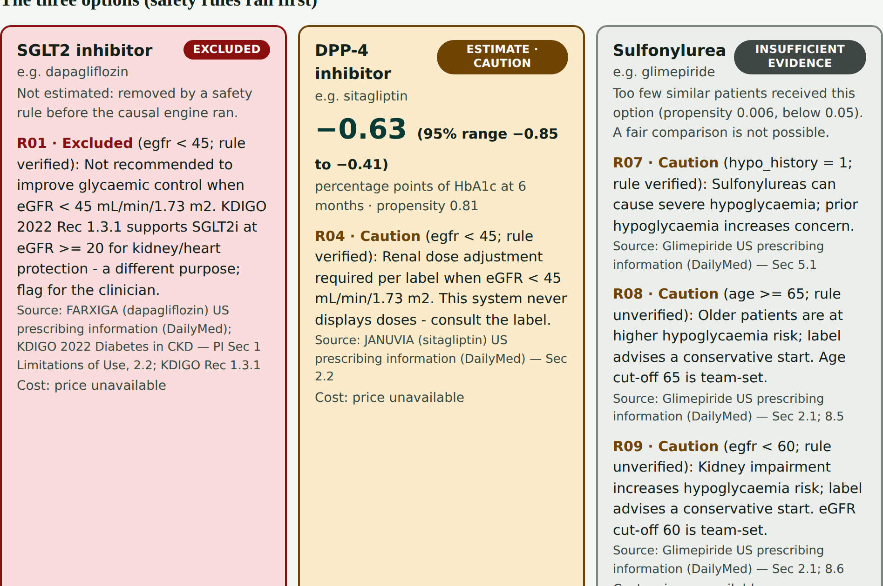
Demo
1 · Typical patient
2 · eGFR 40, past pancreatitis
3 · Older, past hypoglycaemia
Colour key (never green for “recommended”)
Red = excluded by a cited rule
Live demo
Amber = caution
Website (diacausal.netlify.app) or Streamlit, three preset patients
Grey = insufficient evidence
Backup
Teal = estimate with its 95% range
recorded demo video (112 s)
Notes:
Presenter: Graceton, with Rhian driving the laptop. Preset one, a typical patient, gets three estimates with ranges. Preset two has eGFR 40 and past pancreatitis: the SGLT2 inhibitor is excluded in red with its source, and the DPP-4 inhibitor shows an amber caution. Preset three, an older patient with past hypoglycaemia, shows insufficient evidence in grey for the sulfonylurea. Then we switch to the live app; the recorded video is our backup.

Slide 27
Work Completed vs Planned
Completed (by 30 Sept)
Problem, scope, literature and dataset research
Synthetic cohort, checked against real Indian data (NMB-2017)
Safety rules R01–R10; IPW, matching, AIPW, DR-learner
Weight and low-sugar risk; benchmark, 9 of 9 refutation checks
RAG: WHO + FDA sources, cited answers, 60-question test
Website with accounts; chat app with guards, sign-in, voice
Planned (October)
1–9 Oct: medical embeddings and reranker; engine fixes
10–16 Oct: results frozen; doctor review
17–23 Oct: engine and RAG in the chat app; paper draft
24–30 Oct: final report, IEEE paper and viva
Usability study (SUS) with clinicians
Real-data step: hospital records, with ethics approval
Notes:
Presenter: Advik. Completed: the problem and research work; the synthetic cohort, now checked against real Indian data; the cited safety rules and all the causal estimators; the weight and low-sugar outcomes with the benchmark and its checks; the RAG evidence search with cited answers and a 60-question test; and the website and chat app. Planned for October: a better search model, frozen results with a doctor’s review, joining the engine and RAG in the chat app, the paper and report, a usability study, and the real-data step with ethics approval.

Slide 28
Progress – About 64% of the Whole Project
Part | Share | Done | Evidence
Chat app: UI, guards, sign-in, patient panel, guardrails, voice | 20% | ~95% | 392 backend + 238 frontend tests
Causal engine and benchmark | 25% | ~90% | 150 tests; 9 of 9 checks. Missing: real data
RAG evidence search and explanations | 20% | ~75% | 33 tests. Missing: embeddings, reranker
Joining engine + RAG + LLM in the chat app | 15% | ~10% | 3 of 6 stages still skipped
Clinician evaluation (25 cases, SUS) | 10% | ~20% | Pack ready; not yet run
Report and IEEE paper | 10% | ~40% | Mid-sem report done
Total | 100% | ≈ 64% | 0.2×95 + 0.25×90 + 0.2×75 + 0.15×10 + 0.1×20 + 0.1×40
Shares are the team’s estimate of each part of the whole year; each “done” points to tests or files in the repository.
Notes:
Presenter: Pratham. The mid-sem asked for about 25 percent. By our weighted estimate we are at about 64 percent of the whole project. Each part is weighted by its share of the year, and each percentage points to tests or files. Every core part works and is tested on its own. What is left: joining them in the chat app, the doctor’s review and usability study, a better search model, the real-data step and the paper.

Slide 29
Conclusion
1
Causal engine and cited evidence search working
2
Safety rules run before any estimate
3
Honest uncertainty: 95% ranges and refusal to guess
4
Next: one chat app, doctor review, IEEE paper
The doctor always decides. The system supports, and never replaces, clinical judgement.
Notes:
Presenter: Pratham. To conclude: the causal engine works on India-calibrated synthetic data and recovers the planted truth, and the evidence search answers only with quoted, cited sentences. Safety rules always run before any estimate. We are honest about uncertainty, with 95 percent ranges, and we refuse to guess when evidence is thin. Next: joining everything in one chat app, a review by a doctor, and our IEEE paper.

Slide 30
References
[1]
B. M. Shields et al., “Patient stratification for determining optimal second-line and third-line therapy for type 2 diabetes: the TriMaster study,” Nat. Med., vol. 29, pp. 376–383, 2023.
[2]
J. M. Dennis et al., “Development of a treatment selection algorithm for SGLT2 and DPP-4 inhibitor therapies in people with type 2 diabetes,” Lancet Digit. Health, vol. 4, no. 12, pp. e873–e883, 2022.
[3]
L. M. Gudemann et al., “Validation of an algorithm for selection of SGLT2 and DPP4 inhibitor therapies in people with type 2 diabetes across major UK ethnicity groups,” Lancet Reg. Health Eur., vol. 61, 101547, 2026.
[4]
R. M. Anjana et al., “Metabolic non-communicable disease health report of India: the ICMR-INDIAB national cross-sectional study (ICMR-INDIAB-17),” Lancet Diabetes Endocrinol., vol. 11, no. 7, pp. 474–489, 2023.
[5]
E. H. Kennedy, “Towards optimal doubly robust estimation of heterogeneous causal effects,” Electron. J. Stat., vol. 17, no. 2, pp. 3008–3049, 2023.
[6]
P. Lewis et al., “Retrieval-augmented generation for knowledge-intensive NLP tasks,” in Proc. NeurIPS, 2020.
[7]
A. G. Cashin et al., “Transparent reporting of observational studies emulating a target trial – the TARGET statement,” JAMA, vol. 334, no. 12, pp. 1084–1093, 2025.
[8]
R. Nagarathna et al., “A composite of BMI and waist circumference may be a better obesity metric in Indians with high risk for type 2 diabetes (NMB-2017),” Diabetes Res. Clin. Pract., 2020.
[9]
World Health Organization, “Guidelines on second- and third-line medicines and type of insulin for the control of blood glucose levels in non-pregnant adults with diabetes mellitus,” WHO, Geneva, 2018.
Notes:
Presenter: Advik. These are our key references in IEEE style. TriMaster and the Dennis algorithm show that the best second-line drug differs between patients, and Gudemann and colleagues validated that algorithm across UK ethnic groups. ICMR-INDIAB gives the Indian context. Kennedy’s paper is the basis of our DR-learner, Lewis and colleagues introduced retrieval-augmented generation, and the TARGET statement guides how we report studies that emulate a trial. We add NMB-2017, the real Indian survey we use as a realism check, and the WHO 2018 guideline, the main source in our evidence search.

Slide 31
Thank You!
Notes:
Everyone. Thank you for listening. We are happy to take your questions, and we can show the live demo again if needed.

Slide 32
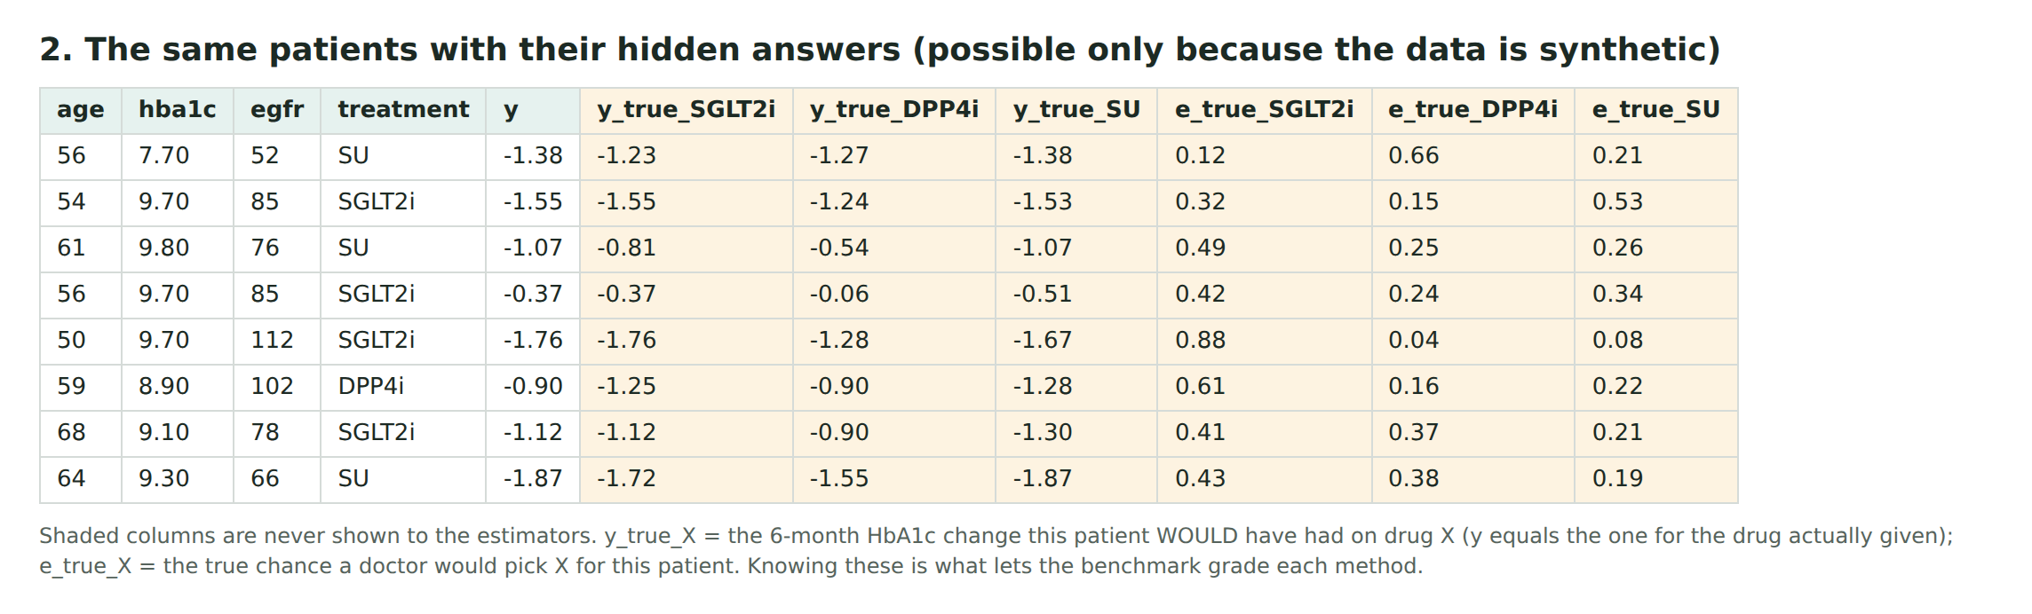
Backup – Why Synthetic Data Is Valid
• Real records never show what would have happened on the other drug, so no real dataset can grade a causal method.
• Synthetic data with a known truth is how causal methods are tested (ACIC challenges, IHDP benchmark).
• Ours: truth −0.211; naive −0.370; AIPW −0.209 with 95% coverage; 9 of 9 refutation checks.
• It proves the method, not the drug effects: 117 numbers = 9 cited, 15 assumed-directional, 93 team-set.
Notes:
Backup for questions. Shaded columns are the hidden answers each patient would have had on each drug. Because we know them, we can grade every method. This proves the method recovers a known effect under realistic bias; it does not prove how much each drug lowers HbA1c in Indian patients.

Slide 33
Backup – Real Indian Diabetes Datasets
Dataset | What it has | Drug + later HbA1c? | Access
NMB-2017 (Nagarathna 2020) | 7,496 adults; HbA1c, BMI, waist, family history | No | Open, CC0 (in our repo)
LASI Wave 1 (IIPS) | ~66,000 adults 45+; HbA1c from dried blood spot | No | Free request with ID
NFHS-5 (2019–21) | Blood glucose; on diabetes medicine or not | No | Registration (DHS Program)
CARRS (Chennai, Delhi) | 12,271 adults, followed every 2 years | No add-on drug | Request to investigators
ICMR-INDIAB | National prevalence (~113,000) | No | Published tables only
Pune clinic study (2025) | 18,950 T2D patients; HbA1c, medicines | Partly | On request to authors
Pima is Native American (US) data, not Indian, and has no drug or outcome: not used. Checked 28 Sept 2026.
Notes:
Backup for questions. These are the real Indian datasets. None records the add-on drug together with HbA1c months later, which a causal engine needs. NMB-2017 is open, so it is in our repository as a realism check; LASI is the next step for calibration.

Slide 34
Backup – From Prototype to a Real Hospital
1 Data: hospital records of metformin patients who started SGLT2i, DPP-4i or a sulfonylurea, with HbA1c 3–9 months later
2 Approvals: hospital ethics committee, de-identification, India’s DPDP Act 2023
3 Same code: the records have the same columns as our synthetic cohort, so nothing changes
4 Checks without a known truth: overlap rule, refutation tests, E-values, agreement with trial results
5 Silent pilot: doctors see the suggestion but decide as usual; later a CDSCO medical-device review
“We proved the method where the truth is known; next, the same code on ethically approved hospital records.”
Notes:
Backup for questions: how it could be used in a real hospital. Real records with ethics approval replace the synthetic cohort with no code change; we check them with the overlap rule, refutation tests and agreement with trials; then a silent pilot. Use in routine care would need a medical-device review.

Slide 35
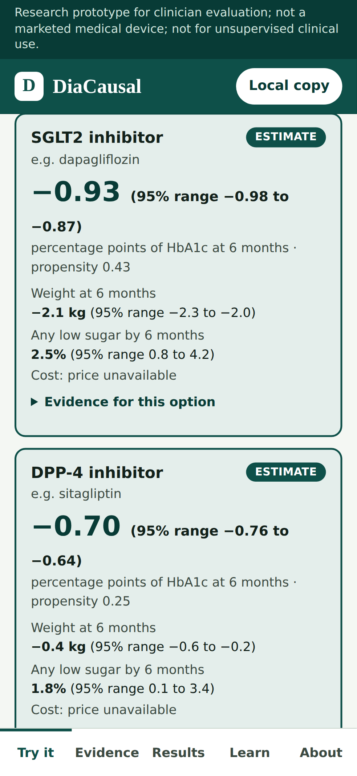
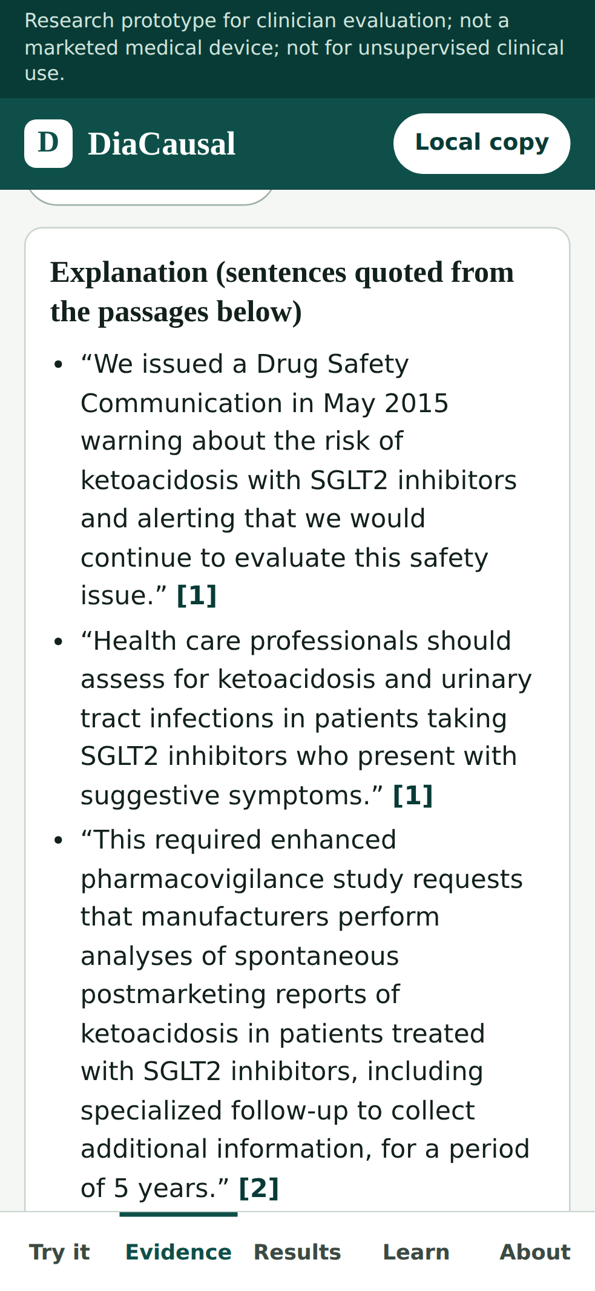
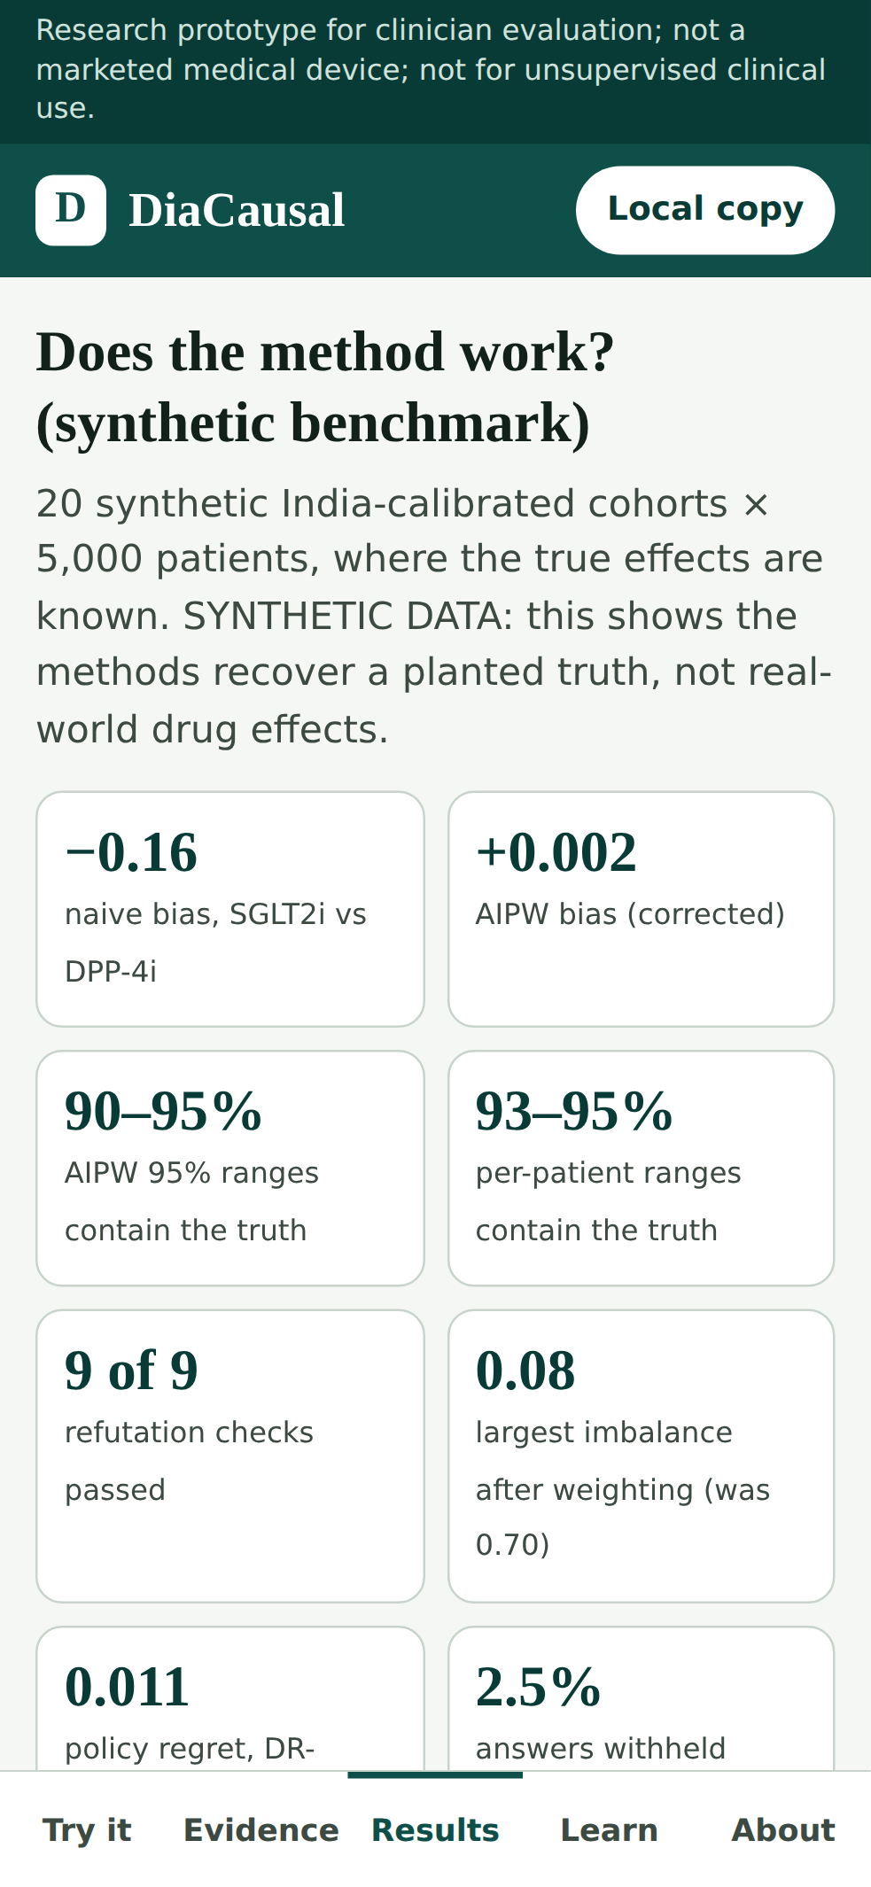
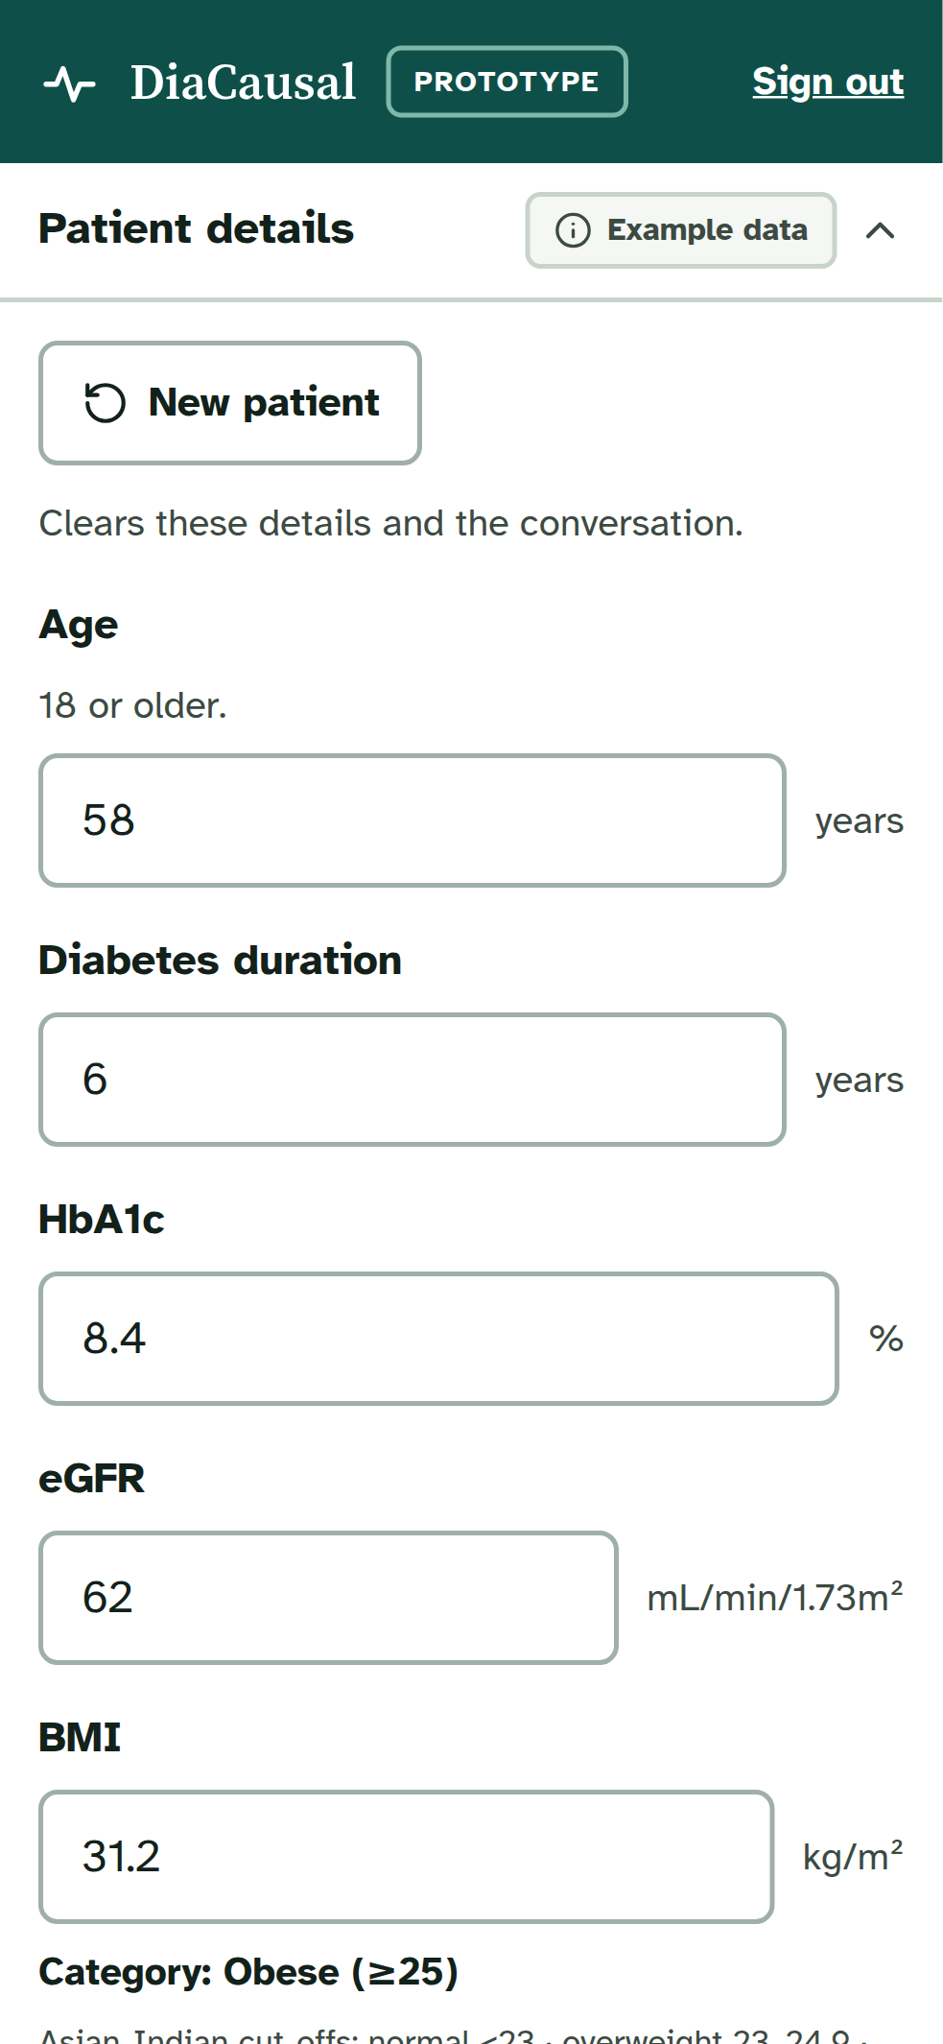
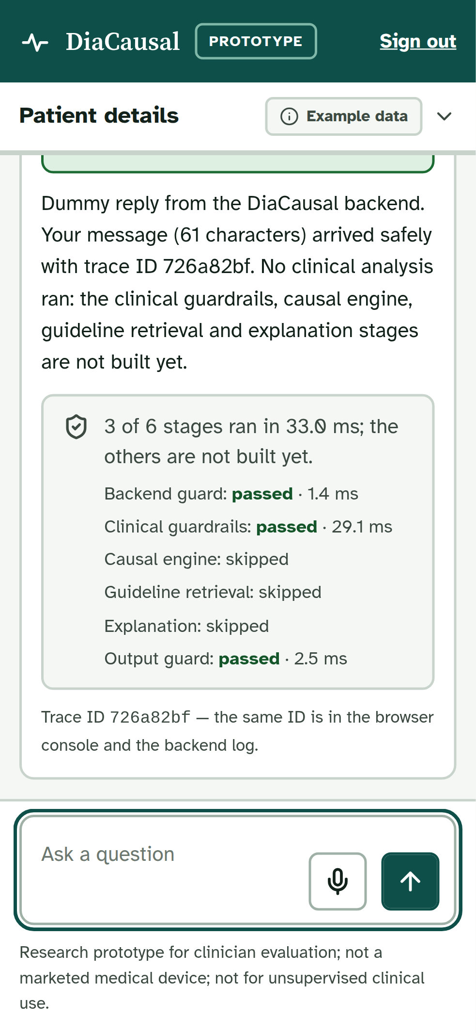
Backup – Phone Screens
Try it
Evidence
Results
Chat: patient panel
Chat: reply
Notes:
Backup: the website and the chat app on a phone.

