Slide 1

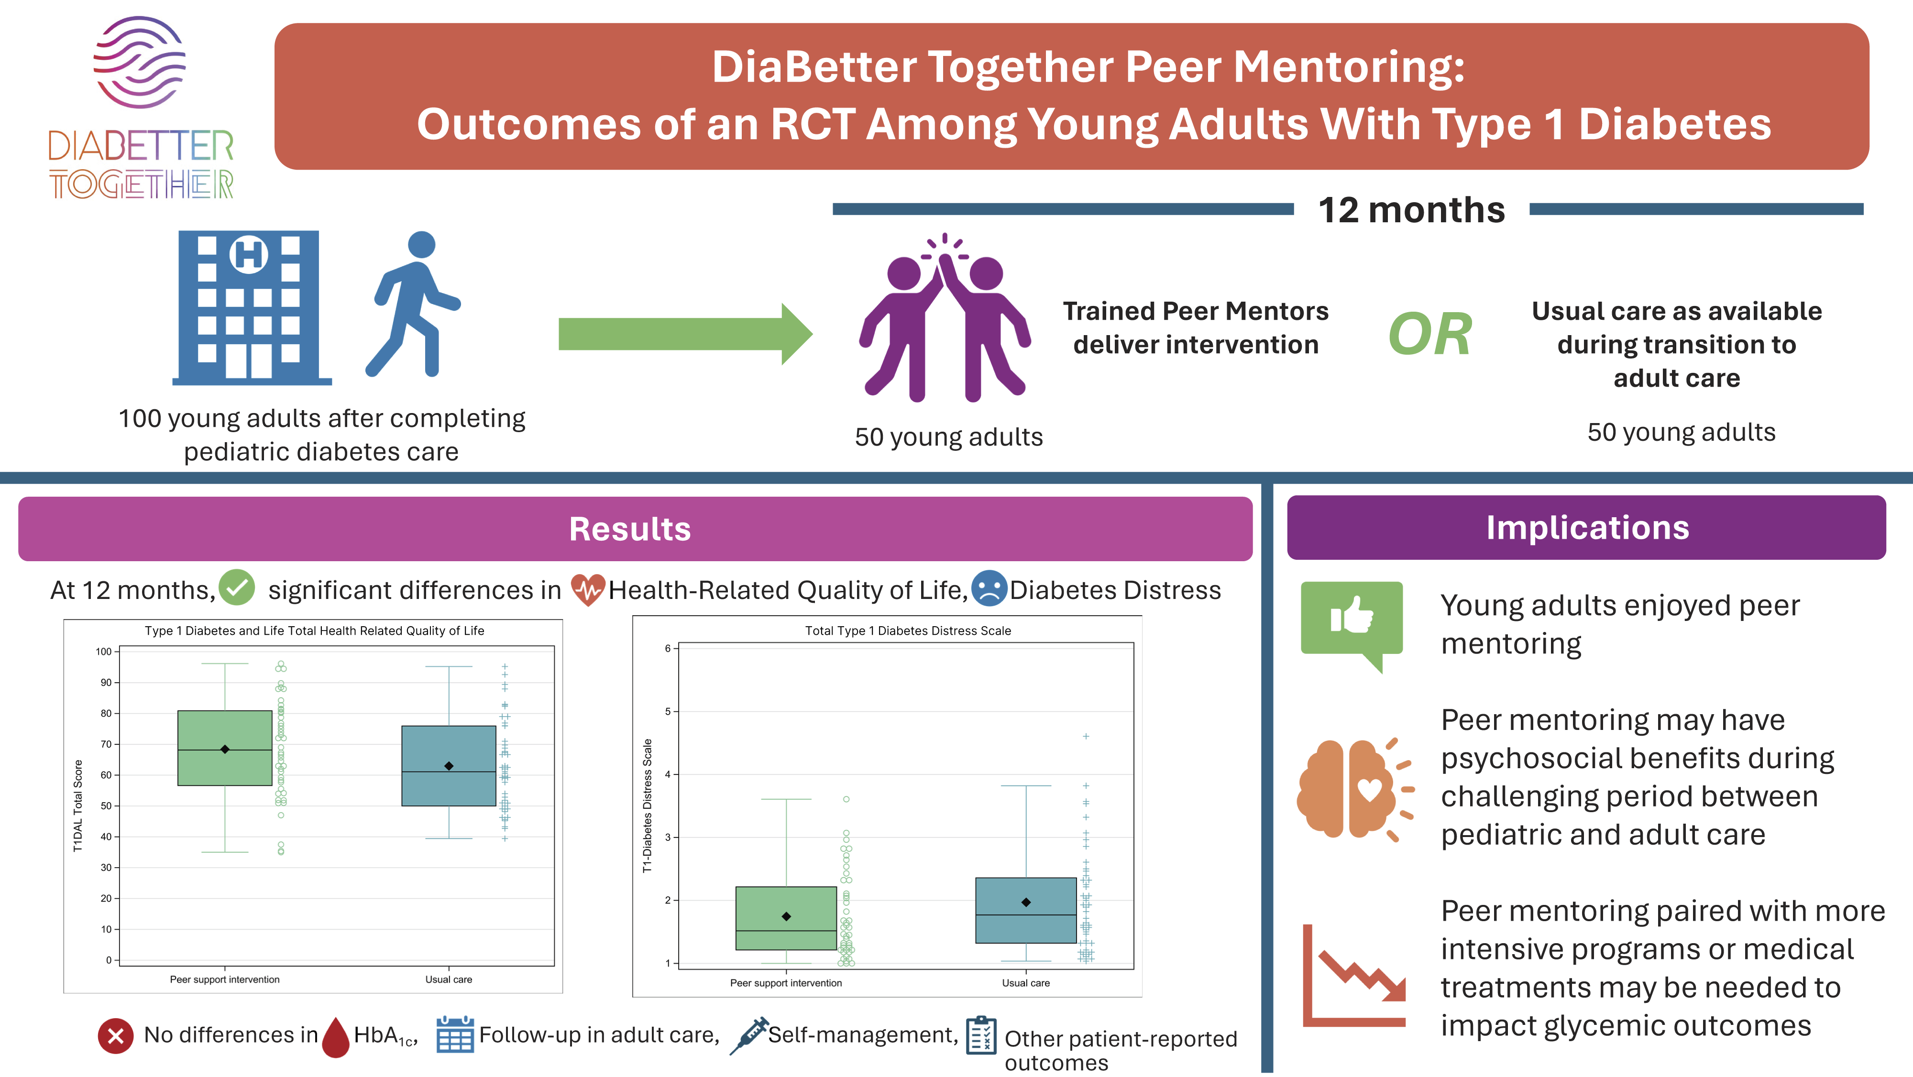
From: DiaBetter Together: Outcomes of a Randomized Controlled Trial Evaluating a Peer Mentor Behavioral Intervention for Young Adults With Type 1 Diabetes During the Transfer From Pediatric to Adult Care
Diabetes Care. 2026;49(8):1357-1365. doi:10.2337/dc26-0395
^{Figure Legend:}
^{Date of Download: 7/21/2026}
Copyright © 2026 American Diabetes Association. All rights reserved, including those for text and data mining, AI training, and similar technologies.

