Slide 1

Agnel Charities'
Fr. C. Rodrigues Institute of Technology, Vashi
(An Autonomous Institute & Permanently Affiliated to University of Mumbai)
Computer Engineering Department
Major Project Progress Presentation-II
B.Tech (Computer) Sem - VII
2026-27
DiaCausal: Intelligent Diabetes Clinical Decision Support System using Causal Inference and RAG
Research prototype for clinician evaluation; not a marketed medical device; not for unsupervised clinical use.
Notes:
Presenter: Pratham. Good morning. We are Group 28. Our project is DiaCausal, a decision-support prototype for choosing the second diabetes drug after metformin. It is a research prototype for clinician evaluation, not a medical device.

Slide 2
Intelligent Diabetes Clinical Decision Support System using Causal Inference and RAG
Group No. 28
Pratham Pawar
Roll no. 1023226
Graceton Santhmayor
Roll no. 1022246
Rhian Roy Kuttikadan
Roll no. 1023268
Advik Saxena
Roll no. 1023245
Guide: Mr. Rahul Jadhav
Department of Computer Engineering · Fr. C. Rodrigues Institute of Technology, Vashi · 2026–27
Notes:
Presenter: Pratham. Our team: Pratham, Graceton, Rhian and Advik, guided by Mr. Rahul Jadhav.

Slide 3
Presentation Outline
Proposed System
slides 4–6
Hardware & Software Requirements
slides 7–8
1
2
Timeline / Gantt Chart
slide 9
System Design
slides 10–13
3
4
Implementation
slides 14–15
Initial Results / Demo
slides 16–18
5
6
Then: completed vs planned work (slide 19) · conclusion · references
Group 28 · DiaCausal · Pratham
3
Notes:
Presenter: Pratham. We follow the six items the department asked for, and end with what is completed and what is planned for October.

Slide 4
Proposed System — the Problem
Adult with type 2 diabetes, already on metformin and not controlled.
Add one of three: SGLT2 inhibitor, DPP-4 inhibitor or sulfonylurea.
Question: what would this patient's HbA1c be in 6 months under each?
Plain comparisons mislead: sicker patients got SGLT2i more often (confounding by indication).
India: 101 million adults with diabetes (ICMR-INDIAB 2023); no open Indian dataset records drug and outcome.
Group | Got SGLT2i | Got SU | Diff.
High HbA1c | 300 pts, −1.2 | 100 pts, −1.0 | −0.2
Lower HbA1c | 100 pts, −0.6 | 300 pts, −0.5 | −0.1
Naive (pooled) | −1.05 | −0.625 | −0.425
Like with like: 0.5 × (−0.2) + 0.5 × (−0.1) = −0.15
The naive answer is about 3× too big. Causal inference corrects this.
Illustrative synthetic numbers; HbA1c change in %
Group 28 · DiaCausal · Rhian
4
Notes:
Presenter: Rhian. When metformin alone is not enough, the doctor adds a second drug. Which one helps this patient most is a what-if question. Old records mislead because doctors gave SGLT2 inhibitors to sicker patients. In this made-up example the naive difference is minus 0.425, but comparing like with like gives minus 0.15, about three times smaller.

Slide 5
Proposed System — How It Works
1. Patient details
age, HbA1c, eGFR, BMI, history
2. Safety rules
cited drug-label rules remove unsafe options
3. Propensity + overlap
enough similar patients?
Too few similar patients? Show “insufficient evidence”, never a guess (propensity < 0.05).
4. AIPW / DR-learner
6-month HbA1c change ± 95% range
5. Cost lookup
INR / month, dated
Audit log records versions, statuses and rule IDs for every request — never the patient's values.
6. Cited evidence (RAG)
licence-cleared passages
7. Clinician decides
decision support only
Group 28 · DiaCausal · Rhian
5
Notes:
Presenter: Rhian. Every request follows the same order. Safety rules first remove unsafe drugs. Then the propensity model checks if enough similar patients got each drug; if not, we say insufficient evidence. Otherwise AIPW and the DR-learner give the six-month HbA1c change with a 95 percent range. Then cost, then cited evidence, and the clinician decides. Everything is logged without patient values.

Slide 6
Proposed System — Safety Rules
Decision support only
the clinician always decides
Safety first
cited rules run before any estimate; excluded options are never estimated
1
2
Honest uncertainty
every estimate has a 95% interval
Refuse to guess
“insufficient evidence” when propensity < 0.05
3
4
No doses, no invented rules
thresholds live only in rules.csv, each with a source
Synthetic data only
every generator number has a source and a status
5
6
On every screen and every reply:
Research prototype for clinician evaluation; not a marketed medical device; not for unsupervised clinical use.
Group 28 · DiaCausal · Advik
6
Notes:
Presenter: Advik. Six rules are never broken, and tests check each one. The strongest: safety rules always run before any estimate, and we never show drug doses.

Slide 7
Hardware & Software Requirements
Tier | Hardware | Software
Development | Laptop, ≥ 8 GB RAM (MacBook Air, Apple silicon) | Python 3.12, NumPy, pandas, scikit-learn, Matplotlib, pytest, Node.js 24, Git/GitHub
Causal engine & API | Same laptop | FastAPI, Uvicorn, Pydantic; Streamlit demo
Website | Any phone or laptop browser | HTML/CSS/JS installable app (works offline); Netlify hosting; Supabase accounts (Mumbai)
Chat application | Laptop or 2-CPU / 4 GB server | FastAPI, React, TypeScript, SQLite, faster-whisper, Docker
RAG | Same laptop | PDF parser, BM25 + vector search, rank fusion; template / free online / local model
Documentation | Any laptop | LaTeX (Overleaf), presentation software
Cost: ₹0 — open-source software and free hosting tiers; effort ≈ 670 person-hours (4 members × 12 h/week × 14 weeks).
Group 28 · DiaCausal · Advik
7
Notes:
Presenter: Advik. Everything runs on an ordinary laptop, and the website runs on any phone. All software is open source and all hosting is on free tiers, so the running cost is zero.

Slide 8
System Requirements
Functional (status on 26 Sept)
Non-functional
ID | Requirement | Status
FR1–2 | Capture and validate patient details, units | Done
FR3 | Cited safety rules with reasons | Done
FR4–5 | Propensity, overlap, “insufficient evidence” | Done
FR6 | 6-month HbA1c change ± 95% | Done
FR7 | Hypoglycaemia risk, weight change | In progress
FR8 | Cost (INR/month), dated | Done*
FR9 | Cited explanation (RAG) | Retrieval done
FR10 | Audit log (no patient values) | Done
FR11 | Consultation summary | In progress
FR12 | Sign-up, MFA, admin approval | Done
Safety: 8 rules enforced by automated tests
Correctness: estimators tested against known truth
Performance: < 3 s per request
Privacy: patient details never leave the device; DPDP Act 2023
Security: HTTPS, authenticator app, admin approval
Usability: SUS ≥ 68; WCAG 2.1 AA
Licences: every source recorded with its licence
*prices shown as “unavailable” until confirmed
Group 28 · DiaCausal · Advik
8
Notes:
Presenter: Advik. Functional requirements say what the system does; nine of twelve are already done. Non-functional requirements say how well: safety tested automatically, under three seconds, privacy, usability score of 68 or more.

Slide 9
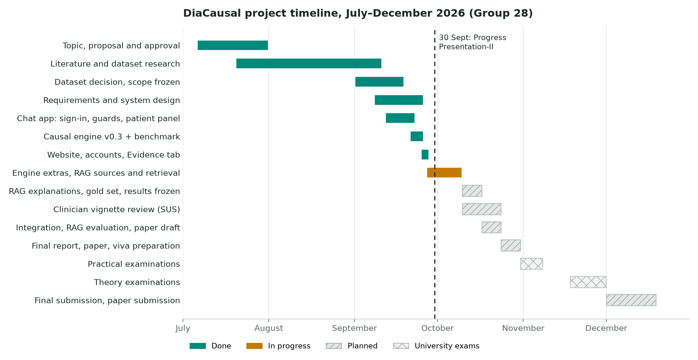
Timeline / Gantt Chart
Early phases (July–August) are approximate. Buffer days: 2 Oct (Gandhi Jayanti), 20 Oct (Dussehra).
Group 28 · DiaCausal · Advik
9
Notes:
Presenter: Advik. Teal is done, amber is in progress, hatched is planned. The dashed line is today's presentation. October is RAG, evaluation, the clinician review and the paper; November is exams; December is final submission.

Slide 10
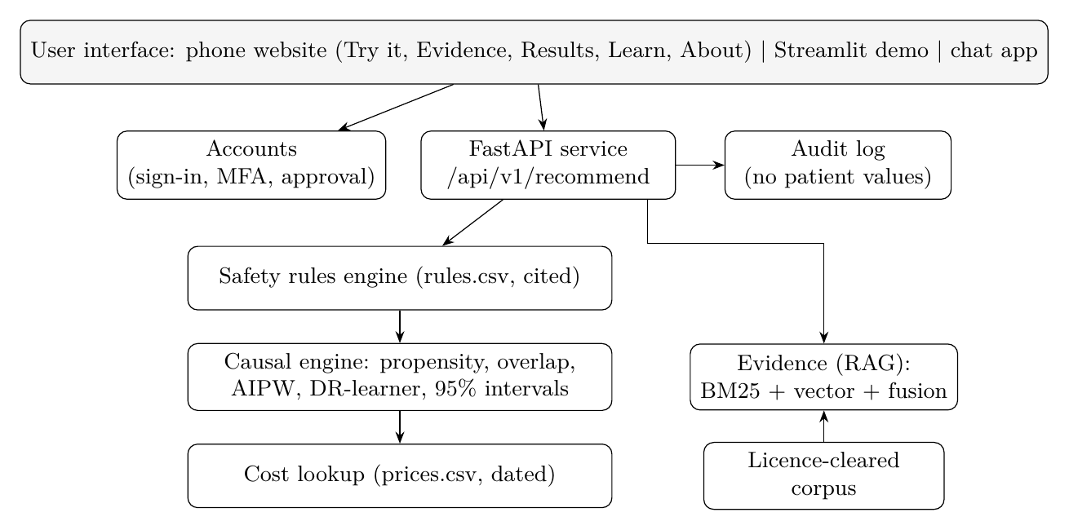
System Design — Architecture
Same answers everywhere: the phone website runs the exported model; tests check it against Python on 155 patients and 40 questions.
Group 28 · DiaCausal · Graceton
10
Notes:
Presenter: Graceton. The layers: the user interface on top, then accounts and the API, then safety rules, the causal engine and cost lookup, with the evidence search on the side and the audit log. The website runs the same model inside the phone, and a test proves it gives identical answers to Python.

Slide 11
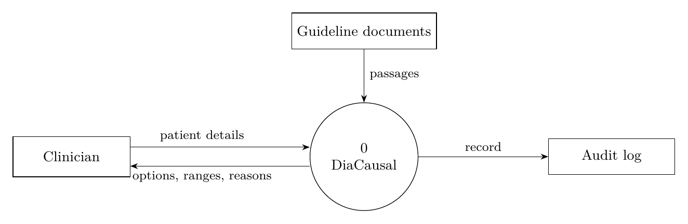
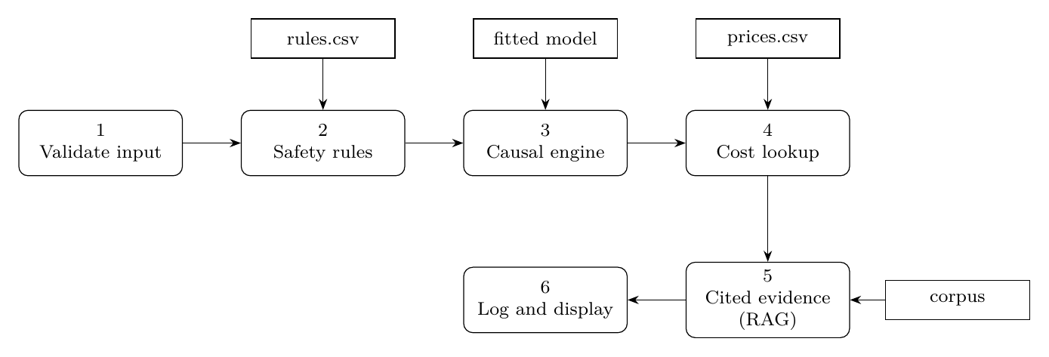
System Design — Data Flow
DFD level 0
DFD level 1
Group 28 · DiaCausal · Graceton
11
Notes:
Presenter: Graceton. Level 0: the clinician gives patient details and gets options with ranges and reasons; guideline documents feed passages; every request is recorded. Level 1 breaks this into six processes with their data stores.

Slide 12
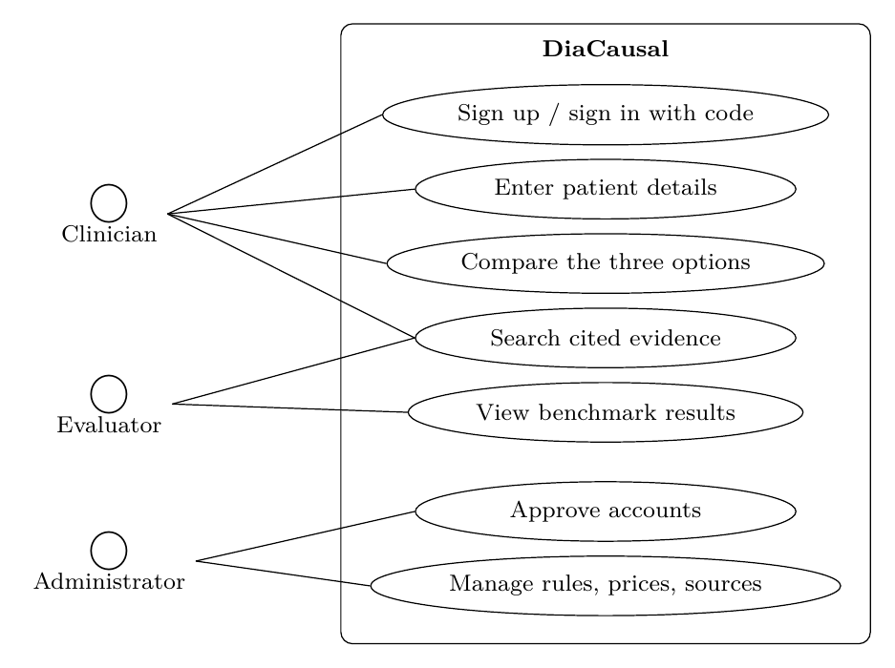
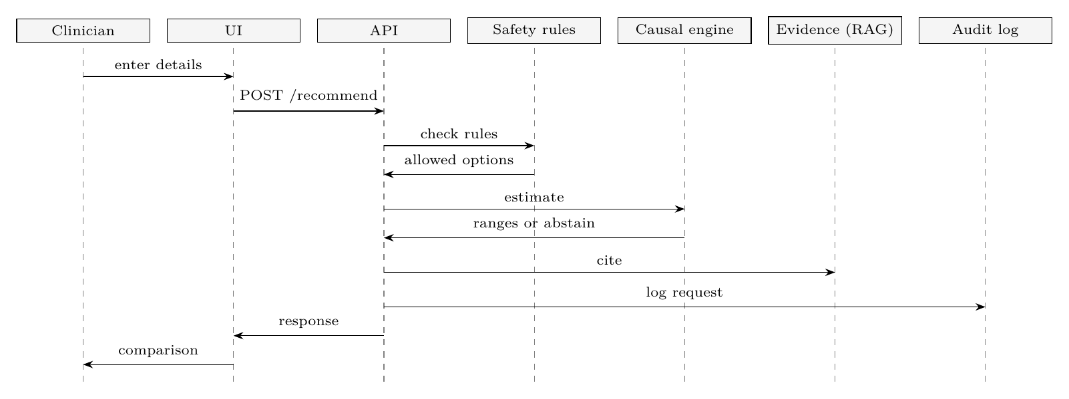
System Design — Use Case & Sequence
Clinician: sign in, enter details, compare options, search evidence
Evaluator: benchmark results, evidence
Administrator: approves accounts; manages rules, prices and sources
Order is fixed: rules → estimate → evidence → log → clinician
Group 28 · DiaCausal · Graceton
12
Notes:
Presenter: Graceton. Three actors: clinician, evaluator and administrator. The sequence shows one consultation: the API checks the rules first, then asks the causal engine, then cites evidence, logs the request and returns the comparison.

Slide 13
System Design — Data & API
rules.csv (10 rules; examples)
Rule | Option | Condition | Action | Source | Status
R01 | SGLT2i | eGFR < 45 | Exclude | FARXIGA label §1, 2.2; KDIGO 2022 | Verified
R05 | DPP-4i | past pancreatitis | Caution | JANUVIA label §1, 5.1 | Verified
R08 | SU | age ≥ 65 | Caution | Glimepiride label §2.1, 8.5 | Team-set cut-off
POST /api/v1/recommend
{"age": 60, "sex": "female", "hba1c": 8.2, "egfr": 40, "bmi": 25.5, ...}
→ applicable, options[3]: status (estimate | excluded | insufficient_evidence),
effect {value, ci_low, ci_high, level 0.95}, safety [rule_id, message, source],
confidence {propensity, overlap_threshold 0.05}, cost, comparisons,
assumptions, versions {engine, params_sha, rules_sha}, request_id, intended_use
Other endpoints: GET /api/v1/rules, GET /health
Every reply: intended-use statement; refused if an estimate lacks an interval or contains dose-like text
Group 28 · DiaCausal · Graceton
13
Notes:
Presenter: Graceton. Rules live in a table, each with a source and a status. Three cut-offs are team-set and flagged for the doctor. The API takes the patient details and returns each option's estimate with its range, or insufficient evidence, with the reasons and versions.

Slide 14
Implementation — What's Built
Module | Status | Evidence
Synthetic India-calibrated cohort | Done | Every number sourced in params.yaml
Safety rules (10, cited) | Done | rules.csv; tests
Propensity + overlap check | Done | Overlap figure
Naive, IPW, matching, AIPW | Done | Results table, 95% CIs
DR-learner (per patient) | Done | Recovery + calibration figures
Benchmark, refutation, E-values | Done | 20 × 5,000 patients; 9/9 checks pass
Streamlit demo + FastAPI | Done | /api/v1/recommend
Phone website + accounts | Done | diacausal.netlify.app; MFA; admin approval
RAG retrieval with citations | In progress | FDA source; Evidence tab
Secondary outcomes, summary | In progress | Target 9 Oct
RAG explanations, clinician review | Planned | 1–23 Oct
168 automated tests pass (139 engine · 13 RAG · 16 website) on Linux, macOS and Windows
Group 28 · DiaCausal · Rhian
14
Notes:
Presenter: Rhian. Much more than 25 percent is built and tested: the full causal engine with benchmark and refutation tests, a live phone website with approved accounts, and the first evidence search. 168 automated tests pass on Linux, Mac and Windows.

Slide 15
Implementation — How the Code Works
AIPW score (doubly robust)
def aipw_scores(Y, T, e, mu):
# phi_a = mu_a(X) + 1{T=a} (Y - mu_a(X)) / e_a(X)
got = (T[:, None] == np.arange(3)[None, :]).astype(float)
return mu + got * (Y[:, None] - mu) / e
DR-learner: this patient's estimate ± 95% interval
beta = pinv(B.T @ B) @ B.T @ pseudo # regress scores on details
value = B @ beta # this patient's effect
se = sqrt(x' V x) # HC3 robust covariance V
interval = value ± 1.96 * se
Safety rules are data, not code: a test scans the code to prove no threshold is typed in.
Output check: every reply is refused if it lacks an interval or contains dose-like text.
Group 28 · DiaCausal · Rhian
15
Notes:
Presenter: Rhian. Two short pieces. AIPW: the outcome model makes a guess and the second term corrects it using patients who really got that drug, weighted by one over the propensity; if either model is right, the average is right. The DR-learner regresses those scores on patient details, and a robust standard error gives each patient's 95 percent interval.

Slide 16
Initial Results — Accuracy
−0.159 → +0.002
bias: naive → AIPW
90–95%
AIPW 95% CI coverage
92.7–94.7%
per-patient interval coverage
0.011
policy regret (naive 0.062)
20 synthetic India-calibrated cohorts × 5,000 patients; true effect −0.211. Balance: largest SMD 0.70 → 0.08 after weighting. Refutation 9/9 passed.
Synthetic data: shows the methods recover a planted truth, not real-world drug effects.
Group 28 · DiaCausal · Rhian
16
Notes:
Presenter: Rhian. Synthetic data, so we know the truth. The naive comparison overstates SGLT2 inhibitor versus DPP-4 inhibitor by about 75 percent; the corrected methods remove almost all the bias. AIPW's 95 percent intervals contain the truth 90 to 95 percent of the time, and the DR-learner's per-patient intervals about 93 to 95 percent.

Slide 17
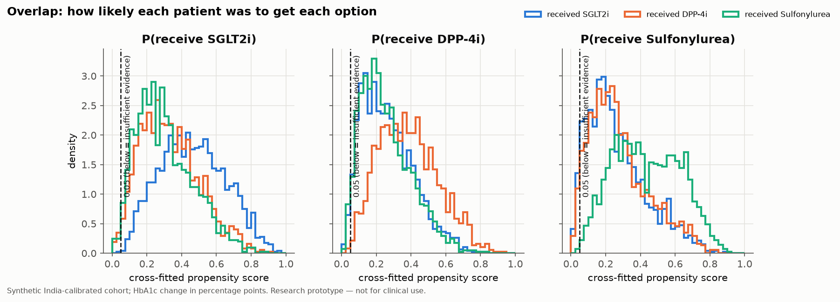
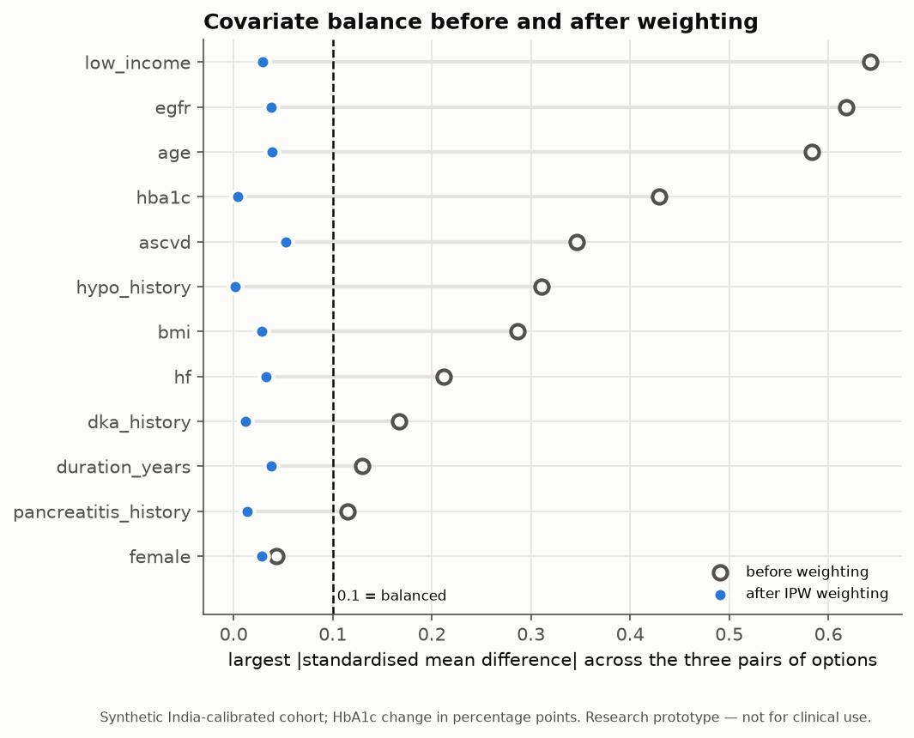
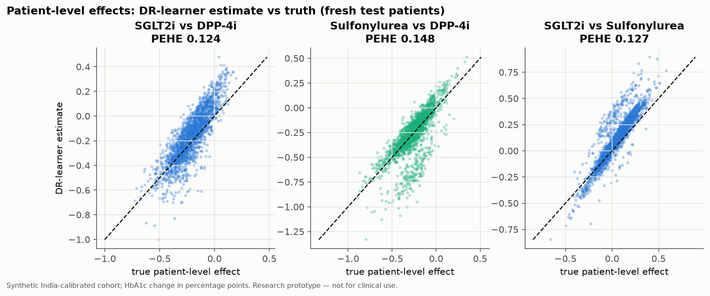
Initial Results — Plots
Overlap (0.05 = abstain)
Balance before/after weighting
Per-patient effects vs truth
Full-size figures and the calibration plot: report Chapter 5 and the website's Results tab.
Group 28 · DiaCausal · Pratham
17
Notes:
Presenter: Pratham. Left: overlap — the dashed line at 0.05 is where we refuse to estimate. Middle: balance — after weighting every patient detail is below the 0.1 line. Right: each dot is a test patient; estimates lie close to the diagonal, meaning the per-patient effects are recovered.

Slide 18
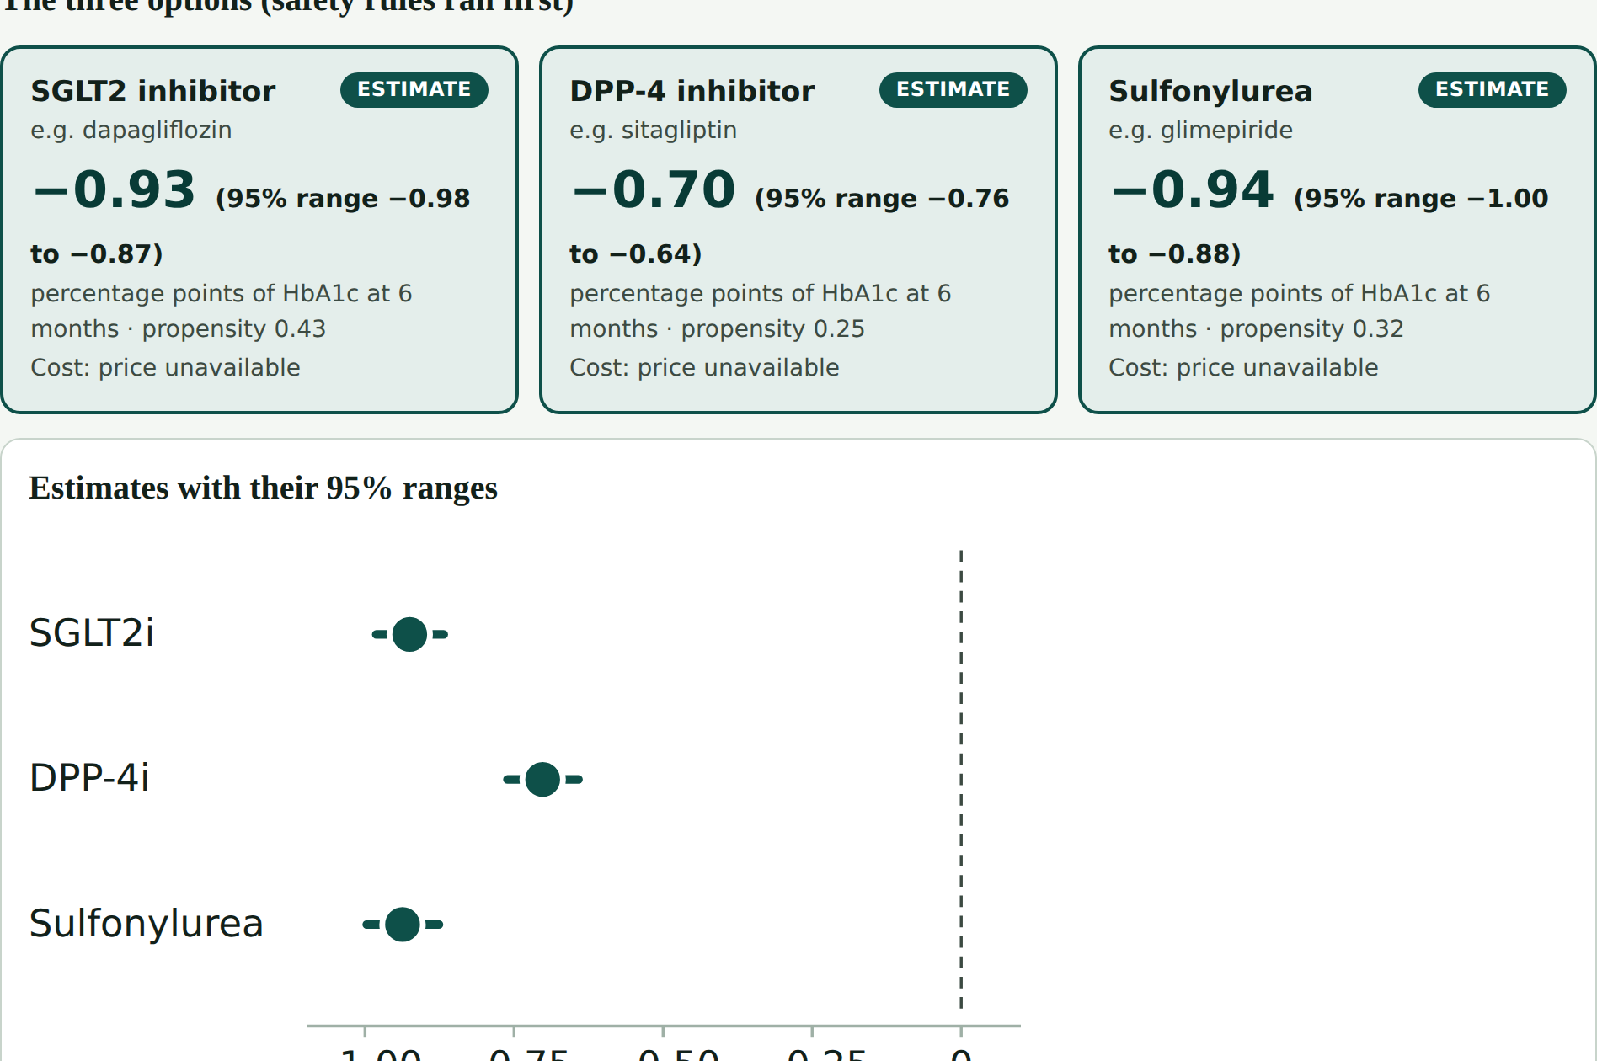
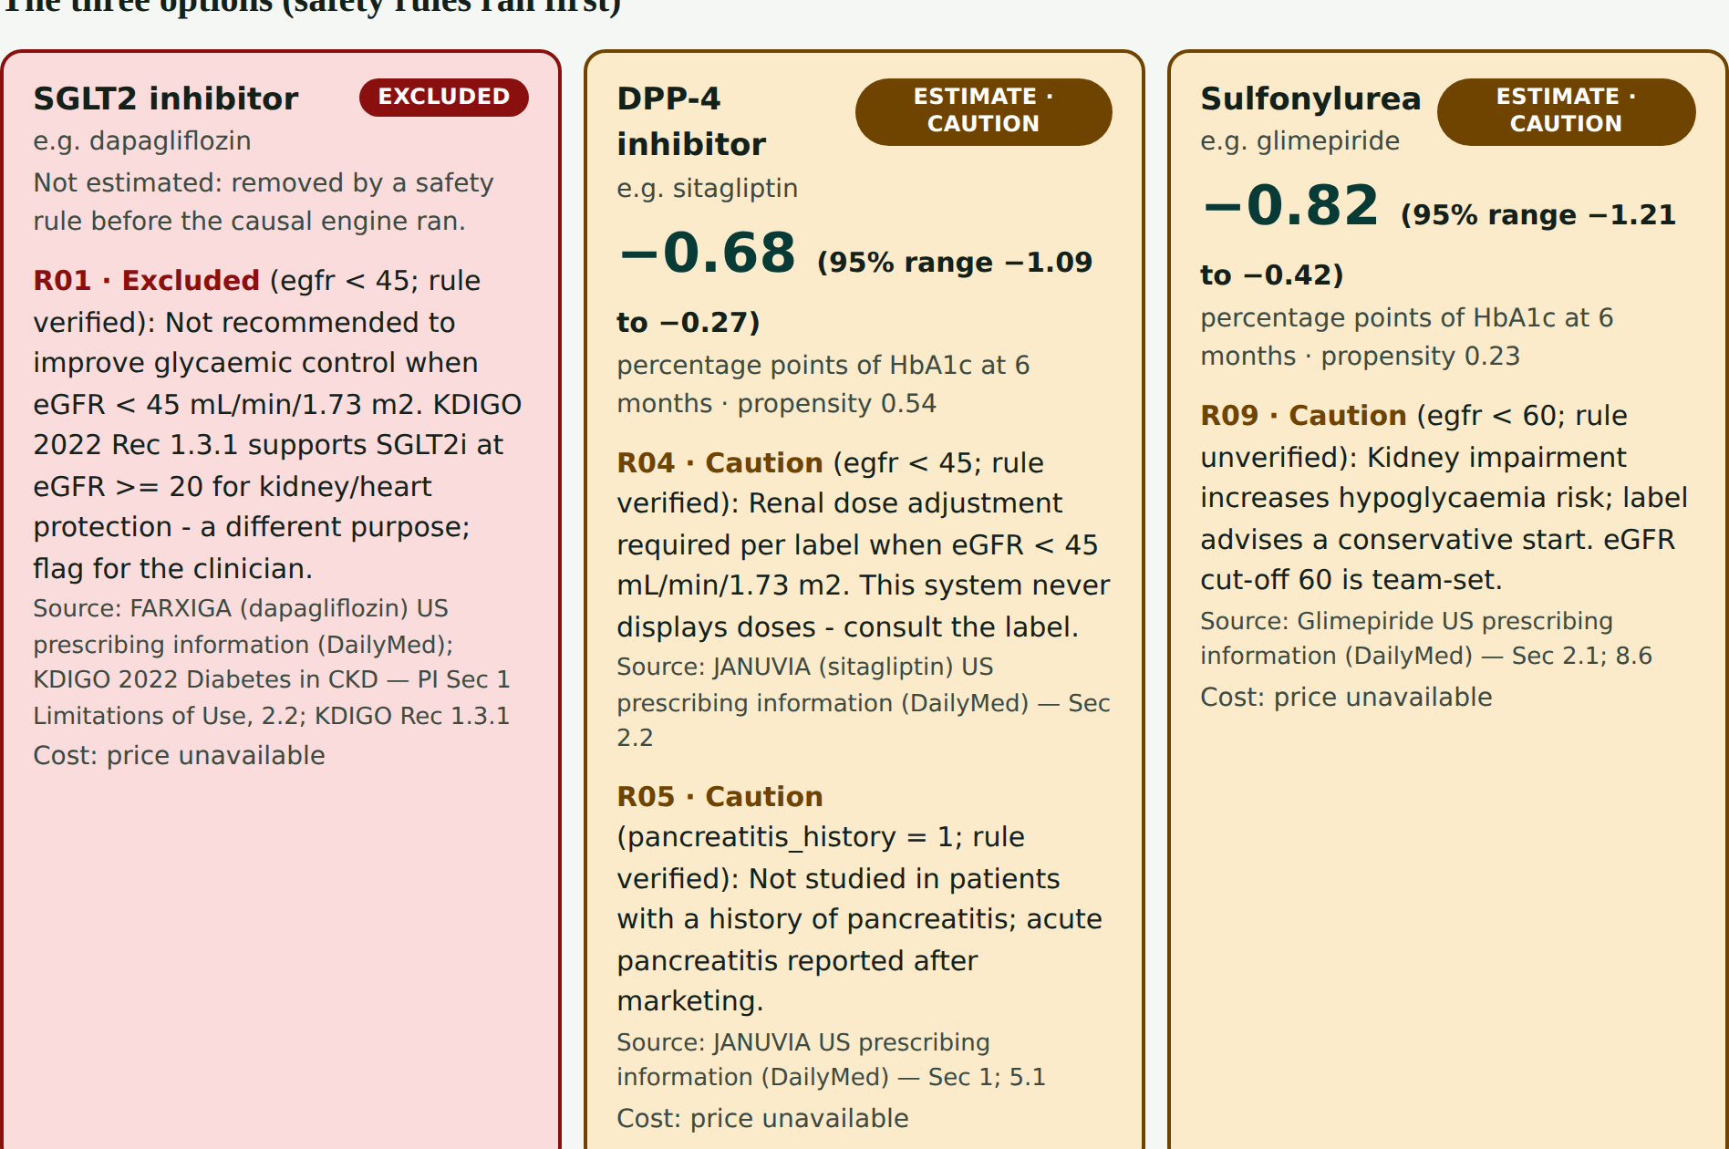
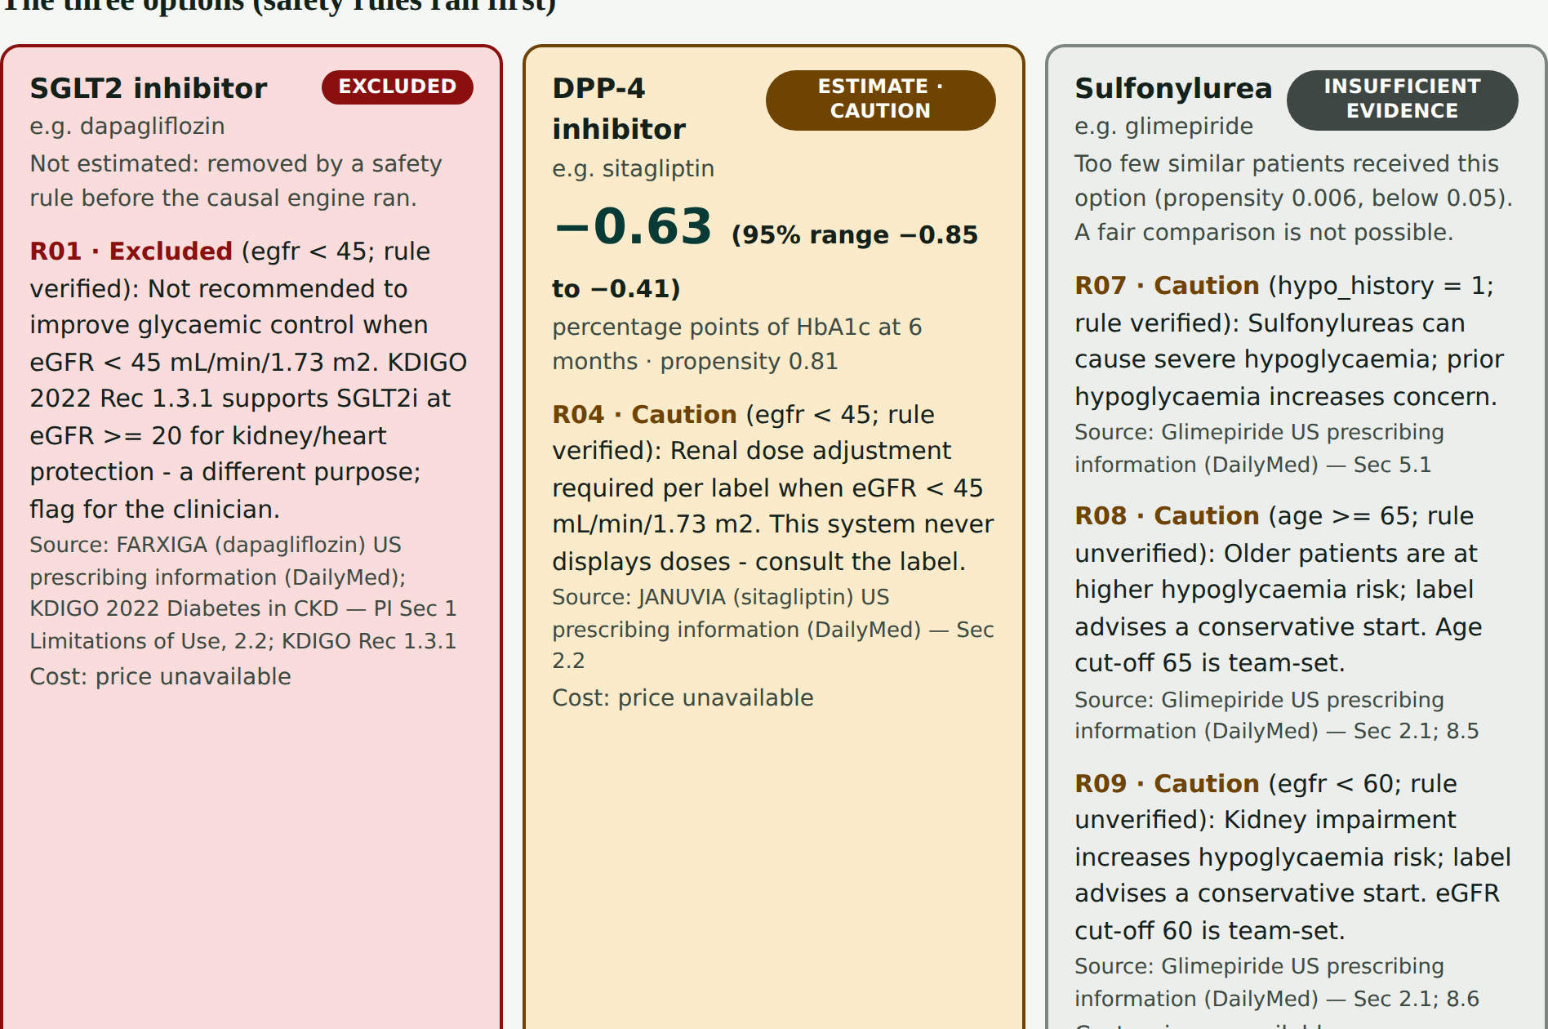

Demo — Live on Any Phone
1 · Typical patient
2 · eGFR 40, pancreatitis
3 · Older, past hypoglycaemia
Red = excluded by a cited rule
diacausal.netlify.app
Add to Home Screen · works offline · never green for “recommended”
Amber = caution
Grey = insufficient evidence
Pine = estimate ± 95% range
Backup: 98-second recorded demo (DiaCausal_demo.mp4)
Group 28 · DiaCausal · Graceton
18
Notes:
Presenter: Graceton. Three preset patients. One: a typical patient, three estimates with ranges. Two: eGFR 40 and past pancreatitis: SGLT2 inhibitor excluded in red with its source, DPP-4 inhibitor caution in amber. Three: an older patient with past hypoglycaemia: sulfonylurea shows insufficient evidence in grey. Then open the live website.

Slide 19
Completed vs Planned
Completed (by 30 Sept)
Planned (October)
Scope, data strategy, requirements, design
Synthetic India-calibrated cohort
Cited safety rules (10)
Propensity, overlap, IPW, AIPW, DR-learner
Benchmark, refutation, E-values
Streamlit demo, FastAPI, 168 tests
Phone website: accounts, MFA, admin approval
Evidence search with citations (1st source)
Hypoglycaemia + weight outcomes; printable summary (by 9 Oct)
More licence-cleared sources; explanation writer (template / free online / offline)
Gold questions; RAG evaluation (recall, citation precision)
Engine inside the chat app
Clinician review of 60 cases; usability (SUS)
Results frozen 16 Oct; IEEE paper; final report
Group 28 · DiaCausal · Advik
19
Notes:
Presenter: Advik. Completed: the whole causal engine, results, demo, API, the phone website with accounts, and the first cited evidence search. Planned for October: secondary outcomes, the RAG explanations and evaluation, integration with the chat app, the clinician review and the research paper.

Slide 20
Conclusion
A causal question, answered causally
per-patient 6-month HbA1c change for three add-on drugs
1
Safety before prediction
cited rules run first; no doses; excluded options never estimated
2
Honest uncertainty
95% intervals; “insufficient evidence” instead of a guess
3
Working today
tested engine, live phone website, first cited evidence; the clinician decides
4
Research prototype for clinician evaluation; not a marketed medical device; not for unsupervised clinical use.
Group 28 · DiaCausal · Pratham
20
Notes:
Presenter: Pratham. Four points to remember: we answer a causal what-if question; safety comes first; we are honest about uncertainty and refuse to guess; and it already runs on any phone, with the clinician always deciding.

Slide 21
References
[1] R. M. Anjana et al., “Metabolic non-communicable disease health report of India: ICMR-INDIAB-17,” Lancet Diabetes Endocrinol., vol. 11, no. 7, pp. 474–489, 2023.
[2] B. M. Shields et al., “Patient stratification for determining optimal second-line and third-line therapy for type 2 diabetes: the TriMaster study,” Nature Medicine, vol. 29, pp. 376–383, 2023.
[3] J. M. Dennis et al., “Development of a treatment selection algorithm for SGLT2 and DPP-4 inhibitor therapies,” Lancet Digit. Health, vol. 4, no. 12, pp. e873–e883, 2022.
[4] A. Tsapas et al., “Comparative effectiveness of glucose-lowering drugs for type 2 diabetes,” Ann. Intern. Med., vol. 173, no. 4, pp. 278–286, 2020.
[5] E. H. Kennedy, “Towards optimal doubly robust estimation of heterogeneous causal effects,” Electron. J. Stat., vol. 17, no. 2, pp. 3008–3049, 2023.
[6] M. A. Hernán and J. M. Robins, Causal Inference: What If. Chapman & Hall/CRC, 2020.
[7] P. C. Austin, “Balance diagnostics for comparing the distribution of baseline covariates…,” Stat. Med., vol. 28, no. 25, pp. 3083–3107, 2009.
[8] P. Lewis et al., “Retrieval-augmented generation for knowledge-intensive NLP tasks,” in Proc. NeurIPS 33, pp. 9459–9474, 2020.
[9] A. Misra et al., “Consensus statement for diagnosis of obesity… for Asian Indians,” J. Assoc. Physicians India, vol. 57, pp. 163–170, 2009.
Group 28 · DiaCausal · Advik
21
Notes:
Presenter: Advik. Our key references, in IEEE style; the full list of 35 is in the report.

Slide 22
Thank You!
Questions? · diacausal.netlify.app
Notes:
Everyone. Thank you. We are happy to take questions, and we can show the live website on a phone.

