Slide 1
Databases
Relational vs Non-Relational

Slide 2
Introduction
What we’re going to talk about:
Comparison between Relational and Non-Relational Databases
Creating a relational Database with Oracle
Creating a non-relational database with MongoDB
Querying

Slide 3
Relational Databases
Relational databases:
SQL
Apache Hive
Non-relational databases:
MongoDB
Elasticsearch
Apache Cassandra

Slide 4
Database Comparison
Database Type | SQL | MongoDB
Structure | Highly Structured | Eventual consistency
Querying | Powerful querying language | Varies
Availability | Database stored on a single server | Distributed Databases

Slide 5
Advantages of SQL
Store data efficiently in predefined schemas
Uses structured query language (SQL) for database access
Linking tables with keys limits data duplication

Slide 6
Advantages of MongoDB
Better able to handle large datasets and streaming data
Producing replicas of data to prevent data loss
If schemas need to change new rows can be added to new datasets without affecting old ones

Slide 7
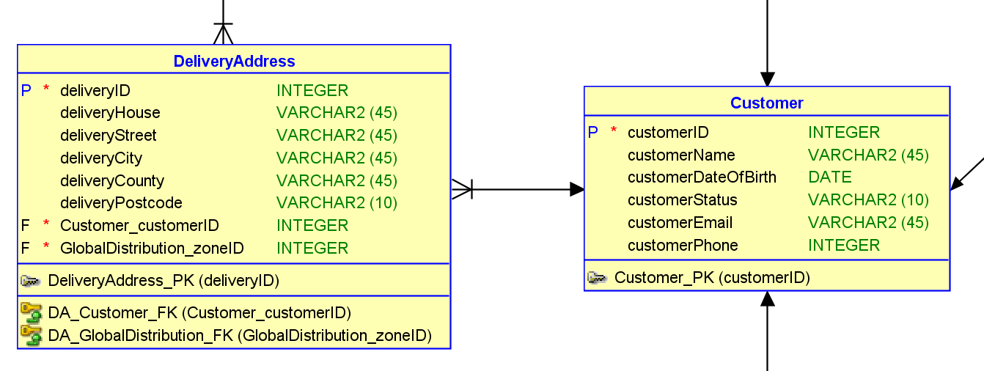
Relational Database
As a member of the Accounts team, I want to store a customer’s delivery address on the system so that orders can be delivered directly to the customer
Identify the entity
Identify the attributes
Identify the primary key
Identify the relationships
Identify the cardinality
Draw a draft
Map the attributes
Refine the Entity Relationship Diagram
has

Slide 8
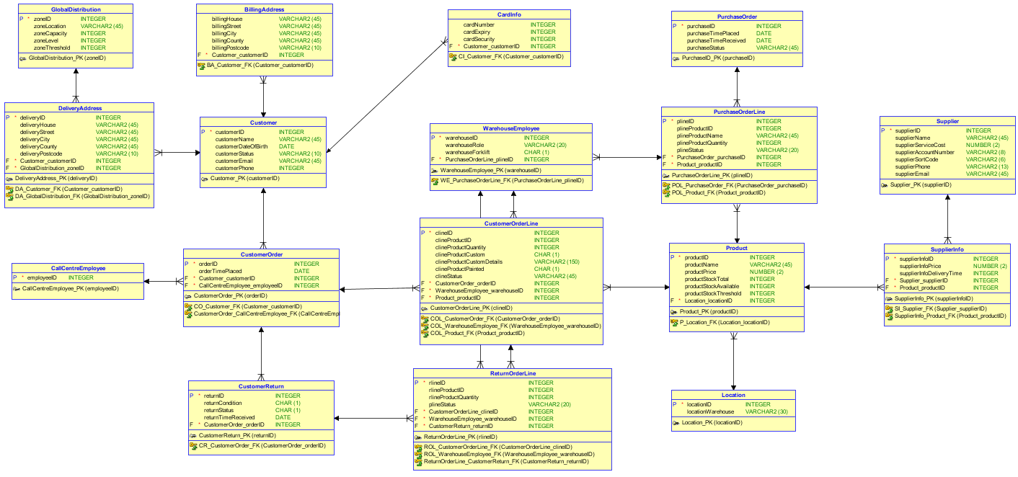
Relational

Slide 9
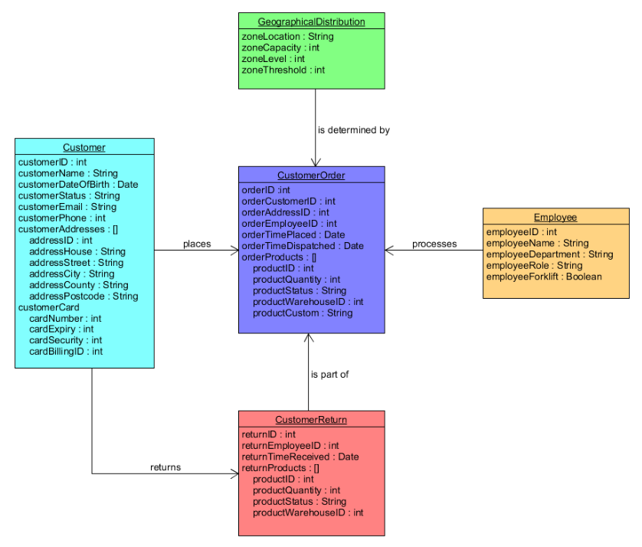
Non-Relational

Slide 10
Oracle: Create
CREATE TABLE Customer
(
customerID INTEGER NOT NULL ,
customerName VARCHAR2 (45) ,
customerDOB DATE ,
customerStatus VARCHAR2 (45) ,
customerEmail VARCHAR2 (45) ,
customerPhone INTEGER ,
PaymentDetails_cardNumber VARCHAR2 (16) NOT NULL ,
PaymentDetails_cardSecurity VARCHAR2 (3) NOT NULL
) ;
ALTER TABLE Customer ADD CONSTRAINT Customer_PK PRIMARY KEY ( customerID ) ;
ALTER TABLE CustomerOrder ADD CONSTRAINT CO_Address_FK FOREIGN KEY ( Address_addressHouse, Address_addressPostcode ) REFERENCES Address ( addressHouse, addressPostcode ) ;
ALTER TABLE CustomerOrder ADD CONSTRAINT CO_Customer_FK FOREIGN KEY ( Customer_customerID ) REFERENCES Customer ( customerID ) ;

Slide 11
MongoDB: Create
db.Customer.ensureIndex ({customerID : 1}, {unique : 1})
db.Customer.insert ({customerID : 800002,
customerName : "Oliver Heald",
customerDateOfBirth : new Date (1940, 02, 18),
customerEmail : "heald@email.com",
customerPhone : 4454370987976,
customerStatus : "hold",
customerCard : {cardNumber : 2345678901234567, cardExpiry : "05/17", cardSecurity : 234, cardBillingID: 810002 }})
customerAddress [{addressID : 810002, addressHouse : "11", addressStreet : "Street" ,
addressCity : "Letchworth Garden City", addressCounty : "Hertfordshire", addressPostcode : "SG6 OH1"}
{addressID : 810003, addressHouse : "12", addressStreet : "Street" ,
addressCity : "Letchworth Garden City", addressCounty : "Hertfordshire", addressPostcode : "SG6 OH1"}})

Slide 12
Oracle & MongoDB: Secure
CREATE ROLE Accounts IDENTIFIED BY password;
GRANT SELECT ON Customer to Accounts;
GRANT INSERT ON Customer to Accounts;
GRANT UPDATE ON Customer to Accounts;
use admin
db.createUser (
user:"Accounts",
pwd:"password",
roles:[{
role:"readWrite",
db:"test",
collection:"Customer"
}]})
db.runCommand ({
updateRole:"test",
privileges:[{
resource:{
db:"test",
collection:"Customer"
}, actions:["find", "update", "insert", "remove"]
}]})
Oracle
MongoDB

Slide 13
Oracle: Query
DECLARE
CURSOR cursor IS SELECT
CustomerOrder.customerOrderid,
CustomerOrderLine.productID,
CustomerOrderLine.clineQuantity,
Product.productprice
FROM Customer
JOIN Customerorder ON CustomerOrder.customerID = Customer.customerID
JOIN Customerorderline ON CustomerOrderLine.clineOrderID = Customerorder.orderID
JOIN Product ON Product.productID = customerorderline.productid
WHERE
Customer.customerid = 5;
order_ID CustomerOrder.orderID%type;
product_ID CustomerOrderLine.productID%type;
quantity CustomerOrderLine.clineQuantity%type;
product_Price product.productPrice%type;
BEGIN
OPEN cursor;
LOOP
FETCH cursor into order_ID, product_ID, quantity, product_Price;
IF cursor%found then
dbms_output.put_line('Order ID: '||order_ID ||
' Product ID: ' || product_ID ||
' Quantity: '|| quantity ||
' Product Price: '|| product_Price||
' Total: ' || quantity * product_Price);
ELSE exit;
END if;
END loop;
END;
/
Order ID: 3 Product ID: 3 Quantity: 1 Product Price: 3000 Total: 3000
Order ID: 4 Product ID: 2 Quantity: 1 Product Price: 100 Total: 100
Order ID: 4 Product ID: 5 Quantity: 2 Product Price: 300 Total: 600

Slide 14
MongoDB: Query
> db.Customer.find().pretty()
> db.Customer.find({customerID:800001},{customerID:1}).pretty()
> db.CustomerOrder.find({ products : {$all : [
{ $elemMatch : {productQuantity:1}},
{ $elemMatch : {productQuantity:1}}]}},
{ "products.productID.$":1, _id:0}).pretty()
{
“products” : [
{
“productID” : 600003,
“productQuantity” : 1,
“productStatus” : “packed”
“warehouseID : 303
}
]
}

Slide 15
Thank you for listening
Chris Luckhurst
Ben Miller
Rhianna Tomlinson

