Slide 1
Databases

Slide 2
Introduction
Relational vs Non-Relational Databases
Database Design
Database Creation (Oracle & MongoDB)
Database Security (Oracle & MongoDB
Database Querying (Oracle & MongoDB)

Slide 3
Relational Databases
Relational databases
Oracle SQL
Apache Hive
Non-relational databases
MongoDB
Elasticsearch
Apache Cassandra

Slide 4
Database Comparison
Database Type | Oracle SQL | MongoDB
Structure | Highly Structured | Eventual consistency
Querying | Powerful querying language | Varies
Availability | Database stored on a single server | Distributed Databases

Slide 5
Advantages of Oracle SQL
Store data efficiently in predefined schemas
Uses structured query language (SQL) for database access
Linking tables with keys limits data duplication

Slide 6
Advantages of MongoDB
Better able to handle large datasets and streaming data
Producing replicas of data to prevent data loss
If schemas need to change new rows can be added to new datasets without affecting old ones

Slide 7
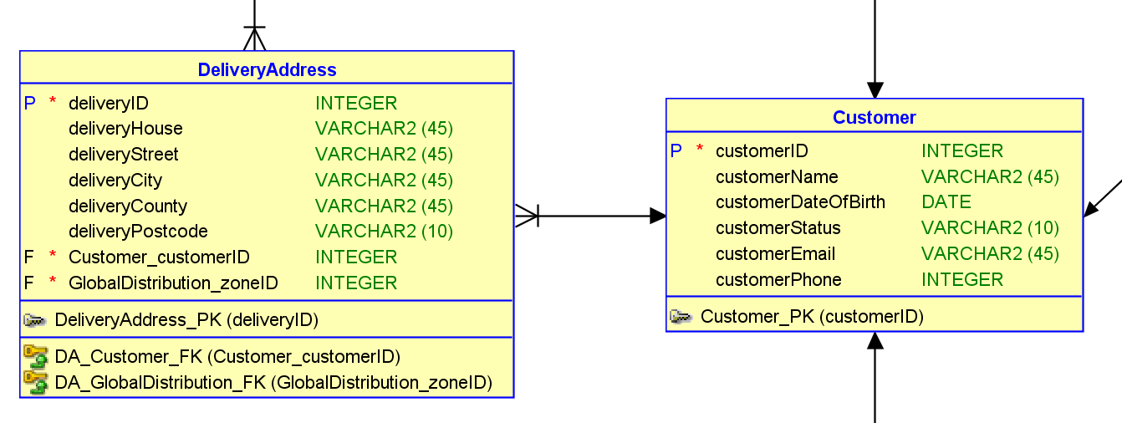
Relational Database
As a member of the Accounts team, I want to store a customer’s delivery address on the system so that orders can be delivered directly to the customer
Identify the entity
Identify the attributes
Identify the primary key
Identify the relationships
Identify the cardinality
Draw a draft
Map the attributes
Refine the Entity Relationship Diagram
has

Slide 8
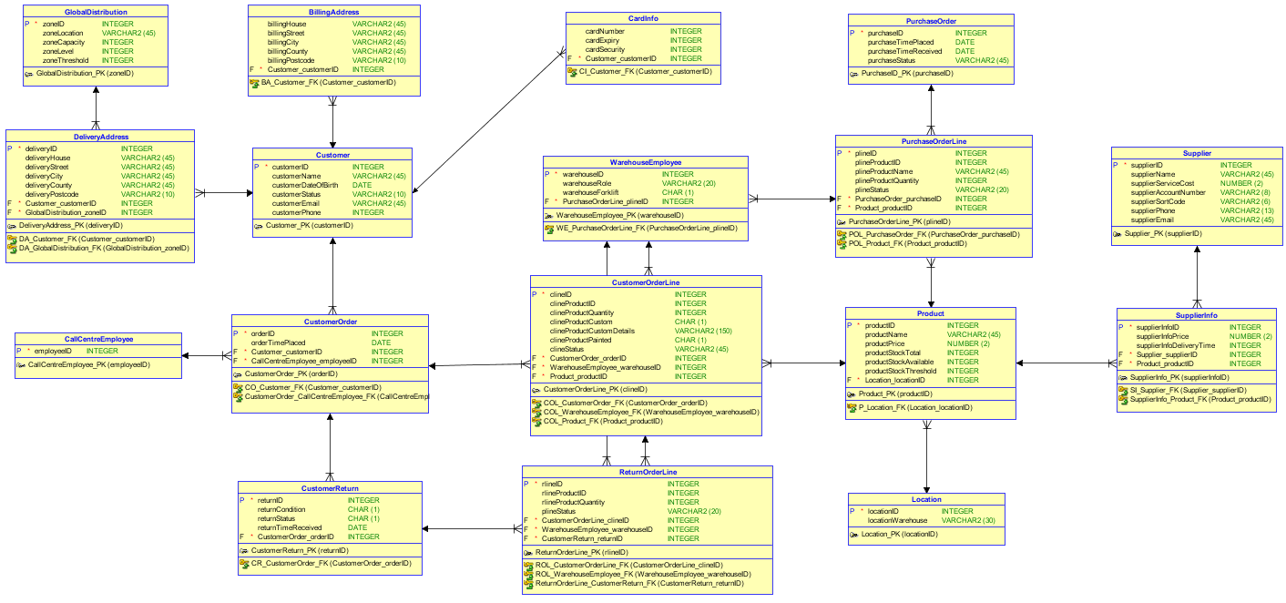
Relational Database

Slide 9
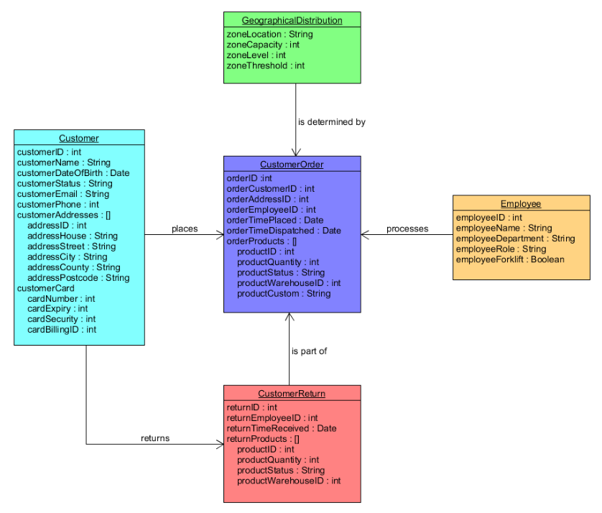
Non-Relational Database

Slide 10
Oracle: Create
CREATE TABLE Customer
(
customerID INTEGER NOT NULL ,
customerName VARCHAR2 (45) ,
customerDOB DATE ,
customerStatus VARCHAR2 (45) ,
customerEmail VARCHAR2 (45) ,
customerPhone INTEGER ,
PaymentDetails_cardNumber VARCHAR2 (16) NOT NULL ,
PaymentDetails_cardSecurity VARCHAR2 (3) NOT NULL
) ;
ALTER TABLE Customer
ADD CONSTRAINT Customer_PK
PRIMARY KEY ( customerID ) ;
ALTER TABLE Customer
ADD CONSTRAINT C_PaymentDetails_FK
FOREIGN KEY ( PaymentDetails_cardNumber, PaymentDetails_cardSecurity )
REFERENCES PaymentDetails ( cardNumber, cardSecurity ) ;

Slide 11
MongoDB: Create
db.Customer.ensureIndex ({customerID : 1}, {unique : 1})
db.Customer.insert ({customerID : 800002,
customerName : "Oliver Heald",
customerDateOfBirth : new Date (1940, 02, 18),
customerEmail : "heald@email.com",
customerPhone : 4454370987976,
customerStatus : "hold",
customerCard : {cardNumber : 2345678901234567,
cardExpiry : "05/17",
cardSecurity : 234,
cardBillingID : 810002 }})
customerAddress [{addressID : 810002,
addressHouse : "11",
addressStreet : "Street" ,
addressCity : "Letchworth Garden City",
addressCounty : "Hertfordshire",
addressPostcode : "SG6 OH1"}
{addressID : 810003,
addressHouse : "12",
addressStreet : "Street",
addressCity : "Letchworth Garden City",
addressCounty : "Hertfordshire",
addressPostcode : "SG6 OH1"}})

Slide 12
Oracle & MongoDB: Secure
CREATE ROLE Accounts IDENTIFIED BY password;
GRANT SELECT ON Customer to Accounts;
GRANT INSERT ON Customer to Accounts;
GRANT UPDATE ON Customer to Accounts;
use admin
db.createUser (
user : "Accounts",
pwd : "password",
roles : [{
role : "readWrite",
db : "NBGardens",
collection : "Customer"
}]})
db.runCommand ({
updateRole : “Accounts",
privileges : [{
resource : {
db : “NBGardens",
collection : "Customer"},
actions : ["find", "update", "insert", "remove"]
}]})
Oracle
MongoDB

Slide 13
Oracle: Query
Customer Order
Product
Customer Order Line
Product ID | Product Name | Product Price
1
2 |  | 400
3 |  | 3000
4
5 |  | 300
Order ID | Customer ID
1
2
3
4
5
Order Line ID | Product ID | Product Quantity
 | 1
 | 2
 | 3
 | 4
 | 5
Order ID: 3 Product ID: 3 Quantity: 1 Product Price: 3000 Total: 3000
Order ID: 4 Product ID: 2 Quantity: 1 Product Price: 100 Total: 100
Order ID: 4 Product ID: 5 Quantity: 2 Product Price: 300 Total: 600
DECLARE
CURSOR cursor IS SELECT
CustomerOrder.customerOrderid,
CustomerOrderLine.productID,
CustomerOrderLine.clineQuantity,
Product.productprice
FROM Customer
JOIN Customerorder ON CustomerOrder.customerID = Customer.customerID
JOIN Customerorderline ON CustomerOrderLine.clineOrderID = Customerorder.orderID
JOIN Product ON Product.productID = customerorderline.productid
WHERE
Customer.customerid = 5;
order_ID CustomerOrder.orderID%type;
product_ID CustomerOrderLine.productID%type;
quantity CustomerOrderLine.clineQuantity%type;
product_Price product.productPrice%type;
BEGIN
OPEN cursor;
LOOP
FETCH cursor into order_ID, product_ID, quantity, product_Price;
IF cursor%found then
dbms_output.put_line('Order ID: '||order_ID ||
' Product ID: ' || product_ID ||
' Quantity: '|| quantity ||
' Product Price: '|| product_Price||
' Total: ' || quantity * product_Price);
ELSE exit;
END if;
END loop;
END;
/

Slide 14
MongoDB: Query
> db.Customer.find().pretty()
> db.Customer.find({customerID:800001},{customerID:1}).pretty()
> db.CustomerOrder.find({ products : {$all : [
{ $elemMatch : {productQuantity:1}},
{ $elemMatch : {productQuantity:1}}]}},
{ "products.productID.$":1, _id:0}).pretty()
{
“products” : [
{
“productID” : 600003,
“productQuantity” : 1,
“productStatus” : “packed”
“warehouseID : 303
}
]
}

Slide 15
Thank you for listening
Chris Luckhurst
Ben Miller
Rhianna Tomlinson

