Slide 1
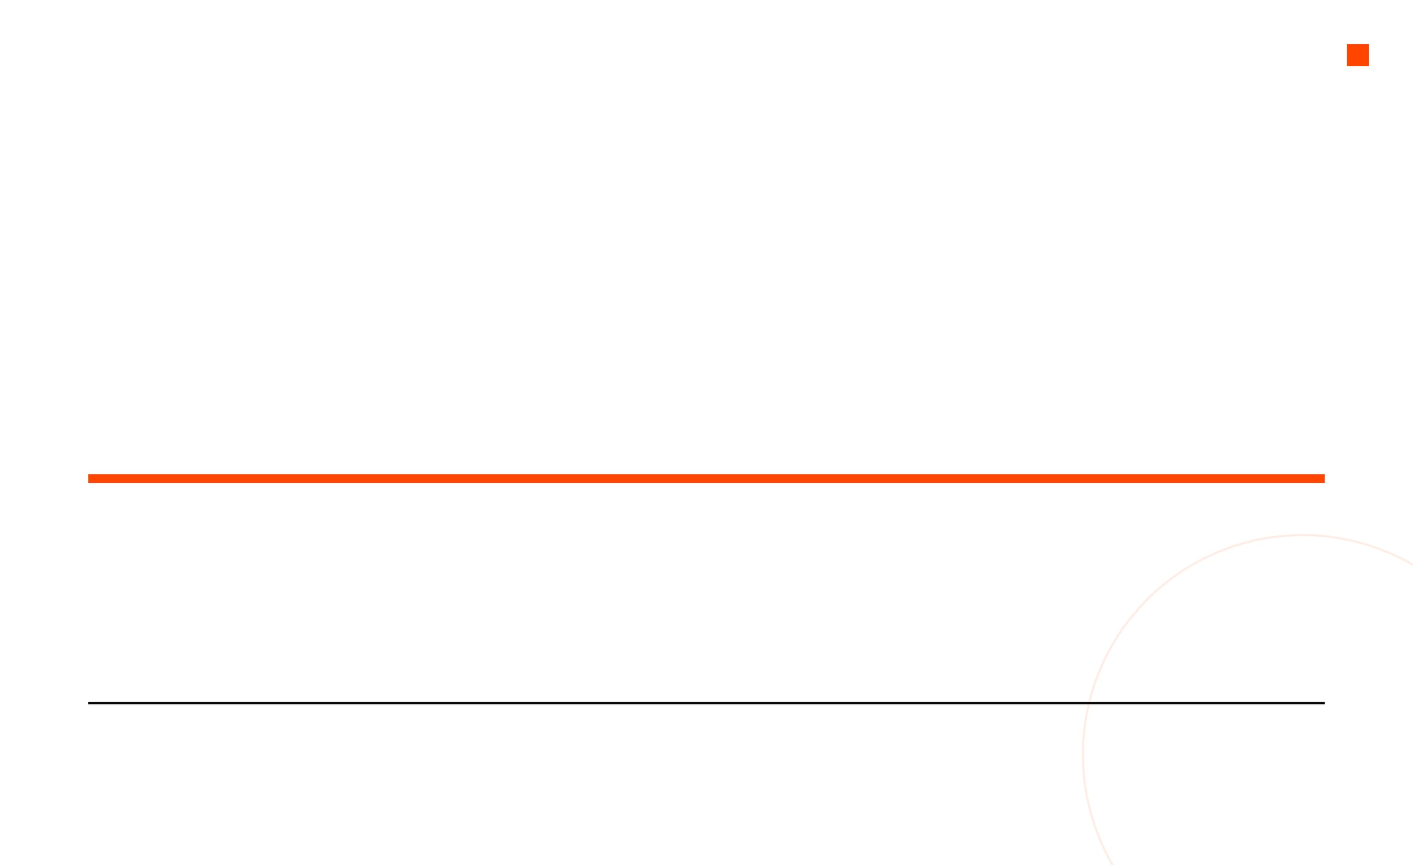
DYNAMIC PROGRAMMING
From Recursion to Optimization Murat Balci, Ph.D. + Manus
A step-by-step journey from naive recursion to efficient problem solving.
DURATION
TOPICS COVERED
~2.5 Hours
Recursion Pitfalls • Memoization • Tabulation • Classic DP Problems

Slide 2

What We Will Cover Today
01
The Problem with Recursion
~20 min
Why naive recursion fails and the cost of redundant computation.
02
Core DP Concepts
~20 min
Overlapping subproblems, optimal substructure, memoization, and tabulation.
03
Classic DP Problems
~60 min
Fibonacci, Climbing Stairs, Coin Change, 0/1 Knapsack, LCS, LIS, Edit Distance.
04
Advanced Techniques & Patterns
~20 min
Space optimization, DP on grids, Matrix Chain Multiplication.
05
Problem-Solving Framework & Practice
~10 min
A systematic approach to recognizing and solving DP problems.

Slide 3

Let's Start with a Simple Question
Consider computing the n-th Fibonacci number, defined as:
A direct recursive implementation seems natural:
int fib(int n) { if (n <= 1) return n; return fib(n-1) + fib(n-2); }
F(0) = 0, F(1) = 1 F(n) = F(n-1) + F(n-2) for n ≥ 2
The sequence:
0, 1, 1, 2, 3, 5, 8, 13, 21, 34, 55, 89, ...
Simple, clean, and mathematically correct. But is it efficient?

Slide 4
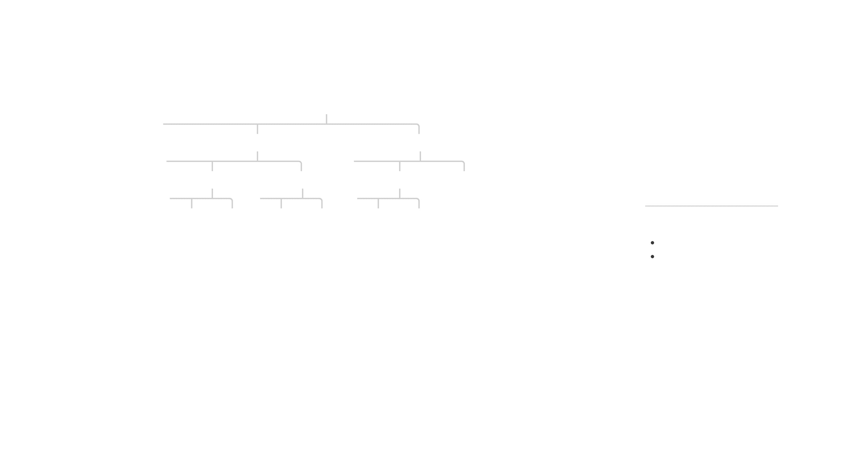
The Hidden Cost — Visualizing the Recursion Tree
fib(5)
15
Total Function Calls
fib(4)
fib(3)
6
fib(3)
fib(2)
fib(2)
fib(1)
Unique Values Needed
fib(2)
fib(1)
fib(1)
fib(0)
fib(1)
fib(0)
Redundant Computations:
fib(3)
: Computed 2 times
fib(2)
: Computed 3 times
fib(1): Computed 5 times

Slide 5
The Explosion — How Bad Does It Get?
N
FUNCTION CALLS
UNIQUE VALUES NEEDED
5
15
6
TIME COMPLEXITY
O(2
^{n}
)
10
177
11
The number of operations roughly doubles with each increment of n.
20
21,891
21
30
2,692,537
31
REAL WORLD IMPACT
40
331,160,281
41
Computing fib(50) would take minutes to hours. Computing fib(100) is practically impossible with this approach.
50
~40,000,000,000
51
Meanwhile, we only need n+1 unique values. The waste is staggering.

Slide 6
Let's Measure It — Timing the Naive Approach
Here is a concrete experiment to see the exponential blowup:
Typical Output:
#include <stdio.h> #include <time.h> int fib(int n) { if (n <= 1) return n; return fib(n-1) + fib(n-2); } int main() { int vals[] = {10, 20, 25, 30, 35, 40}; for (int i = 0; i < 6; i++) { clock_t start = clock(); int result = fib(vals[i]); double elapsed = (double)(clock()-start)/CLOCKS_PER_SEC; printf("fib(%d) = %d, Time: %.4fs\n", vals[i], result, elapsed); } return 0; }
$ gcc fib_test.c -o fib_test && ./fib_test
fib(10) = 55, Time: 0.0000s
fib(20) = 6765, Time: 0.0001s
fib(25) = 75025, Time: 0.0012s
fib(30) = 832040, Time: 0.0130s
fib(35) = 9227465, Time: 0.1440s
fib(40) = 102334155, Time: 1.5800s
OBSERVATION
Each +5 in n multiplies the time by roughly 10x. This is unsustainable.

Slide 7

Why Does This Happen? Overlapping Subproblems
The root cause is overlapping subproblems: the same subproblems are solved repeatedly.
COMMON IN RECURSIVE ALGORITHMS
Counting paths in a grid
In the recursion tree for fib(5):
Making change with coins
fib(3) is solved
2 times
Comparing two strings
fib(2) is solved
3 times
Optimizing resource allocation
fib(1) is solved
5 times
fib(0) is solved
3 times
KEY INSIGHT
If we could store and reuse previously computed results, we could eliminate all redundant work.
For just n=5, we have 15 calls for 6 unique values.

Slide 8

Another Motivating Example — Climbing Stairs
Problem: You are climbing a staircase with n steps. Each time you can climb 1 or 2 steps. How many distinct ways can you reach the top?
N (STAIRS)
WAYS
NAIVE CALLS
5
8
15
10
89
177
20
10,946
21,891
int climb(int n) { if (n <= 1) return 1; return climb(n-1) + climb(n-2); }
30
1,346,269
2,692,537
40
165,580,141
331,160,281
The recursion tree is identical in structure to Fibonacci! The same exponential blowup occurs.
Same problem, same waste. We need a better strategy.

Slide 9

Yet Another Example — Counting Paths in a Grid
Problem: Given an m × n grid, count paths from top-left to bottom-right, moving only right or down.
int count_paths(int m, int n) { if (m == 1 || n == 1) return 1; return count_paths(m-1, n) + count_paths(m, n-1); }
Start
10×10 Grid:
92,000+ calls
20×20 Grid:
Billions of calls
The pattern is clear: whenever a problem breaks into overlapping subproblems, naive recursion wastes enormous computation.
End
f(m, n) = f(m-1, n) + f(m, n-1)

Slide 10

Enter Dynamic Programming — The Core Idea
Dynamic Programming (DP) is an algorithmic technique that solves complex problems by breaking them down into simpler subproblems.
01
02
03
Break into overlapping subproblems
Solve each subproblem only once
Store results for future use
OVERLAPPING SUBPROBLEMS
OPTIMAL SUBSTRUCTURE
The problem can be broken down into subproblems which are reused several times. (e.g., Fibonacci, Grid Paths)
An optimal solution to the problem contains within it optimal solutions to its subproblems. (e.g., Shortest Path, Knapsack)
Coined by Richard Bellman in the 1950s.
"Programming" refers to mathematical planning/optimization, not coding.

Slide 11



Two Approaches to Dynamic Programming
TOP-DOWN (Memoization)
BOTTOM-UP (Tabulation)
Start from the original problem and recurse downward
Start from the smallest subproblems and build upward
Cache (memoize) results of subproblems as they are computed
Fill a table iteratively in a systematic order
No recursion needed — uses loops instead
Still uses recursion, but avoids redundant computation
THINK
"Build the answer from the ground up"
THINK
"Remember what you've already computed"
Both approaches yield the same time complexity. The choice depends on the problem and personal preference.

Slide 12
Memoization — Fibonacci Transformed
C — Array-Based Memo
C++ — STL Map Approach
#include <string.h> int memo[100]; int fib_memo(int n) { if (memo[n] != -1) return memo[n]; if (n <= 1) return n; memo[n] = fib_memo(n-1) + fib_memo(n-2); return memo[n]; } // Init: memset(memo, -1, sizeof(memo));
#include <unordered_map> using namespace std; unordered_map<int, int> cache; int fib_memo(int n) { if (cache.count(n)) return cache[n]; if (n <= 1) return n; cache[n] = fib_memo(n-1) + fib_memo(n-2); return cache[n]; }
We use a global array
memo[]
initialized to
-1
to cache results.
PERFORMANCE IMPACT
fib_memo(50)
now returns instantly.
Time complexity drops from
O(2
^{n}
)
to
O(n)
.

Slide 13
Tabulation — Fibonacci Bottom-Up
The bottom-up approach builds the solution iteratively, filling a table from smallest to largest subproblem.
dp array state for n=7:
0
1
2
3
4
5
6
7
int fib_tab(int n) { if (n <= 1) return n; // Initialize table int dp[n + 1]; dp[0] = 0; dp[1] = 1; // Fill table bottom-up for (int i = 2; i <= n; i++) dp[i] = dp[i-1] + dp[i-2]; return dp[n]; }
0
1
1
2
3
5
8
13
dp[2] = dp[1] + dp[0] = 1 + 0 = 1
dp[3] = dp[2] + dp[1] = 1 + 1 = 2
dp[4] = dp[3] + dp[2] = 2 + 1 = 3
...
dp[7] = dp[6] + dp[5] = 8 + 5 = 13
Time: O(n)
Space: O(n)
Massive improvement over O(2
^{n}
)

Slide 14

Space Optimization — Fibonacci in O(1) Space
Since each Fibonacci number depends only on the previous two, we don't need the entire array.
THE SLIDING WINDOW
prev2
prev1
current
int fib_optimized(int n) { if (n <= 1) return n; int prev2 = 0, prev1 = 1; for (int i = 2; i <= n; i++) { int curr = prev1 + prev2; prev2 = prev1; prev1 = curr; } return prev1; } // O(1) space — only two variables!
3
5
8
Next iteration: prev2 ← 5 (old prev1) prev1 ← 8 (old current)
Time Complexity
O(n)
Space Complexity
O(1)
Common DP optimization: when recurrence depends on fixed k previous states, space can be reduced to O(k).

Slide 15

Performance Comparison Summary — Fibonacci
APPROACH
TIME COMPLEXITY
SPACE COMPLEXITY
FIB(40) TIME
Naive Recursion
O(n) stack
~35 seconds
O(2
^{n}
)
Memoization
O(n)
O(n)
< 0.001 seconds
Tabulation
O(n)
O(n)
< 0.001 seconds
Space-Optimized
O(n)
O(1)
< 0.001 seconds
THE POWER OF DYNAMIC PROGRAMMING
The leap from
O(2
^{n}
)
to
O(n)
is massive.
For n=40, that is a speedup of over
300 million times
.

Slide 16

Memoization vs Tabulation — When to Use Which
ASPECT
MEMOIZATION (TOP-DOWN)
TABULATION (BOTTOM-UP)
Implementation
Recursive + cache
Iterative + table
Subproblems
Only those needed
All subproblems
Stack Overflow
Yes (deep recursion)
No
Readability
Often more intuitive
Sometimes less obvious
Space Opt.
Harder to optimize
Easier to optimize
Debugging
Harder to trace
Easier to trace
RULE OF THUMB
Start with memoization to get the recurrence right, then convert to tabulation for production code.

Slide 17
The DP Problem-Solving Recipe
01
IDENTIFY
04
SET BASE CASES
Does the problem have overlapping subproblems and optimal substructure?
What are the trivial subproblems you can solve directly?
02
DEFINE STATE
05
DETERMINE ORDER
What parameters uniquely describe a subproblem? This becomes your DP array index.
In what order should subproblems be solved? (Crucial for tabulation)
03
WRITE RECURRENCE
06
OPTIMIZE
Express the solution to a subproblem in terms of smaller subproblems.
Can you reduce space complexity? Can you reconstruct the solution path?
Let's apply this recipe to several classic problems.

Slide 18

Classic Problem 1 — Climbing Stairs (Revisited)
Applying the Recipe
int climbStairs(int n) { if (n <= 1) return 1; int dp[n + 1]; dp[0] = 1; dp[1] = 1; for (int i = 2; i <= n; i++) dp[i] = dp[i-1] + dp[i-2]; return dp[n]; }
STATE
dp[i] = number of ways to reach step i
RECURRENCE
dp[i] = dp[i-1] + dp[i-2] (arrive from 1 step below or 2 steps below)
Extension
What if you can climb 1, 2, or 3 steps?
dp[i] = dp[i-1] + dp[i-2] + dp[i-3]
BASE CASES
dp[0] = 1 (ground) dp[1] = 1 (first step)

Slide 19

Classic Problem 2 — Coin Change (Minimum Coins)
Problem: Given coin denominations and a target amount, find the minimum number of coins needed.
Naive Recursive Approach:
#include <limits.h> int coinChange(int coins[], int n, int amount) { if (amount == 0) return 0; if (amount < 0) return INT_MAX; int best = INT_MAX; for (int i = 0; i < n; i++) { int sub = coinChange(coins, n, amount - coins[i]); if (sub != INT_MAX && sub + 1 < best) best = sub + 1; } return best; }
EXAMPLE
Coins: [1, 5, 10, 25] Amount: 30
For amount=100 with coins [1, 5, 10, 25], this
25
5
makes
billions
of recursive calls.
+
=
30
Answer: 2 coins

Slide 20
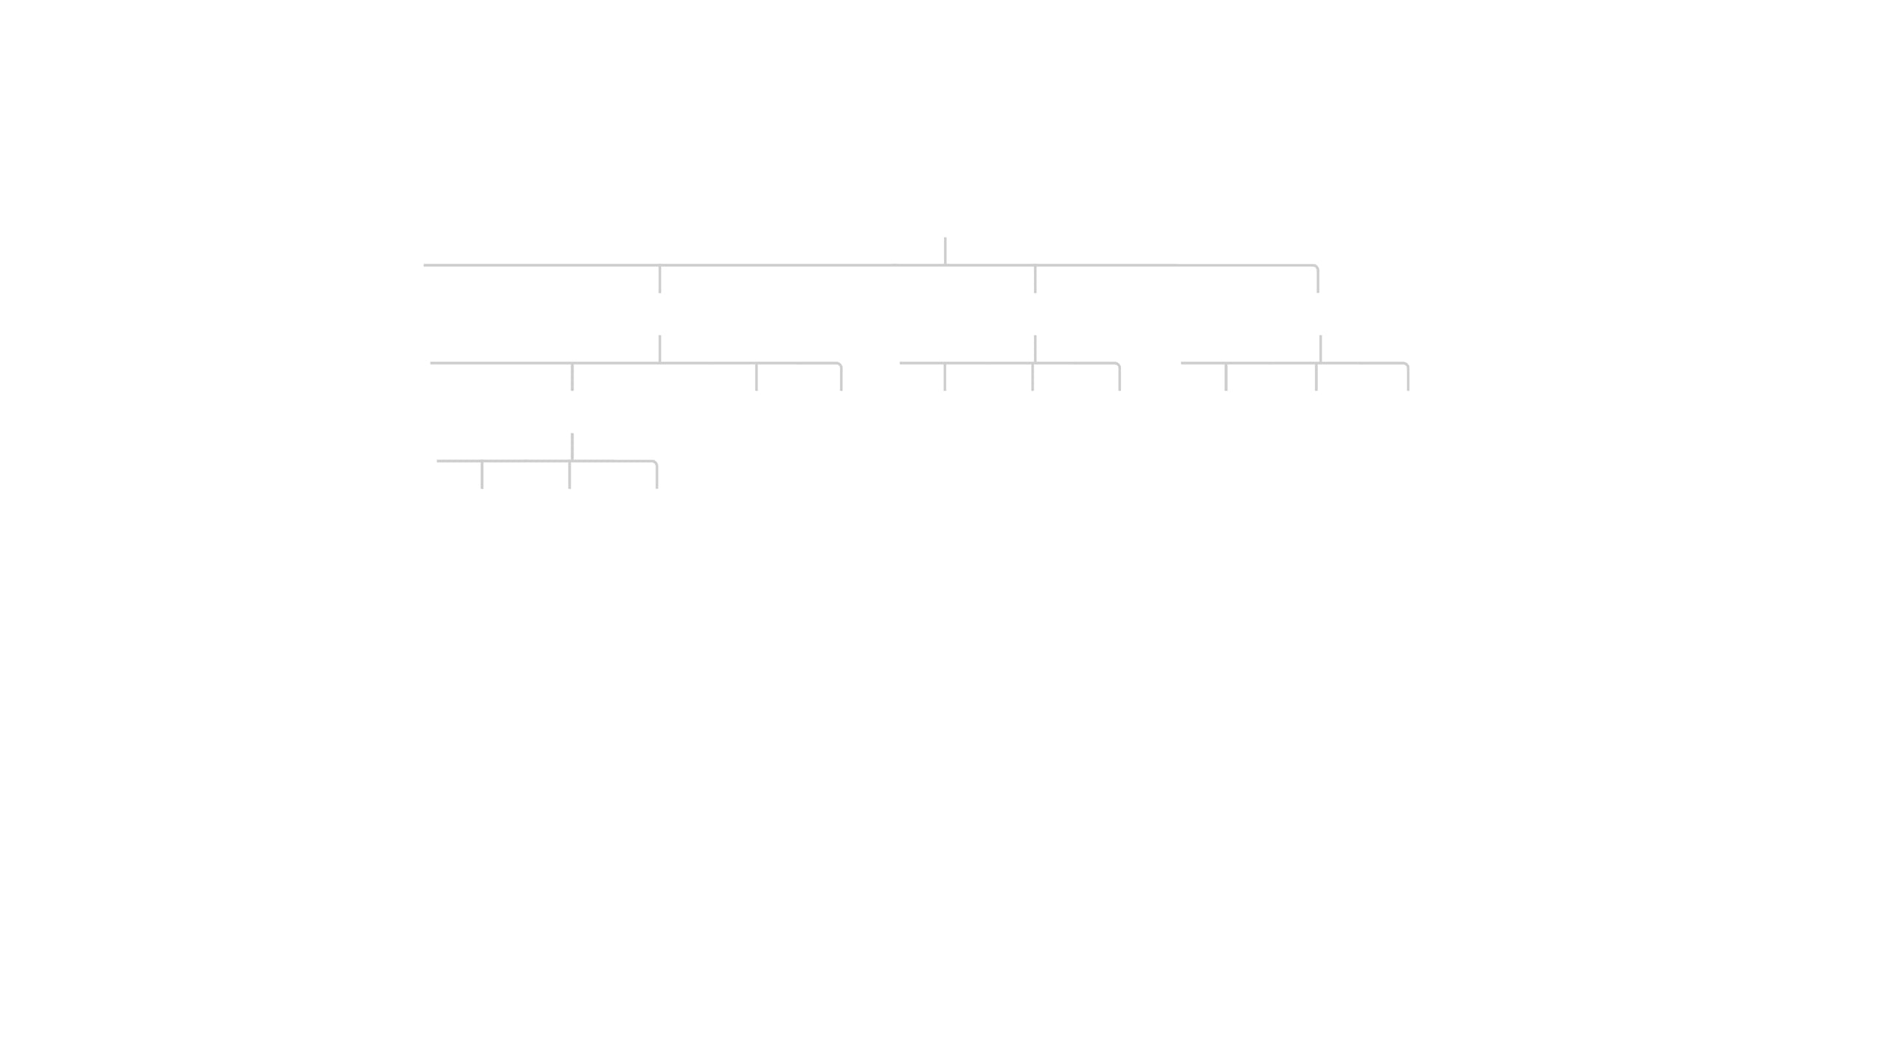
Coin Change — The Recursion Tree Explodes
coins = [1, 2, 5], amount = 6
cc(6)
cc(5)
cc(4)
cc(1)
cc(4)
cc(3)
cc(0)
cc(3)
cc(2)
cc(-1)
cc(0)
cc(-1)
cc(-4)
cc(3)
cc(2)
cc(-1)
HIGHER BRANCHING FACTOR
EXPLOSIVE GROWTH
Unlike Fibonacci (2 branches), Coin Change has k branches (where k is number of coins).
Many subproblems like
cc(4)
and
cc(3)
are
recomputed repeatedly.
Complexity:
O(k
^{n}
)

Slide 21

Coin Change — DP Solution
Applying the Recipe
int coinChange(int coins[], int n, int amount) { // Initialize with infinity (unreachable) int dp[amount + 1]; for (int i = 0; i <= amount; i++) dp[i] = amount + 1; // acts as infinity dp[0] = 0; for (int i = 1; i <= amount; i++) for (int j = 0; j < n; j++) if (coins[j] <= i && dp[i-coins[j]] + 1 < dp[i]) dp[i] = dp[i - coins[j]] + 1; return dp[amount] > amount ? -1 : dp[amount]; }
STATE
dp[i] = minimum coins to make amount i
RECURRENCE
dp[i] = min(dp[i - coin] + 1) for each coin where coin ≤ i
Note: We initialize with infinity to represent "impossible". If the final answer is still infinity, we return -1.
BASE CASE
dp[0] = 0 (zero coins needed for amount zero)

Slide 22
Coin Change — Step-by-Step Walkthrough
coins = [1, 3, 4]
amount = 6
Final DP Table:
dp[0]
= 0
(base case)
0
1
2
3
4
5
6
dp[1]
= min(dp[0]+1) = 1
(use 1)
0
1
2
1
1
2
2
dp[2]
= min(dp[1]+1) = 2
(use 1)
dp[3]
= min(dp[2]+1, dp[0]+1) = 1
(use 3)
dp[4]
= min(dp[3]+1, dp[1]+1, dp[0]+1) = 1
(use 4)
GREEDY VS DP
Greedy Approach: Always pick largest coin. 6 = 4 + 1 + 1 → 3 coins (Suboptimal) DP Approach: 6 = 3 + 3 → 2 coins (Optimal)
dp[5]
= min(dp[4]+1, dp[2]+1, dp[1]+1) = 2
(4+1)
dp[6]
= min(dp[5]+1, dp[3]+1, dp[2]+1) = 2
(3+3)
Time: O(amount × |coins|) Space: O(amount)

Slide 23

Coin Change Variant — Count the Number of Ways
Problem: How many different ways can you make change for a given amount? (Order does not matter)
int coinChangeWays(int coins[], int n, int amount) { int dp[amount + 1]; memset(dp, 0, sizeof(dp)); dp[0] = 1; // one way to make 0 // Iterate coins in OUTER loop for (int i = 0; i < n; i++) for (int j = coins[i]; j <= amount; j++) dp[j] += dp[j - coins[i]]; return dp[amount]; }
EXAMPLE
coins = [1, 2, 5], amount = 5
Answer: 4 ways
CRITICAL DETAIL
5
The loop order matters! Putting coins in the outer loop ensures we count combinations (sets), not permutations (sequences). (e.g., "1+2" and "2+1" are counted as the same way)
2 + 2 + 1
2 + 1 + 1 + 1
1 + 1 + 1 + 1 + 1

Slide 24


Classic Problem 3 — 0/1 Knapsack
Problem:
Given a set of items, each with a
weight and a value, determine which items
Max Capacity: 7 kg
to include in a collection so that:
Total weight ≤ Capacity
ITEM 1
ITEM 2
1 kg | $1
3 kg | $4
Total value is maximized
ITEM 3
ITEM 4
THE "0/1" CONSTRAINT
4 kg | $5
5 kg | $7
You cannot break items. You must either take the item whole (1) or leave it (0). (This distinguishes it from the "Fractional Knapsack" problem, which can be solved greedily.)
Which combination yields the highest value?

Slide 25
0/1 Knapsack — Why Greedy Fails
Item 1
Item 2
Item 3
Capacity: 50
Value:
$60
Value:
$100
Value:
$120
Weight:
10
Weight:
20
Weight:
30
Ratio: 6.0 (Best)
Ratio: 5.0
Ratio: 4.0
GREEDY STRATEGY
OPTIMAL STRATEGY
Pick highest value/weight ratio first.
Try all combinations (DP).
Capacity: 50
Capacity: 50
1
2
2
3
Total Value: $160 (Item 1 + Item 2)
Total Value: $220 (Item 2 + Item 3)
Item 3 (wt 30) doesn't fit in the remaining 20 space.
Ignoring the "best ratio" item fills the bag more efficiently.

Slide 26

0/1 Knapsack — Naive Recursion
THE CHOICE
int max(int a, int b) { return a > b ? a : b; } int knapsack(int W, int wt[], int val[], int n) { // Base Case if (n == 0 || W == 0) return 0; // If weight of item exceeds capacity, skip it if (wt[n-1] > W) return knapsack(W, wt, val, n-1); // Max of: include item OR exclude item return max( val[n-1] + knapsack(W - wt[n-1], wt, val, n-1), knapsack(W, wt, val, n-1) ); }
For each item (starting from the last), we have two choices: 1. Include it: Add its value, subtract its weight from capacity, move to next item. 2. Exclude it: Skip item, keep capacity, move to next item.
Recurrence Relation: K(n, W) = max( val[n] + K(n-1, W-wt[n]), K(n-1, W) )
^{n}
Exponential time complexity. Like Fibonacci, it recomputes the same subproblems (n, W) many times.
O(2
)

Slide 27

0/1 Knapsack — DP Solution (Tabulation)
Applying the Recipe
int knapsack(int wt[], int val[], int n, int W) { int dp[n+1][W+1]; memset(dp, 0, sizeof(dp)); for (int i = 1; i <= n; i++) { for (int w = 0; w <= W; w++) { dp[i][w] = dp[i-1][w]; // skip item if (wt[i-1] <= w) { int take = val[i-1] + dp[i-1][w - wt[i-1]]; if (take > dp[i][w]) dp[i][w] = take; } } } return dp[n][W]; }
STATE
dp[i][w] = max value using subset of first i items with capacity w.
Time Complexity: O(N × W) Space Complexity: O(N × W) (Can be optimized to O(W))
RECURRENCE
If wt[i] > w: (skip item) dp[i][w] = dp[i-1][w] Else: (max of skip vs take) dp[i][w] = max(dp[i-1][w], val[i] + dp[i-1][w-wt[i]])
BASE CASE
dp[0][..] = 0 (0 items) dp[..][0] = 0 (0 capacity)

Slide 28
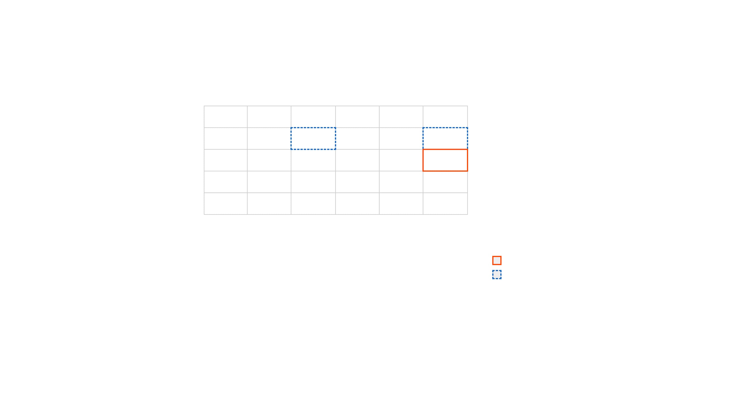
0/1 Knapsack — Filling the DP Table
ITEMS (WT, VAL)
[(2,3), (3,4), (4,5), (5,6)]
CAPACITY
W = 5
0
1
2
3
4
5
Calculating dp[2][5]
No Item
0
0
0
0
0
0
Item 1 (2, 3)
0
0
3
3
3
3
Item 2: wt=3, val=4 Capacity: 5
Item 2 (3, 4)
0
0
3
4
4
7
Option 1 (Exclude): dp[1][5] = 3
Item 3 (4, 5)
0
0
3
4
5
7
Option 2 (Include): val + dp[1][5-3] = 4 + dp[1][2] = 4 + 3 = 7
Item 4 (5, 6)
0
0
3
4
5
7
Result: max(3, 7) = 7
Current Cell
Dependencies

Slide 29


0/1 Knapsack — Space Optimization
THE OBSERVATION
int knapsack_opt(int wt[], int val[], int n, int W) { int dp[W + 1]; memset(dp, 0, sizeof(dp)); for (int i = 0; i < n; i++) // Traverse BACKWARDS to avoid reusing item for (int w = W; w >= wt[i]; w--) { int take = val[i] + dp[w - wt[i]]; if (take > dp[w]) dp[w] = take; } return dp[W]; }
To calculate values for item
i
, we only need values from item
i-1
(the previous row).
We can collapse the 2D table into a single
1D array
.
WHY BACKWARDS?
If we iterate forward, we might use the
same item multiple times
Dependency Direction
(because
dp[w-wt]
would already be updated for the current item).
src
...
new
dp[w]
depends on
dp[w-wt]
(a smaller index).

Slide 30




Classic Problem 4 — Longest Common Subsequence (LCS)
Problem: Given two sequences, find the length of the longest subsequence present in both of them.
EXAMPLE 1
A
B
C
D
E
A
C
E
SUBSEQUENCE VS. SUBSTRING
A subsequence appears in the same relative order but not necessarily contiguously. "ACE" is a subsequence of "ABCDE".
LCS: "ACE" (Length 3)
EXAMPLE 2
A
G
G
T
A
B
REAL-WORLD APPLICATIONS
Version Control (git diff)
G
X
T
X
A
Y
B
Bioinformatics (DNA alignment)
Spell Checkers
LCS: "GTAB" (Length 4)
(Note: 'A' in the second string is skipped to maintain order)

Slide 31

LCS — Naive Recursive Approach
THE LOGIC
int lcs_recursive(char* s1, char* s2, int i, int j) { // Base Case: End of either string if (i == 0 || j == 0) return 0; // If characters match if (s1[i-1] == s2[j-1]) return 1 + lcs_recursive(s1, s2, i-1, j-1); // If they don't match, try both options int a = lcs_recursive(s1, s2, i-1, j); int b = lcs_recursive(s1, s2, i, j-1); return a > b ? a : b; }
Compare the last characters of strings A and B: 1. Match: If A[i] == B[j], this char is part of LCS. Add 1 and recurse on both remainders. 2. No Match: If A[i] != B[j], we skip one char from either A or B and take the max.
O(2
^{n}
)
Exponential time complexity. In the worst case (no matches), we branch twice at every step.
Recurrence Relation: # If match 1 + LCS(i-1, j-1) # If no match max(LCS(i-1, j), LCS(i, j-1))

Slide 32



LCS — DP Solution with Table
Applying the Recipe
int longestCommonSubseq(char* t1, char* t2) { int m = strlen(t1), n = strlen(t2); int dp[m+1][n+1]; memset(dp, 0, sizeof(dp)); for (int i = 1; i <= m; i++) for (int j = 1; j <= n; j++) { if (t1[i-1] == t2[j-1]) dp[i][j] = dp[i-1][j-1] + 1; else dp[i][j] = dp[i-1][j] > dp[i][j-1] ? dp[i-1][j] : dp[i][j-1]; } return dp[m][n]; }
STATE
dp[i][j] = length of LCS between text1[0..i-1] and text2[0..j-1].
RECURRENCE
Diagonal = Match
Top/Left = Skip
If text1[i-1] == text2[j-1]: 1 + dp[i-1][j-1] (Match!) Else: max(dp[i-1][j], dp[i][j-1])
BASE CASE
dp[0][..] = 0 (Empty string) dp[..][0] = 0

Slide 33


LCS — Step-by-Step Table Construction
S1 (ROWS)
"GAC"
S2 (COLS)
"AGCAT"
" "
A
G
C
A
T
CASE 1: MISMATCH
" "
0
0
0
0
0
0
Cell: S1[0]='G', S2[1]='A' 'G' != 'A' dp[1][2] = max(dp[0][2], dp[1][1]) dp[1][2] = max(0, 0) = 0
G
0
0
0
0
0
0
A
0
0
1
1
1
1
C
0
1
1
2
2
2
CASE 2: MATCH
Cell: S1[1]='A', S2[0]='A' 'A' == 'A' dp[2][1] = 1 + dp[1][0] dp[2][1] = 1 + 0 = 1
*Table shows partial progress. Final answer is dp[3][5] = 2 ("AC").

Slide 34


Classic Problem 5 — Longest Increasing Subsequence (LIS)
Problem:
Given an integer array
nums
, return
EXAMPLE
the length of the longest strictly increasing
10
9
2
5
3
7
101
subsequence.
18
Subsequence: Elements can be skipped, but relative order must be maintained.
Strictly Increasing: Each element must be strictly greater than the previous one (no duplicates allowed in the chain).
LIS: [2, 5, 7, 18] Length: 4
(Note: [2, 3, 7, 101] is also valid)
WHY NOT JUST SORT?
If we sort the array, we lose the original relative order of elements. The problem requires the subsequence to exist in the original array.

Slide 35

LIS — DP Solution
Applying the Recipe
STATE
int lengthOfLIS(int nums[], int n) { if (n == 0) return 0; int dp[n]; for (int i = 0; i < n; i++) dp[i] = 1; for (int i = 1; i < n; i++) for (int j = 0; j < i; j++) if (nums[j] < nums[i] && dp[j]+1 > dp[i]) dp[i] = dp[j] + 1; int ans = 0; for (int i = 0; i < n; i++) if (dp[i] > ans) ans = dp[i]; return ans; }
dp[i] = length of LIS ending at index i.
RECURRENCE
For all j < i where nums[j] < nums[i]: dp[i] = max(dp[i], 1 + dp[j])
BASE CASE
Complexity:
O(n
²
) Time, O(n) Space.
dp[i] = 1 for all i (every element is an LIS of length 1)
*There is a more advanced O(n log n) solution using Binary Search (Patience
Sorting), but this DP approach is the foundational one.
FINAL ANSWER
max(dp) — the LIS could end at any index

Slide 36




Classic Problem 6 — Edit Distance
Problem:
Find the minimum number of operations
EXAMPLE: HORSE → ROS
required to convert
word1
to
word2
.
HORSE
ALLOWED OPERATIONS
RORSE
REPLACE 'H' WITH 'R'
Insert a character
ROSE
DELETE 'R'
Delete a character
ROS
DELETE 'E'
Replace a character
Total Operations: 3
Applications: Spell checking (autocorrect), DNA sequence alignment, Natural Language Processing.

Slide 37

Edit Distance — Recursive Formulation
THE LOGIC
int min3(int a, int b, int c) { if (a < b) return a < c ? a : c; return b < c ? b : c; } int minDistance(char* w1, char* w2, int i, int j) { if (i == 0) return j; // Insert remaining if (j == 0) return i; // Delete remaining if (w1[i-1] == w2[j-1]) return minDistance(w1, w2, i-1, j-1); return 1 + min3( minDistance(w1, w2, i, j-1), // Insert minDistance(w1, w2, i-1, j), // Delete minDistance(w1, w2, i-1, j-1) // Replace ); }
Compare the last characters of strings A and B:
1.
Match:
No cost. Recurse on
(i-1, j-1)
.
2.
Mismatch:
Take min of 3 operations (+1 cost):
Insert:
Recurse on
(i, j-1)
Exponential time complexity. Worse than LCS — 3 branches at each step.
Delete:
Recurse on
(i-1, j)
O(3
^{m}
)
Replace:
Recurse on
(i-1, j-1)
Recurrence Relation: # If match: ED(i-1, j-1) # If mismatch: 1 + min( ED(i, j-1), # Insert ED(i-1, j), # Delete ED(i-1, j-1) # Replace )

Slide 38

Edit Distance — DP Solution
Applying the Recipe
int minDistance(char* w1, char* w2) { int m = strlen(w1), n = strlen(w2); int dp[m+1][n+1]; for (int i = 0; i <= m; i++) dp[i][0] = i; for (int j = 0; j <= n; j++) dp[0][j] = j; for (int i = 1; i <= m; i++) for (int j = 1; j <= n; j++) { if (w1[i-1] == w2[j-1]) dp[i][j] = dp[i-1][j-1]; else dp[i][j] = 1 + min3( dp[i][j-1], dp[i-1][j], dp[i-1][j-1]); } return dp[m][n]; }
STATE
dp[i][j] = min operations to convert word1[0..i] to word2[0..j].
RECURRENCE
↖
Replace / Match
←
Insert
If match: dp[i-1][j-1] Else: 1 + min( dp[i][j-1] (Insert), dp[i-1][j] (Delete), dp[i-1][j-1] (Replace) )
↑
Delete
BASE CASE
dp[i][0] = i (Delete all) dp[0][j] = j (Insert all)

Slide 39


Edit Distance — Table Walkthrough
WORD1 (ROWS)
"HORSE"
WORD2 (COLS)
"ROS"
" "
R
O
S
MISMATCH EXAMPLE
" "
0
1
2
3
Cell: 'H' vs 'R' 1 + min(0, 1, 1) = 1 (Replace 'H' with 'R')
H
1
1
2
3
O
2
2
1
2
R
3
2
2
2
MATCH EXAMPLE
S
4
3
3
2
Cell: 'O' vs 'O' Take diagonal value directly. dp[2][2] = dp[1][1] = 1
E
5
4
4
3
FINAL ANSWER
dp[5][3] = 3 (HORSE → ROS)

Slide 40
Classic Problem 7 — Grid Paths with Obstacles
Problem: A robot starts at top-left (0,0) and wants to reach bottom-right. It can only move Down or Right. Some cells are obstacles. How many unique paths exist?
int uniquePathsWithObstacles(int grid[][100], int m, int n) { int dp[m][n]; memset(dp, 0, sizeof(dp)); if (grid[0][0] == 0) dp[0][0] = 1; for (int i = 0; i < m; i++) for (int j = 0; j < n; j++) { if (grid[i][j] == 1) dp[i][j] = 0; else { if (i > 0) dp[i][j] += dp[i-1][j]; if (j > 0) dp[i][j] += dp[i][j-1]; } } return dp[m-1][n-1]; }
RECURRENCE LOGIC
Example DP Table (1 = Path Count)
If grid[i][j] is obstacle: dp[i][j] = 0 Else: dp[i][j] = dp[i-1][j] + dp[i][j-1] (Sum of paths from top and left)
1
1
1
1
0
1
1
1
2

Slide 41
Classic Problem 8 — Minimum Path Sum
Problem: Find a path from top-left to bottom-right which minimizes the sum of all numbers along its path. You can only move either down or right.
RECURRENCE RELATION
dp[i][j] = grid[i][j] + min( dp[i-1][j], # from top dp[i][j-1] # from left )
1
3
1
1
5
1
int minPathSum(int grid[][100], int m, int n) { for (int i = 0; i < m; i++) for (int j = 0; j < n; j++) { if (i == 0 && j == 0) continue; else if (i == 0) grid[i][j] += grid[i][j-1]; else if (j == 0) grid[i][j] += grid[i-1][j]; else { int mn = grid[i-1][j] < grid[i][j-1] ? grid[i-1][j] : grid[i][j-1]; grid[i][j] += mn; } } return grid[m-1][n-1]; }
4
2
1
Path: 1 → 3 → 1 → 1 → 1 = 7

Slide 42

Classic Problem 9 — House Robber
Problem: You are a robber planning to rob houses along a street. Each house has a certain amount of money stashed.
int rob(int nums[], int n) { if (n == 0) return 0; if (n == 1) return nums[0]; int dp[n]; dp[0] = nums[0]; dp[1] = nums[0] > nums[1] ? nums[0] : nums[1]; for (int i = 2; i < n; i++) { int take = nums[i] + dp[i-2]; dp[i] = take > dp[i-1] ? take : dp[i-1]; } return dp[n-1]; }
THE CONSTRAINT
Adjacent houses have connected security systems. You cannot rob two adjacent houses on the same night.
Example: [2, 7, 9, 3, 1]
2
7
9
3
1
The Choice (Recurrence)
Total: 2 + 9 + 1 = 12
dp[i] = max( dp[i-1], // Skip house i nums[i] + dp[i-2] // Rob house i )

Slide 43

Classic Problem 10 — Maximum Subarray
Problem: Find the contiguous subarray (containing at least one number) which has the largest sum.
EXAMPLE
-2
1
-3
4
-1
2
1
-5
4
THE CORE DECISION
Max Sum: 6 (from [4, -1, 2, 1])
At each element
nums[i]
, we ask:
"Should I start a new subarray here, or extend the
int maxSubArray(int nums[], int n) { int max_sum = nums[0]; int current = nums[0]; for (int i = 1; i < n; i++) { // Extend or start fresh? current = nums[i] > current + nums[i] ? nums[i] : current + nums[i]; if (current > max_sum) max_sum = current; } return max_sum; }
previous one?"
current_sum = max(nums[i], current_sum + nums[i]) max_sum = max(max_sum, current_sum)
Time: O(n)
Space: O(1)

Slide 44


Advanced — Matrix Chain Multiplication
THE PROBLEM
EXAMPLE: A, B, C
Matrix multiplication is associative: (AB)C = A(BC). However, the cost (number of scalar multiplications) depends heavily on the order of parenthesization.
A 10×30
B 30×5
C 5×60
Option 1: (AB)C
(10*30*5) + (10*5*60) = 1500 + 3000
4,500 ops
THE COST MODEL
Option 2: A(BC)
Multiplying a matrix p×q by q×r requires:
(30*5*60) + (10*30*60) = 9000 + 18000
Cost = p * q * r operations
27,000 ops
6x Slower! Order matters.

Slide 45

Matrix Chain Multiplication — DP Solution
Applying the Recipe
int matrixChainOrder(int p[], int size) { int n = size - 1; int dp[n+1][n+1]; memset(dp, 0, sizeof(dp)); for (int l = 2; l <= n; l++) // chain length for (int i = 1; i <= n-l+1; i++) { int j = i + l - 1; dp[i][j] = INT_MAX; for (int k = i; k < j; k++) { int cost = dp[i][k] + dp[k+1][j] + p[i-1]*p[k]*p[j]; if (cost < dp[i][j]) dp[i][j] = cost; } } return dp[1][n]; }
STATE
dp[i][j]
= min scalar multiplications needed for chain
A
_{i}
...A
_{j}
.
RECURRENCE
Try every split point k between i and j: dp[i][j] = min( dp[i][k] + dp[k+1][j] + p[i-1]*p[k]*p[j] )
O(n
³
)
Interval DP Pattern. Three nested loops: Length, Start Index, Split Point.
BASE CASE
dp[i][i] = 0 (Single matrix requires 0 ops)

Slide 46

Recognizing DP Problems
1. OPTIMIZATION
2. COUNTING
3. FEASIBILITY
Maximize Value
Number of Ways
Is it possible?
Profit, Loot, Subsequence Length
Grid Paths, Climbing Stairs
Subset Sum, Interleaving String
Minimize Cost
Count Distinct
Can we reach?
Path Sum, Edit Distance, Coins
Arrangements, Partitions
Jump Game (often Greedy, but DP too)
"Longest" / "Shortest"
THE CONSTRAINT CHECK (INPUT SIZE N)
N ~ 10-20
N ~ 100-1000
N ~ 10
⁵
+
O(2
^{N}
) or O(N!)
O(N
²
) or O(N
³
)
O(N) or O(N log N) Greedy / Divide & Conquer
Recursion / Backtracking
Dynamic Programming

Slide 47
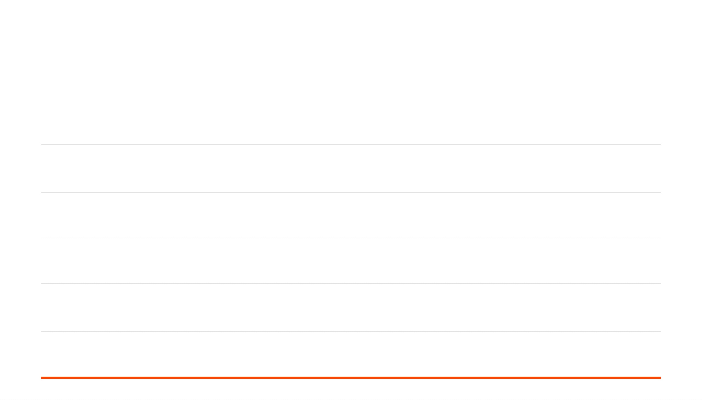
Common DP Patterns — A Reference Table
PATTERN
TYPICAL STATE
COMPLEXITY
EXAMPLES
Linear (1D)
O(N)
Climbing Stairs, House Robber, Fibonacci
dp[i]
depends on
dp[i-k]
Grid (2D)
O(N*M)
Unique Paths, Min Path Sum
dp[i][j]
dp[i-1][j]
depends on
,
dp[i][j-1]
Knapsack
O(N*W)
0/1 Knapsack, Subset Sum, Partition Equal Subset
dp[i][w]
(item i, weight w)
String Alignment
O(N*M)
LCS, Edit Distance, Interleaving String
dp[i][j]
(suffix/prefix i, j)
Unbounded Knapsack
O(N*W) or O(W)
Coin Change, Rod Cutting
dp[w]
(capacity w)
Interval / MCM
Matrix Chain Mult, Burst Balloons, Palindromic Subseq
dp[i][j]
(range i to j)
O(N
³
)

Slide 48

Bonus Problem — Longest Palindromic Subsequence
Pattern: Range DP
int longestPalinSubseq(char* s) { int n = strlen(s); int dp[n][n]; memset(dp, 0, sizeof(dp)); for (int i = n-1; i >= 0; i--) { dp[i][i] = 1; for (int j = i+1; j < n; j++) { if (s[i] == s[j]) dp[i][j] = dp[i+1][j-1] + 2; else dp[i][j] = dp[i+1][j] > dp[i][j-1] ? dp[i+1][j] : dp[i][j-1]; } } return dp[0][n-1]; }
Problem:
Given a string
s
, find the length of the
longest palindromic subsequence.
RECURRENCE RELATION
Example: "bbbab"
State: dp[i][j] = LPS length in s[i...j] If s[i] == s[j]: 2 + dp[i+1][j-1] Else: max(dp[i+1][j], dp[i][j-1])
b
b
b
a
b
LPS: "bbbb" (Length 4)

Slide 49

Bonus Problem — Subset Sum
Pattern: 0/1 Knapsack (Feasibility)
#include <stdbool.h> bool isSubsetSum(int nums[], int n, int target) { // dp[j] = true if sum j is possible bool dp[target + 1]; memset(dp, false, sizeof(dp)); dp[0] = true; // Sum 0 always possible for (int i = 0; i < n; i++) for (int j = target; j >= nums[i]; j--) if (dp[j - nums[i]]) dp[j] = true; return dp[target]; }
Problem:
Given a set of non-negative integers and a
value
sum
, determine if there is a subset of the given
set with sum equal to given
sum
.
Example: Target = 9
RECURRENCE RELATION
3
34
4
12
5
2
State: dp[i][j] = True if sum 'j' is possible using first 'i' items. Logic: dp[i][j] = dp[i-1][j] // Exclude OR dp[i-1][j - nums[i]] // Include
Result: True (4 + 5 = 9)

Slide 50





Common Mistakes & Pitfalls
THE GREEDY TRAP
INCOMPLETE STATE
Assuming a locally optimal choice leads to a global optimum. DP is needed when future consequences matter.
Failing to include all changing parameters in the DP state key. If it affects the future, it must be in the state.
Example: "Buy/Sell Stock" problems. Wrong: dp[day] Right: dp[day][has_stock]
Example: Coin Change with coins [1, 3, 4]. Target 6: Greedy takes 4+1+1 (3 coins). Optimal is 3+3 (2 coins).
OFF-BY-ONE ERRORS
WRONG DIRECTION
Incorrect table sizing or loop boundaries. DP tables often
Iterating in the wrong order. You cannot calculate a state if its dependencies haven't been computed yet.
need size
N+1
to handle base cases (like empty
string/array).
Example: 0/1 Knapsack with 1D array. Must iterate backwards to avoid reusing items. Iterating forwards turns it into Unbounded Knapsack.
Example: Edit Distance for strings of len M, N.
Table needs size
(M+1) x (N+1)
.

Slide 51

The DP Mastery Roadmap
RECURSION & MEMOIZATION
1
Understand the call stack, overlapping subproblems, and caching results.
Fibonacci, Climbing Stairs
1D DYNAMIC PROGRAMMING
2
Linear dependencies. Solving for i based on i-1, i-2.
House Robber, Maximum Subarray
2D GRIDS & MATRICES
3
Spatial dependencies. Moving through a grid.
Unique Paths, Min Path Sum
CLASSIC MULTI-VARIABLE PATTERNS
4
Two strings, knapsack weights, complex state transitions.
LCS, Edit Distance, 0/1 Knapsack, LIS
ADVANCED DP
5
Intervals, Bitmasks, Trees, and Probability.
Matrix Chain Mult, TSP (Bitmask), Tree Diameter

Slide 52
Summary — Key Takeaways
THE PHILOSOPHY
THE METHODOLOGY
Smart Recursion
The 4-Step Recipe
DP is essentially recursion with caching. We trade space for time to avoid re-calculating the same subproblems.
1. Define the State (dp[i]). 2. Find the Recurrence (Transitions). 3. Identify Base Cases. 4. Determine Order of computation.
Two Pillars
Overlapping Subproblems: The same small problems appear repeatedly. Optimal Substructure: Optimal solution can be built from optimal sub-solutions.
Two Approaches
The Impact
Memoization (Top-Down): Easy to write, good for sparse states. Tabulation (Bottom-Up): Iterative, no recursion overhead, enables space optimization.
Reduces complexity from Exponential O(2
^{N}
) to Polynomial O(N
^{k}
).
"Those who cannot remember the past are condemned to repeat it."

Slide 53

Practice Problems & Resources
LEVEL 1: WARM-UP (1D DP)
Books
Climbing Stairs
Min Cost Climbing Stairs
CLRS (Intro to Algorithms)
House Robber
Maximum Subarray
Chapter 15: Dynamic Programming
LEVEL 2: CORE PATTERNS (2D / GRID)
Grokking Algorithms
Chapter 9: Dynamic Programming
Unique Paths I & II
Minimum Path Sum
Platforms
Coin Change
Longest Common Subsequence
Longest Increasing Subsequence
Edit Distance
LeetCode (Tag: Dynamic Programming)
LEVEL 3: CHALLENGE
HackerRank (Algorithms / DP)
VisualAlgo.net
Burst Balloons
Regular Expression Matching
Palindrome Partitioning II
Best Time to Buy/Sell Stock IV
Pro Tip: Don't just memorize solutions. Draw the recursion tree and the DP table for every problem you solve.

Slide 54

Thank You
Dynamic Programming: From Recursion to Optimization
QUESTIONS?
CS 301 — Algorithms & Data Structures

