Slide 1
Modernizing Clinical Research with Interactive Open Source Tools
Becca Krouse
Rho, Inc.

Slide 2
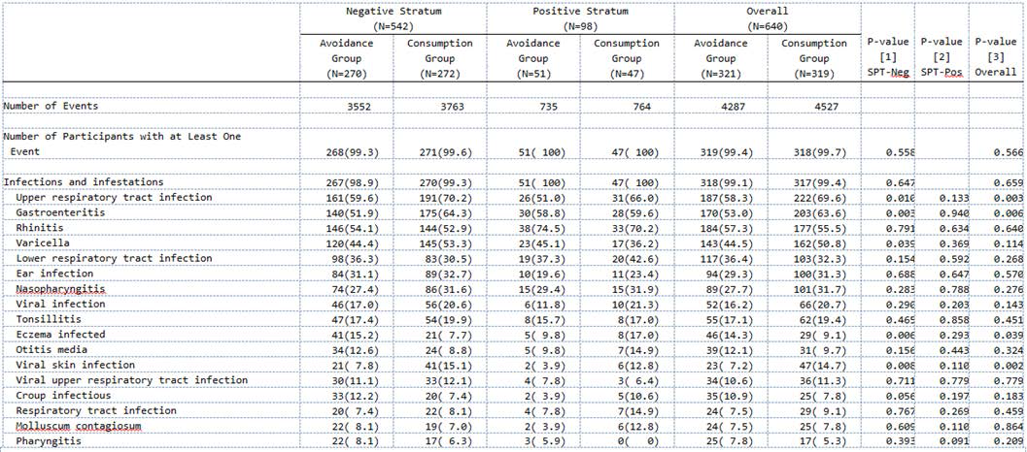
Background - Motivation
Page 1 of many…
Notes:
Remove text and enlarge table

Slide 3
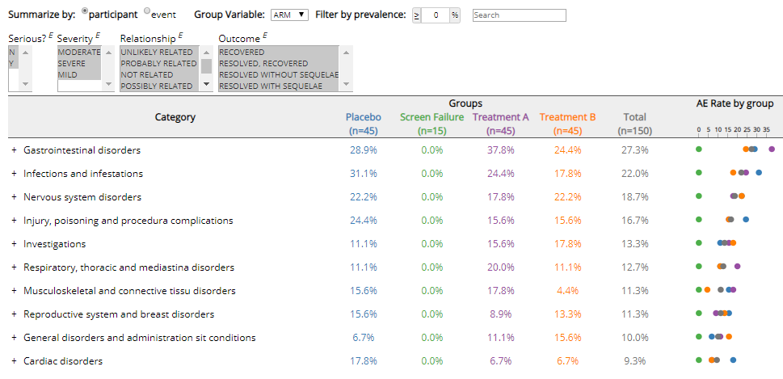
Background - Motivation
Solution: building open source interactive tools

Slide 4
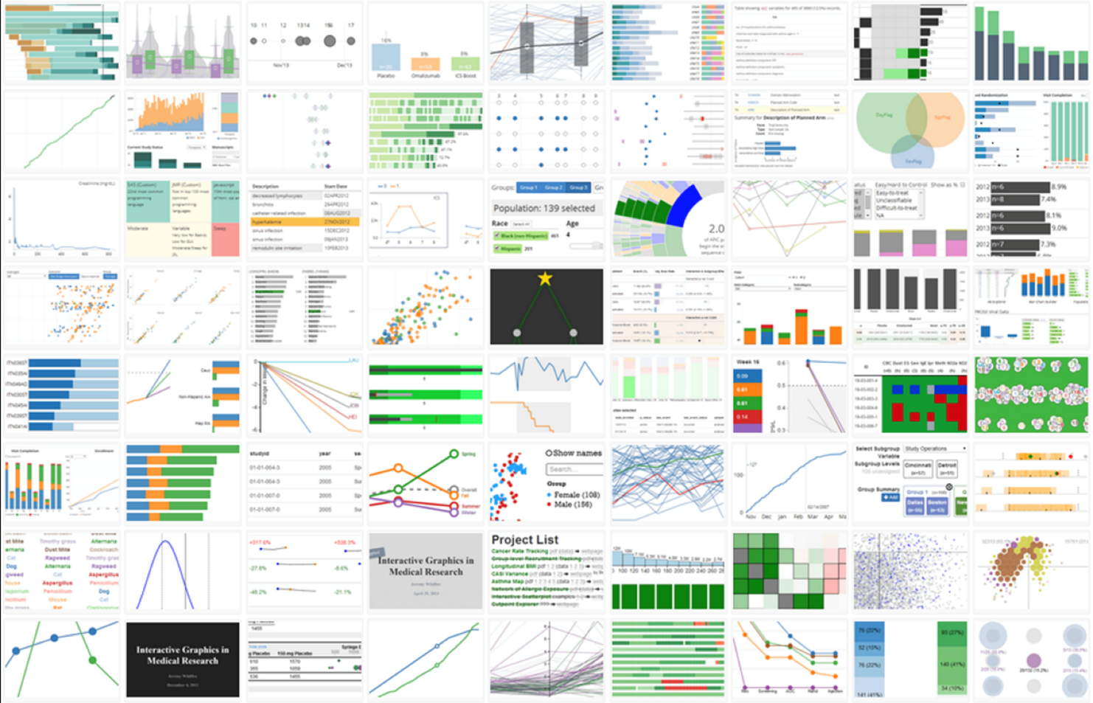

Slide 5
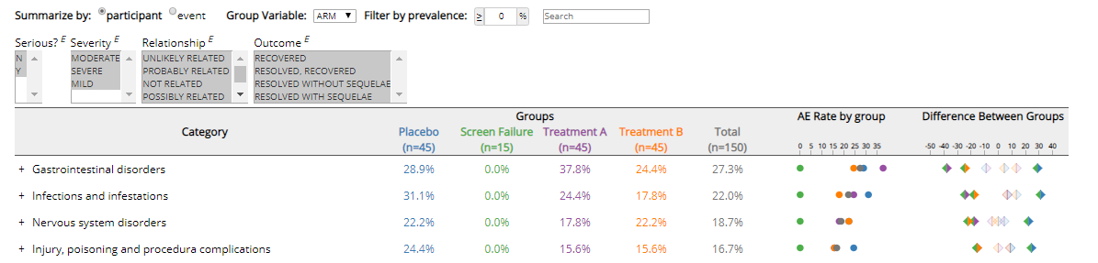
Design process

Slide 6
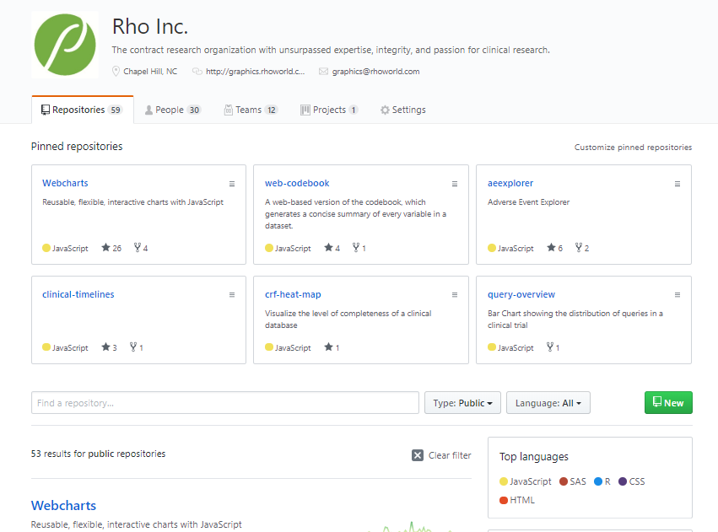
Development process
Notes:
Everything is under active development

Slide 7
Technology
Web-based (core)
R interface
JavaScript
HTML
+
CSS
+
D3
Webcharts
Web library
R wrapper
+

Slide 8

Industry Collaboration

Slide 9
Interactive Safety Graphics Taskforce
Sub-team of the ASA Biopharm-DIA Safety Working Group
Interdisciplinary effort in pharma industry
Goals:
Provide a clinical workflow for safety monitoring
Use of open source model

Slide 10
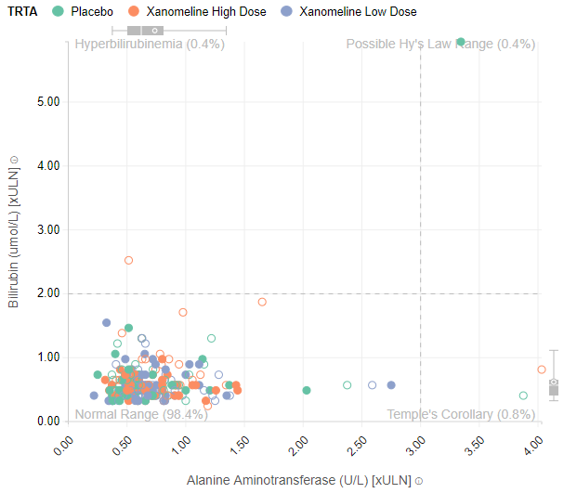
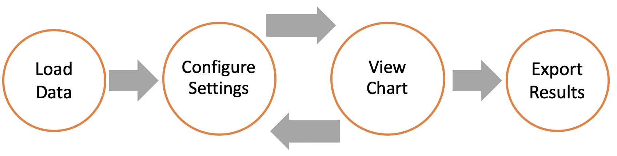
Interactive Safety Graphics Taskforce: Projects
Tools for monitoring liver toxicity
Clinical workflow
Interactive graphic
Framework for building and customizing
Demo

Slide 11
Questions?
Contact:
graphics@rhoworld.com
Rho Graphics Website: https://rhoinc.github.io/graphics/
ASA-DIA Working Group:
https://safetygraphics.github.io

Slide 12
Reserve

Slide 13
Links
Web examples:
Safety charts: https://rhoinc.github.io/viz-library/examples/0011-safetyExplorer-queries/aetable.html
Paneled outlier explorer: https://rhoinc.github.io/viz-library/examples/0019-paneled-outlier-explorer/
Web-codebook explorer: https://rhoinc.github.io/viz-library/examples/0012-web-codebook-explorer/
R examples:
safetyexploreR package
Github: RhoInc/safetyexploreR
Shiny apps:
Becca-krouse.shinyapps.io/aetableapp
Becca-krouse.shinyapps.io/safetyapp
Datadigest package
GitHub: RhoInc/datadigest
CRAN: https://cran.r-project.org/web/packages/datadigest/vignettes/datadigest.html

