Slide 1
Make GitHub Your Web-based Version-controlled Code Repository
Spencer Childress
Shane Rosanbalm
Notes:
Ask audience whether they’re predominantly SAS or R users.

Slide 2
Outline
Motivation
Technical Background
Accessing Remote Code Libraries
%install_github Source Code
Examples (time permitting)
Questions

Slide 3
Motivation
R ecosystem embraces collaboration
Hosting services like CRAN and GitHub promote exchange of code
SAS ecosystem is less open
SAS provides base functionality
Code appears in PDFs, not on a hosting service
Collaboration helps improve methods
GitHub hosts and tracks changes to code

Slide 4
Technical Background: Code Libraries
A collection of programs
Stored locally, on a network, or remotely
Accessing individual programs:
R: source('program.R')
SAS: %include 'program.sas';
Accessing libraries:
R: .libPaths('code-library')
SAS: option sasautos = 'code-library';

Slide 5

Technical Background: GitHub
How people build software
Web-based or enterprise hosting service
Code libraries organized by owner and repo
Accessible by browser and by an application programming interface (API)
Public and private repos
Cloud-based and enterprise offerings

Slide 6

Technical Background: git
Distributed version control system
Tracks changes to files including code

Slide 7
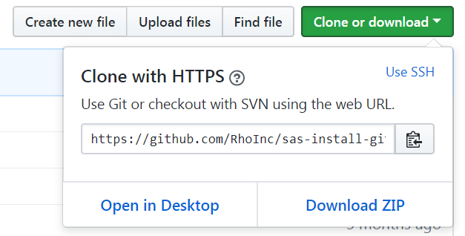
Accessing Remote Code Libraries: Manually
Navigate to the repo
Download the repo
Unzip the repo
Source the repo
Use that code
Notes:
Mention this method does not have the advantages of version control.

Slide 8
Accessing Remote Code Libraries: Programmatically
with R
with SAS
# source install_github install.packages( 'devtools' )
# download repo devtools::install_github( 'owner/repo' )
# source downloaded library library(repo)
* source install_github ; %include 'install_github.sas';
* point to repo ; %install_github( repo = owner/repo,
/* source file or folder */ file = <file path>, folder = <folder path> );
Notes:
Mention we developed the SAS macro.

Slide 9
%install_github Source Code
Sourcing a single remote file:
filename fileURL url "&fileURL"; *assign fileref;
%include fileURL; *source fileref;
filename fileURL clear; *clear fileref;

Slide 10
%install_github Source Code
Hitting the GitHub API:
filename inFolder temp; *assign fileref;
proc http
url = "&folderURL" /*point to GitHub*/
method = 'GET' /*request data*/
out = inFolder; /*direct response to fileref*/
run;
libname inFolder json
fileref = inFolder; *assign libref to fileref;

Slide 11
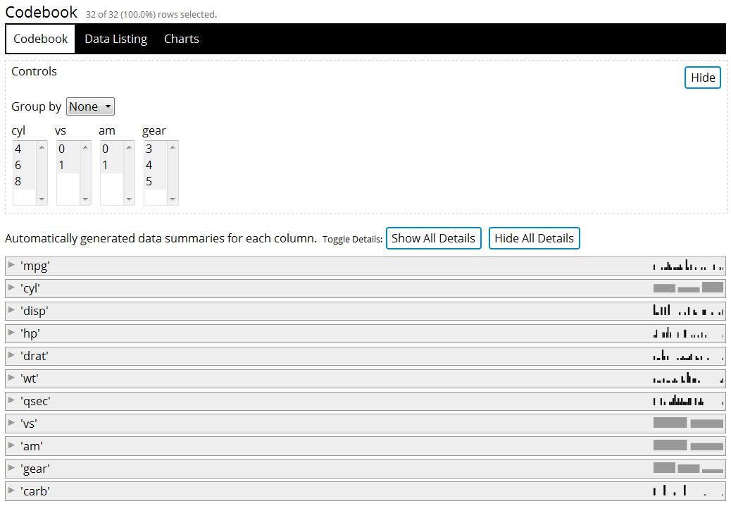
R Example
devtools::install_github( 'RhoInc/datadigest' )
datadigest::codebook( data = mtcars )
Notes:
Describe the output.

Slide 12
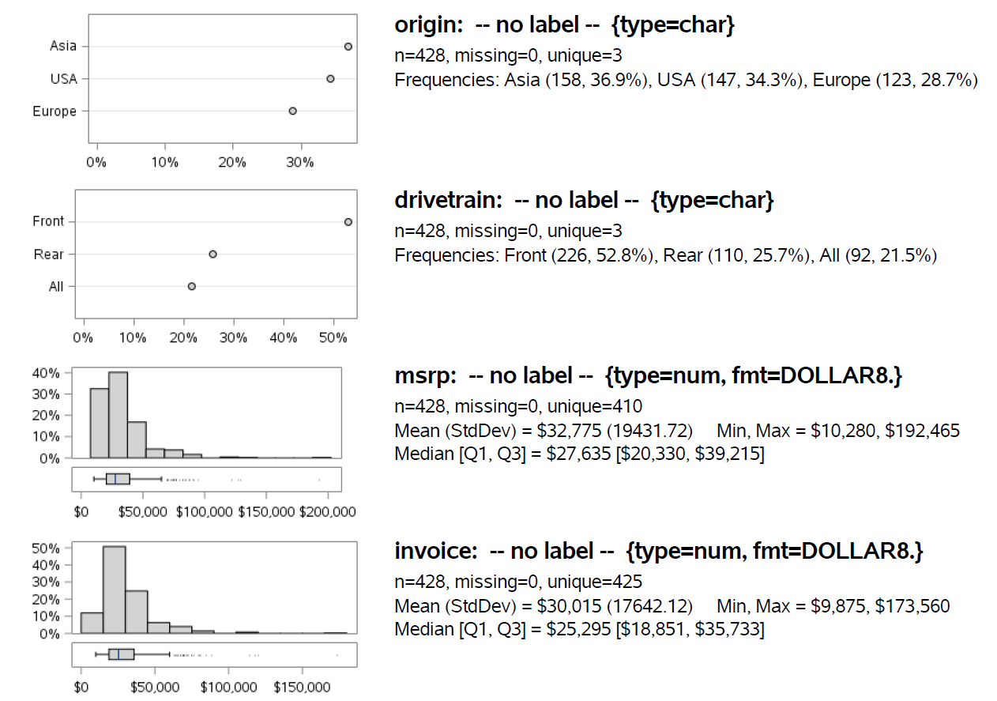
SAS Example
%install_github(
repo = RhoInc/sas-codebook,
folder = Macros
);
%codebook_generic(
data = sashelp.cars
);
Notes:
Describe the output.

Slide 13
Questions, Comments, Excellent
github.com/RhoInc/sas-install-github
Spencer Childress
spencer_childress@rhoworld.com
GitHub: samussiah
Shane Rosanbalm
shane_rosanbalm@rhoworld.com
GitHub: srosanba

