Slide 1
Make GitHub Your Web-based Version-controlled Code Repository
Spencer Childress
Shane Rosanbalm

Slide 2
Outline
Background
Code libraries
GitHub
git
Accessing remote code libraries
Manually
Programmatically
Recap
Questions

Slide 3
Code libraries
A collection of programs
Stored locally, on a network, or remotely
Accessing individual programs:
R: .source('program.R')
SAS: %include 'program.sas';
Accessing libraries:
R: .libPaths('code-library')
SAS: option sasautos = 'code-library';

Slide 4

GitHub
How people build software
Web-based hosting service
Code libraries organized by owner and repo
Accessible by browser and by an application programming interface (API)
Rho Inc.’s

Slide 5

git
Distributed version control system
Tracks changes to files including code

Slide 6
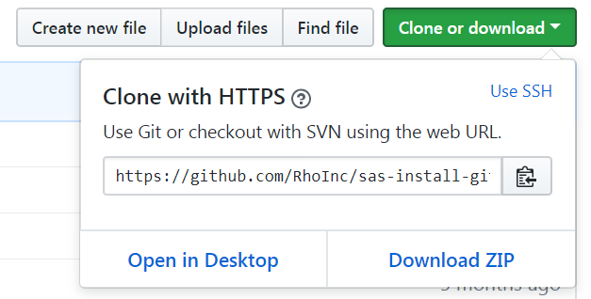
Accessing remote code libraries
Navigate to the repo
Download the repo
Unzip the repo
Source the repo
Use that code

Slide 7
Accessing remote code libraries
R
SAS
Get the code that gets the code
install.packages('devtools') library(devtools)
Get the code you want
install_github('useR/endswithR') library(endswithR)
%include 'install_github.sas';
%install_github(
repo = RhoInc/sas-violinPlot,
file = src/violinPlot.sas
);

Slide 8
Recap
GitHub stores code in the cloud
git tracks changes to code
R and SAS can access code stored locally and remotely
Local code can stagnate
Remote code is always up-to-date, and git ensures all versions are available

Slide 9


