Slide 1
Make GitHub Your Web-based Version-controlled Code Repository
Spencer Childress
Shane Rosanbalm
Notes:
Ask audience whether they’re predominantly SAS or R users.

Slide 2
Outline
Motivation
Technical Background
Accessing Remote Code Libraries
Manually
Programmatically
Recap
Questions

Slide 3
Motivation
Collaboration helps improve methods
Open source encourages collaboration
Hosting services allow exchange of code and work through the cloud
Version control tracks changes
GitHub provides each of these services

Slide 4
Technical Background: Code Libraries
A collection of programs
Stored locally, on a network, or remotely
Accessing individual programs:
R: .source('program.R')
SAS: %include 'program.sas';
Accessing libraries:
R: .libPaths('code-library')
SAS: option sasautos = 'code-library';

Slide 5

Technical Background: GitHub
How people build software
Web-based hosting service
Code libraries organized by owner and repo
Accessible by browser and by an application programming interface (API)
Public and private repos

Slide 6

Technical Background: git
Distributed version control system
Tracks changes to files including code

Slide 7
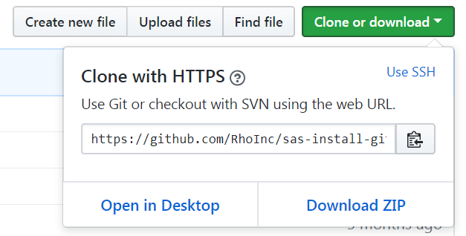
Accessing Remote Code Libraries: Manually
Navigate to the repo
Download the repo
Unzip the repo
Source the repo
Use that code

Slide 8
Accessing Remote Code Libraries: Programmatically
R
SAS
# source install_github install.packages( 'devtools' )
# download repo devtools::install_github( 'owner/repo' )
# source downloaded library library(repo)
* source install_github ; %include 'install_github.sas';
* point to repo ; %install_github( repo = owner/repo,
/* source file or folder */ file = <file path>, folder = <folder path> );

Slide 9
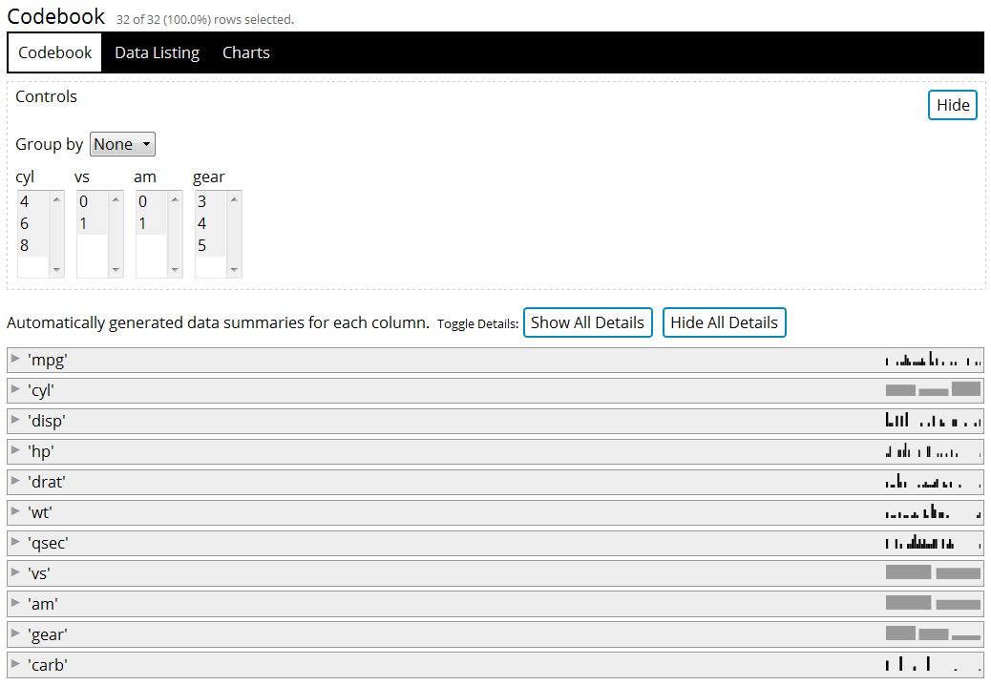
R Example
devtools::install_github( 'RhoInc/datadigest' )
datadigest::codebook( data = mtcars )

Slide 10
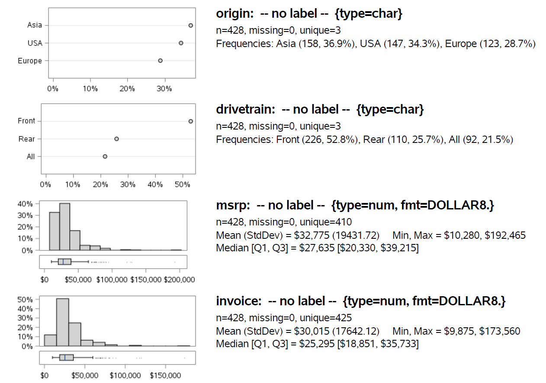
SAS Example
install_github(
repo = RhoInc/sas-codebook,
folder = Macros
);
%codebook_generic(
data = sashelp.cars
);

Slide 11
Questions, Comments, Excellent
github.com/RhoInc/sas-install-github
Spencer Childress
spencer_childress@rhoworld.com
GitHub: samussiah
Shane Rosanbalm
shane_rosanbalm@rhoworld.com
GitHub: srosanba

