Slide 1

Towards Holistic Adverse Drug Reaction Detection Using Multiple Complementary Data Sources Interactive Web-Based Exploration of the 3.8 Million Adverse Event Reports in the OpenFDA Database
Jeremy Wildfire
Statistical Scientist
Rho
@rhoworld
@jwildfire

Slide 2
Disclaimer
The views and opinions expressed in the following PowerPoint slides are those of the individual presenter and should not be attributed to Drug Information Association, Inc. (“DIA”), its directors, officers, employees, volunteers, members, chapters, councils, Communities or affiliates, or any organization with which the presenter is employed or affiliated.
These PowerPoint slides are the intellectual property of the individual presenter and are protected under the copyright laws of the United States of America and other countries. Used by permission. All rights reserved. Drug Information Association, Drug Information Association Inc., DIA and DIA logo are registered trademarks. All other trademarks are the property of their respective owners.

Slide 3
Rho Center for Applied Data Visualization
Team of statisticians and programmers building tools specifically tailored to clinical trials research
Rho:
http://www.rhoworld.com
Rho Center for Applied Data Visualization:
http://graphics.rhoworld.com
Source Code and Technical Documentation:
https://github.com/RhoInc/

Slide 4
Objective
Empower researchers to answer questions using publically available adverse event data.
What are the 5 most common drugs associated with adverse events related to Asthma?

Slide 5
Tools
FDA Adverse Event Reporting System (FAERS)
Database that contains information on adverse event and medication error reports submitted to FDA
OpenFDA API
System for querying FAERS
OpenFDA Explorer
Webpage that uses OpenFDA API to explore FAERS

Slide 6
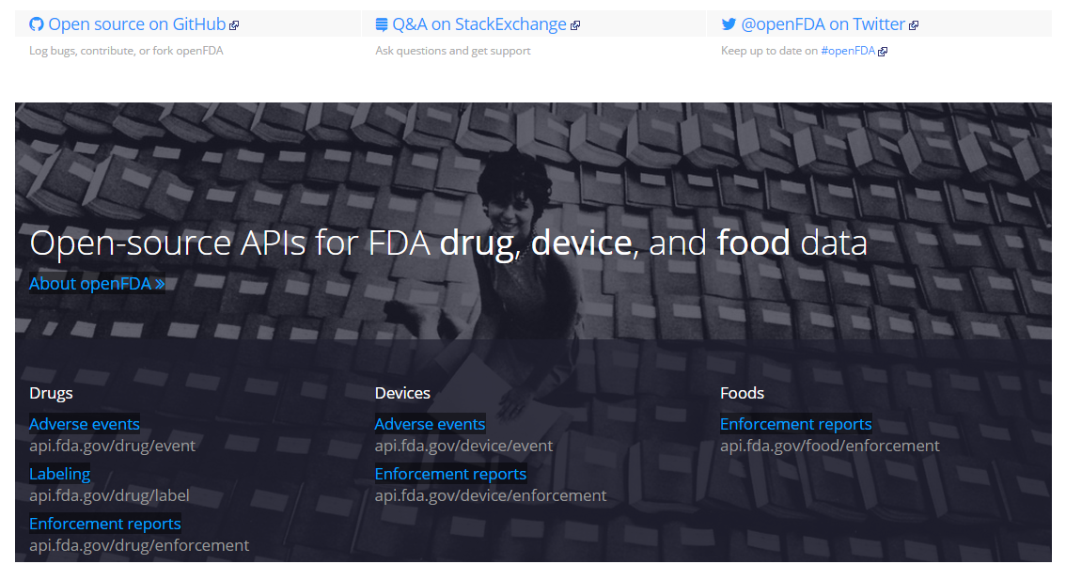
OpenFDA Initiative
OpenFDA Homepage:
https://open.fda.gov/
Notes:
“The goal of the project is to create easy access to public data, to create a new level of openness and accountability, to ensure the privacy and security of public FDA data, and ultimately to educate the public and save lives.” - https://open.fda.gov/about/
OpenFDA provides controlled access to several domains of FDA data using Application Programming Interfaces or APIs (more about those in a second). Today, we’ll focus on Adverse Events for Drugs, but the concepts presented today could be applied to other OpenFDA data as well.

Slide 7
About OpenFDA
OpenFDA provides access to public FDA data
Launched in June 2014
Created by Office of Informatics and Technology Innovation (OITI) at the FDA
Usage (first 4 months)
40,000 users
4.5 million data calls
Open Source Development
Github
StackExchange
Twitter
Notes:
OpenFDA is an initiative in the Office of Informatics and Technology Innovation (OITI) at the Food and Drug Administration led by the Chief Health Informatics Officer (CHIO), Dr. Taha Kass-Hout, MD, MS.

Slide 8
OpenFDA – Source Data
FDA Adverse Event Reporting System (FAERS)
Quarterly Reporting from 1969 to Present
Primary Users: Data Analysts
Data Access
Direct data download – 1 per quarter
Summary Statistics
FOI Request
FAERS Homepage
http://www.fda.gov/Drugs/GuidanceComplianceRegulatoryInformation/Surveillance/AdverseDrugEffects/

Slide 9
FAERS – Data types
Demographics
- a single record for each event report
Drug/biologic information
- for as many medications as were reported for the event
MedDRA terms for the event
- 1 or more for an event
Patient outcomes
- 0 or more for an event
Report sources
- 0 or more for an event
Drug therapy start dates and end dates
- 0 or more per drug per event
MedDRA terms for diagnoses for the reported drugs
- 0 or more per drug per event

Slide 10
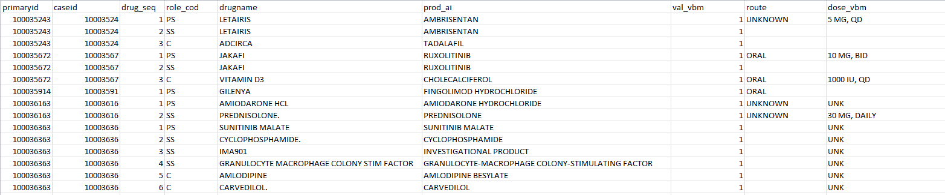
FAERS – Sample Data
Sample FAERS data from Q3 2014
Drug/biologic information (1 of 7 files)
15 of 689,000 records
Full Data Set (XML, 46.1 MB)
http://www.fda.gov/downloads/Drugs/GuidanceComplianceRegulatoryInformation/Surveillance/UCM443582.zip

Slide 11
OpenFDA API
Application Programming Interface
Primary Users: Software Developers
Access to FAERS data (2004-present) using 4 parameters:
Search: filter results meeting a criteria
Count: get the number of unique values for a field
Limit & Skip: # of results and position of first result
More than 3.8 million total reports, but …
…1000 results at a time
Can’t “download the data”

Slide 12
Top 5 for Asthma – Version 1
What are the 5 most common Asthma Drugs?
Search:
Drug Indication = Asthma
Count:
Medicinal Product (Generic)
Limit:
5
Medicinal Product | # of Reports
ALBUTEROL SULFATE | 14915
MONTELUKAST SODIUM | 12288
ALBUTEROL | 8583
OMALIZUMAB | 7469
FLUTICASONE PROPIONATE | 5970

Slide 13
Top 5 for Asthma – Version 2
Query:
https://api.fda.gov/drug/event.json?search=patient.drug.drugindication:%22asthma%22&count=patient.drug.generic_name.exact&limit=5
Results:
{"meta": {
"disclaimer": "openFDA is a beta research project and not for clinical use. While we make every effort to ensure that data is accurate, you should assume all results are unvalidated.",
"license": "http://open.fda.gov/license",
"last_updated": "2015-01-21"
},
"results": [
{"term": "ALBUTEROL SULFATE”, "count": 14915},
{"term": "MONTELUKAST SODIUM", "count": 12288},
{"term": "ALBUTEROL”, "count": 8583},
{"term": "OMALIZUMAB”, "count": 7469},
{"term": "FLUTICASONE PROPIONATE", "count": 5790}
]}

Slide 14
OpenFDA Explorer – Overview
Webpage linked to OpenFDA API
Allows users to query the FDA data in real time.
Intuitive user-interface provides high-level overview
Quickly compare Drugs/Compounds/Companies
OpenFDA Explorer
http://graphics.rhoworld.com/tools/openFDA/
Source Code:
https://github.com/RhoInc/

Slide 15
OpenFDA Explorer – System Design
OpenFDA Explorer is built using standard web technology
html, css, javascript, xml
Graphics created with: d3.js
Design Schema
FAERS
Database
OpenFDA Explorer
Webpage
OpenFDA API
Live updates with user input

Slide 16
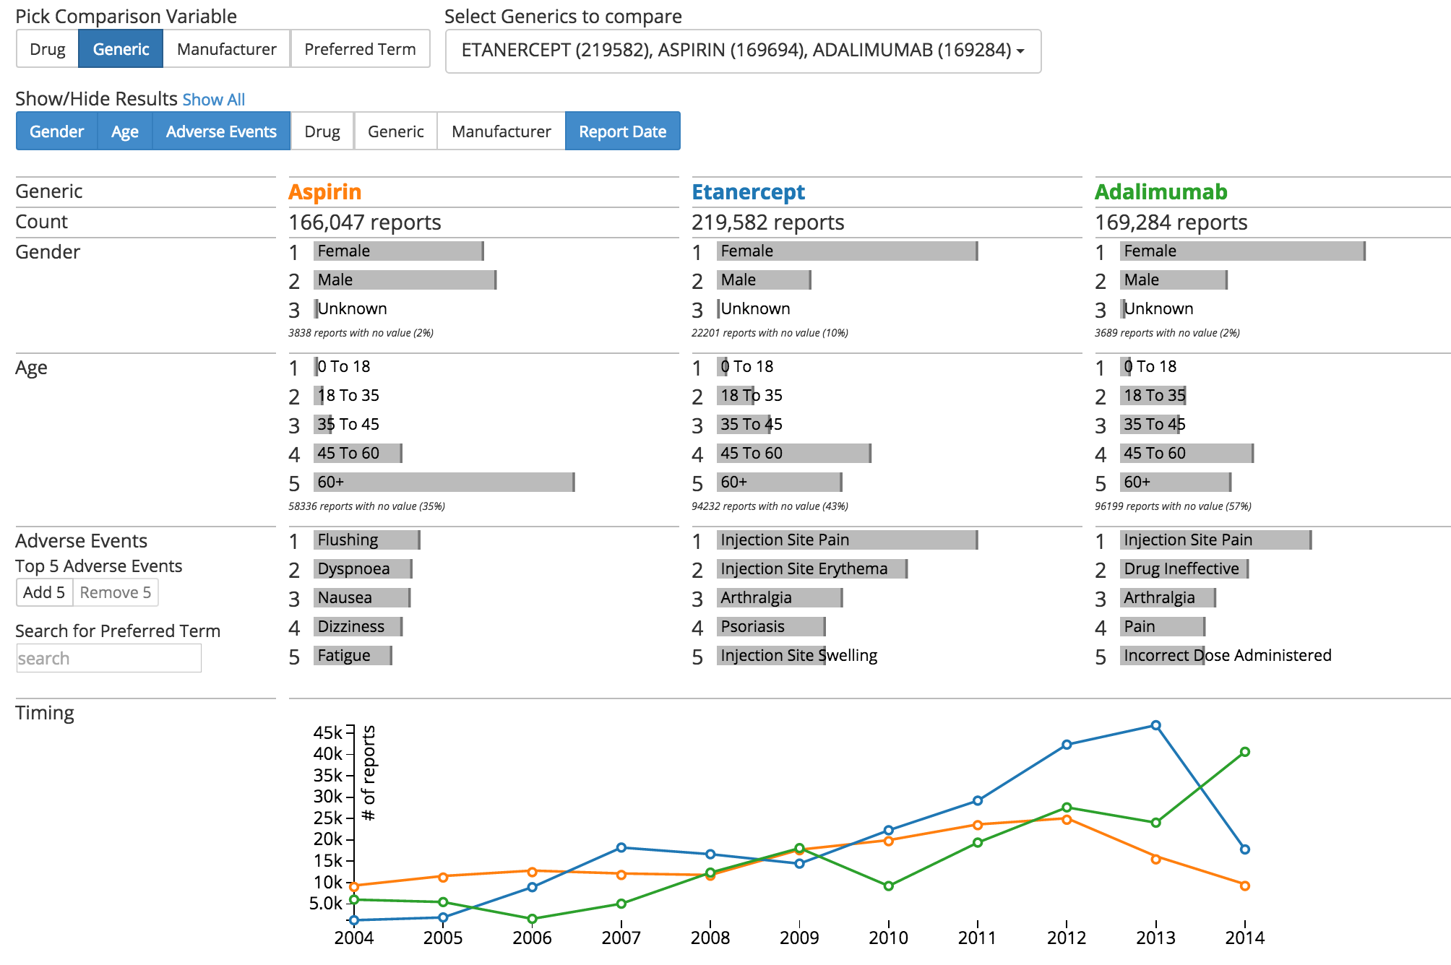
OpenFDA Explorer – Home Page

Slide 17
OpenFDA Explorer – Group Selection

Slide 18
OpenFDA Explorer – Comparison Variables

Slide 19
OpenFDA Explorer – Outcome Domains

Slide 20
Top 5 for Asthma – Version 3
What are the 5 most common Asthma Drugs?

Slide 21
OpenFDA Explorer – Real-time Exploration

Slide 22
OpenFDA Explorer – Next Steps
Filters
Comparisons vs. “Expected” (Reporting Ratios)
More Results/Comparison variables
Device AEs
Enforcement Reports
Tool for comparing other data vs. OpenFDA

Slide 23
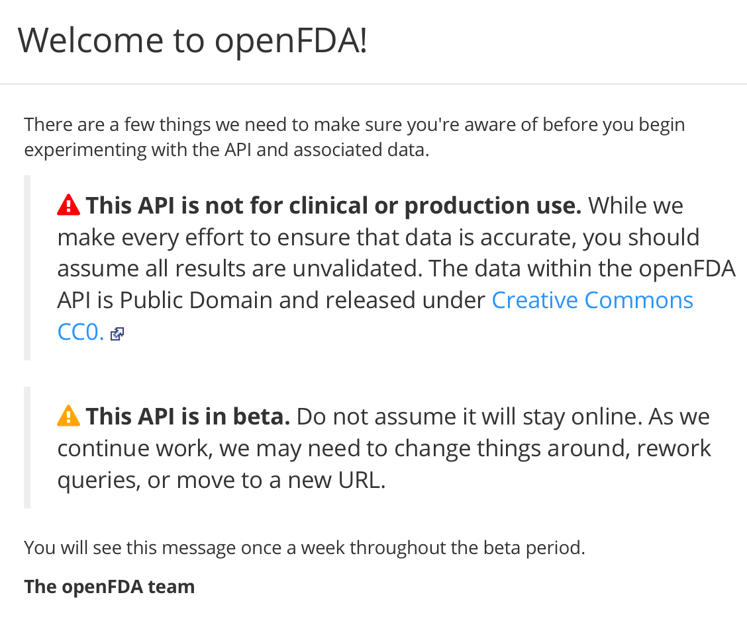
Limitations – OpenFDA API
OpenFDA

Slide 24
Limitations – OpenFDA Explorer
Only returns top 100 results
Descriptive statistics only
Aggregate data only
Multiple Drugs/AEs per Report complicates interpretation

Slide 25
Other resources
OpenFDA resources:
@openfda on twitter
StackExchange
Github
Reddit
Other OpenFDA applications
Search UI: http://openfdasearch.herokuapp.com/
R package: https://github.com/rOpenHealth/openfda
R/Shiny: http://54.201.82.167/RR_D/
More Data: www.HealthData.gov
Other Graphics: graphics.rhoworld.com

Slide 26
Thank You
Jeremy Wildfire
Statistical Scientist
Rho
@jwildfire
Join the conversation #DIA2015

