Slide 2
A Strip Plot Gets Jittered into a Beeswarm
by Shane Rosanbalm

Slide 3
Outline
Some preliminaries
Describe what a beeswarm plot is
Introduce the %beeswarm macro
Demonstrate the simplest use case
Explain how it works under the covers
Demonstrate more complex use cases
If time remains
Discuss the JITTER option in 9.4
Demonstrate a paneled beeswarm plot

Slide 4
Some dummy data
data dummy;
do trt = 1 to 3;
do subjects = 1 to 30 - 4*trt by 1;
response = sqrt(trt)*(rannor(1)+3);
output;
end;
end;
run;
trt | subject | response
1 | 1 | 4.80482
1 | 2 | 2.92008
1 | 3 | 3.39658
1 | 4 | 1.91668
1 | 5 | 5.23829
1 | 6 | 2.37577
1 | 7 | 3.51366
… | … | …

Slide 5
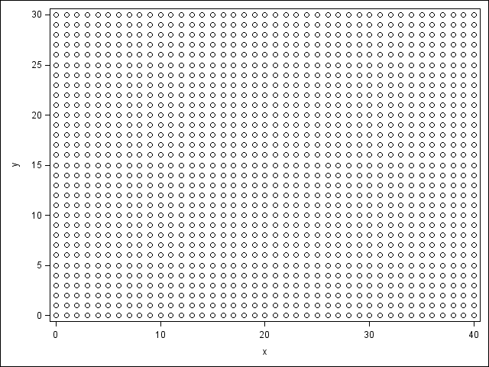
How many circles can we squeeze onto a scatter plot?
data fill;
do y = 0 to 30;
do x = 0 to 40;
output;
end;
end;
run;
proc sgplot data=fill;
scatter x=x y=y;
run;

Slide 6
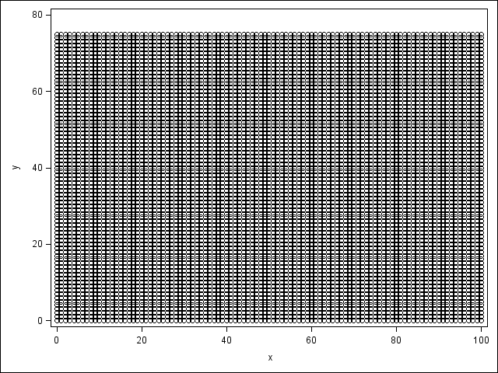
How many circles can we squeeze onto a scatter plot?
data fill;
do y = 0 to 75;
do x = 0 to 100;
output;
end;
end;
run;
proc sgplot data=fill;
scatter x=x y=y;
run;

Slide 7
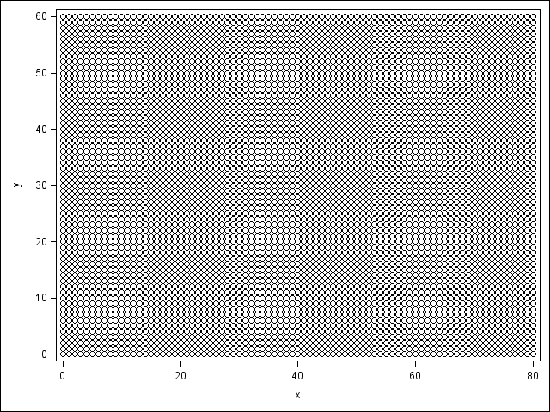
How many circles can we squeeze onto a scatter plot?
data fill;
do y = 0 to 60;
do x = 0 to 80;
output;
end;
end;
run;
proc sgplot data=fill;
scatter x=x y=y;
run;

Slide 8
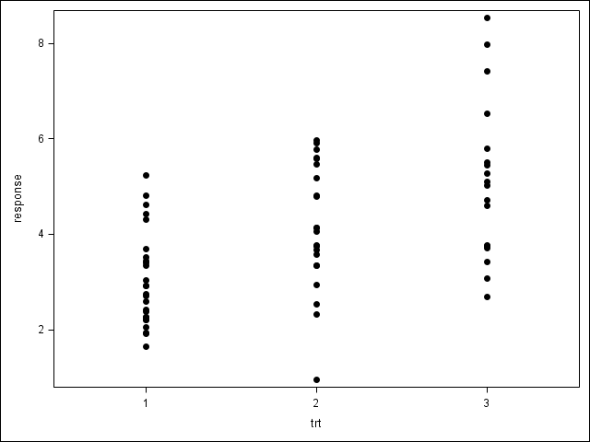
Strip Plot

Slide 9
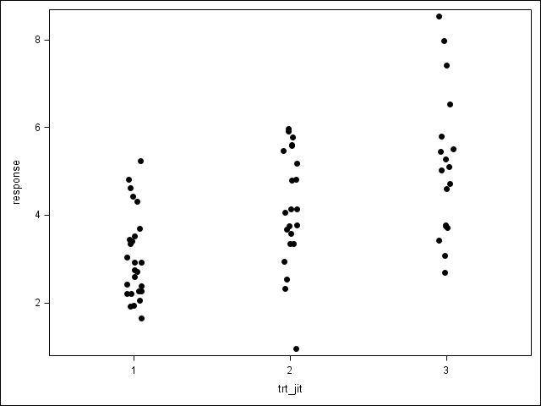
Jittered Strip Plot

Slide 10
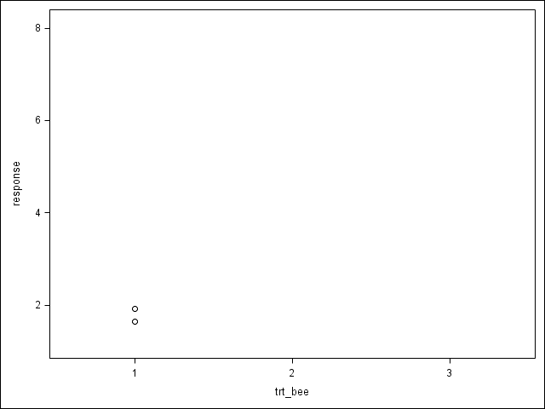
An algorithmic approach

Slide 11
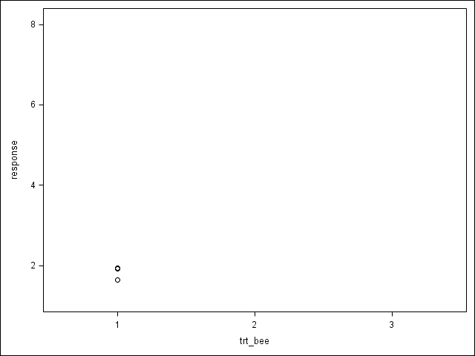
The third data point conflicts with the second

Slide 12
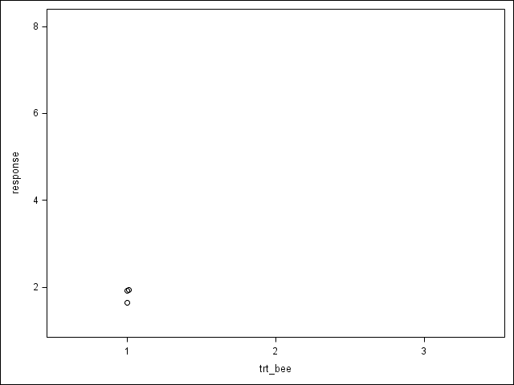
Try moving it 0.01 to the right

Slide 13

Try moving it 0.02 to the right

Slide 14

Try moving it 0.03 to the right

Slide 15

Try moving it 0.04 to the right

Slide 16

The fourth data point conflicts with the second

Slide 17

Try moving it 0.01 to the left

Slide 18
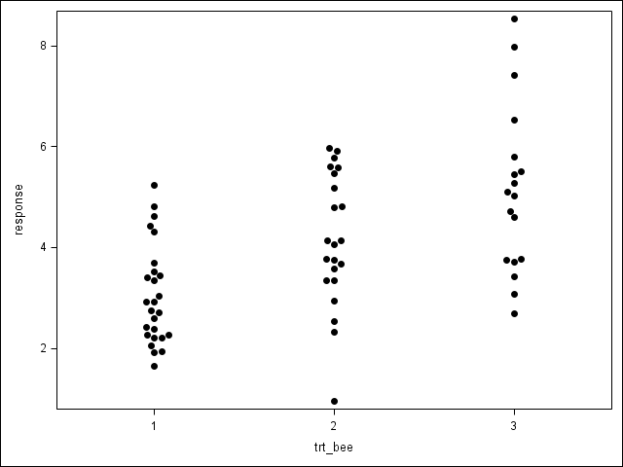
Beeswarm Plot

Slide 19
Strip to Jitter to Beeswarm

Slide 20
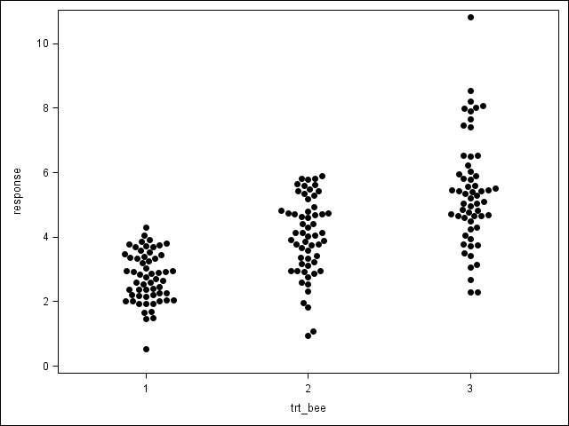
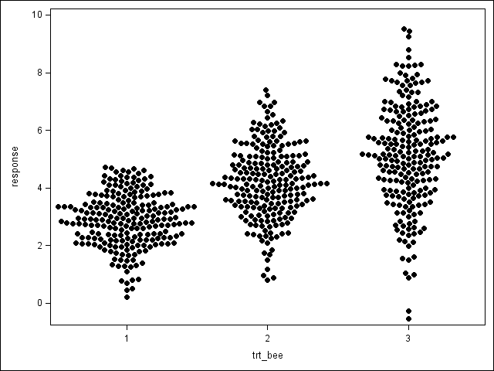
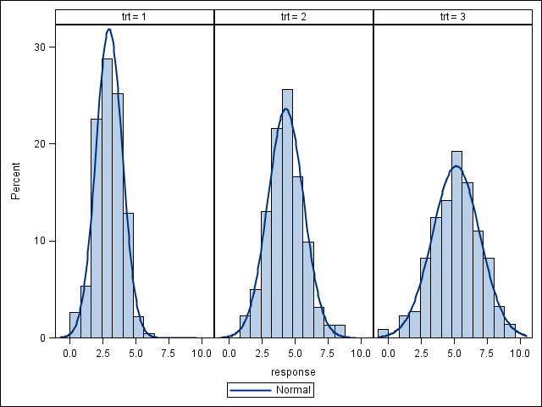
On the appropriateness of beeswarms

Slide 21
Code for a strip plot
proc sgplot data=dummy;
scatter x=trt y=response /
markerattrs=(symbol=circlefilled);
xaxis min=0.5 max=3.5 integer;
run;

Slide 22
Code for a jittered strip plot
data jitter;
set dummy;
trt_jit = trt - 0.05 + 0.1*ranuni(1);
run;
proc sgplot data=jitter;
scatter x=trt_jit y=response /
markerattrs=(symbol=circlefilled);
xaxis min=0.5 max=3.5 integer;
run;

Slide 23
Code for a beeswarm plot
%beeswarm(data=dummy
,respvar=response
,grpvar=trt
);
proc sgplot data=beeswarm;
scatter x=trt_bee y=response /
markerattrs=(symbol=circlefilled);
xaxis min=0.5 max=3.5 integer;
run;
The macro creates a new variable named TRT_BEE

Slide 24
How to use the %beeswarm macro
Required Inputs:
A dataset (data=)
A response (or y) variable (respvar=)
A grouping (or x) variable (grpvar=)
Outputs:
A dataset (out=beeswarm)
This output dataset is a near copy of the input dataset, with one additional variable having been added: &grpvar._bee

Slide 25
Code and output
%beeswarm
(data=dummy
,respvar=response
,grpvar=trt
);
proc sgplot data=beeswarm;
scatter x=trt_bee y=response /
markerattrs=(symbol=circlefilled);
xaxis min=0.5 max=3.5 integer;
run;

Slide 26
How the macro works
Assume (for the moment) that we are producing a graph using SGPLOT with all default settings
Width: 640px
Height: 480px
Marker size: 7px

Slide 27
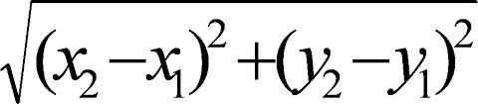
How the macro works
We want to use the distance formula to avoid overlays
Two circles of the same diameter will not overlay if the distance between their centers is greater than their diameter
What is the diameter of a default circle marker?

Slide 28
How many circles can we squeeze onto a scatter plot?
data fill;
do y = 0 to 60;
do x = 0 to 80;
output;
end;
end;
run;
proc sgplot data=fill;
scatter x=x y=y;
run;

Slide 29
Scale X and Y values based on the number of markers that fit on a graph
Response correction
- (max-min)/60
Grouping correction
- ngrps/80
Now the X and Y values are in the same scale, and the units correspond to the diameter of a circle

Slide 30
Softening the “Default” Assumption
More markers fit on a page if you:
Increase width,
Increase height,
Decrease marker size
Fewer markers fit on a page if you:
Decrease width,
Decrease height,
Increase marker size

Slide 31
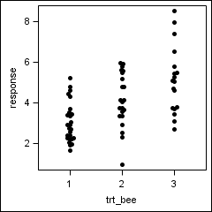
Change from 640px by 480px to 2.5in by 2.5in
80 and 60 no longer work as correction factors

Slide 32
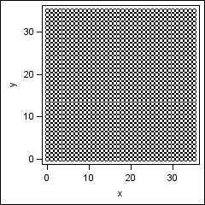
How many markers fit 2.5in by 2.5in?
data fill;
do y = 0 to 35;
do x = 0 to 35;
output;
end;
end;
run;
ods graphics /
width=2.5in height=2.5in;
proc sgplot data=fill;
scatter x=x y=y;
run;

Slide 33
Optional Arguments
rmarkers=
number of markers that will fit in the response/continuous direction; default=60
gmarkers=
number of markers that will fit in the grouping/categorical direction; default=80

Slide 34
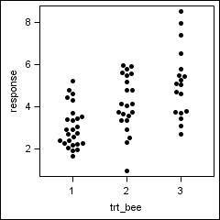
rmarkers=/gmarkers= put to use
%beeswarm(data=dummy
,respvar=response
,grpvar=trt
,rmarkers=35
,gmarkers=35
);
ods graphics /
width=2.5in height=2.5in;
proc sgplot data=beeswarm;
scatter x=trt_bee y=response /
markerattrs=(symbol=circlefilled);
xaxis min=0.5 max=3.5 integer;
run;

Slide 35
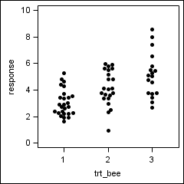
Bounding tick marks
Because the response correction is based on (max-min), forcing a larger axis range causes overlays

Slide 36

Optional Arguments
rmin= (response axis minimum)
rmax= (response axis maximum)
%beeswarm(data=dummy
,respvar=response
,grpvar=trt
,rmarkers=35
,gmarkers=35
,rmin=0
,rmax=10
);
ods graphics /
width=2.5in height=2.5in;
proc sgplot data=beeswarm;
scatter x=trt_bee y=response /
markerattrs=(symbol=circlefilled);
xaxis min=0.5 max=3.5 integer;
yaxis min=0 max=10;
run;

Slide 37
In summary
The beeswarm plot improves upon the jittered strip plot.
Only move points when necessary.
Only move the minimum distance.
The %beeswarm macro does not create a plot, it adds a variable to a dataset.
The programmer then uses this variable in a scatter plot.
Use rmarkers= and gmarkers= to adjust for non-default dimensions.
Use rmin= and rmax= to adjust for bounding tick marks.

Slide 38
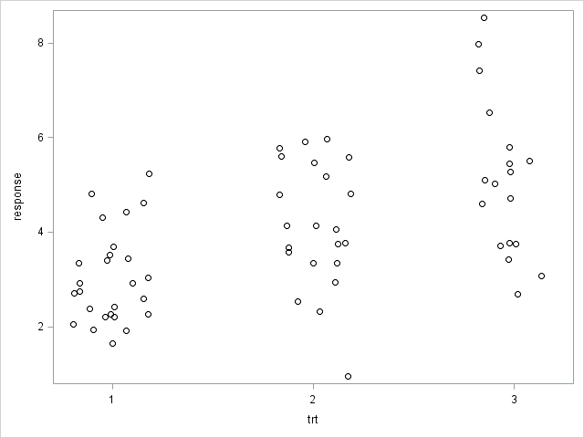
Enrichment #1: the JITTER option
proc sgplot data=dummy;
scatter x=trt y=response / jitter
markerattrs=(color=black);
xaxis min=0.5 max=3.5 integer;
run;

Slide 39
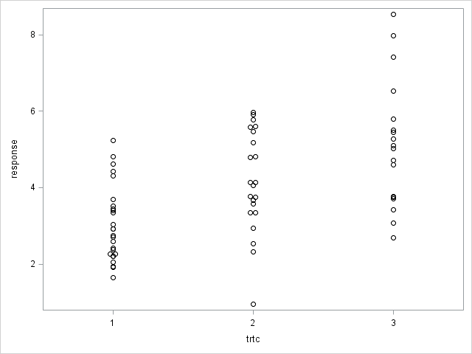
JITTER with a discrete x-axis
data dummyc;
set dummy;
trtc = put(trt,1.);
run;
proc sgplot data=dummyc;
scatter x=trtc y=response /
jitter
markerattrs=(color=black);
run;

Slide 40
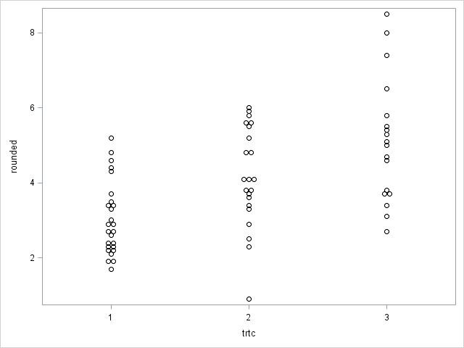
JITTER with more discrete y-values
data rounded;
set dummyc;
rounded = round(response,0.1);
run;
proc sgplot data=rounded;
scatter x=trtc y=rounded / jitter
markerattrs=(color=black);
run;

Slide 41
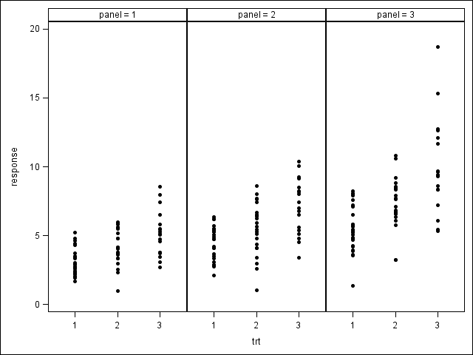
Enrichment #2: Paneled Graphs

Slide 42
A paneled strip plot
data dummy_panel;
do panel = 1 to 3;
do trt = 1 to 3;
do subjects = 1 to 30 - 4*trt*floor(sqrt(panel)) by 1;
response = sqrt(trt)*sqrt(panel)*(rannor(1)+3);
output;
end;
end;
end;
run;
proc sgpanel data=dummy_panel;
panelby panel / columns=3;
scatter x=trt y=response /
markerattrs=(symbol=circlefilled);
colaxis min=0.5 max=3.5 integer;
run;

Slide 43
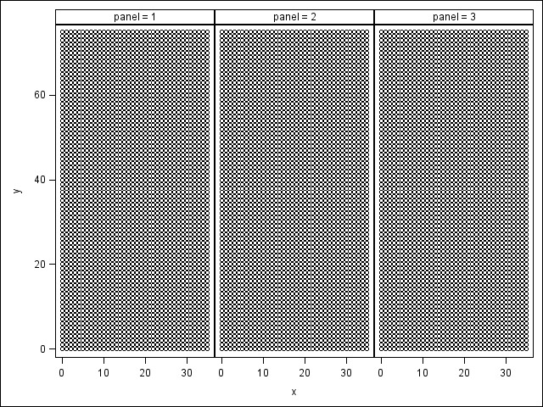
Do a fit test for rmarkers= and gmarkers=.
data fill;
do panel = 1 to 3;
do y = 0 to 75;
do x = 0 to 35;
output;
end;
end;
end;
run;
proc sgpanel data=fill;
panelby panel / columns=3;
scatter x=x y=y;
colaxis thresholdmax=0;
rowaxis thresholdmax=0;
run;

Slide 44
How to beeswarm paneled graphs?
Split the original dataset into 3 smaller datasets (one per panel).
Call the beeswarm macro 3 times (once per panel).
Stack the smaller beeswarm datasets back together into one large beeswarm dataset.

Slide 45
Call the macro once per panel
%do i = 1 %to 3;
data panel&i;
set dummy_panel;
where panel eq &i;
run;
%beeswarm(data=panel&i
,respvar=response
,grpvar=trt
,rmarkers=75
,gmarkers=35
,rmin=0
,rmax=20
,out=beeswarm&i
);
%end;

Slide 46
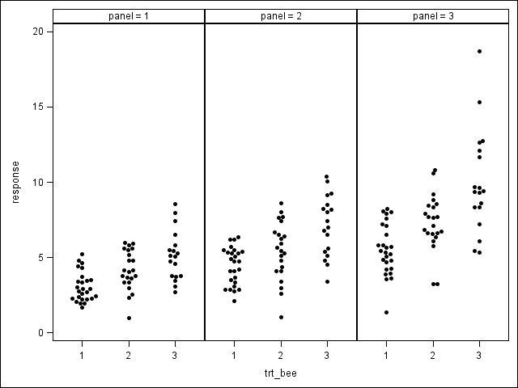
Stack and plot
data beeswarm;
set %do i = 1 %to 3; beeswarm&i %end;;
run;
proc sgpanel data=beeswarm;
panelby panel / columns=3;
scatter x=trt_bee y=response /
markerattrs=(symbol=circlefilled);
colaxis min=0.5 max=3.5 integer;
run;

Slide 47
The End

Slide 48
Contact Information
shane_rosanbalm@rhoworld.com
graphics.rhoworld.com

