Slide 1

Monitoring Adverse Events using an Interactive Web-Based Tool
Ryan Bailey
Rho, Inc.

Slide 2
Immune Tolerance Network (ITN)
International Research Consortium sponsored by the NIH
27 active studies
>2500 participants enrolled
Rho serves as the Statistics and Data Coordinating Center

Slide 3
ITN027AI AbATE Trial
Autoimmunity-blocking Antibody for Tolerance in type 1 diabetes (AbATE)
Randomized, open-labeled, controlled trial
Randomly assigned at a 2:1 ratio to receive:
Teplizumab plus standard diabetes management
vs
Standard diabetes management alone
77 participants
>1400 adverse events

Slide 4
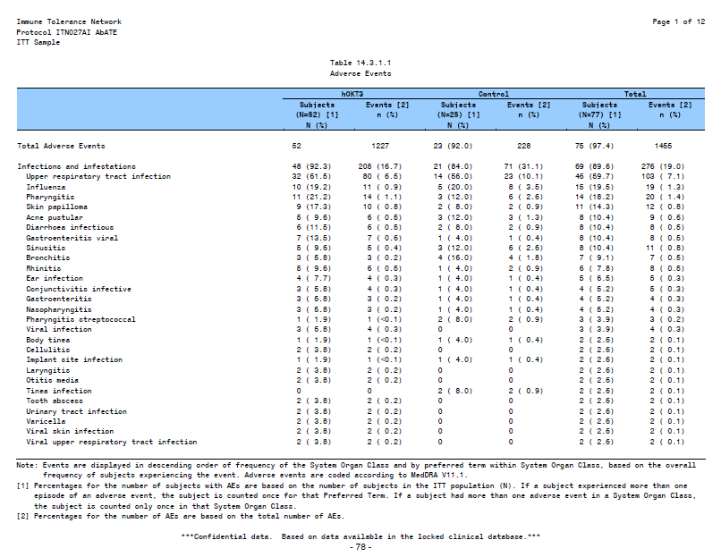




Traditional Reporting Method

Slide 5
The Problem with Traditional Reporting
Long and tedious
Static and unresponsive
Signal:NOISE

Slide 6
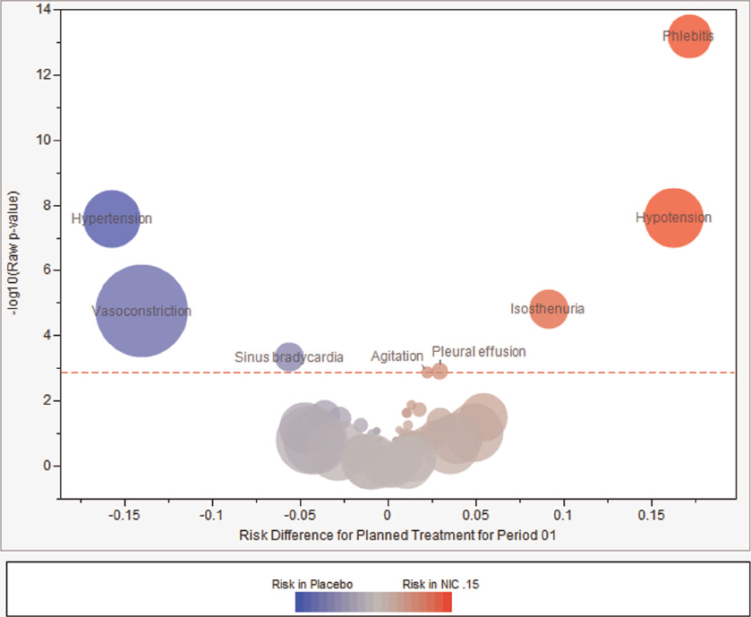
Possible Solutions
Zink RC, Wolfinger RD, Mann G. Summarizing the incidence of adverse events using volcano plots and time intervals. Clin Trials 2013; 10: 398-406.

Slide 7
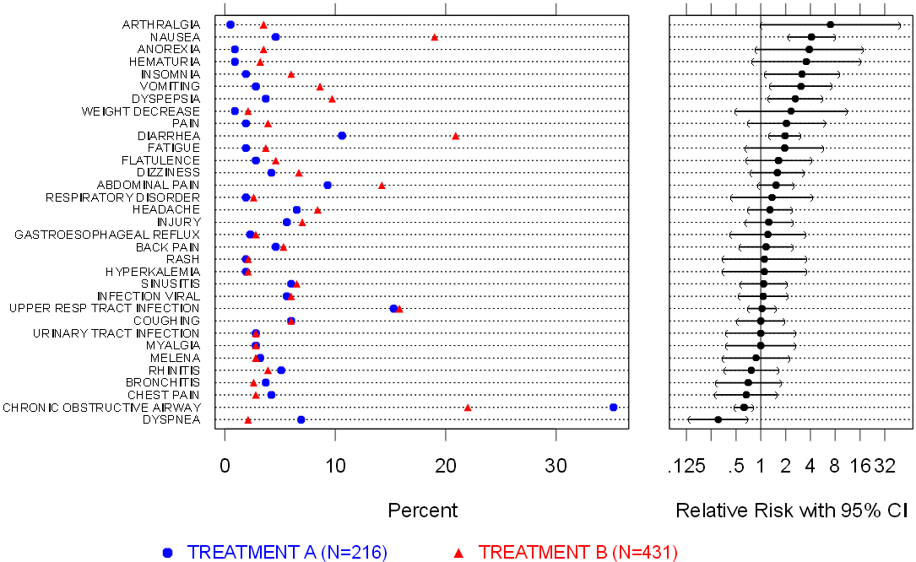
Possible Solutions
Amit O, Heiberger RM, Lane PW. Graphical approaches to the analysis of safety data from clinical trials. Pharmaceut Statist 2008; 7: 20-35.

Slide 8
The Challenge
Give medical monitors and safety monitoring committees a better way of digesting these data…
…without sacrificing our ethical obligation to provide a comprehensive listing of all adverse events.

Slide 9
The Solution
Create an interactive
Adverse Events Explorer

Slide 10
The Value
Speeds comprehension
Eases the burden on the reviewers
Limits the “Noise” in the data
Gives the experts control

Slide 11
Future Uses
Analyzing outcomes data
Conducting meta-analyses
Mining mechanistic datasets
Exploring data

Slide 12
Technical Details
Programmed in HTML and JavaScript
Interactivity comes from a JavaScript library called “D3” or Data Driven Documents

Slide 13
Disclosures
This project funded with federal funds from the NIAID, NIH under contract HHSN272200800029C
Data presented are from ITN027AI AbATE study

Slide 14
Acknowledgments
Jeremy Wildfire
Emily Wilson
Nathan Bryant
Brandy Lind
James Rochon, PhD

Slide 15
Questions Comments Discussion

Slide 16
Contact us with questions: graphics@rhoworld.com

Slide 17
Reserve Slides

Slide 18
Ethical Appeal of Technology
Data sets increasing in size and complexity
Existing tools can’t keep up
Industry under scrutiny for time to market
Patients deserve our very best

Slide 19
Why Web-based Technology?
Freely available, open source language
Coder has ultimate design control
Easy to deploy and share

Slide 20

Good Starter Resource for D3

Slide 21
Link
http://webserv2.dev.rhoworld.com/rhoportal/page.html?id=127

