Slide 1
Use of an interactive web-based heat map calendar to monitor study event data
Nathan Bryant
Rho, Inc.

Slide 2
Inner-City Asthma Consortium (ICAC)
National clinical research group sponsored by the NIH
Rho serves as the Statistical and Clinical Coordinating Center
10 clinical sites around the U.S.
~4000 participants enrolled in past and current studies
>120,000 individual study events

Slide 3
Uses for Event Data
Scheduling
Evaluating workload
Data-cleaning
Summarizing study progress

Slide 4
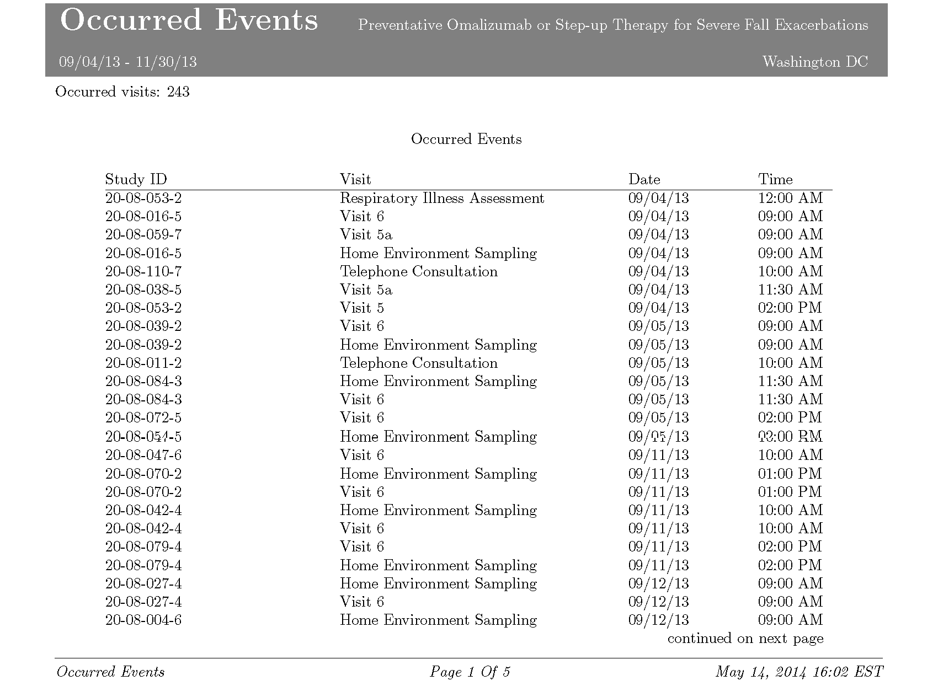
Current Tools

Slide 5
Current Tools

Slide 6
Room for Improvement
Presentation not useful for all types of users
Patterns over time not shown
Errors/Irregularities difficult to find
Can be slow to run

Slide 7
The Solution
A web-based tool with a graphical approach

Slide 8
The Value
Speeds comprehension
Patterns
Irregularities
Ability to drill down as needed
year/month day/hour
Benefits users of all types
Flexible and customizable

Slide 9
Technical Details
Programmed in HTML and JavaScript
Interactivity comes from a JavaScript library called “D3” or Data Driven Documents

Slide 10
Disclosures
This project funded with federal funds from the NIAID, NIH under contracts HSN272200900052C and HHSN2722010000521
Data presented are from the PROSE study

Slide 11
Acknowledgments
Jeremy Wildfire
Emily Wilson
Ryan Bailey
Michelle Walter

Slide 12
Questions Comments Discussion

Slide 13
Contact us with questions: graphics@rhoworld.com

Slide 14
Current Tools
Web-based data management system (DMS)
Schedule/record events
Run standardized reports
Notes:
Events = clinic visits, phone calls, discontinuations

Slide 15
Future Improvements
Tighten link with DMS
Pair with visit scheduling function?
Combine event data across multiple studies
Notes:
Allow to refine timeframe?
Allow coordinating center to compare across sites?
Allow to select multiple values within a filter dropdown?

Slide 16
Room for Improvement
User-friendly presentation
Show patterns over time
High-level view (month/year)
Lower-level view (day/hour)
Highlight irregularities
Speed up filters for investigation

