Slide 1
Use of an Interactive Data Dashboard to Monitor Studies for Large Multi-Center Trials
Emily Wilson
Rho, Inc.

Slide 2
Inner-City Asthma Consortium (ICAC)
NIH-funded, multi-center clinical research consortium
Rho serves as the Statistical and Clinical Coordinating Center
9 studies
10 sites across the U.S.
~4000 participants enrolled in past and current studies
>10,000,000 data points collected

Slide 3
Our Challenge
Massive volume of data
Scattered across sources
Time consuming

Slide 4
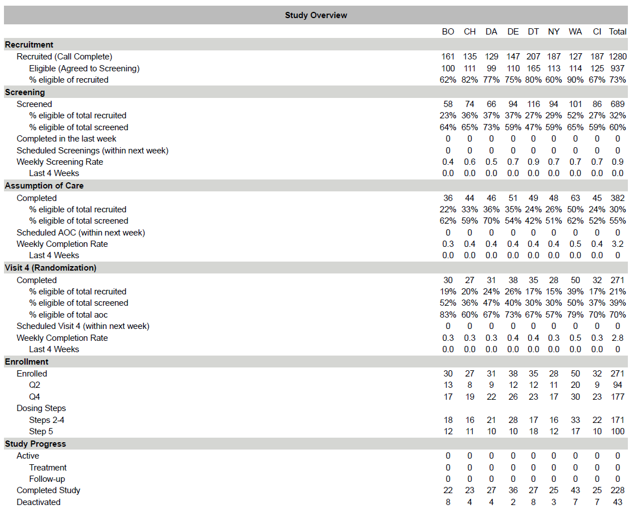
Traditional Monitoring Method

Slide 5
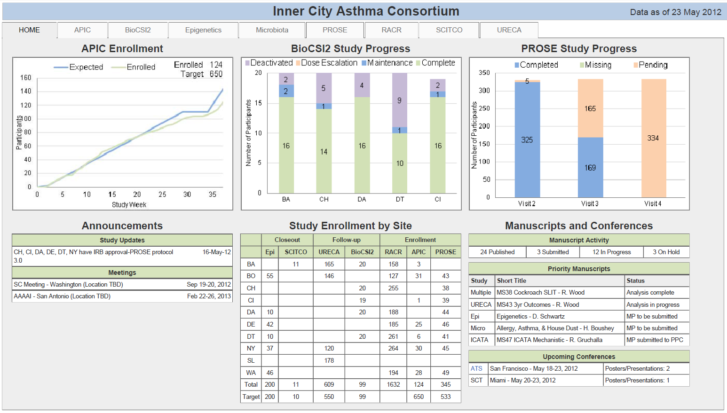
There has to be a better way…

Slide 6
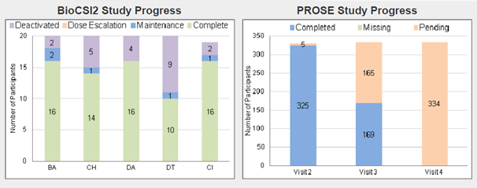
This is great, but…
Static
Lack of drill-down
Cumbersome update process
Cluttered

Slide 7
The Solution
Create an interactive data dashboard

Slide 8
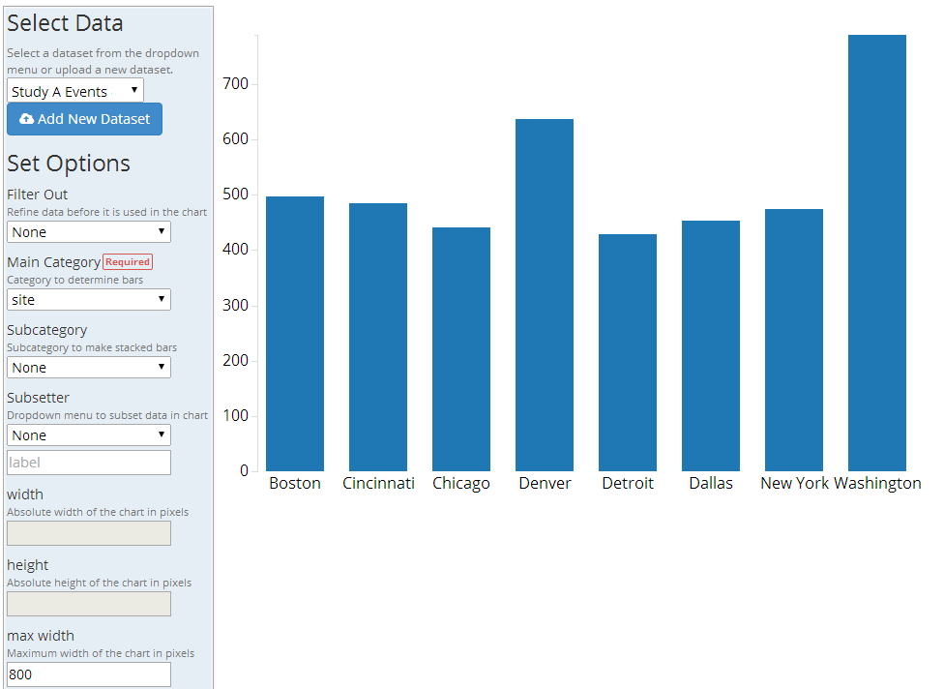

Behind the Scenes

Slide 9
The Value
One, easy to access location
Easy to digest
Simple customization

Slide 10
Future Enhancements
Role based dashboard
Cross study graphics

Slide 11
Technical Details
Programmed in HTML and JavaScript
Interactivity comes from a JavaScript library called “D3” or Data Driven Documents

Slide 12
Disclosures
This project funded with federal funds from the NIAID, NIH under contract HHSN2722010000521
Data presented are from ICAC studies

Slide 13
Acknowledgments
Jeremy Wildfire
Nathan Bryant
Ryan Bailey
Michelle Walter
Rich Budrevich

Slide 14
Questions Comments Discussion

Slide 15
Contact us with questions: graphics@rhoworld.com

Slide 16
Reserve Slides

Slide 17

Getting Started

Slide 18

Getting Started

