Slide 1
Dynaban :
An alternative firmware for
Dynamixel servos
Rhoban team
(work in progress)
http://www.rhoban.com/

Slide 2
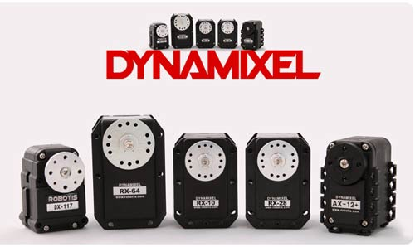
Dynamixel
Robotis Dynamixel servos : standard for low-cost robotics
Good mechanics and motor (usually Maxon)
Handy serial daisy chainable half-duplex Dynamixel protocol
Electronics features : accurate magnetic encoder (for MX serie), current sensing, thermistor (temperature), integrated H-bridge

Slide 3
The firmware
These servos feature a programmable µController
The original firmware is NOT open-source
→ We decided to write a custom alternative firmware for those servos

Slide 4
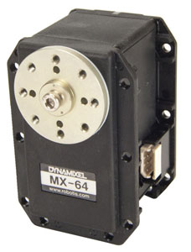

Why ?
Advanced motor primitive design while considering servos as black boxes is not viable
We want to explore force/compliant control (bio-inspiration)
And we all like open-source !

Slide 5
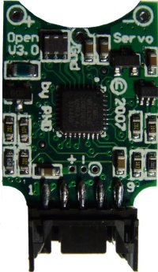
State of the art
DDServo (Darmstadt Dribblers) is a project providing custom electronics and firmware for the RX-28/RX-64.
Erolf (Fumanoids) is a board with an IMU dedicated to the communication with the servos (the hardware and the software are open-sourced).
Morpheus firmware is an alternative firmware for AX-12 servos (open-source)
OpenServo is a board to get a better control of low-cost servos (communicates via I²C)

Slide 6
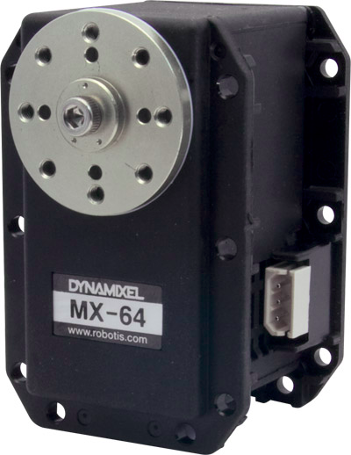
Diving into MX64
~200 U.S.$
Features Maxon motor
200:1 Gearbox

Slide 7
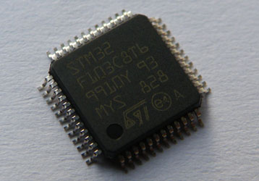
Diving into MX64
µController : STM32F103
  32bit @72Mhz, 120k flash 20k ram
  Widespread ARM Cortex-M3

Slide 8
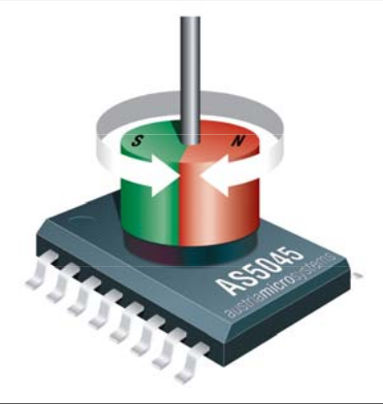
Diving into MX64
Magnetic encoder
  AS5045 chip
  Using a hall-effect sensor array
  Know the orientation of a magnet
  12 bits / 20khz

Slide 9
Diving into MX64
H-bridge (using drivers & mosfets)
Half-duplex driver for serial communication
Current sensing
  0,005 ohm sensing resistor
  MAX9918 amplifier
Thermistor
Voltage divider (3/23)
Two linear regulators : 3.3V & 5V ← Heat

Slide 10
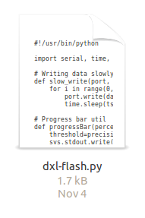
How ?
Servos comes with an integrated serial bootloader
BTW, it's programmable via RoboPlus
We first wrote our own script to flash servos (sending custom binaries)

Slide 11
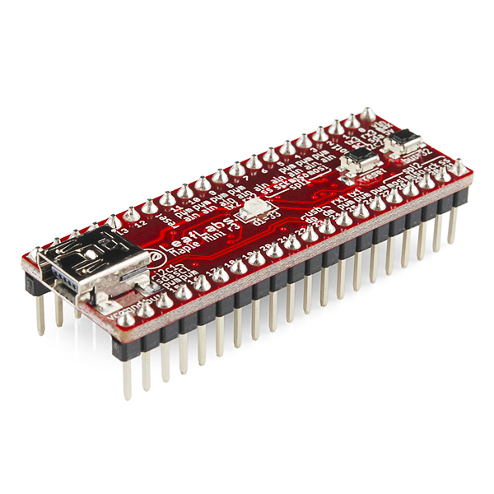
Writing firmware
Previous experiences on STM32 using Maple Mini
We based our project on libmaple, a STM32 library
  Arduino-like functions
  Mainly C, some C++

Slide 12

Danger !
First test : BOOM !
  We broke a servo trying to drive its motor, the mosfets exploded !
Be careful !
  A bad firmware can break the servo
  Custom firmware voids servo warranty
  Robotis doesn't sell electronics separately

Slide 13

What our firmware currently DOES
  Drive the LED ( for real !)
  Sample the encoder (position) and the current (torque)
  Communicate through serial with Dynamixel 1.0 protocol (not all features are implemented… yet)
  Drive the motor, with a safe abstraction layer
  Servoing the position using a PID controller
  Proof of concepts for torque servoing

Slide 14

What we plan to do (soon)
  Finish the implementation of the protocol
  Do fancy control loops (torque control)
  Clean the code (as much as possible)
  Open-source the code !

Slide 15

Writing firmware
Possibilities :
  Reducing the power consumption ? (Underclocking?)
  Adding features
    Optimizing the protocol ?
    Sending pre-timed trajectories ?
  Creating open-source electronics ?
  Insist on Robotis to release open-source servos :-)

Slide 16
Questions

Slide 17
Thanks for listening
See you soon on GitHub !

