Slide 1

https://github.com/RhodaJiang/Evidence-Economy-and-Social-Policy-2025-2026-SEM2-
W10 Tutorial
Evidence, Economy, and Social Policy (2025-2026)
✉️ ljiang3@ed.ac.uk

Slide 2
Recap (10-15min)
Any open questions from lectures?
What did you learn?
Preliminaries
Central banks
Central bank independence
Central banks become controversial
Rethinking economic policymaking
What points stood out?

Slide 3
Activity(35-40min)
Discussion questions:
After multiple rounds of Quantitative Easing, why do you think the production of money by state institutions remains such a fringe part of economic policy debates?
Thinking about the possibility of developing a new macroeconomic policy strategy to deliver growth in the UK, how could you bring together new ideas about fiscal policy (last week) and monetary policy (this week) and how would you communicate this effectively?
Or, after a succession of economic policy resets under Rishi Sunak and Keir Starmer - and after the disaster that was the Liz Truss "mini-budget" - has the window of opportunity to reframe UK economic policy now closed?
News story or piece of evidence
Notes:
<Reproduction in Education, Society and Culture>

Slide 4
Wrap-up

Slide 5
https://github.com/RhodaJiang/Evidence-Economy-and-Social-Policy-2025-2026-SEM2-
W9 Tutorial
Evidence, Economy, and Social Policy (2025-2026)
✉️ ljiang3@ed.ac.uk

Slide 6
Recap (10-15min)
Any open questions from lectures?
What did you learn?
What is fiscal policy?
Austerity as a dominant frame
Austerity frames policy in the UK
Institutionalising austerity?
What points stood out?

Slide 7
Activity(35-40min)
Discussion questions:
Why do you think the austerity policy frame was able to become so dominant in certain places after the global financial crisis?
Why do you think Keir Starmer and Rachel Reeves decided, before the last general election, to commit to the fiscal policy approach that they did? Did they have other alternatives and, if so, what might they have been? Does the government still have those same options now? If you don't think they do, why?
Would a different prime minister and chancellor have any greater flexibility to change things?
What reforms do you think should be made to the OBR and the broader process of setting fiscal rules and frameworks?
News story or piece of evidence
Notes:
<Reproduction in Education, Society and Culture>

Slide 8
Wrap-up
Rachel Reeves pledges to borrow only to invest under Labour fiscal rules: Link
David Rubenstein Show: Rachel Reeves

Slide 9
https://github.com/RhodaJiang/Evidence-Economy-and-Social-Policy-2025-2026-SEM2-
W8 Tutorial
Evidence, Economy, and Social Policy (2025-2026)
✉️ ljiang3@ed.ac.uk

Slide 10
Recap (10-15min)
Any open questions from lectures?
What did you learn?
Lecture 1: A neutral means of exchange? Money, investment and rents
Lecture 2: Inevitabilities? Financial instability and crises
What points stood out?

Slide 11
Activity(35-40min)
Discussion questions:
Should all types of capital be treated the same or should there be differences? For example, should financial capital be taxed differently to production capital or labour (as is typically the case at the moment)?
Should we distinguish between financial capital according to its uses for policy considerations (e.g., financial capital that is reinvested into firms vs capital that is taken out of a firm as rent) or should we leave it to market forces to decide how financial capital is used?
Should governments actively work against the emergence of financial crises? Why? If so, how should that be done?
News story or piece of evidence
Notes:
<Reproduction in Education, Society and Culture>

Slide 12
Wrap-up
Case relevant: China's drivers fret as robotaxis pick up pace - and passengers
Policy should distinguish between the actual uses of capital rather than leave its allocation entirely to market forces.The Apollo Go case shows that what matters is not simply whether capital stays within the firm, but whether it creates real productivity and public value or instead expands private control, redistributes existing income, and shifts social costs onto workers and society.
Money’s “social face”:
Money’s “social face”: the figures and symbols displayed on currency reveal a country’s cultural values and political priorities.

Slide 13
https://github.com/RhodaJiang/Evidence-Economy-and-Social-Policy-2025-2026-SEM2-
W7 Tutorial
Evidence, Economy, and Social Policy (2025-2026)
✉️ ljiang3@ed.ac.uk

Slide 14
Recap (10-15min)
Any open questions from lectures?
What did you learn?
Lecture 1: An economy: simply the sum of its parts?
Lecture 2: Do states intervene in or co-constitute markets?
What points stood out?

Slide 15
Activity(35-40min)
Discussion questions:
How do you colloquially speak about the "the role of the state"? What sort of conception of the economy does that reflect? Where does your intuitive understanding of the state and the economy come from? Which influences have shaped it?
If the way we structure national accounts about the economy are products of convention, how can we make sure that we use those measures in a way that is suitable? What might be the biggest pitfalls in common uses of concepts, such as GDP in the evaluation of state and private sector activity?
What opportunities arise if we study empirically how innovation in the economy emerges? Why are many traditional narratives about innovation not reflecting all aspects of the evidence we could consider? What evidence gets typically selected and what evidence left out - and why might that be the case?
News story or piece of evidence
Notes:
<Reproduction in Education, Society and Culture>

Slide 16
Lecture 1 | Key concepts
THREE KEY WORDS
Evidence • Economy • Social policy
Evidence
Economy
Social policy
Information used to justify claims.
In this course: evidence from economic analysis (data, models, evaluation) and how it can be misread or misused.
A system of production, exchange, and distribution, embedded in institutions and politics.
Collective choices about welfare, risk, and redistribution (state, market, family, and third sector).
Example: “Does a benefit reform reduce poverty?”
Example: “How do taxes and benefits shape incentives and resources?”
Example: “Who should insure whom, and on what terms?”
EESP | Lecture 1
Core framing terms
12/18

Slide 17
Wrap-up
Looking at the economy through a social policy lens changes what becomes visible: ideas that seem reasonable and robust in mainstream economics can look partial, because this lens foregrounds welfare, risk, redistribution, and what gets left out of standard narratives (as Mazzucato’s “myths” illustrate).
Before answering any question, it helps to clarify the purpose of the evaluation and define the key concepts—because your framing and definitions will largely determine what counts as evidence and what conclusions you end up drawing.

Slide 18
https://github.com/RhodaJiang/Evidence-Economy-and-Social-Policy-2025-2026-SEM2-
W6 Tutorial
Evidence, Economy, and Social Policy (2025-2026)
✉️ ljiang3@ed.ac.uk

Slide 19
Recap (10-15min)
Any open questions from lectures?
What did you learn?
Lecture 1: Poverty, inequality, and social programs to address them
Lecture 2: Does Inequality Matter? How people perceive economic disparities and redistribution. With Michael Förster, previously Senior Economist at the OECD where he led the organisation's inequality work for many years.
What points stood out?

Slide 20
Activity(35-40min)
Discussion questions:
The Great Gatsby Curve links higher inequality to lower social mobility. What mechanisms could generate this relationship, and what role could policy plausibly play to improve social mobility?
Poverty as structural failure versus morale failure: what current policies and policy proposals can you think of that are based on each underlying view?
Evaluation hinges on the counterfactual. What is the counterfactual and why is it hard to observe? What are the strengths and limitations of various counterfactual approaches?
Draw on a news story or piece of evidence that illustrates a concept from the lecture or discussion questions.
Notes:
<Reproduction in Education, Society and Culture>

Slide 21
Wrap-up
The concept of poverty, the perceived causes of poverty, and the consequences attributed to poverty can all shape final policy responses.
Therefore, policy evaluation must take these factors into account to select an appropriate evaluation approach.

Slide 22
https://github.com/RhodaJiang/Evidence-Economy-and-Social-Policy-2025-2026-SEM2-
W5 Tutorial
Evidence, Economy, and Social Policy (2025-2026)
✉️ ljiang3@ed.ac.uk

Slide 23
Recap (10-15min)
Any open questions from lectures?
What did you learn?
Lecture 1 - Principles of insurance: Social insurance vs private insurance
Lecture 2 - Public goods provision and subsidies
What points stood out?

Slide 24
Activity(35-40min)
Discussion questions:
Why are some risks insured socially while others are left to markets?
In what ways does social insurance blur the boundary between insurance and redistribution? Why does this matter politically?
When should governments prefer direct public provision over subsidies to private providers?
Why do governments directly provide services like healthcare or education rather than relying only on subsidies?
Draw on a news story or piece of evidence that illustrates a concept from the lecture or discussion questions.

Slide 25
Wrap-up
Pay attention to the key concepts that emerged in the lectures.
A perpetual tug-of-war between state rules and market responses.

Slide 26
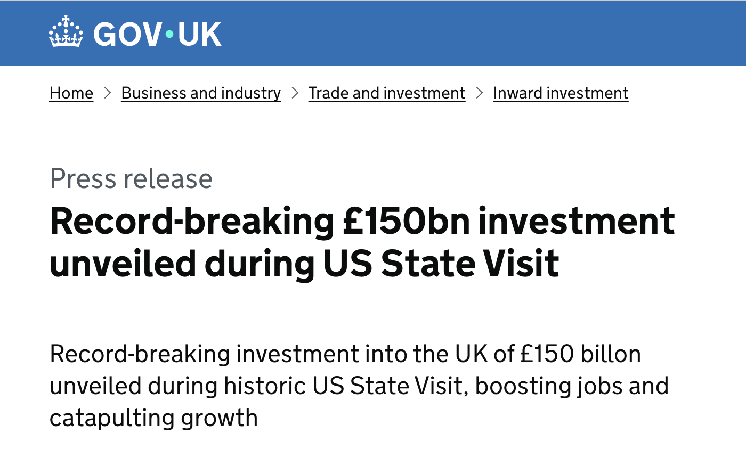
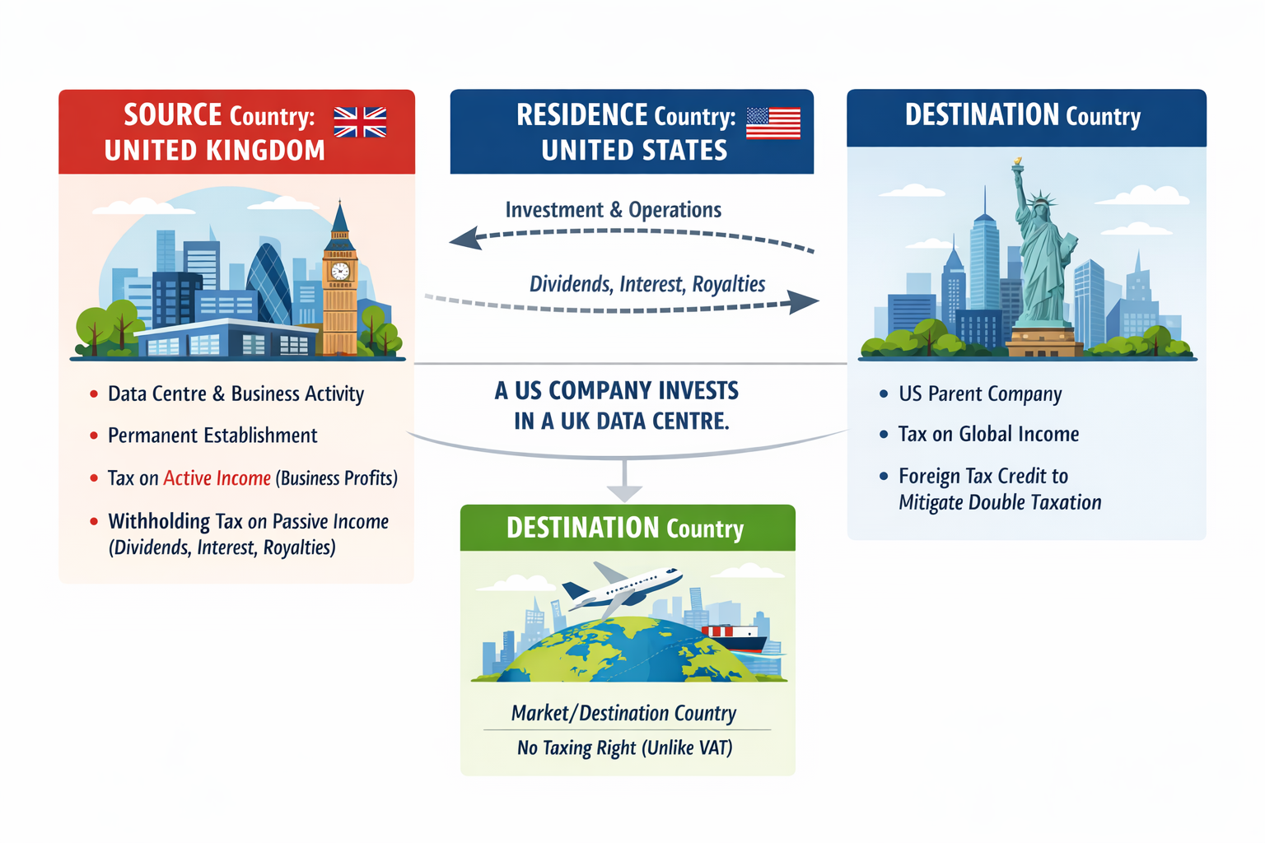
Wrap-up
Source: https://www.gov.uk/government/news/record-breaking-150bn-investment-unveiled-during-us-state-visit?utm_source=chatgpt.com

Slide 27
https://github.com/RhodaJiang/Evidence-Economy-and-Social-Policy-2025-2026-SEM2-
W4 Tutorial
Evidence, Economy, and Social Policy (2025-2026)
✉️ ljiang3@ed.ac.uk

Slide 28
Recap (10-15min)
Insightful moment:
From w2: “What types of evidence do you think are most influential in economic policy debates and what are the consequences of that?”
Both positive and negative aspects, even other perspectives(eg, economic, politic, environmental, social…)
From w3: “Do you think the current mainstream approach, i.e. equating market prices with value is going to be a more permanent feature or do you think value conceptions will change again?”
A good analytical framework for developing an argument is to consider the short term and the long term: in the short term, …; in the long run, … .
From w3: An interesting example of “When Economics Overrides Ethics” (framing / reframing)

Slide 29
Recap (10-15min)
Insightful moment:
From w3: the understanding of “market failure”

Slide 30
Recap (10-15min)
Any open questions from lectures?
What did you learn?
Lecture 1: State Intervention and Regulation of Markets
Lecture 2: Taxes and Benefits
What points stood out?

Slide 31
Activity(35-40min)
Discussion questions:
How do we distinguish between market-correcting and market-distorting interventions in practice? Can the same policy plausibly be described as both?
Compare cash transfers and in-kind benefits: what are the economic trade-offs in terms of efficiency, targeting, and political support
Can redistribution ever be efficiency-enhancing?
Draw on a news story or piece of evidence that illustrates a concept from the lecture or discussion questions.
Notes:
在实践中，我们如何区分纠正市场的干预与扭曲市场的干预？同一项政策是否有可能被合理地同时描述为两者？
比较现金转移与实物福利：在效率、精准性（定向性）以及政治支持方面，各自存在哪些经济上的权衡？
再分配是否有可能提升效率？

Slide 32
Wrap-up
(Lukas) Your job in this course: make claims precise, interrogate evidence, and argue transparently.
Understanding “market-correcting” and “market-distorting”

Slide 33
https://github.com/RhodaJiang/Evidence-Economy-and-Social-Policy-2025-2026-SEM2-
W3 Tutorial
Evidence, Economy, and Social Policy (2025-2026)
✉️ ljiang3@ed.ac.uk

Slide 34
Recap (~10min)
Any open questions from lectures?
What did you learn?
Lecture 1: Markets and utility: a straight-forward story?
Lecture 2: Is it all in the price? Questions about economic value
What points stood out?

Slide 35
Activity(35-40min)
Discussion questions:
The dominant way in which economic value is conceptualised has changed many times historically. Do you think the current mainstream approach, i.e. equating market prices with value is going to be a more permanent feature or do you think value conceptions will change again? What might drive that change and in what direction?
We know that people don't regularly behave as classic economic theories postulate. But when we do not rely on assumptions about economic behaviour, modelling market interactions becomes very complicated, as we need to expand the scope of evidence we use greatly. In what circumstances may it be useful and sufficient as a policy maker to rely on stronger assumptions about economic behaviour? How should we go about such uses though?
News stories or piece of evidence

Slide 36
Wrap-up
The blind spots of “big system”: (Davies, 2024: p76)
the belief in markets as computing fabric,
the flattening of time and uncertainty and
the commitment to Ricardianism.
Notes:
Capitalism and neoliberalism involve different concepts and dimensions, which fully demonstrate the complexity of these two ideas. It is essential to grasp this complexity and extract the most crucial fundamental characteristics from it.

Slide 37
https://github.com/RhodaJiang/Evidence-Economy-and-Social-Policy-2025-2026-SEM2-
W2 Tutorial
Evidence, Economy, and Social Policy (2025-2026)
✉️ ljiang3@ed.ac.uk

Slide 38
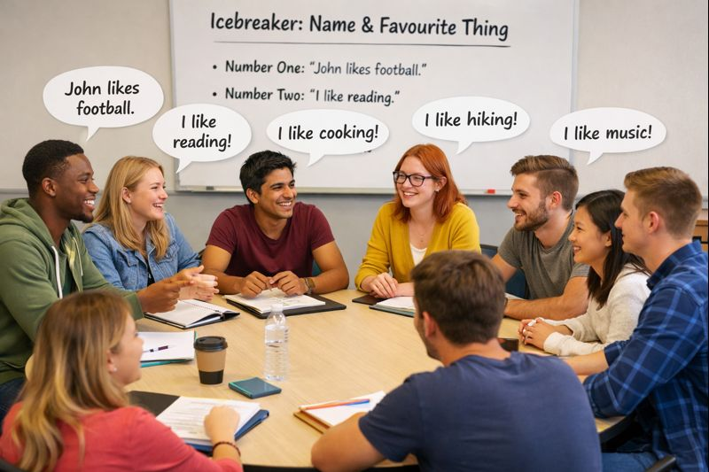
Icebreaker Activity: Name & Favourite Thing (8-10min)
The first person says their name and one thing they like.
The second person repeats the first person's name and their favourite thing, then adds their own name and favourite.
The third person repeats the second person's name and favourite thing, then adds their own.
Continue this pattern, with each person repeating the previous person's name and favourite thing, then adding their own.

Slide 39
Recap (10min)
Any open questions from lectures?
What did you learn?
Lecture 1 - Evidence, Economy, and Social Policy: an introduction to the course
Lecture 2 - “Left” vs “Right” social policy? Why economic analyses are much more complex
What points stood out?

Slide 40
Activity (20-25min)
Discussion questions:
To what extent do you agree with Mirowski's argument that a neoliberal state is one that uses strong actions to shape the economy?
To what extent do you think economic policy-making is based on evidence?
What types of evidence do you think are most influential in economic policy debates and what are the consequences of that?
For question 3, it might be useful to think of a current or recent example from the news to illustrate your argument.

Slide 41
Wrap-up
(Lukas) Your job in this course: make claims precise, interrogate evidence, and argue transparently.
Understanding “capitalism” and “neoliberalism”
Notes:
Capitalism and neoliberalism involve different concepts and dimensions, which fully demonstrate the complexity of these two ideas. It is essential to grasp this complexity and extract the most crucial fundamental characteristics from it.

