Slide 1

https://github.com/RhodaJiang/Evidence-Economy-and-Social-Policy-2025-2026-SEM2-
W3 Tutorial
Evidence, Economy, and Social Policy (2025-2026)
✉️ ljiang3@ed.ac.uk

Slide 2
Recap (~10min)
Any open questions from lectures?
  What did you learn?
    Lecture 1: Markets and utility: a straight-forward story?
    Lecture 2: Is it all in the price? Questions about economic value
  What points stood out?

Slide 3
Activity(35-40min)
Discussion questions:
The dominant way in which economic value is conceptualised has changed many times historically. Do you think the current mainstream approach, i.e. equating market prices with value is going to be a more permanent feature or do you think value conceptions will change again? What might drive that change and in what direction?
We know that people don't regularly behave as classic economic theories postulate. But when we do not rely on assumptions about economic behaviour, modelling market interactions becomes very complicated, as we need to expand the scope of evidence we use greatly. In what circumstances may it be useful and sufficient as a policy maker to rely on stronger assumptions about economic behaviour? How should we go about such uses though?
News stories or piece of evidence

Slide 4
Wrap-up
The blind spots of “big system”: (Davies, 2024: p76)
  the belief in markets as computing fabric,
  the flattening of time and uncertainty and
  the commitment to Ricardianism.
Notes:
Capitalism and neoliberalism involve different concepts and dimensions, which fully demonstrate the complexity of these two ideas. It is essential to grasp this complexity and extract the most crucial fundamental characteristics from it.

Slide 5
https://github.com/RhodaJiang/Evidence-Economy-and-Social-Policy-2025-2026-SEM2-
W2 Tutorial
Evidence, Economy, and Social Policy (2025-2026)
✉️ ljiang3@ed.ac.uk

Slide 6
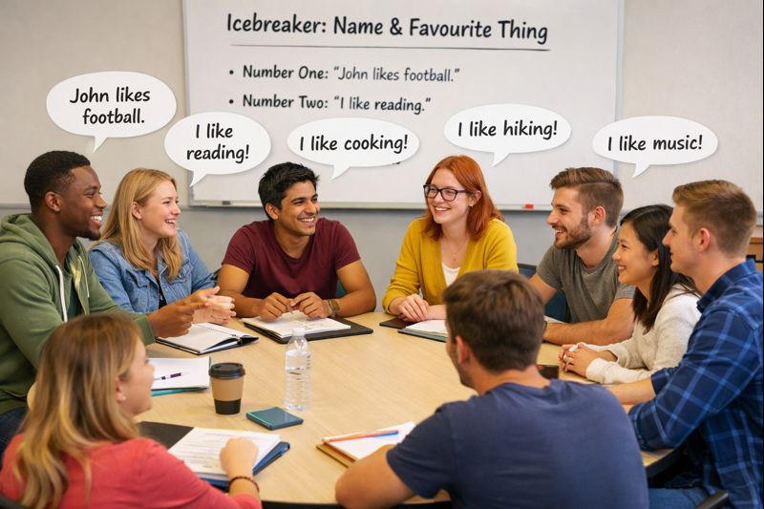
Icebreaker Activity: Name & Favourite Thing (8-10min)
The first person says their name and one thing they like.
The second person repeats the first person's name and their favourite thing, then adds their own name and favourite.
The third person repeats the second person's name and favourite thing, then adds their own.
Continue this pattern, with each person repeating the previous person's name and favourite thing, then adding their own.

Slide 7
Recap (10min)
Any open questions from lectures?
  What did you learn?
    Lecture 1 - Evidence, Economy, and Social Policy: an introduction to the course
    Lecture 2 - “Left” vs “Right” social policy? Why economic analyses are much more complex
  What points stood out?

Slide 8
Activity (20-25min)
Discussion questions:
To what extent do you agree with Mirowski's argument that a neoliberal state is one that uses strong actions to shape the economy?
To what extent do you think economic policy-making is based on evidence?
What types of evidence do you think are most influential in economic policy debates and what are the consequences of that?
For question 3, it might be useful to think of a current or recent example from the news to illustrate your argument.

Slide 9
Wrap-up
(Lukas) Your job in this course: make claims precise, interrogate evidence, and argue transparently.
Understanding “capitalism” and “neoliberalism”
Notes:
Capitalism and neoliberalism involve different concepts and dimensions, which fully demonstrate the complexity of these two ideas. It is essential to grasp this complexity and extract the most crucial fundamental characteristics from it.

