Slide 1

https://github.com/RhodaJiang/Evidence-Economy-and-Social-Policy-2025-2026-SEM2-
W6 Tutorial
Evidence, Economy, and Social Policy (2025-2026)
✉️ ljiang3@ed.ac.uk

Slide 2
Recap (10-15min)
Any open questions from lectures?
  What did you learn?
    Lecture 1: Poverty, inequality, and social programs to address them
    Lecture 2: Does Inequality Matter? How people perceive economic disparities and redistribution. With Michael Förster, previously Senior Economist at the OECD where he led the organisation's inequality work for many years.
  What points stood out?

Slide 3
Activity(35-40min)
Discussion questions:
The Great Gatsby Curve links higher inequality to lower social mobility. What mechanisms could generate this relationship, and what role could policy plausibly play to improve social mobility?
Poverty as structural failure versus morale failure: what current policies and policy proposals can you think of that are based on each underlying view?
Evaluation hinges on the counterfactual. What is the counterfactual and why is it hard to observe? What are the strengths and limitations of various counterfactual approaches?
Draw on a news story or piece of evidence that illustrates a concept from the lecture or discussion questions.
Notes:
<Reproduction in Education, Society and Culture>

Slide 4
Wrap-up
The concept of poverty, the perceived causes of poverty, and the consequences attributed to poverty can all shape final policy responses.
Therefore, policy evaluation must take these factors into account to select an appropriate evaluation approach.

Slide 5
https://github.com/RhodaJiang/Evidence-Economy-and-Social-Policy-2025-2026-SEM2-
W5 Tutorial
Evidence, Economy, and Social Policy (2025-2026)
✉️ ljiang3@ed.ac.uk

Slide 6
Recap (10-15min)
Any open questions from lectures?
  What did you learn?
    Lecture 1 - Principles of insurance: Social insurance vs private insurance
    Lecture 2 - Public goods provision and subsidies
  What points stood out?

Slide 7
Activity(35-40min)
Discussion questions:
Why are some risks insured socially while others are left to markets?
In what ways does social insurance blur the boundary between insurance and redistribution? Why does this matter politically?
When should governments prefer direct public provision over subsidies to private providers?
Why do governments directly provide services like healthcare or education rather than relying only on subsidies?
Draw on a news story or piece of evidence that illustrates a concept from the lecture or discussion questions.

Slide 8
Wrap-up
Pay attention to the key concepts that emerged in the lectures.
A perpetual tug-of-war between state rules and market responses.

Slide 9
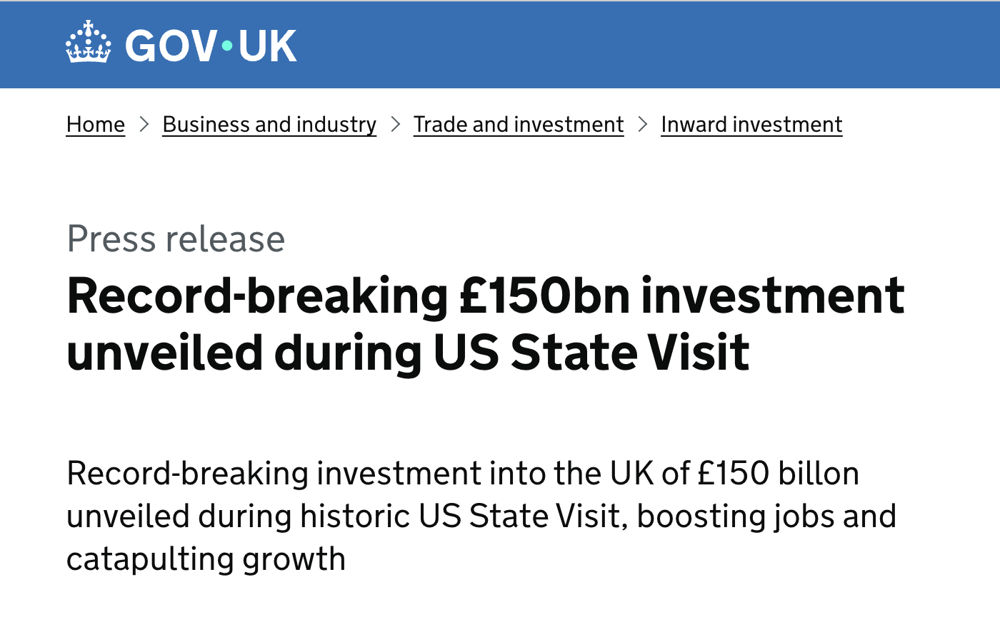
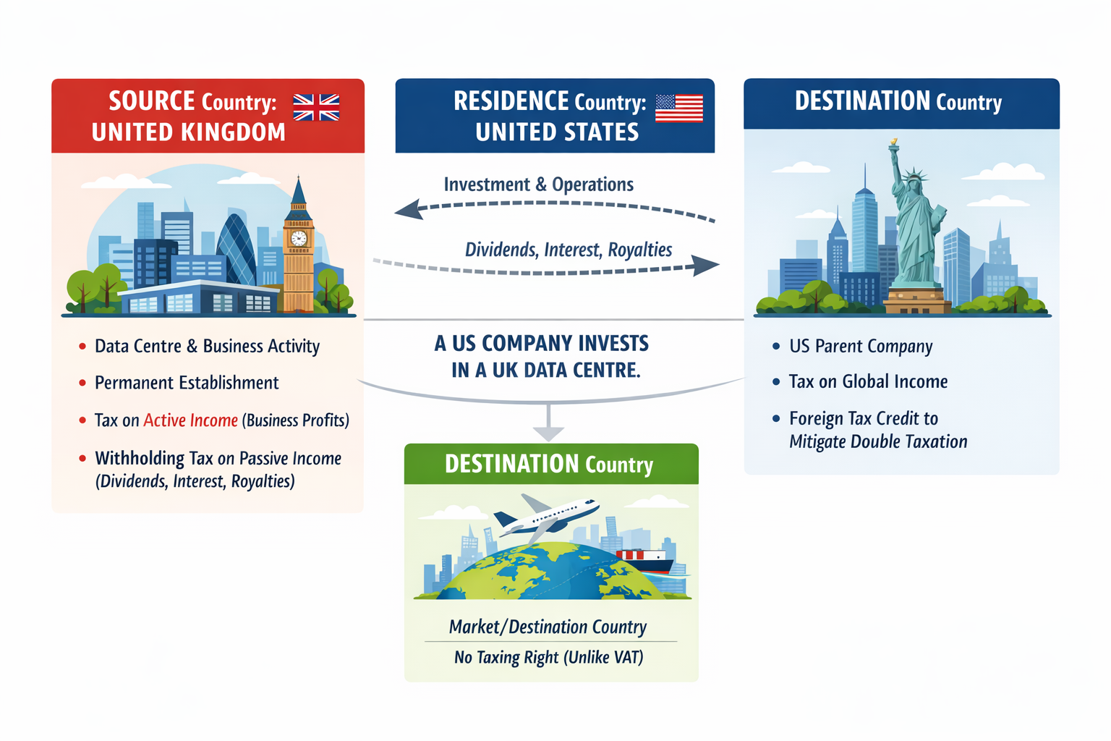
Wrap-up
Source: https://www.gov.uk/government/news/record-breaking-150bn-investment-unveiled-during-us-state-visit?utm_source=chatgpt.com

Slide 10
https://github.com/RhodaJiang/Evidence-Economy-and-Social-Policy-2025-2026-SEM2-
W4 Tutorial
Evidence, Economy, and Social Policy (2025-2026)
✉️ ljiang3@ed.ac.uk

Slide 11
Recap (10-15min)
Insightful moment:
  From w2: “What types of evidence do you think are most influential in economic policy debates and what are the consequences of that?”
    Both positive and negative aspects, even other perspectives(eg, economic, politic, environmental, social…)
  From w3: “Do you think the current mainstream approach, i.e. equating market prices with value is going to be a more permanent feature or do you think value conceptions will change again?”
    A good analytical framework for developing an argument is to consider the short term and the long term: in the short term, …; in the long run, … .
  From w3: An interesting example of “When Economics Overrides Ethics” (framing / reframing)

Slide 12
Recap (10-15min)
Insightful moment:
  From w3: the understanding of “market failure”

Slide 13
Recap (10-15min)
Any open questions from lectures?
  What did you learn?
    Lecture 1: State Intervention and Regulation of Markets
    Lecture 2: Taxes and Benefits
  What points stood out?

Slide 14
Activity(35-40min)
Discussion questions:
How do we distinguish between market-correcting and market-distorting interventions in practice? Can the same policy plausibly be described as both?
Compare cash transfers and in-kind benefits: what are the economic trade-offs in terms of efficiency, targeting, and political support
Can redistribution ever be efficiency-enhancing?
Draw on a news story or piece of evidence that illustrates a concept from the lecture or discussion questions.
Notes:
在实践中，我们如何区分纠正市场的干预与扭曲市场的干预？同一项政策是否有可能被合理地同时描述为两者？
比较现金转移与实物福利：在效率、精准性（定向性）以及政治支持方面，各自存在哪些经济上的权衡？
再分配是否有可能提升效率？

Slide 15
Wrap-up
(Lukas) Your job in this course: make claims precise, interrogate evidence, and argue transparently.
Understanding “market-correcting” and “market-distorting”

Slide 16
https://github.com/RhodaJiang/Evidence-Economy-and-Social-Policy-2025-2026-SEM2-
W3 Tutorial
Evidence, Economy, and Social Policy (2025-2026)
✉️ ljiang3@ed.ac.uk

Slide 17
Recap (~10min)
Any open questions from lectures?
  What did you learn?
    Lecture 1: Markets and utility: a straight-forward story?
    Lecture 2: Is it all in the price? Questions about economic value
  What points stood out?

Slide 18
Activity(35-40min)
Discussion questions:
The dominant way in which economic value is conceptualised has changed many times historically. Do you think the current mainstream approach, i.e. equating market prices with value is going to be a more permanent feature or do you think value conceptions will change again? What might drive that change and in what direction?
We know that people don't regularly behave as classic economic theories postulate. But when we do not rely on assumptions about economic behaviour, modelling market interactions becomes very complicated, as we need to expand the scope of evidence we use greatly. In what circumstances may it be useful and sufficient as a policy maker to rely on stronger assumptions about economic behaviour? How should we go about such uses though?
News stories or piece of evidence

Slide 19
Wrap-up
The blind spots of “big system”: (Davies, 2024: p76)
  the belief in markets as computing fabric,
  the flattening of time and uncertainty and
  the commitment to Ricardianism.
Notes:
Capitalism and neoliberalism involve different concepts and dimensions, which fully demonstrate the complexity of these two ideas. It is essential to grasp this complexity and extract the most crucial fundamental characteristics from it.

Slide 20
https://github.com/RhodaJiang/Evidence-Economy-and-Social-Policy-2025-2026-SEM2-
W2 Tutorial
Evidence, Economy, and Social Policy (2025-2026)
✉️ ljiang3@ed.ac.uk

Slide 21
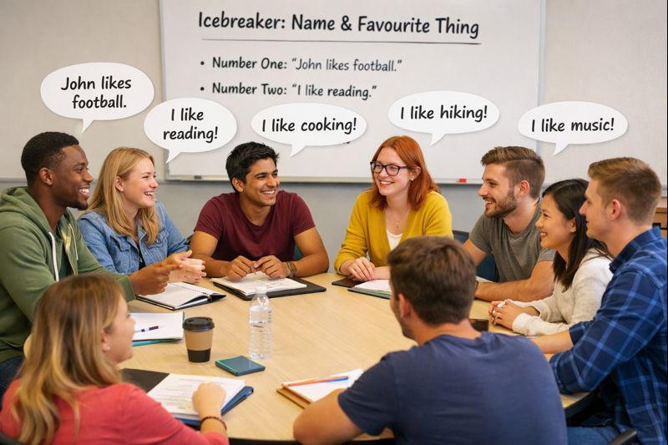
Icebreaker Activity: Name & Favourite Thing (8-10min)
The first person says their name and one thing they like.
The second person repeats the first person's name and their favourite thing, then adds their own name and favourite.
The third person repeats the second person's name and favourite thing, then adds their own.
Continue this pattern, with each person repeating the previous person's name and favourite thing, then adding their own.

Slide 22
Recap (10min)
Any open questions from lectures?
  What did you learn?
    Lecture 1 - Evidence, Economy, and Social Policy: an introduction to the course
    Lecture 2 - “Left” vs “Right” social policy? Why economic analyses are much more complex
  What points stood out?

Slide 23
Activity (20-25min)
Discussion questions:
To what extent do you agree with Mirowski's argument that a neoliberal state is one that uses strong actions to shape the economy?
To what extent do you think economic policy-making is based on evidence?
What types of evidence do you think are most influential in economic policy debates and what are the consequences of that?
For question 3, it might be useful to think of a current or recent example from the news to illustrate your argument.

Slide 24
Wrap-up
(Lukas) Your job in this course: make claims precise, interrogate evidence, and argue transparently.
Understanding “capitalism” and “neoliberalism”
Notes:
Capitalism and neoliberalism involve different concepts and dimensions, which fully demonstrate the complexity of these two ideas. It is essential to grasp this complexity and extract the most crucial fundamental characteristics from it.

